Slide 1
1 Harpsichord from Michele Todini’s Galleria Armonica, Rome, about 1670 (Metropolitan Museum of Art, New York); ...
Notes:
1 Harpsichord from Michele Todini’s Galleria Armonica, Rome, about 1670 (Metropolitan Museum of Art, New York); plan with reconstruction of the original compass, bridge, and nut; the line below the rose indicates the direction of the soundboard grain (drawing by the author)
Unless provided in the caption above, the following copyright applies to the content of this slide: Early Music, Vol. XXXV, No. 4 © The Author 2007. Published by Oxford University Press. All rights reserved.

Slide 2
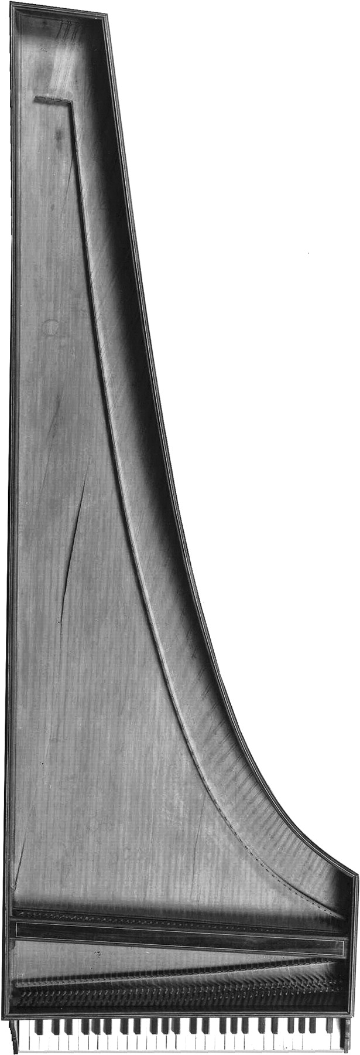
2 Harpsichord by Bartolomeo Cristofori, Florence, between 1688 and 1700 (Florence, Collezione del Conservatorio ...
Notes:
2 Harpsichord by Bartolomeo Cristofori, Florence, between 1688 and 1700 (Florence, Collezione del Conservatorio Cherubini, Galleria dell’Accademia; photo by Marco Rabatti and Sergio Domingie); the compass was originally GG (without GG♯) to c′′′
Unless provided in the caption above, the following copyright applies to the content of this slide: Early Music, Vol. XXXV, No. 4 © The Author 2007. Published by Oxford University Press. All rights reserved.

Slide 3
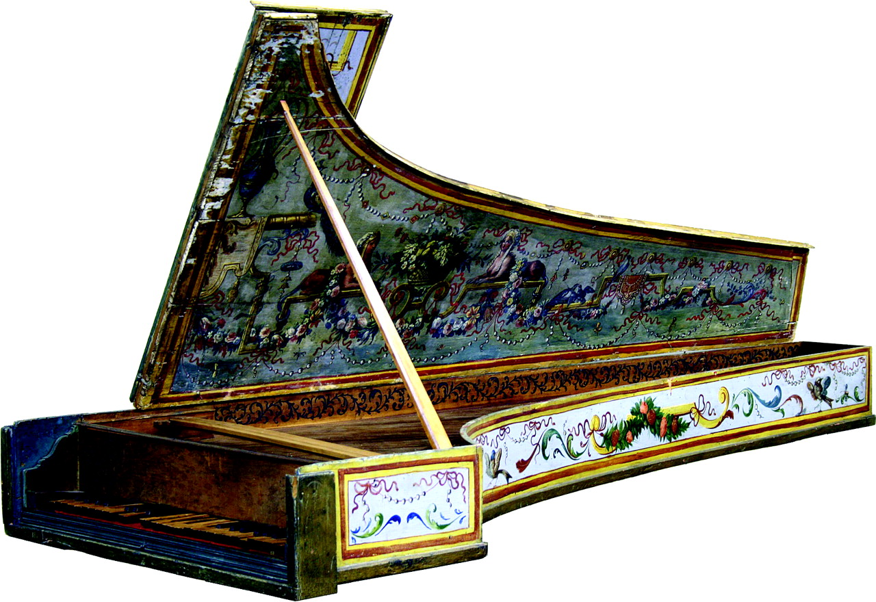
3 Harpsichord attributed to Bartolomeo Cristofori, Florence, about 1700–20 (Stearns Collection of Musical ...
Notes:
3 Harpsichord attributed to Bartolomeo Cristofori, Florence, about 1700–20 (Stearns Collection of Musical Instruments, University of Michigan, Ann Arbor, cat. no.1332; photo by Christopher Dempsey); the painted decoration is not original
Unless provided in the caption above, the following copyright applies to the content of this slide: Early Music, Vol. XXXV, No. 4 © The Author 2007. Published by Oxford University Press. All rights reserved.

Slide 4
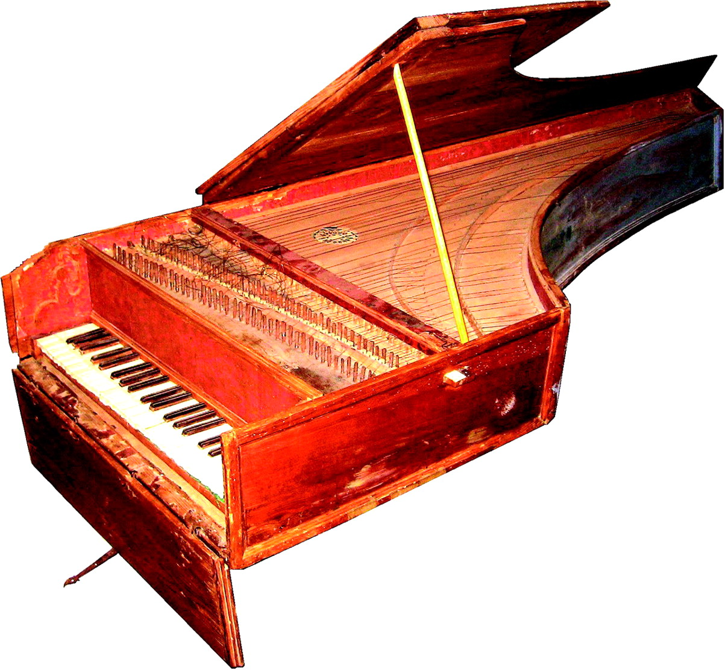
4 Harpsichord by Joseph Bueno, Valladolid, 1712 (Fundación Joaquín Díaz, Urueña, Valladolid; photo by the ...
Notes:
4 Harpsichord by Joseph Bueno, Valladolid, 1712 (Fundación Joaquín Díaz, Urueña, Valladolid; photo by the author)
Unless provided in the caption above, the following copyright applies to the content of this slide: Early Music, Vol. XXXV, No. 4 © The Author 2007. Published by Oxford University Press. All rights reserved.

Slide 5
5 Cross-sections of bridges (left to right) by Andreas Ruckers (Antwerp, 1607), Joseph Bueno (Valladolid, ...
Notes:
5 Cross-sections of bridges (left to right) by Andreas Ruckers (Antwerp, 1607), Joseph Bueno (Valladolid, 1712), José Calisto (Portugal, 1780), Manuel Antunes (Lisbon, 1767) and Vincenzio Sodi (Florence, 1782; similar to the bridges of Cristofori and Ferrini); the bar is 10 mm long (all the instruments except the Bueno are in the National Music Museum, Vermillion, SD; drawing by the author)
Unless provided in the caption above, the following copyright applies to the content of this slide: Early Music, Vol. XXXV, No. 4 © The Author 2007. Published by Oxford University Press. All rights reserved.

Slide 6
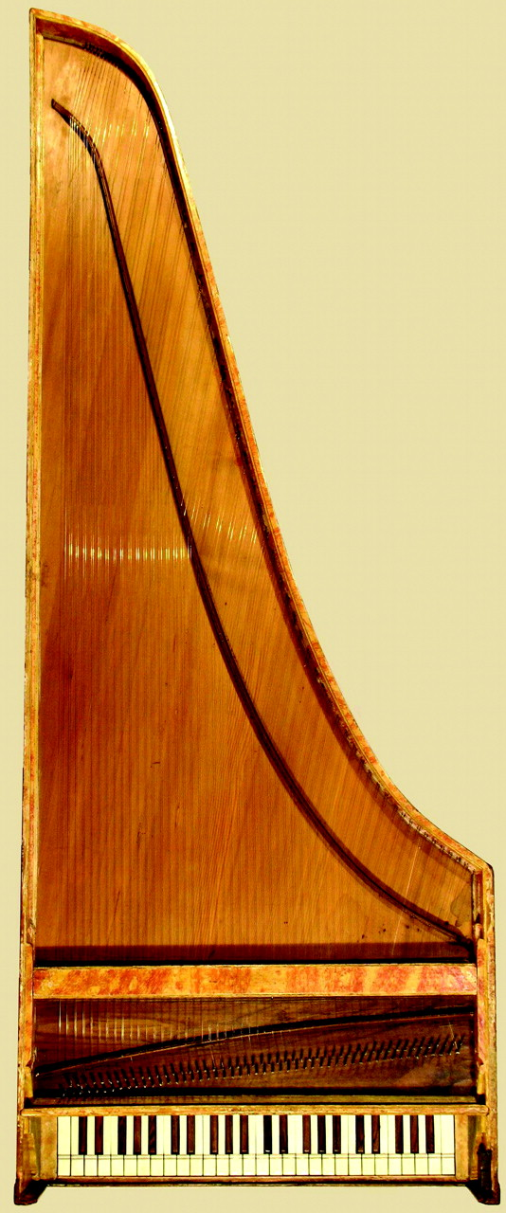
6 Harpsichord by an unknown Spanish maker, probably Salamanca province, first half of the 18th century (private ...
Notes:
6 Harpsichord by an unknown Spanish maker, probably Salamanca province, first half of the 18th century (private collection, USA; photograph by John Phillips)
Unless provided in the caption above, the following copyright applies to the content of this slide: Early Music, Vol. XXXV, No. 4 © The Author 2007. Published by Oxford University Press. All rights reserved.

Slide 7
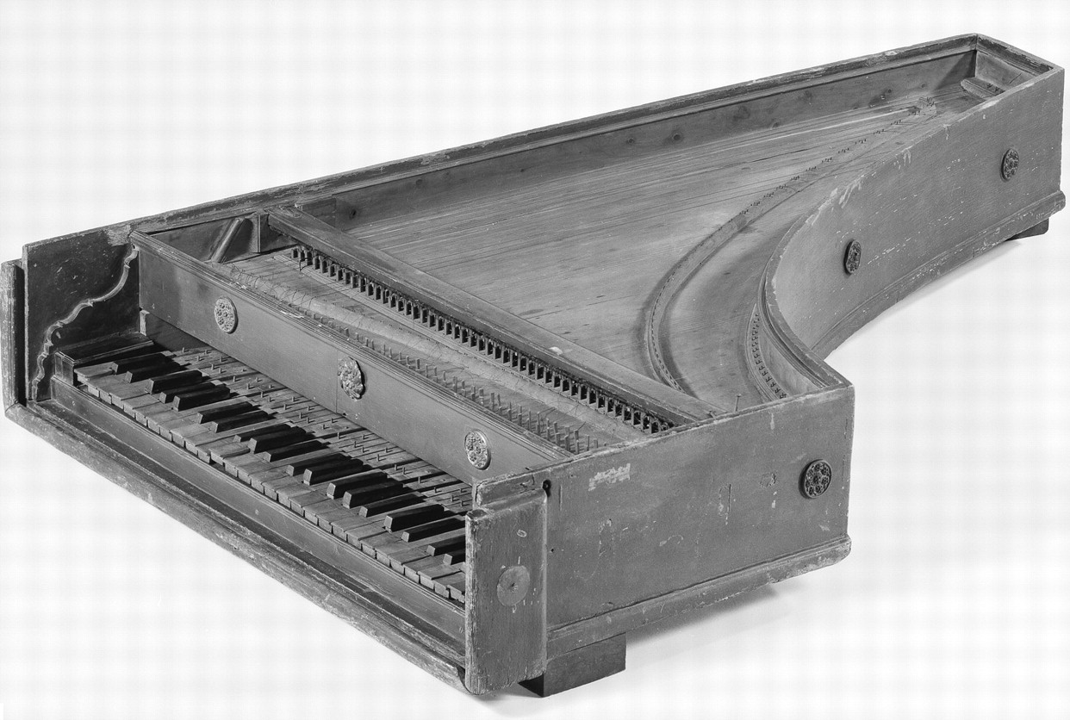
7 Harpsichord attributed to Manuel Ângelo Villa, Lisbon, first half of the 18th century (reproduced with ...
Notes:
7 Harpsichord attributed to Manuel Ângelo Villa, Lisbon, first half of the 18th century (reproduced with permission) (Berlin, Musikinstrumenten-Museum, Kat.-Nr.4)
Unless provided in the caption above, the following copyright applies to the content of this slide: Early Music, Vol. XXXV, No. 4 © The Author 2007. Published by Oxford University Press. All rights reserved.

Slide 8
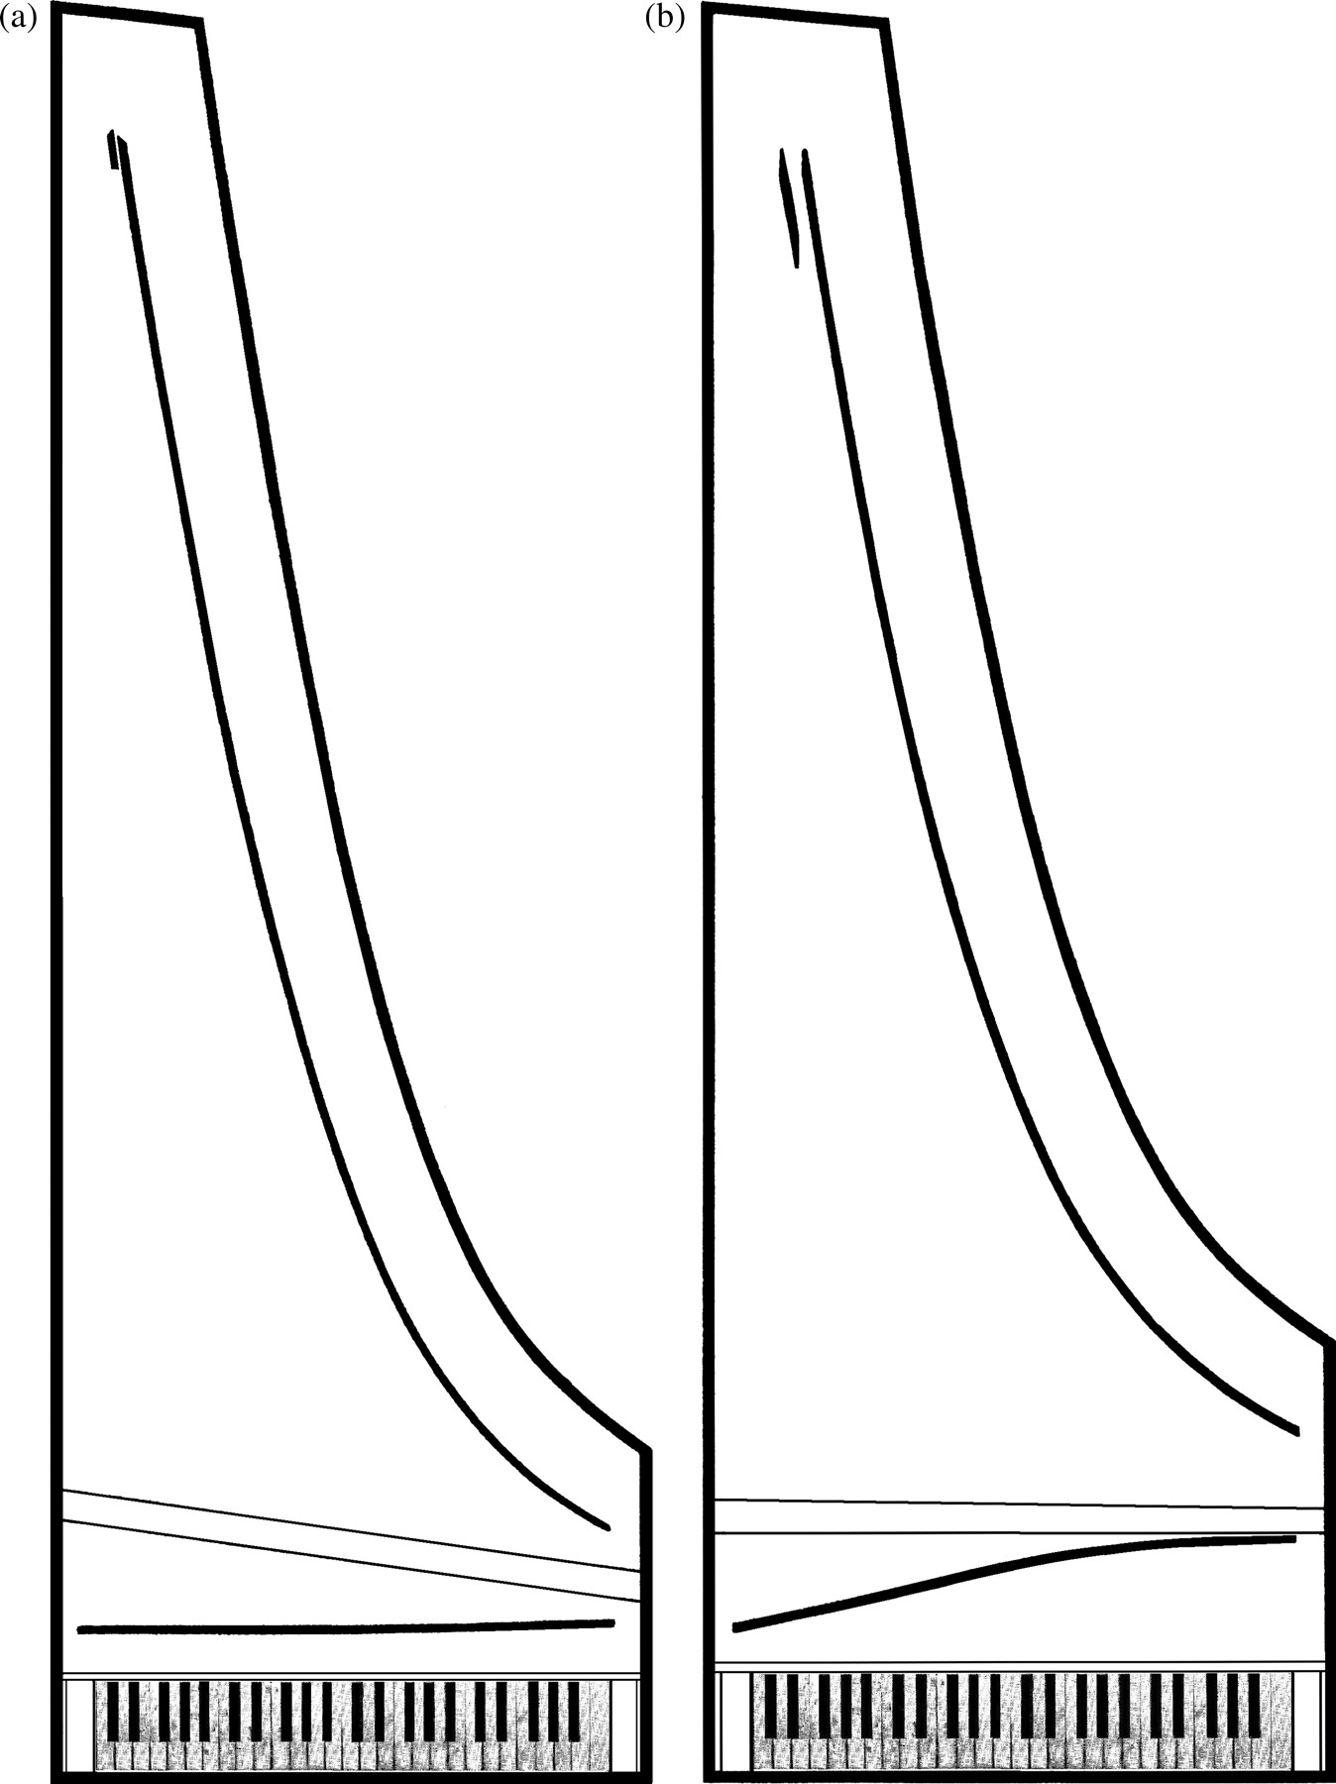
8 Plans of instruments by Bartolomeo Cristofori, Florence, 1722: (a) harpsichord (Grassi Museum, Leipzig); (b) ...
Notes:
8 Plans of instruments by Bartolomeo Cristofori, Florence, 1722: (a) harpsichord (Grassi Museum, Leipzig); (b) piano (Museo degli Strumenti Musicali, Rome) (both drawn by the author after plans in Schwarz, 2002)
Unless provided in the caption above, the following copyright applies to the content of this slide: Early Music, Vol. XXXV, No. 4 © The Author 2007. Published by Oxford University Press. All rights reserved.

Slide 9
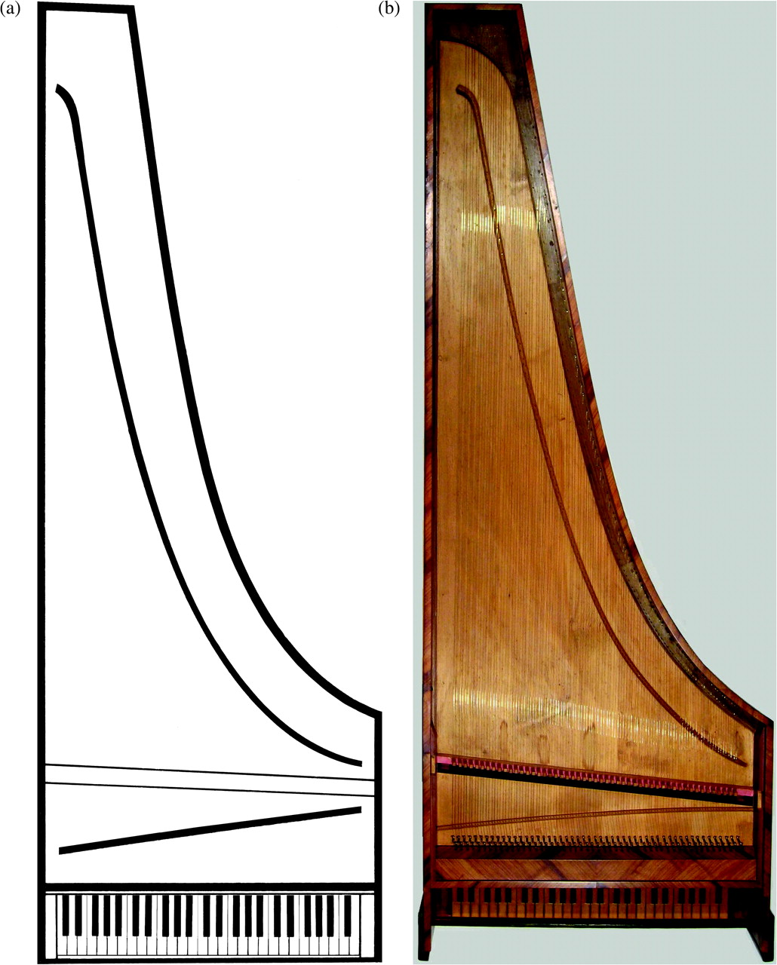
9 Plans of typical Portuguese instruments: (a) harpsichord by an unknown maker (Museu da Música, Lisbon, ...
Notes:
9 Plans of typical Portuguese instruments: (a) harpsichord by an unknown maker (Museu da Música, Lisbon, no.456; drawn by the author after a photo and measurements in Doderer and van der Meer, 2005); (b) piano by Manuel Antunes, Lisbon, 1767 (National Music Museum, Vermillion, cat. no.5055; Rawlins Fund, 1990; photo by the author)
Unless provided in the caption above, the following copyright applies to the content of this slide: Early Music, Vol. XXXV, No. 4 © The Author 2007. Published by Oxford University Press. All rights reserved.

Slide 10
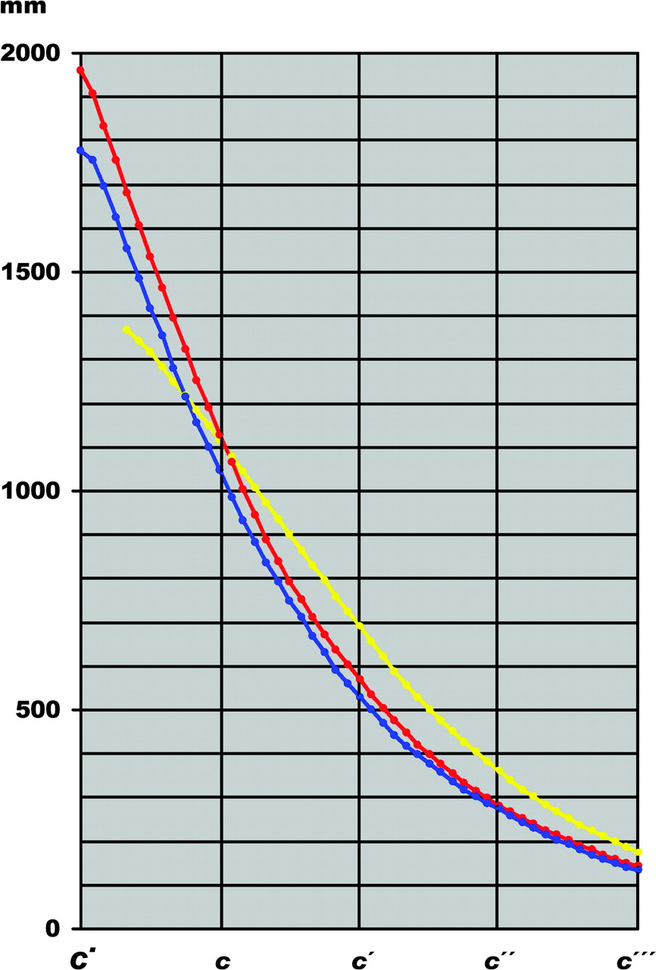
10 Graph of the string lengths of typical Florentine and Portuguese instruments: in red, a piano by Cristofori, ...
Notes:
10 Graph of the string lengths of typical Florentine and Portuguese instruments: in red, a piano by Cristofori, 1726 (Grassi Museum, Leipzig; data from Schwarz, 2002); in blue, the piano by Manuel Antunes, 1767. The Antunes curve is substantially the same as that of the Cristofori, although it is slightly lower because of the shorter scaling (c′′= 273 mm; Cristofori’s c′′= 281 mm), presumably designed for a somewhat higher pitch. For comparison, the strongly foreshorted 8′scaling of the Andreas Ruckers harpsichord of 1607 (National Music Museum; c′′= 359 mm) is shown in yellow
Unless provided in the caption above, the following copyright applies to the content of this slide: Early Music, Vol. XXXV, No. 4 © The Author 2007. Published by Oxford University Press. All rights reserved.

Slide 11
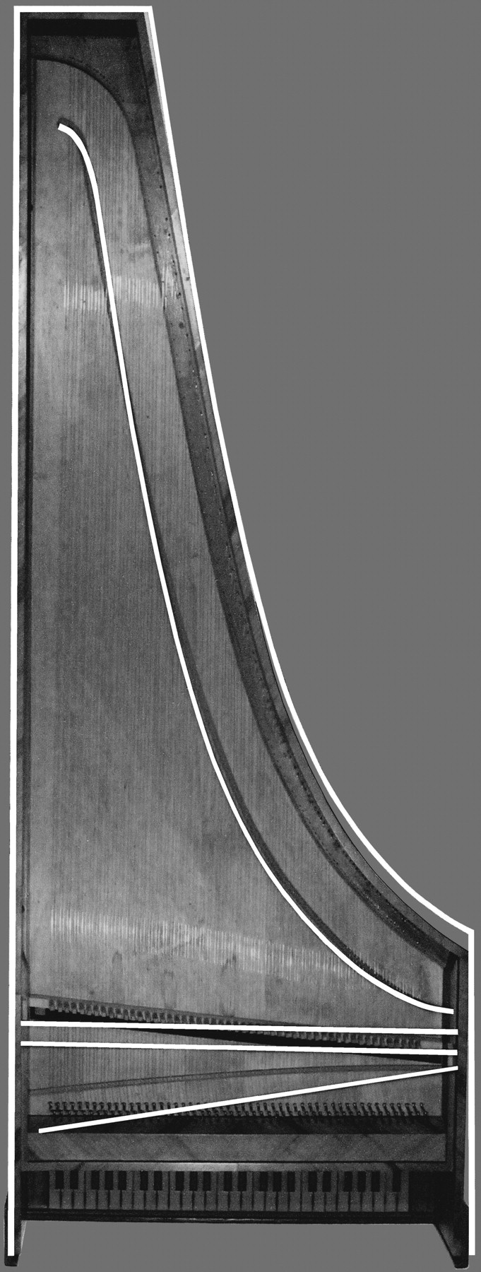
11 Outline, nut, bridge and gap of a harpsichord by Joaquim José Antunes, Lisbon, 1758 (Museu da Música, Lisbon; ...
Notes:
11 Outline, nut, bridge and gap of a harpsichord by Joaquim José Antunes, Lisbon, 1758 (Museu da Música, Lisbon; drawn by the author after the x-ray plan and measurements in Doderer and van der Meer, 2005), superimposed in white on a photo of the piano made by his elder brother Manuel in 1767
Unless provided in the caption above, the following copyright applies to the content of this slide: Early Music, Vol. XXXV, No. 4 © The Author 2007. Published by Oxford University Press. All rights reserved.

Slide 12
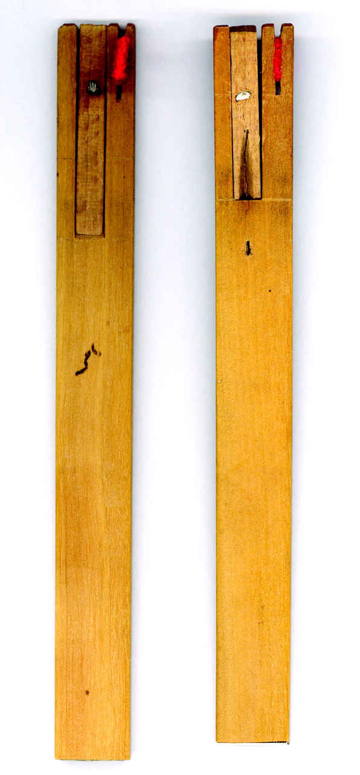
12 Jacks of the Calisto harpsichord (photo by the author)
Notes:
12 Jacks of the Calisto harpsichord (photo by the author)
Unless provided in the caption above, the following copyright applies to the content of this slide: Early Music, Vol. XXXV, No. 4 © The Author 2007. Published by Oxford University Press. All rights reserved.

Slide 13
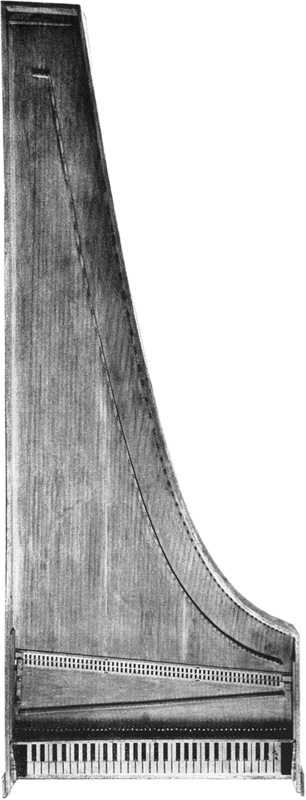
13 Harpsichord by an unknown Florentine maker (Grassi Museum, Leipzig, no.89; photo from Henkel, 1979, ...
Notes:
13 Harpsichord by an unknown Florentine maker (Grassi Museum, Leipzig, no.89; photo from Henkel, 1979, reproduced with permission)
Unless provided in the caption above, the following copyright applies to the content of this slide: Early Music, Vol. XXXV, No. 4 © The Author 2007. Published by Oxford University Press. All rights reserved.

Slide 14
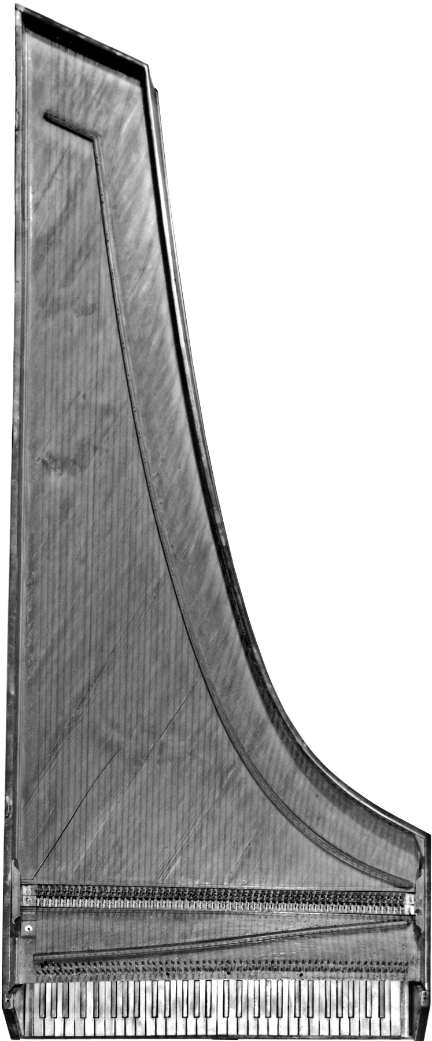
14 Harpsichord by Vincenzio Sodi, Florence, 1782 (National Music Museum, Vermillion, cat. no.9825; Arne B. and ...
Notes:
14 Harpsichord by Vincenzio Sodi, Florence, 1782 (National Music Museum, Vermillion, cat. no.9825; Arne B. and Jeanne F. Larson Fund and gift of Conrad Seaman, Pittsburgh, 2000; photo by Simon Spicer)
Unless provided in the caption above, the following copyright applies to the content of this slide: Early Music, Vol. XXXV, No. 4 © The Author 2007. Published by Oxford University Press. All rights reserved.

Slide 15
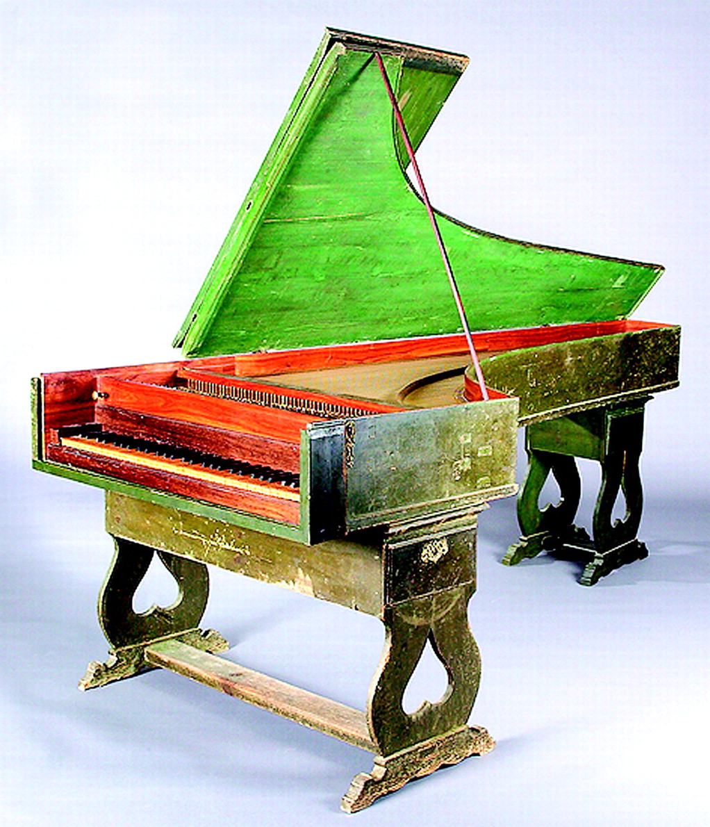
15 Harpsichord by José Calisto, Portugal (probably Lisbon), 1780 (National Music Museum, Vermillion, cat. ...
Notes:
15 Harpsichord by José Calisto, Portugal (probably Lisbon), 1780 (National Music Museum, Vermillion, cat. no.6204; Rawlins Fund, 1999; photo by Bill Willroth, Sr.)
Unless provided in the caption above, the following copyright applies to the content of this slide: Early Music, Vol. XXXV, No. 4 © The Author 2007. Published by Oxford University Press. All rights reserved.

Slide 16
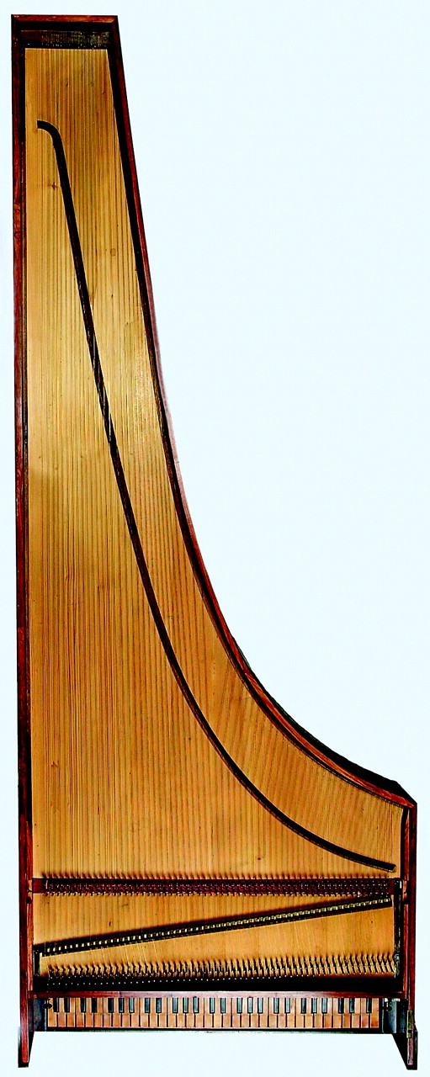
16 Plan of the Calisto harpsichord (photo by Bill Willroth, Sr.)
Notes:
16 Plan of the Calisto harpsichord (photo by Bill Willroth, Sr.)
Unless provided in the caption above, the following copyright applies to the content of this slide: Early Music, Vol. XXXV, No. 4 © The Author 2007. Published by Oxford University Press. All rights reserved.

