Slide 1
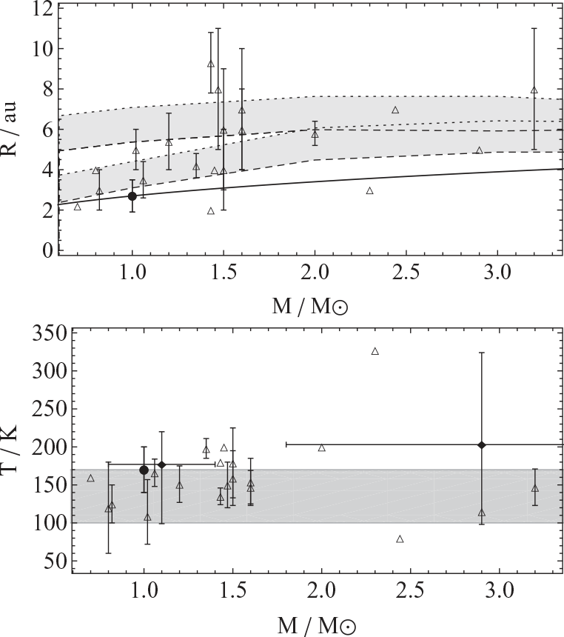
Figure 1 Upper panel: radius of the observed warm dust. The shaded regions show the snow border found from numerical ...
Notes:
Figure 1 Upper panel: radius of the observed warm dust. The shaded regions show the snow border found from numerical models at times t = 106 yr (upper) and t = 107 yr (lower). The solid line shows the analytic approximation to the snow line given in equation (1). Lower panel: temperature of the observed warm dust. The shaded region shows the snow border. In both plots, the open triangles show the individual systems shown in Table 1. The filled diamonds (only in the temperature plot) show two samples from Morales et al. (2011) and the error bars show the range in the samples. The filled circles show the location of our Solar system's snow line and the range shows the extent of our asteroid belt.
Unless provided in the caption above, the following copyright applies to the content of this slide: © 2012 The Authors Published by Oxford University Press on behalf of the Royal Astronomical Society

Slide 2
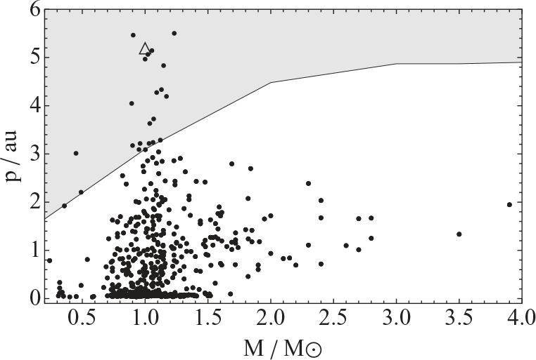
Figure 2. The distribution of observed giant planet periastron separation, p, against the mass of the central star, M. ...
Notes:
Figure 2. The distribution of observed giant planet periastron separation, p, against the mass of the central star, M. The open triangle shows where Jupiter lies. The shaded region shows the icy region outside of the lower limit to the snow line predicted by our numerical models.
Unless provided in the caption above, the following copyright applies to the content of this slide: © 2012 The Authors Published by Oxford University Press on behalf of the Royal Astronomical Society

