Slide 1
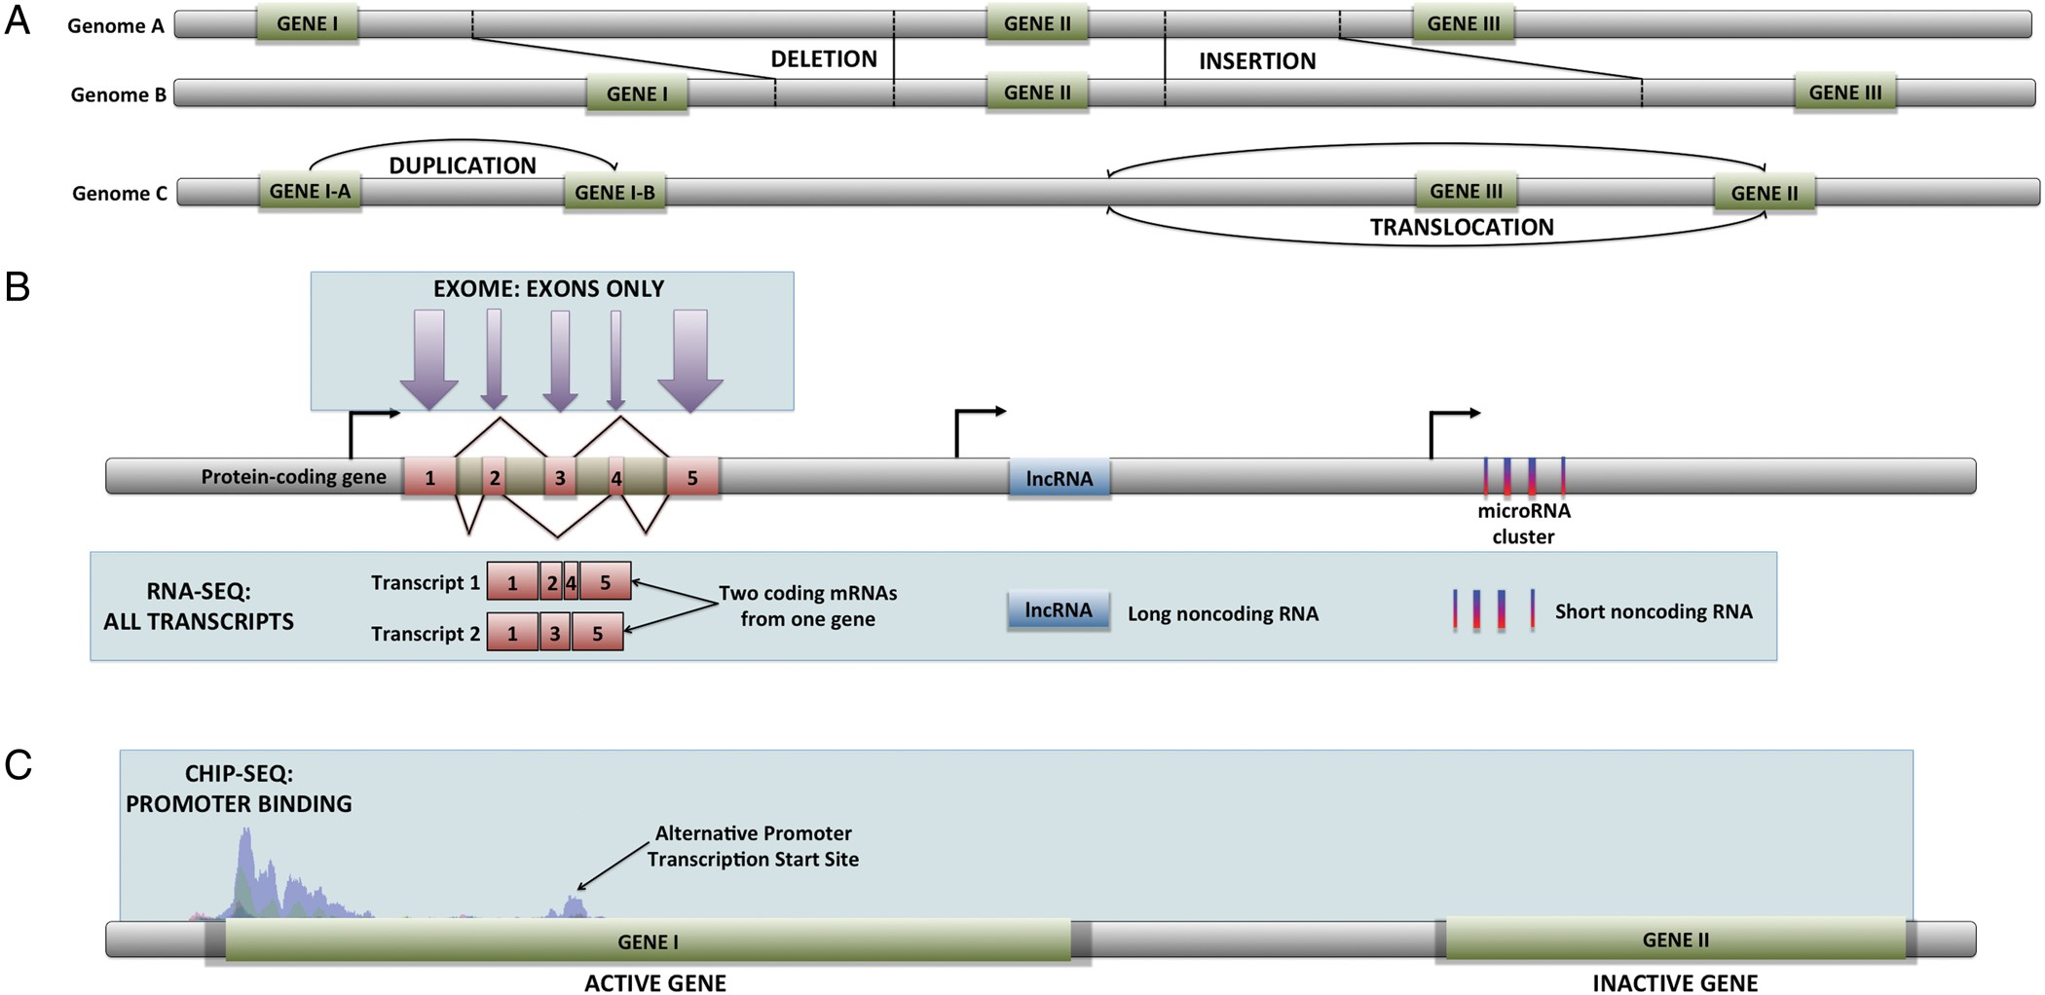
Figure 1 Graphic representation of the most commonly used HTS technologies. (A) Whole genome sequencing allows the ...
Notes:
Figure 1 Graphic representation of the most commonly used HTS technologies. (A) Whole genome sequencing allows the detection of changes in genome structure such as insertion/deletion events, gene duplications, and translocations. (B) Whole exome sequencing produces only sequences within exons from genomic DNA. RNA-Seq generates the complete sequences of every RNA transcript, including alternative transcripts, and noncoding RNAs. (C) ChIP-Seq is able to identify the DNA-binding sites for specific transcription factors, as well as any other protein capable of binding to DNA.
Unless provided in the caption above, the following copyright applies to the content of this slide: Published by Oxford University Press 2014. This work is written by (a) US Government employee(s) and is in the public domain in the US.

Slide 2
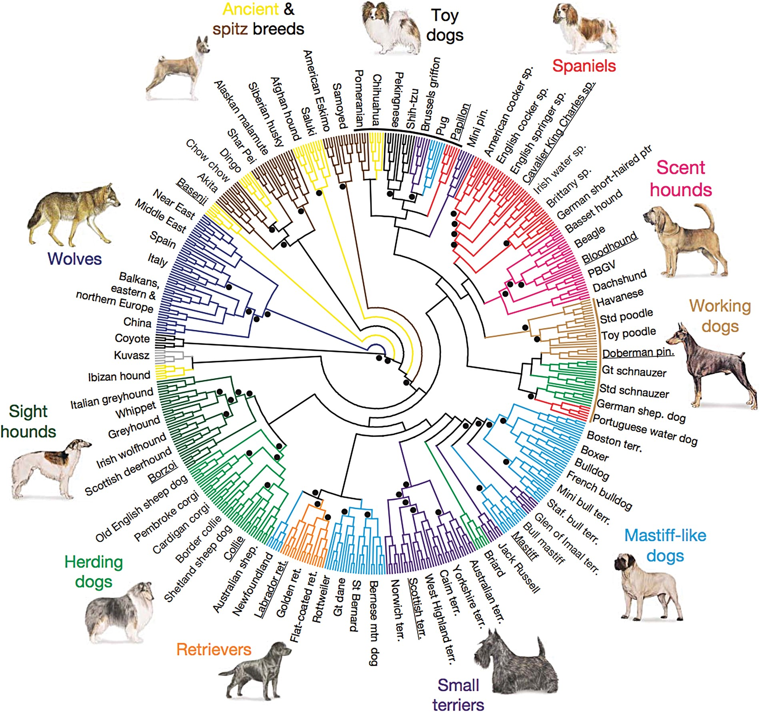
Figure 2 Cladogram from (vonHoldt et al. 2010) depicting the structure of domestic dog breeds as ascertained from ...
Notes:
Figure 2 Cladogram from (vonHoldt et al. 2010) depicting the structure of domestic dog breeds as ascertained from 48,036 autosomal SNP loci. Relationship between breeds was determined by haplotype-sharing for 10-SNP windows with at least 6 members representing each breed.
Unless provided in the caption above, the following copyright applies to the content of this slide: Published by Oxford University Press 2014. This work is written by (a) US Government employee(s) and is in the public domain in the US.

Slide 3
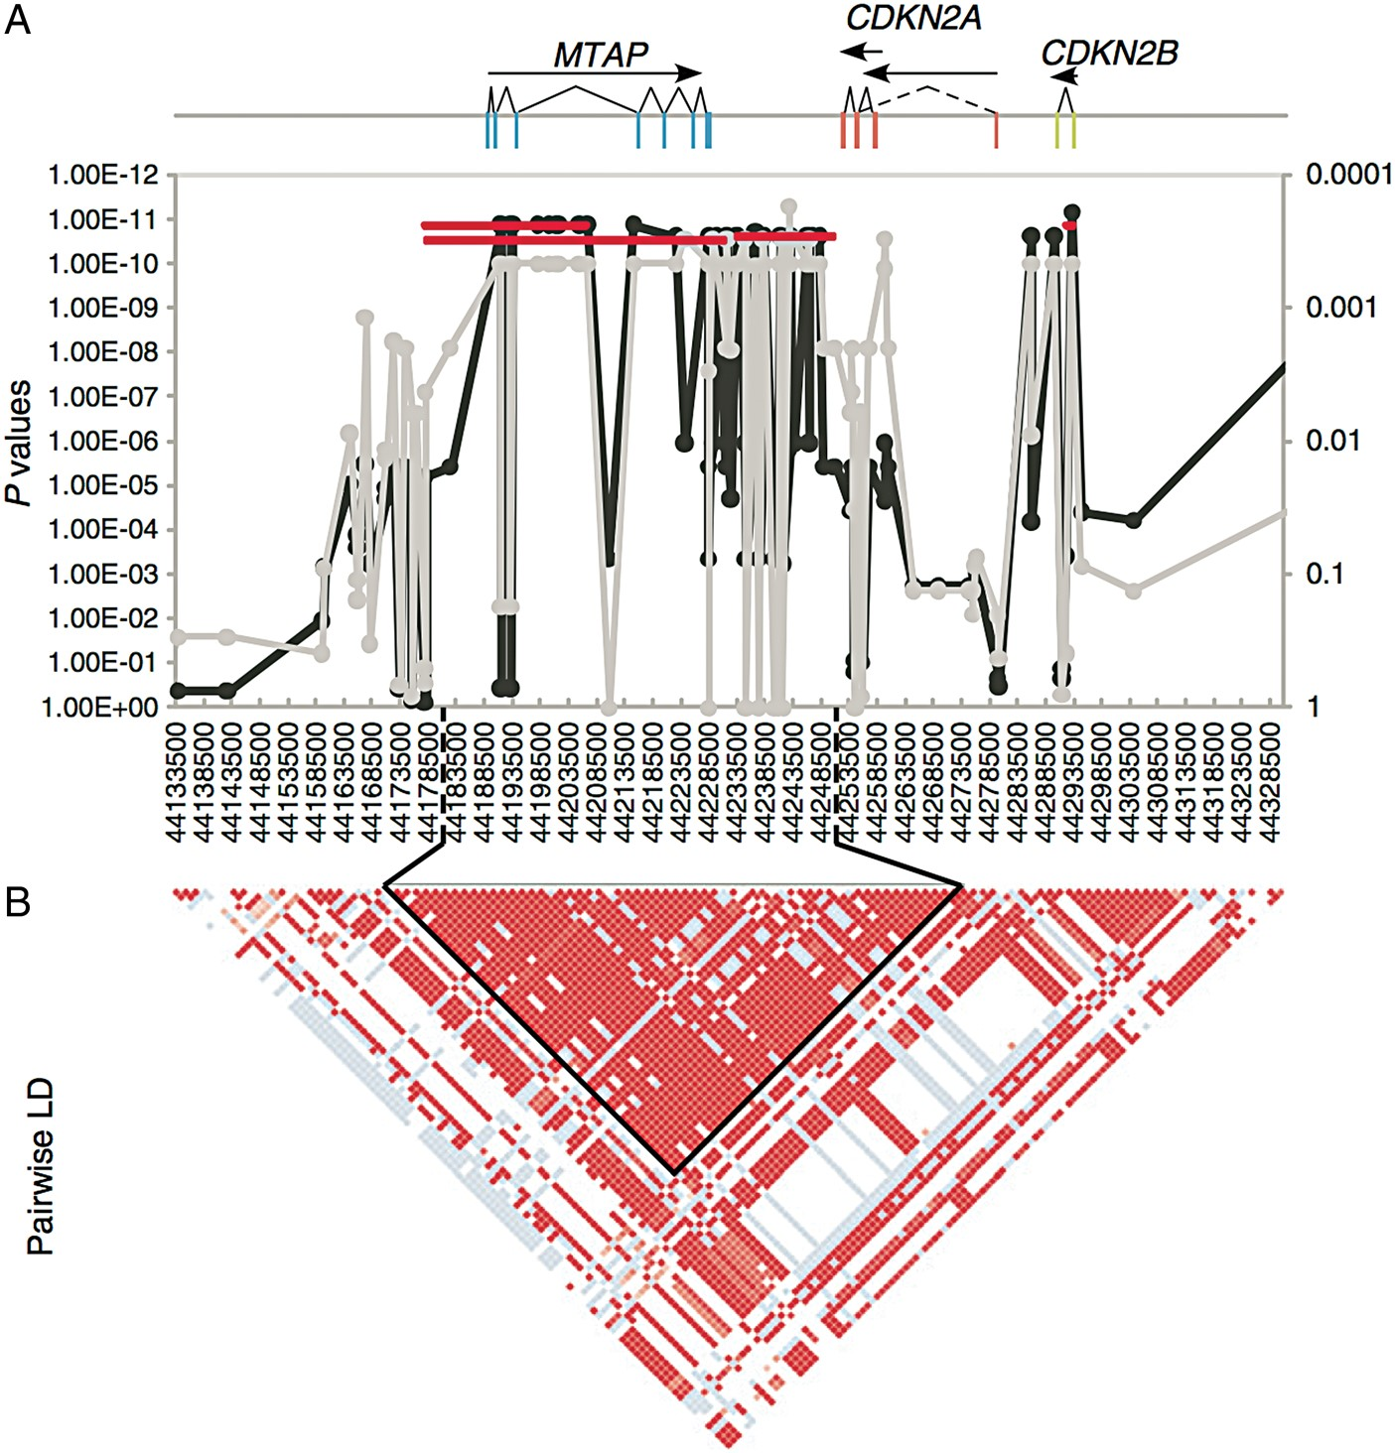
Figure 3 The region encompassing MTAP and CDK genes shown to be highly associated with histiocytic sarcoma from ...
Notes:
Figure 3 The region encompassing MTAP and CDK genes shown to be highly associated with histiocytic sarcoma from (Shearin et al. 2012). A 195-kb region on CFA11 is shown with X-axes for all plots listing SNPs in proximal-distal order. (A) 3 genes are shown with exons indicated as rectangles, introns as lines, and transcripts as arrows. Fisher exact association of HS with allele frequency is plotted along the Y-axis. The light gray line denotes association in a discovery cohort of 24 cases and 20 controls with P values on the right Y-axis. The black line indicates association in the complete cohort after imputation of genotypes (P values on left Y-axis). Horizontal lines depict haplotype association (P values on left Y-axis). (B) Pairwise LD plot with solid blocks indicating D′ = 1 and LOD score of 2. The black outline shows a haplotype block with 28 of 30 equally associated SNPs in this region.
Unless provided in the caption above, the following copyright applies to the content of this slide: Published by Oxford University Press 2014. This work is written by (a) US Government employee(s) and is in the public domain in the US.

