Slide 1
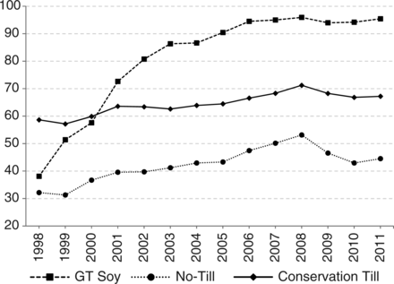
Figure 1. Conservation tillage and GT adoption rates for US soybeans (percent of acres)
Notes:
Figure 1. Conservation tillage and GT adoption rates for US soybeans (percent of acres)
Unless provided in the caption above, the following copyright applies to the content of this slide: © The Author 2016. Published by Oxford University Press on behalf of the Agricultural and Applied Economics Association. All rights reserved. For permissions, please e-mail: journals.permissions@oup.com

Slide 2
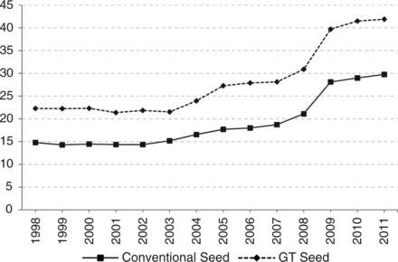
Figure 2. US soybean seed prices, 1998–2011 ($/50lb)
Notes:
Figure 2. US soybean seed prices, 1998–2011 ($/50lb)
Unless provided in the caption above, the following copyright applies to the content of this slide: © The Author 2016. Published by Oxford University Press on behalf of the Agricultural and Applied Economics Association. All rights reserved. For permissions, please e-mail: journals.permissions@oup.com

Slide 3
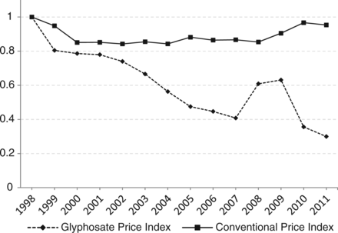
Figure 3. US soybean herbicide prices, 1998–2011
Notes:
Figure 3. US soybean herbicide prices, 1998–2011
Unless provided in the caption above, the following copyright applies to the content of this slide: © The Author 2016. Published by Oxford University Press on behalf of the Agricultural and Applied Economics Association. All rights reserved. For permissions, please e-mail: journals.permissions@oup.com

