Slide 1
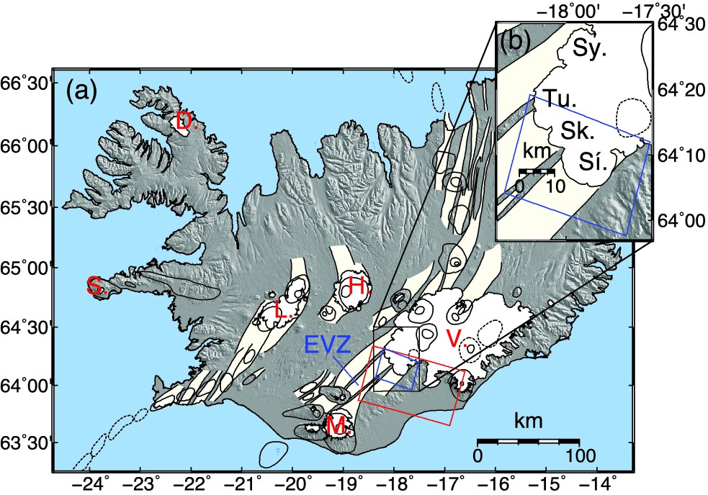
Figure 1. (a) Ice caps and tectonic setting of Iceland. Fissure swarms are shown in light yellow and central volcanoes ...
Notes:
Figure 1. (a) Ice caps and tectonic setting of Iceland. Fissure swarms are shown in light yellow and central volcanoes with their associated calderas are represented by oval outlines (after Einarsson & Saemundsson 1987). The Eastern Volcanic Zone (EVZ) is displayed in blue. Main ice caps names are indicated in red (D.: Drangajökull, S.: Snæfelsjökull, L.: Langjökull, M.: Mýrdalsjökull, H.: Hofsjökull, and V.: Vatnajökull). The color boxes show the area spanned by our InSAR data: red for the full scene and blue for the cropped one. The black box gives the area shown in (b). (b) Zoom in the southwestern region of Vatnajökull, with the names of the four surging outlet glaciers studied here (Sy.: Sylgjujökull, Tu.: Tungnaárjökull, Sk.: Skaftárjökull and Sí.: Síðujökull) and the cropped InSAR scene outlines (blue box).
Unless provided in the caption above, the following copyright applies to the content of this slide: © The Authors 2014. Published by Oxford University Press on behalf of The Royal Astronomical Society.

Slide 2
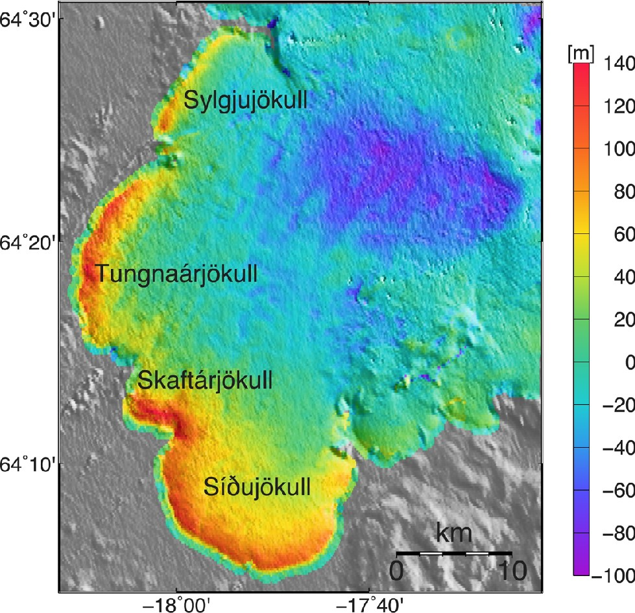
Figure 2. Surface elevation change at Sylgjujökull, Tungnaárjökull, Skaftárjökull and Síðujökull outlet glaciers ...
Notes:
Figure 2. Surface elevation change at Sylgjujökull, Tungnaárjökull, Skaftárjökull and Síðujökull outlet glaciers between 1993 and 1995. Negative values indicate an ice loss while positive values indicate a gain in ice.
Unless provided in the caption above, the following copyright applies to the content of this slide: © The Authors 2014. Published by Oxford University Press on behalf of The Royal Astronomical Society.

Slide 3
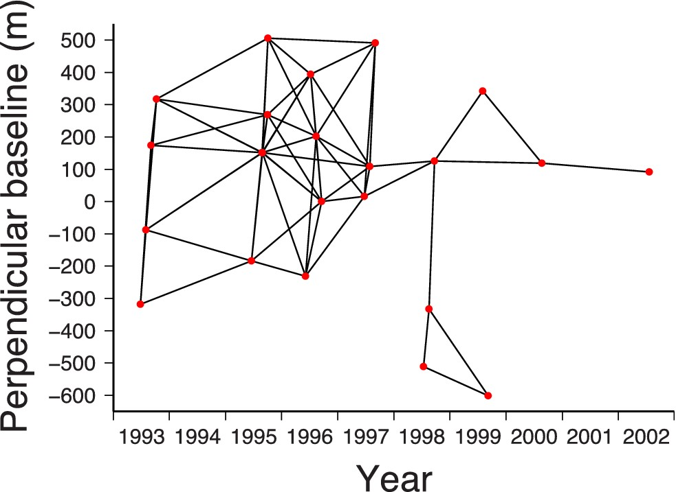
Figure 3. Connections (black lines) between individual InSAR acquisitions (red dots) forming the 65 highly coherent ...
Notes:
Figure 3. Connections (black lines) between individual InSAR acquisitions (red dots) forming the 65 highly coherent small-baseline interferograms used in the study. The y-axis displays the perpendicular baseline between each image and an arbitrary master image on 1996 September 17.
Unless provided in the caption above, the following copyright applies to the content of this slide: © The Authors 2014. Published by Oxford University Press on behalf of The Royal Astronomical Society.

Slide 4
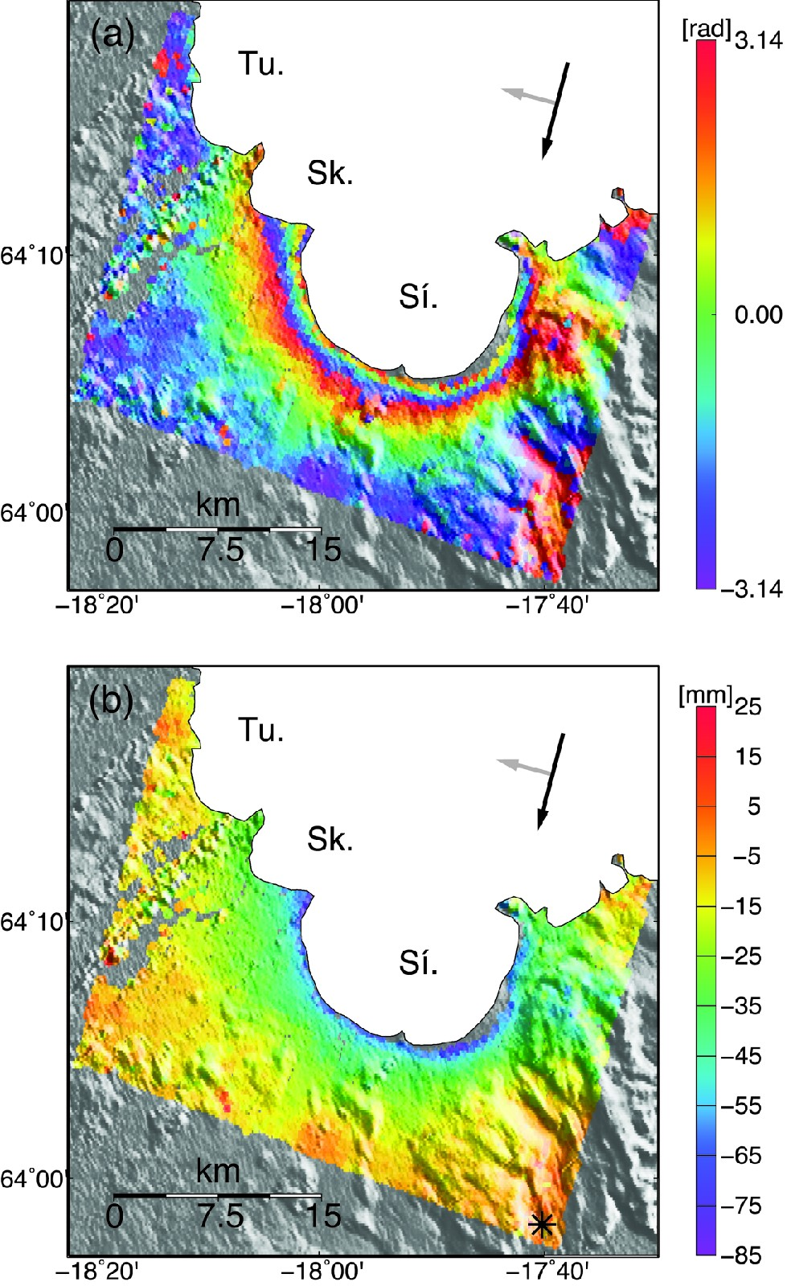
Figure 4. Interferograms spanning 1993 July 31 to 1995 June 19, showing the surge at Tungnaárjökull (Tu.), ...
Notes:
Figure 4. Interferograms spanning 1993 July 31 to 1995 June 19, showing the surge at Tungnaárjökull (Tu.), Skaftárjökull (Sk.) and Síðujökull (Sí.) outlet glaciers. The black and grey arrows show the azimuth of the satellite and the look direction, respectively. (a) Wrapped interferogram showing the deformation in fringes between ±π. One full fringe (2π) equals 28.3 mm deformation. (b) Unwrapped interferogram. The black star designates the reference area and negative values indicate LOS lengthening.
Unless provided in the caption above, the following copyright applies to the content of this slide: © The Authors 2014. Published by Oxford University Press on behalf of The Royal Astronomical Society.

Slide 5
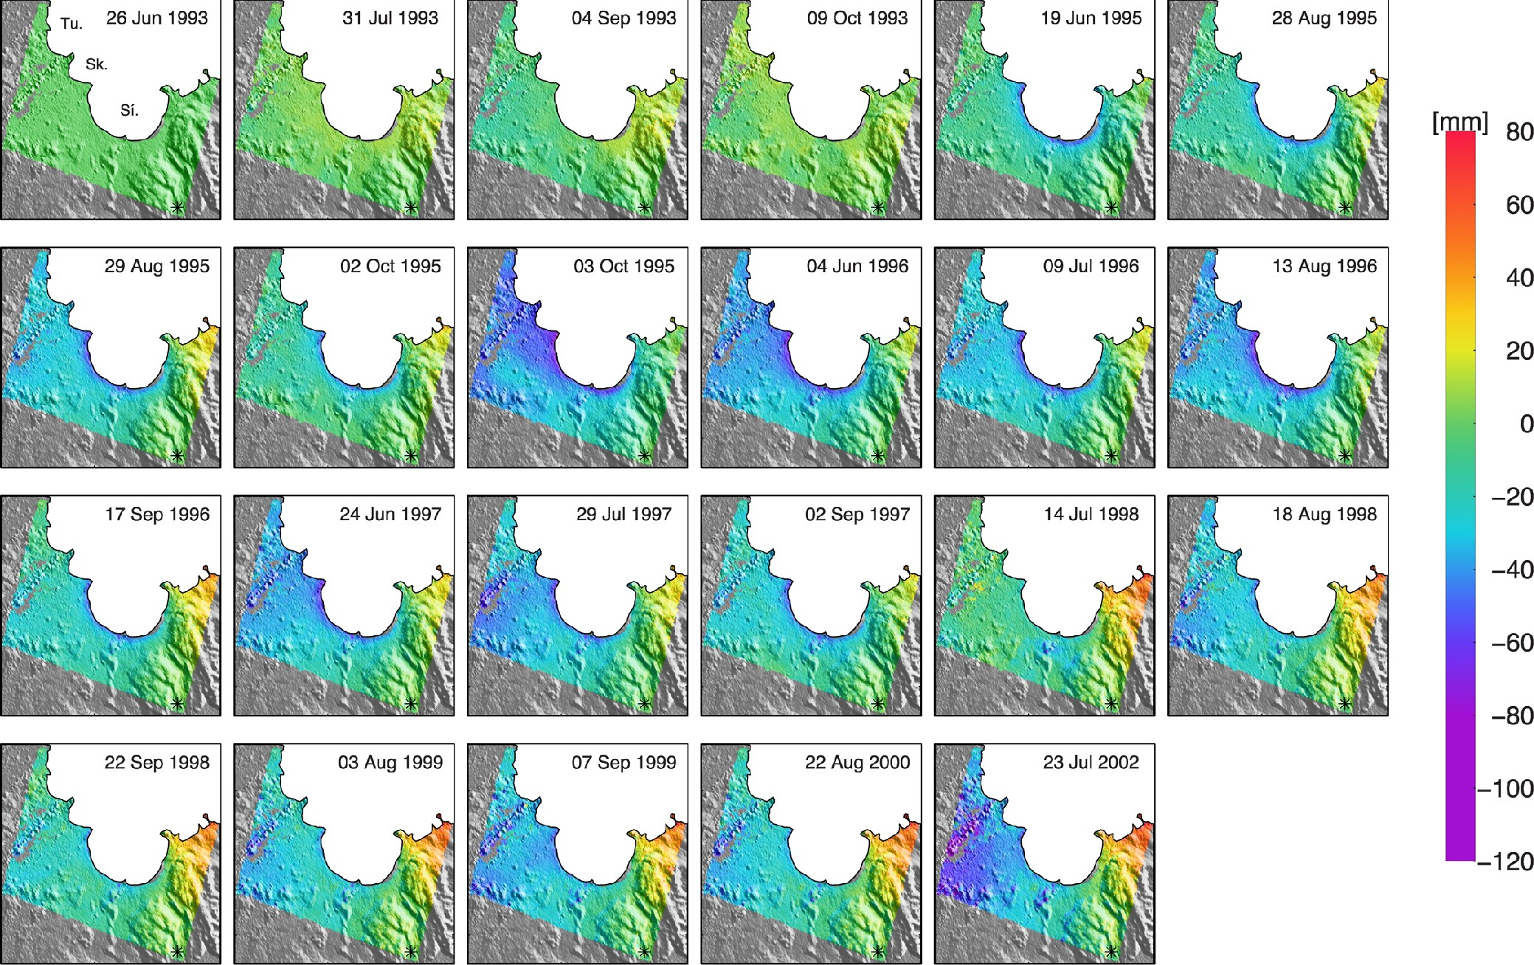
Figure 5. Single-master time-series created from the 65 small baseline interferograms, spanning 1993–2002. The ...
Notes:
Figure 5. Single-master time-series created from the 65 small baseline interferograms, spanning 1993–2002. The deformation shown is in LOS (negative values for LOS lengthening), relative to the reference area indicated by the black star. Each panel shows the cumulative change from the first interferogram on 1993 June 26, where Tu., Sk. and Sí. indicate Tungnaárjökull, Skaftárjökull and Síðujökull, respectively. The colour scale has been modified such that points from −80 mm to −120 mm appear in the same colour, to enhance the viewing of the surge signal.
Unless provided in the caption above, the following copyright applies to the content of this slide: © The Authors 2014. Published by Oxford University Press on behalf of The Royal Astronomical Society.

Slide 6
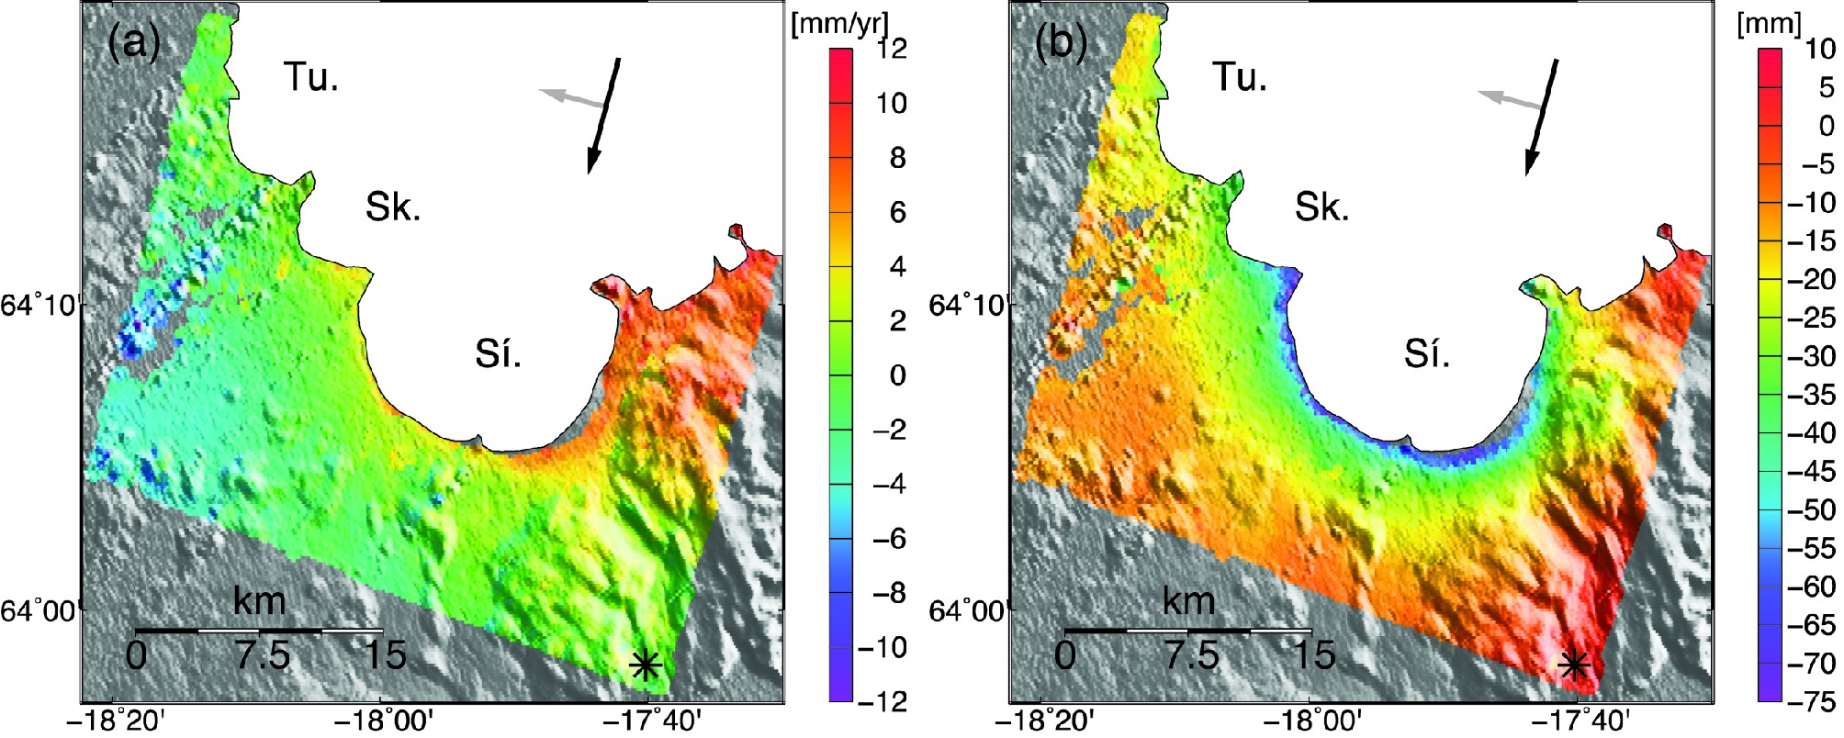
Figure 6. Inferred deformation signals from the linear inversion ran on the single-master time-series: (a) GIA signal ...
Notes:
Figure 6. Inferred deformation signals from the linear inversion ran on the single-master time-series: (a) GIA signal estimated as a continuous velocity, in mm yr−1, (b) surge displacement estimated as a step function, in mm. Both results are shown in LOS and with respect to the reference area, where negative values stand for LOS lengthening (note the difference in colour scaling). The black and grey arrows show the azimuth of the satellite and the look direction, respectively. Tu., Sk. and Sí. indicate Tungnaárjökull, Skaftárjökull and Síðujökull outlet glaciers, respectively.
Unless provided in the caption above, the following copyright applies to the content of this slide: © The Authors 2014. Published by Oxford University Press on behalf of The Royal Astronomical Society.

Slide 7
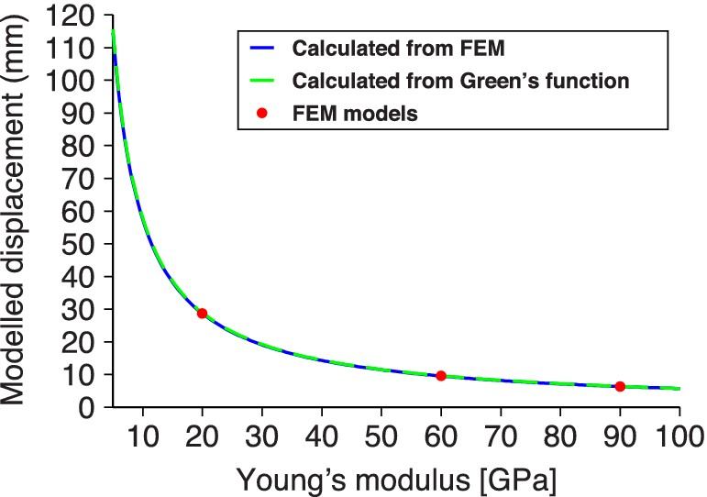
Figure 7. Vertical deformation observed at a randomly chosen mesh node as a function of Young's modulus. The red ...
Notes:
Figure 7. Vertical deformation observed at a randomly chosen mesh node as a function of Young's modulus. The red circles show results from the finite element models run with E = 20, 60 and 90 GPa. The blue line gives the vertical deformation calculated with the finite element model result using E = 20 GPa and scaling it for the different values of E, according to Hooke's law. The dashed green line, superimposed on the blue one, represents the deformation calculated with the Green's function approach using E = 40 GPa, and scaled to other values of E using Hooke's law.
Unless provided in the caption above, the following copyright applies to the content of this slide: © The Authors 2014. Published by Oxford University Press on behalf of The Royal Astronomical Society.

Slide 8
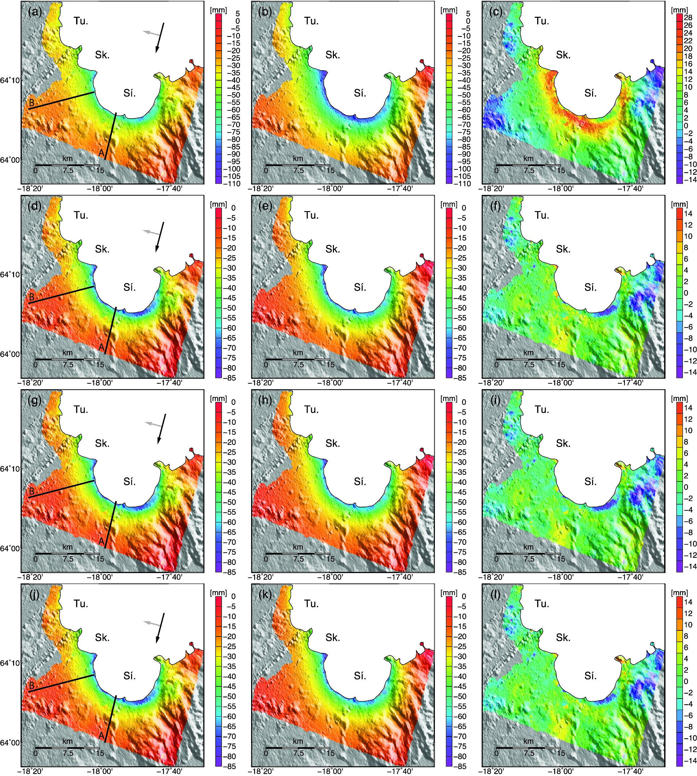
Figure 8. Top row: (a) Referenced LOS surge displacement estimated from the InSAR data (output from the least-squares ...
Notes:
Figure 8. Top row: (a) Referenced LOS surge displacement estimated from the InSAR data (output from the least-squares inversion minus the ramp and offset estimated from the Bayesian approach), (b) best-fit one-layer elastic model (E = 46.4 GPa and v = 0.17) converted to LOS, and (c) residual between (a) and (b), respectively. Rows 2–4 show similar set of panels for the other models. (d), (e) and (f) Same as above but with the two-layer elastic best-fit model with v1 = v2 = 0.25, E1 = 12.9 GPa, and E2 = 70.5 GPa. (g), (h) and (i) Same as above with v1 = 0.17, E1 = 12.9 GPa, v2 = 0.25 and E2 = 73.9 GPa. (j), (k) and (l) Same as above with v1 = v2 = 0.17, E1 = 12.8 GPa and E2 = 76.2 GPa. Tu., Sk. and Sí. indicate Tungnaárjökull, Skaftárjökull and Síðujökull outlet glaciers, respectively. The black and grey arrows show the azimuth of the satellite and the look direction, respectively. The black lines locate the profiles A and B presented in Fig. 11. Note the difference in scale between plots (a)–(c) from the one-layer elastic models and plots (d)–(l) from the two-layer elastic models.
Unless provided in the caption above, the following copyright applies to the content of this slide: © The Authors 2014. Published by Oxford University Press on behalf of The Royal Astronomical Society.

Slide 9
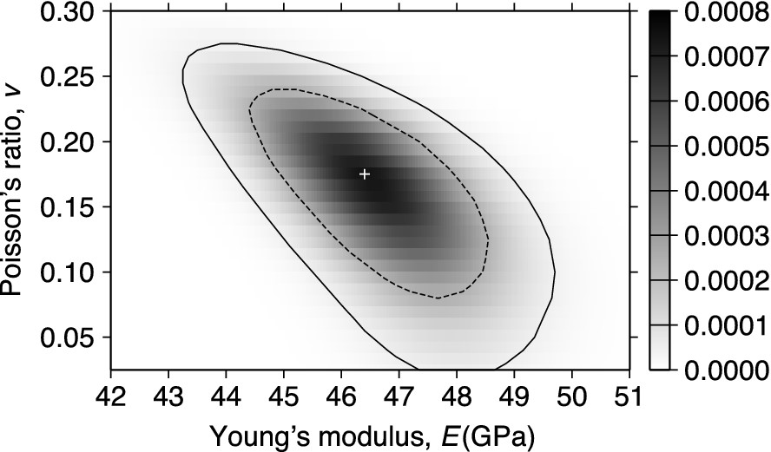
Figure 9. Probability distribution estimate of the Young's modulus (E) and Poisson's ratio (v) for one-elastic layer ...
Notes:
Figure 9. Probability distribution estimate of the Young's modulus (E) and Poisson's ratio (v) for one-elastic layer models. The best model (white cross) predicts E = 46.4 GPa and v = 0.17. The black outline shows the 95 per cent confidence region, located between 43.2 and 49.7 GPa for E and 0 and 0.27 for v, the black dashed line gives the 68 per cent confidence region.
Unless provided in the caption above, the following copyright applies to the content of this slide: © The Authors 2014. Published by Oxford University Press on behalf of The Royal Astronomical Society.

Slide 10
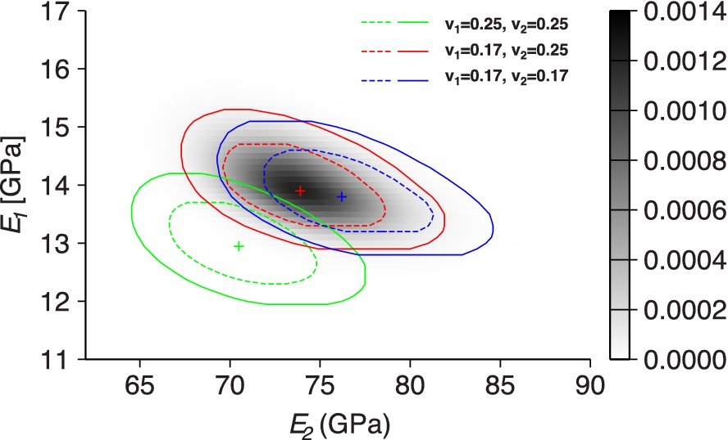
Figure 10. Probability distribution estimates of the Young's moduli for the upper (E₁) and lower ...
Notes:
Figure 10. Probability distribution estimates of the Young's moduli for the upper (E1) and lower (E2) layers for the two-layer elastic models. The plus symbols indicate the best-fit models in each case, the continuous outlines the 95 per cent confidence regions, and the dashed lines the 68 per cent confidence regions. In green, we show the distribution for the models with v1 = v2 = 0.25, indicating a best-fit model of E1 = 12.9$^{+1.3}_{-1.0}$ GPa and E2 = 70.5$^{+7.0}_{-6.0}$ GPa. In red, we show the results for our preferred model with v1 = 0.17 and v2 = 0.25, giving a best estimate of E1 = 13.9$^{+1.4}_{-1.0}$ GPa and E2 = 73.9$^{+8.0}_{-6.6}$ GPa. Results for the models with v1 = v2 = 0.17 are shown in blue and predict a best-fit model of E1 = 13.8$^{+1.3}_{-1.0}$ GPa and E2 = 76.2$^{+8.4}_{-6.9}$ GPa. The uncertainties given here correspond to the 95 per cent confidence regions. The colour scale shows the probability distribution for our preferred model.
Unless provided in the caption above, the following copyright applies to the content of this slide: © The Authors 2014. Published by Oxford University Press on behalf of The Royal Astronomical Society.

Slide 11
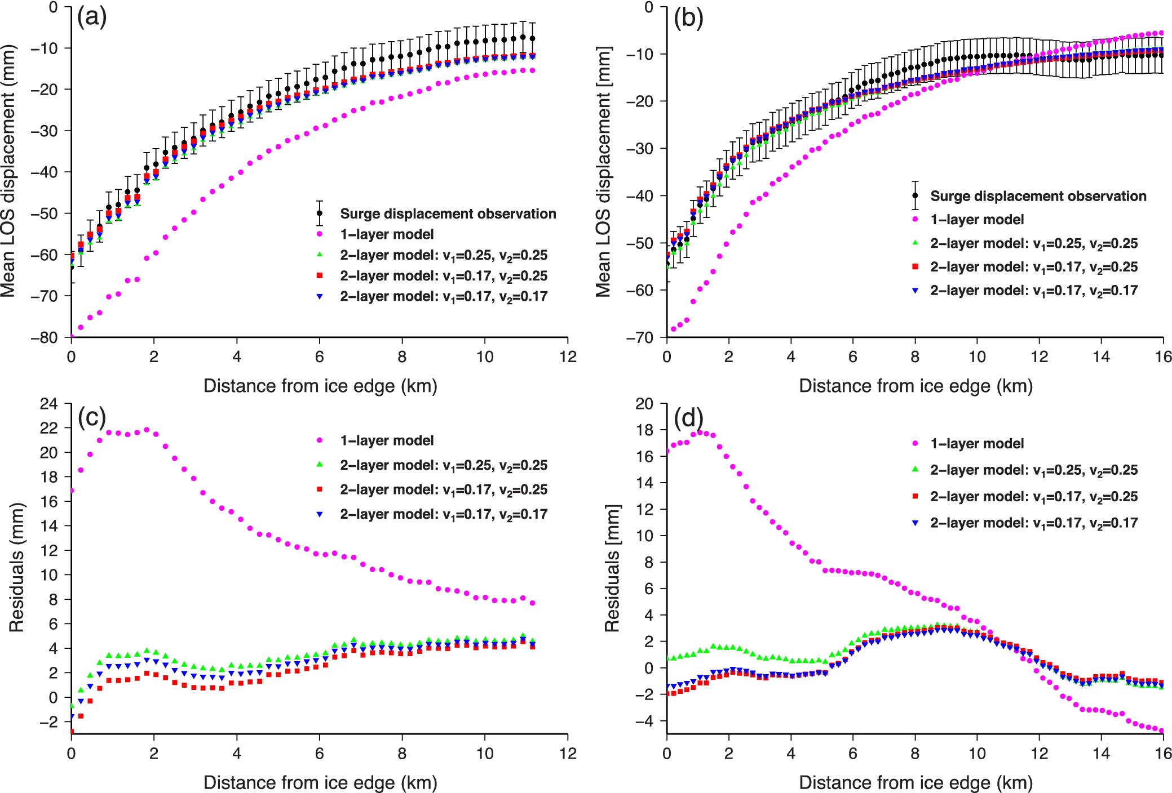
Figure 11. Plots showing the deformation along two profiles (location on Fig. 8). Results from profile A are displayed ...
Notes:
Figure 11. Plots showing the deformation along two profiles (location on Fig. 8). Results from profile A are displayed on the left side panels and results from profile B are shown in the right side panels. (a) and (b) Comparison between the surge displacement field (corresponding to dsurge) and the best-fit models (where we added the ramp and offset estimated by the Bayesian approach), in black and coloured symbols, respectively. (c) and (d) Residual displacement along each profile for each of the best-fit models. In all four panels, purple circles indicate the results obtained with the best-fit one-layer model, the green triangles are used for the best-fit two-layer model with v1 = v2 = 0.25, the red squares correspond to the best-fit two-layer model with v1 = 0.17 and v2 = 0.25 (preferred model), and the blue inverted triangles show the best-fit two-layer model with v1 = v2 = 0.17.
Unless provided in the caption above, the following copyright applies to the content of this slide: © The Authors 2014. Published by Oxford University Press on behalf of The Royal Astronomical Society.

