Slide 1
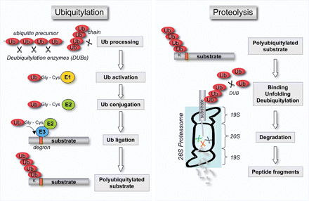
Figure 1 The ubiquitin-proteasome system. Free ubiquitin is generated from processing of ubiquitin precursors or ...
Notes:
Figure 1 The ubiquitin-proteasome system. Free ubiquitin is generated from processing of ubiquitin precursors or ubiquitin chains by DUBs. An enzymatic cascade, involving the E1, E2, and E3 enzymes, forms covalently conjugated ubiquitin chains on target proteins that are singled out by the presence of a degradation signal (degron). The ubiquitylated substrate is recognized by the proteasome, where also unfolding and deubiquitylation take place prior to hydrolysis in its interior chamber. For more details see text.
Unless provided in the caption above, the following copyright applies to the content of this slide: Published on behalf of the European Society of Cardiology. All rights reserved. © The Author 2009. For permissions please email: journals.permissions@oxfordjournals.org.

Slide 2
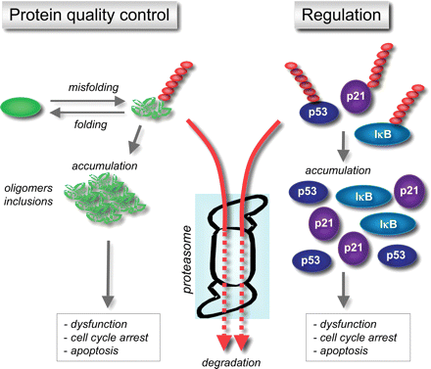
Figure 2 Protein quality control and regulation by the UPS. Proteasomal degradation of regulatory proteins as well as ...
Notes:
Figure 2 Protein quality control and regulation by the UPS. Proteasomal degradation of regulatory proteins as well as misfolded proteins is a continuously ongoing process, here indicated by red arrows. Extrinsic and intrinsic factors can cause stress that impairs the ability to degrade substrates whereupon potentially harmful protein accumulation takes place as indicated by grey arrows.
Unless provided in the caption above, the following copyright applies to the content of this slide: Published on behalf of the European Society of Cardiology. All rights reserved. © The Author 2009. For permissions please email: journals.permissions@oxfordjournals.org.

