Slide 1
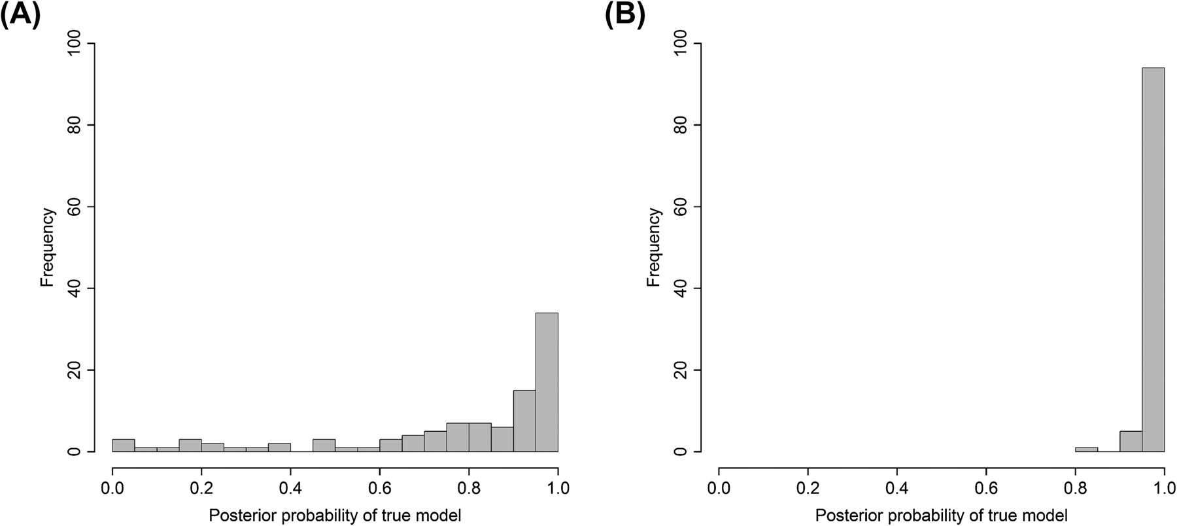
FIG. 1. Histograms showing the distribution of posterior probabilities from using our model-averaged model on the ...
Notes:
FIG. 1. Histograms showing the distribution of posterior probabilities from using our model-averaged model on the simulated data set. (A) The posterior probabilities of the E distribution when the rates were simulated under DE. (B) The posterior probabilities of the LN distribution when the rates were simulated under DLN.
Unless provided in the caption above, the following copyright applies to the content of this slide: © The Author(s) 2011. Published by Oxford University Press on behalf of the Society for Molecular Biology and Evolution.This is an Open Access article distributed under the terms of the Creative Commons Attribution Non-Commercial License (http://creativecommons.org/licenses/by-nc/3.0), which permits unrestricted non-commercial use, distribution, and reproduction in any medium, provided the original work is properly cited.

Slide 2
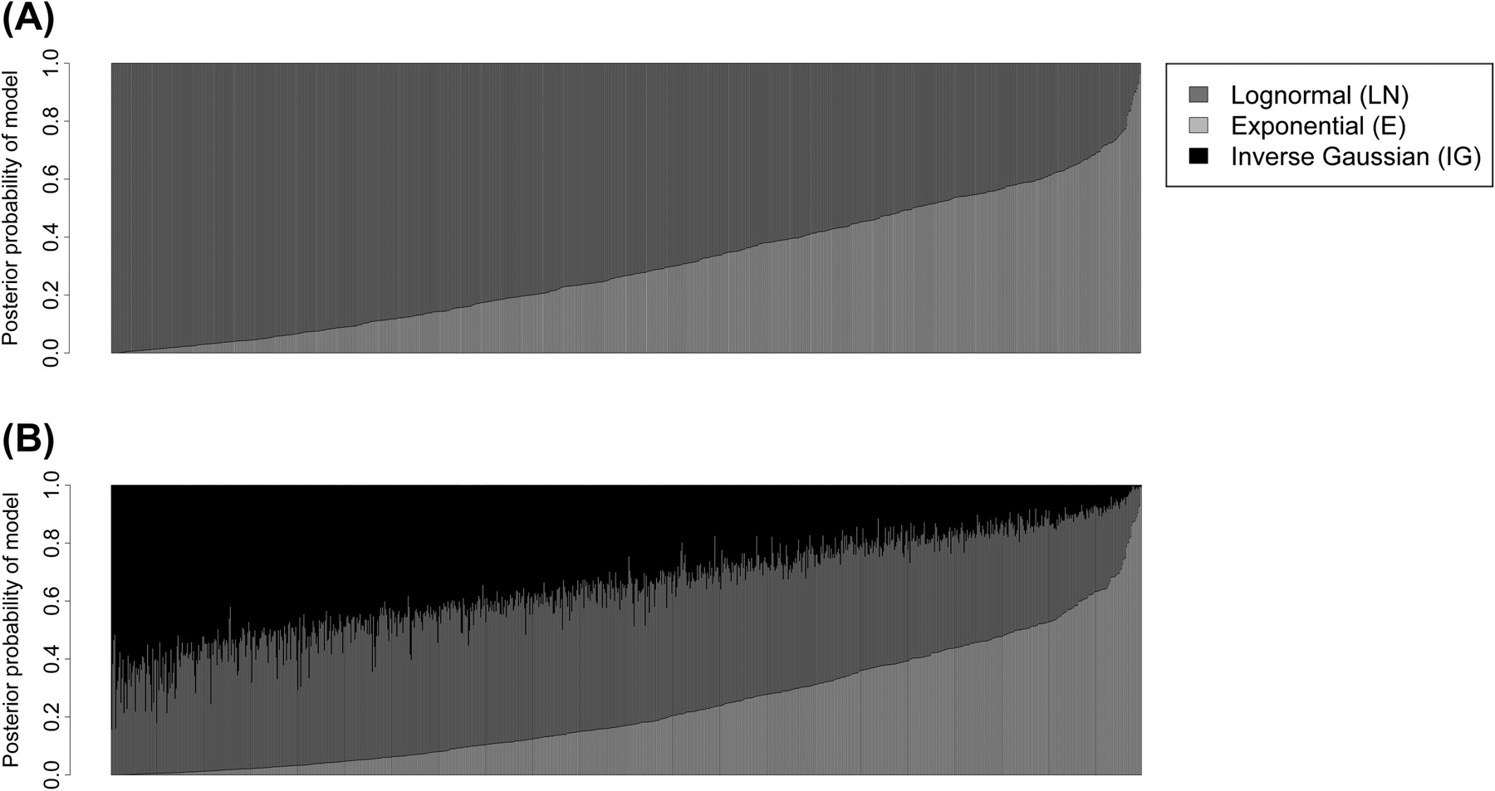
FIG. 2. Bar plots showing the distribution of posterior probabilities of each distribution when applying ...
Notes:
FIG. 2. Bar plots showing the distribution of posterior probabilities of each distribution when applying model-averaged models (A) MLN,E (n = 1002) and (B) MLN,IG,E (n = 1008) on the mammalian data set. Data are sorted by the posterior probability of E.
Unless provided in the caption above, the following copyright applies to the content of this slide: © The Author(s) 2011. Published by Oxford University Press on behalf of the Society for Molecular Biology and Evolution.This is an Open Access article distributed under the terms of the Creative Commons Attribution Non-Commercial License (http://creativecommons.org/licenses/by-nc/3.0), which permits unrestricted non-commercial use, distribution, and reproduction in any medium, provided the original work is properly cited.

Slide 3
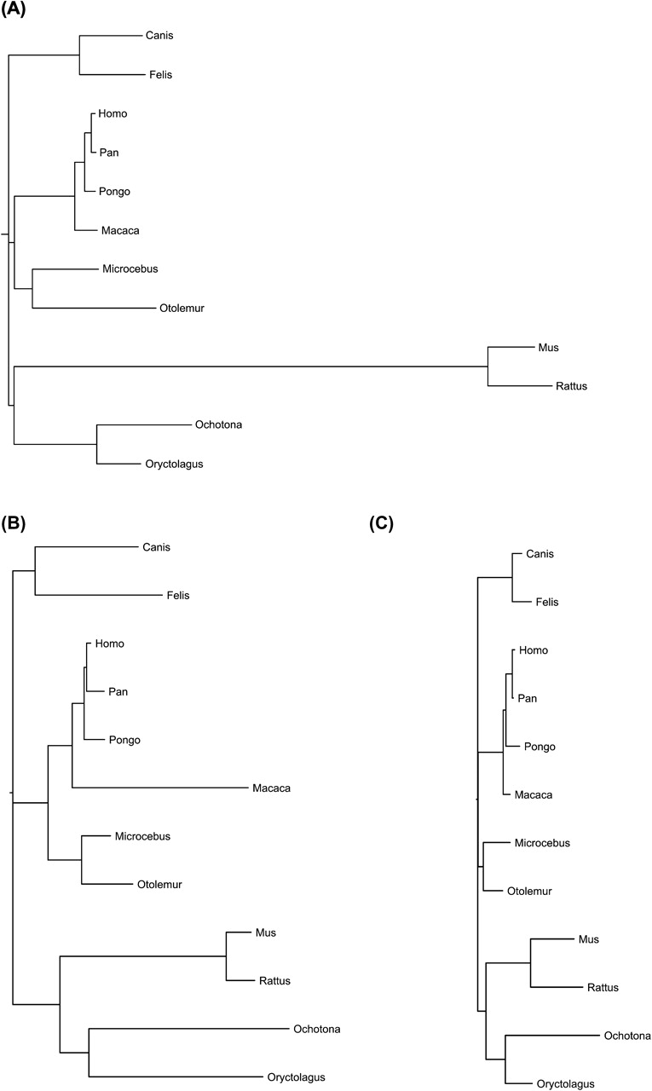
FIG. 3. Point estimates of example gene trees from the M_{LN,E} analysis, showing the difference in trees ...
Notes:
FIG. 3. Point estimates of example gene trees from the MLN,E analysis, showing the difference in trees between data which supports (A) the LN model, (B) the E model, and (C) neither model.
Unless provided in the caption above, the following copyright applies to the content of this slide: © The Author(s) 2011. Published by Oxford University Press on behalf of the Society for Molecular Biology and Evolution.This is an Open Access article distributed under the terms of the Creative Commons Attribution Non-Commercial License (http://creativecommons.org/licenses/by-nc/3.0), which permits unrestricted non-commercial use, distribution, and reproduction in any medium, provided the original work is properly cited.

Slide 4
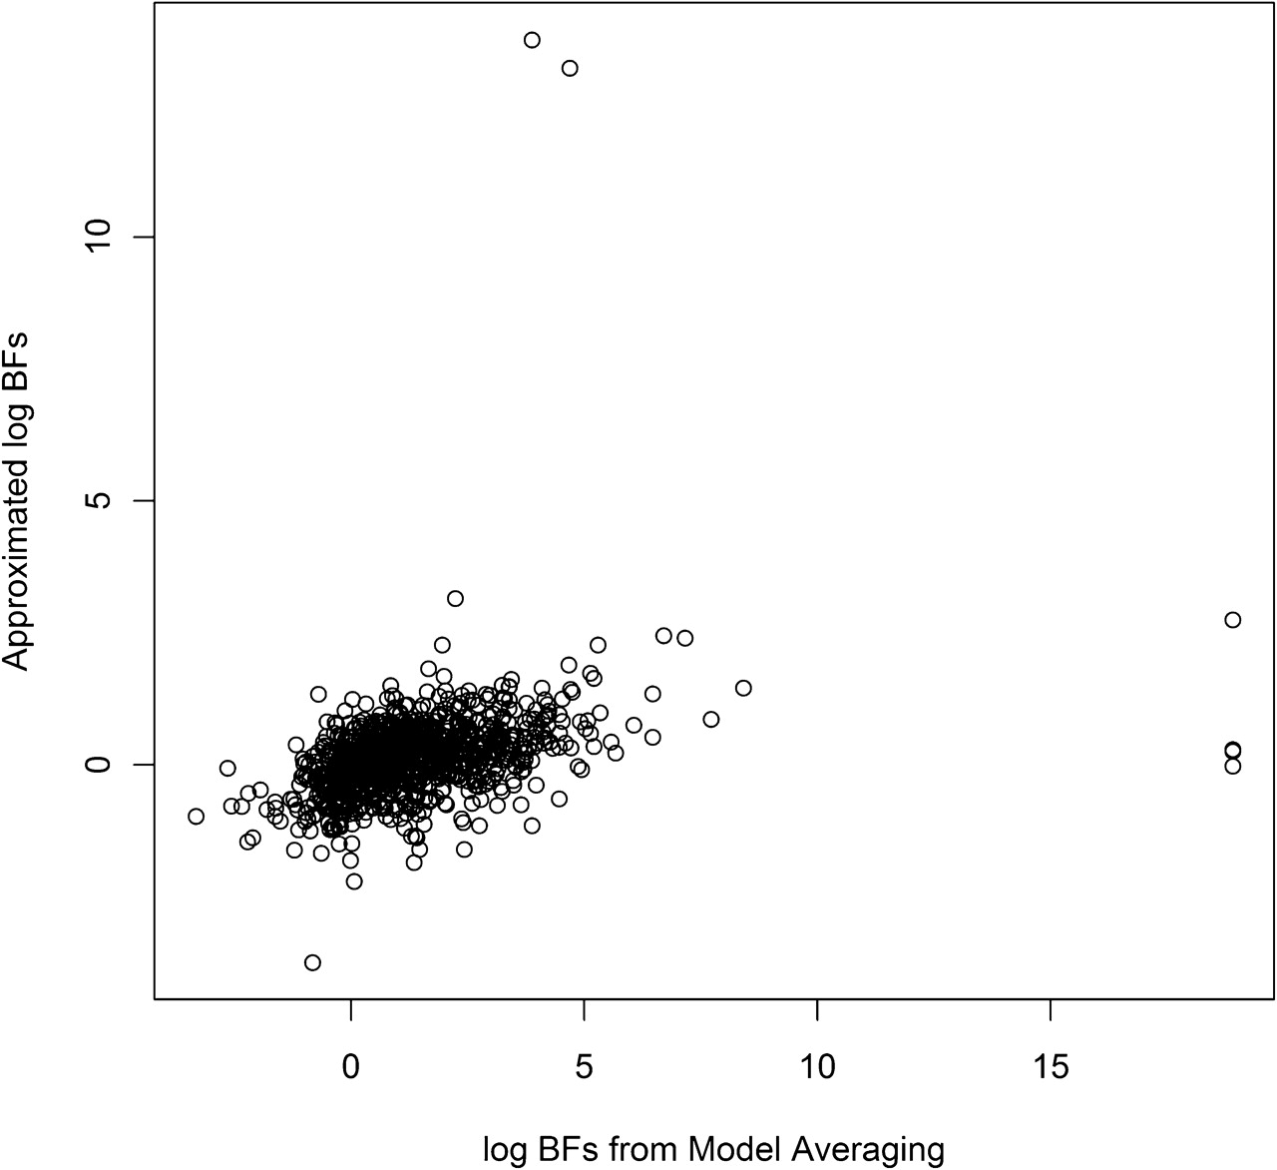
FIG. 5. Scatter plot of BF values for the mammalian data calculated by using model averaging versus using an ...
Notes:
FIG. 5. Scatter plot of BF values for the mammalian data calculated by using model averaging versus using an approximation with importance sampling (n=961).
Unless provided in the caption above, the following copyright applies to the content of this slide: © The Author(s) 2011. Published by Oxford University Press on behalf of the Society for Molecular Biology and Evolution.This is an Open Access article distributed under the terms of the Creative Commons Attribution Non-Commercial License (http://creativecommons.org/licenses/by-nc/3.0), which permits unrestricted non-commercial use, distribution, and reproduction in any medium, provided the original work is properly cited.

Slide 5
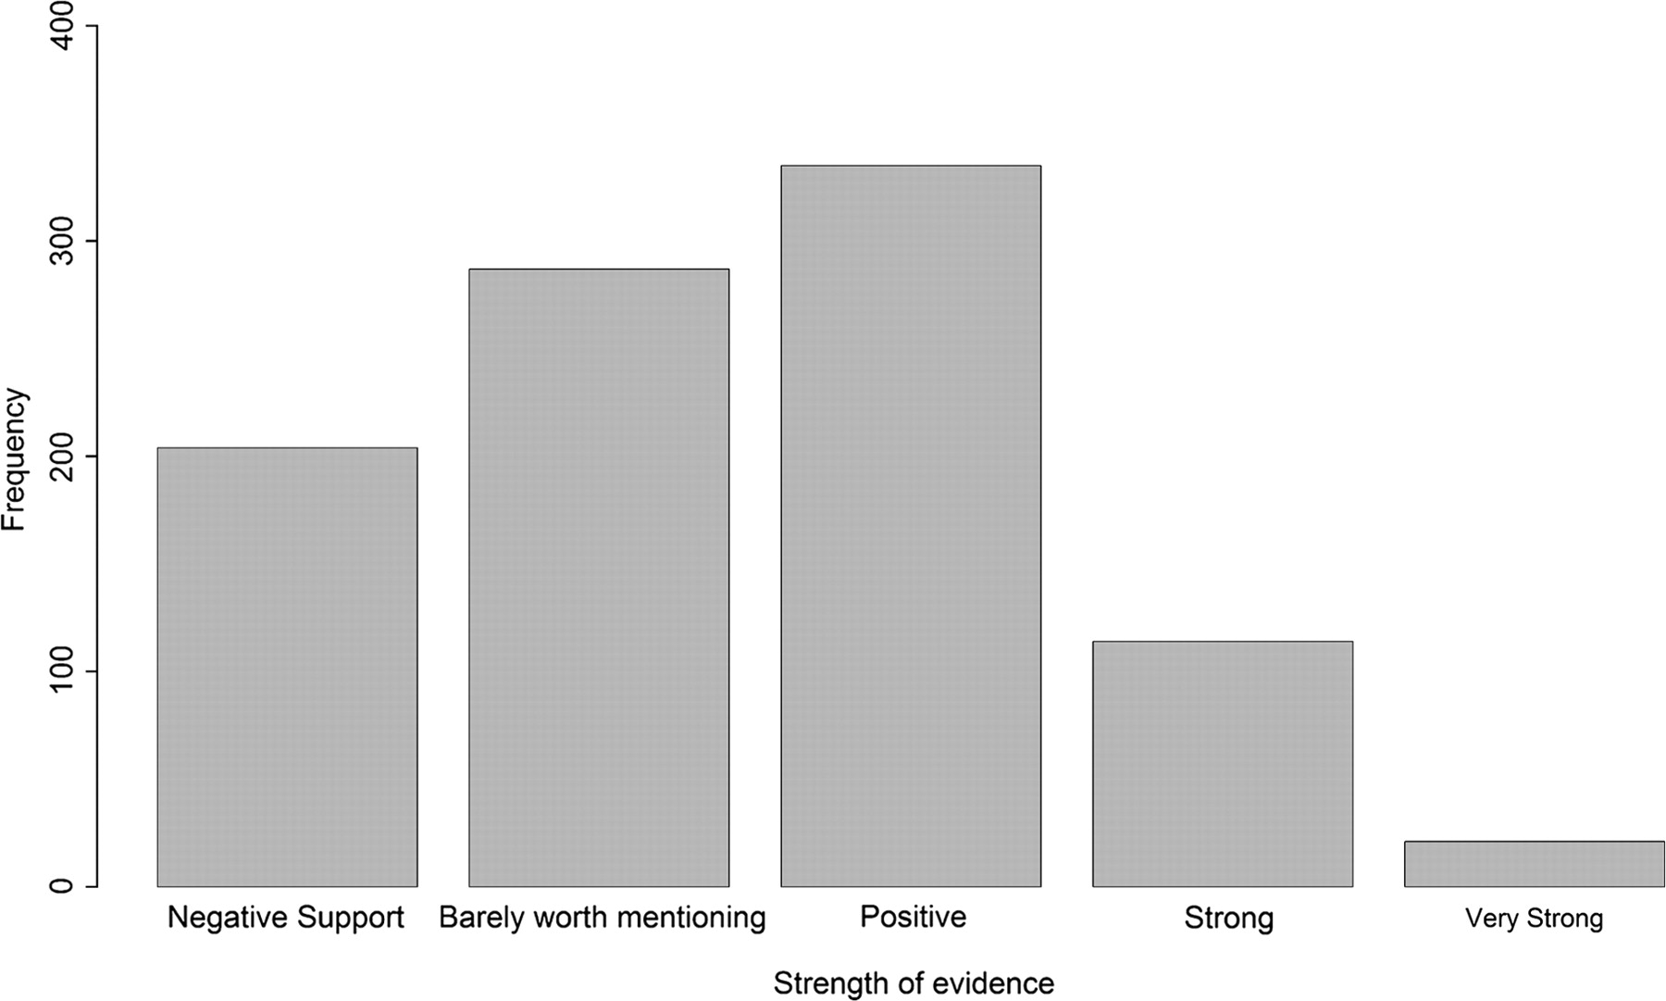
FIG. 6. Interpretation of the BF for support of the F_{LN} model in the mammalian data set (n=961). The ...
Notes:
FIG. 6. Interpretation of the BF for support of the FLN model in the mammalian data set (n=961). The support is categorized as follows: negative support (BF<1), barely worth mentioning (1<BF<3), positive (3<BF<20), strong (20<BF150).
Unless provided in the caption above, the following copyright applies to the content of this slide: © The Author(s) 2011. Published by Oxford University Press on behalf of the Society for Molecular Biology and Evolution.This is an Open Access article distributed under the terms of the Creative Commons Attribution Non-Commercial License (http://creativecommons.org/licenses/by-nc/3.0), which permits unrestricted non-commercial use, distribution, and reproduction in any medium, provided the original work is properly cited.

Slide 6
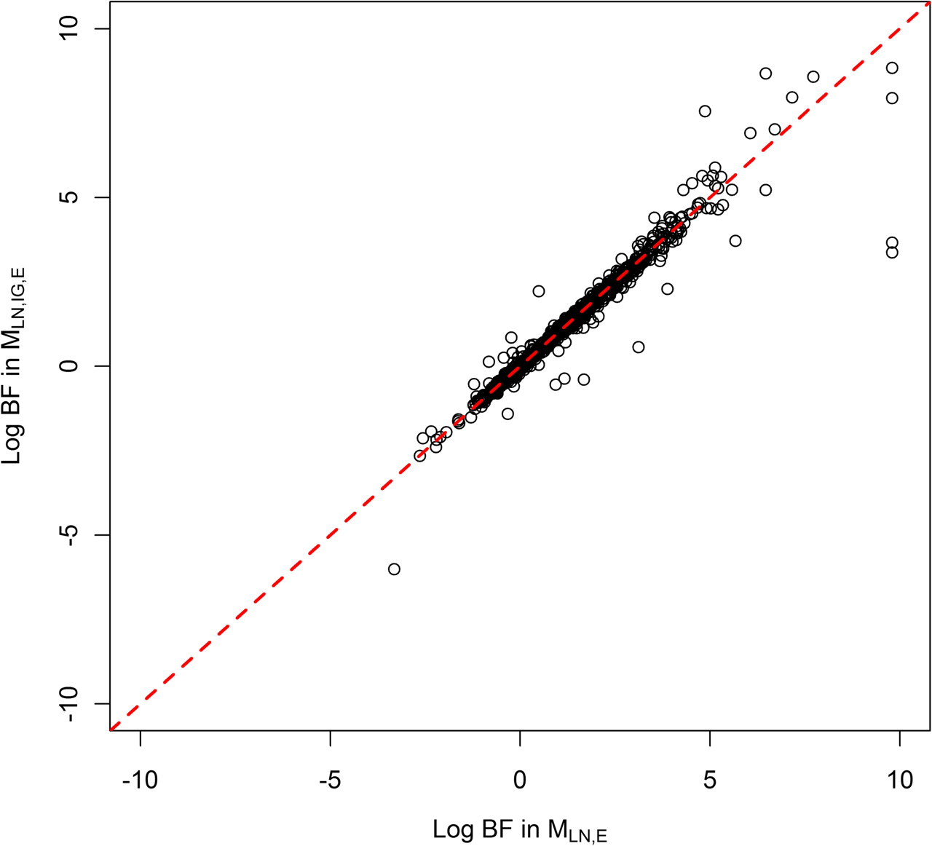
FIG. 4. Scatter plot of the log BFs of F_{LN} against F_{E} in the M_{LN,E} model against the ...
Notes:
FIG. 4. Scatter plot of the log BFs of FLN against FE in the MLN,E model against the same value in the MLN,IG,E model (n= 883). Where the posterior probability of a model was 0, we assigned a probability of 0.5/9001 (≈0.00005; 9001 is the total number of sampled trees), which is used as a minimum value.
Unless provided in the caption above, the following copyright applies to the content of this slide: © The Author(s) 2011. Published by Oxford University Press on behalf of the Society for Molecular Biology and Evolution.This is an Open Access article distributed under the terms of the Creative Commons Attribution Non-Commercial License (http://creativecommons.org/licenses/by-nc/3.0), which permits unrestricted non-commercial use, distribution, and reproduction in any medium, provided the original work is properly cited.

