Slide 1
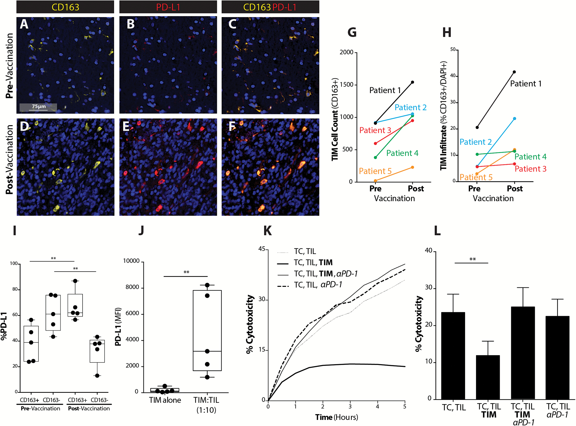
Fig. 1 GBM TIMs expand to inhibit vaccine-induced T-cell mediated tumor cytolysis via PD-1/PD-L1 regulatory pathway. ...
Notes:
Fig. 1 GBM TIMs expand to inhibit vaccine-induced T-cell mediated tumor cytolysis via PD-1/PD-L1 regulatory pathway. (A, D) CD163, DAPI, (B, E) PD-L1, DAPI, and (C, F) CD163, PD-L1, and DAPI co-staining are shown across pre- and post-DC vaccination samples from a GBM patient at 40× magnification (scale bar represents 75µm). (G) CD163+ cell count across pre– and post–DC vaccine treatment patient samples was quantified (n = 5). (H) Percent of CD163+ cells of total number of cells (DAPI+) was quantified (n = 5). (I) The percent of CD163+ cells dually expressing PD-L1 was quantified before and after vaccination (n = 5) (**P < .01). (J) PD-L1 expression on CD11b+ TIMs in the absence or presence of CD3+ TILs from freshly resected GBM shown (**P < .01) (n = 5). (K) Representative plot demonstrating TIL cytolysis of tumor cells (TC) over time in the absence or presence of TIMs or PD-1 mAb shown for freshly resected GBM. (L) GBM tumor cell cytolysis at selected time point of 4 hours in the absence or presence of TIMs or PD-1 mAb shown (n = 11/group) (**P < .01).
Unless provided in the caption above, the following copyright applies to the content of this slide: © The Author(s) 2017. Published by Oxford University Press on behalf of the Society for Neuro-Oncology. All rights reserved. For permissions, please e-mail: journals.permissions@oup.com

Slide 2
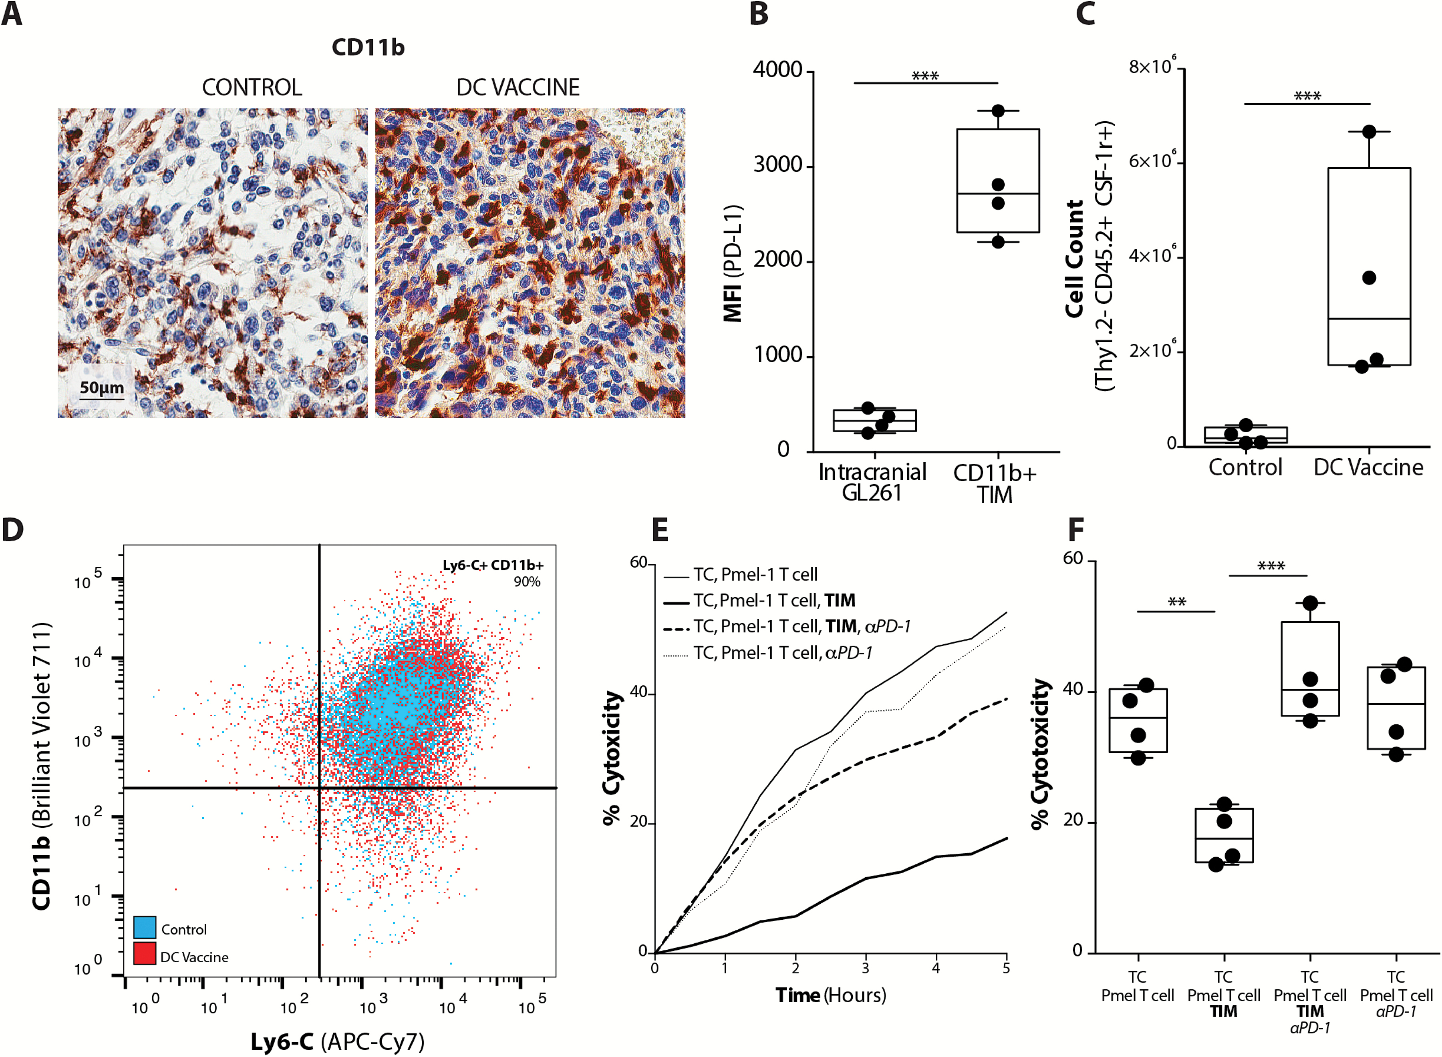
Fig. 2 Murine glioma TIMs expand in response to vaccination to inhibit T cell-mediated tumor cytolysis. (A) CD11b ...
Notes:
Fig. 2 Murine glioma TIMs expand in response to vaccination to inhibit T cell-mediated tumor cytolysis. (A) CD11b IHC staining of nontreatment control and DC vaccinated tumor-bearing mice (scale bar represents 50µm). (B) Mean fluorescence intensity for PD-L1 expression on FACS intracranial GL261 gliomas (CD11b− CD3− cells) and TIMs (CD11b+ CD3−); (n = 4/group) (***P < .001). Flow cytometric characterization of (C) the absolute number of Thy1.2−, CD45.2+, CSF-1R+ cells (n = 4/group) (***P < .001), and (D) representative scatter plot of percent CD11b+, Ly6-C+ TIMs from tumors of control and DC vaccinated mice. (E) Representative xCELLigence plot of Pmel-1 T cell cytolysis of GL261-hgp100 cells (TC) over time in the absence or presence of TIMs or PD-1 mAb. (F) Quantitation of Pmel-1 T-cell induced tumor cell cytolysis at 4 hours in the absence or presence of TIMs or PD-1 mAb (n = 4) (**P < .01, ***P < .001).
Unless provided in the caption above, the following copyright applies to the content of this slide: © The Author(s) 2017. Published by Oxford University Press on behalf of the Society for Neuro-Oncology. All rights reserved. For permissions, please e-mail: journals.permissions@oup.com

Slide 3
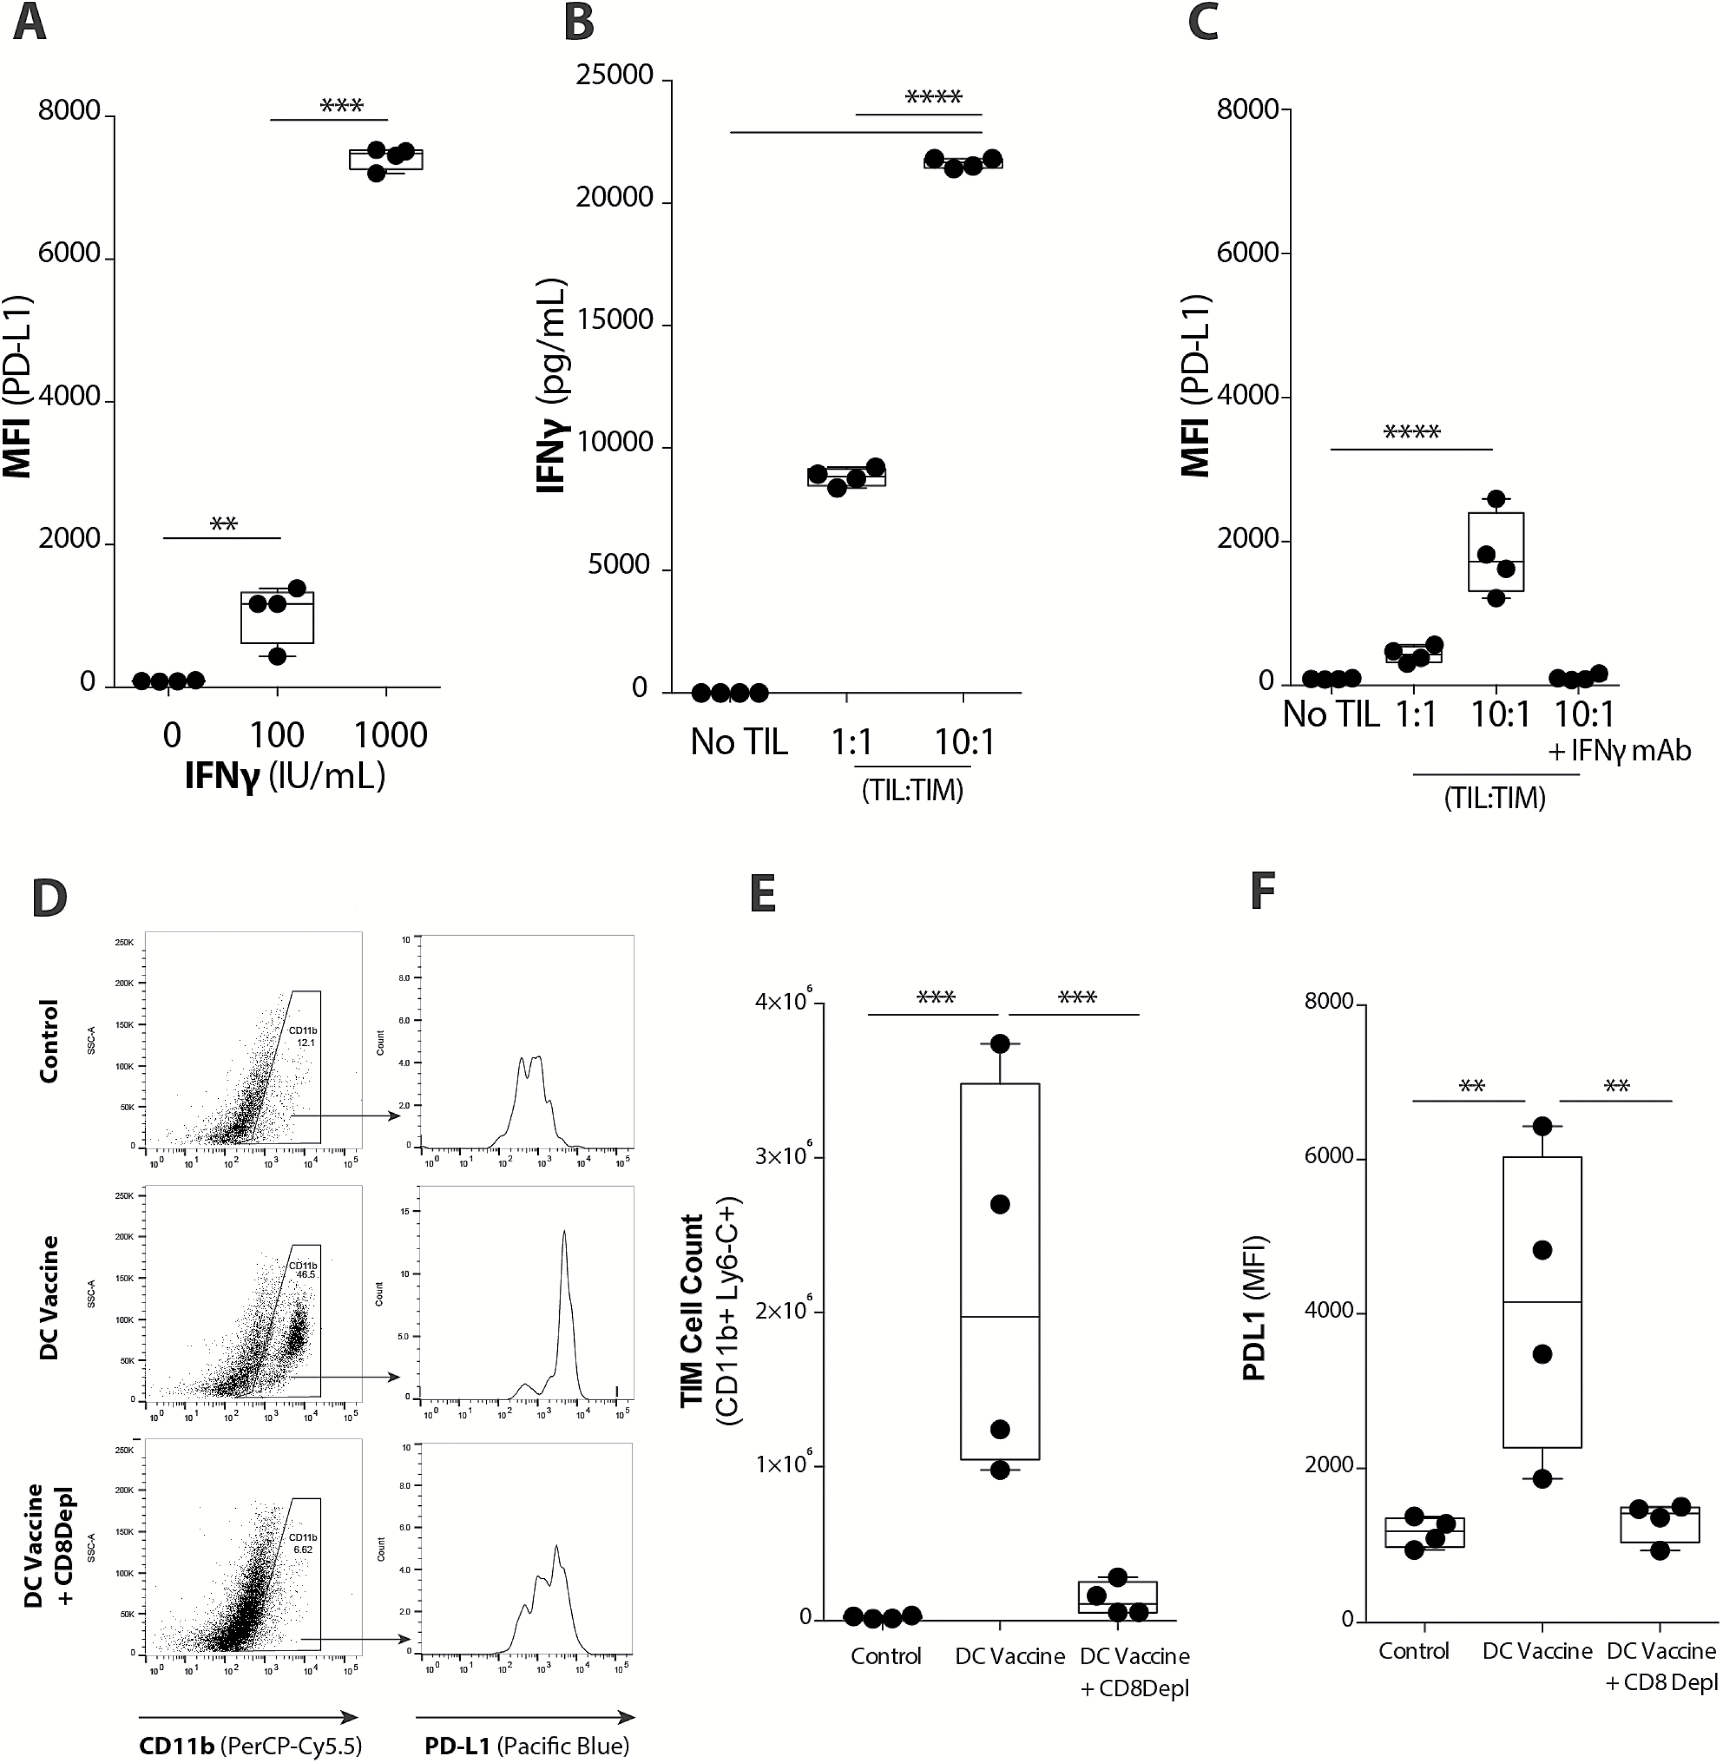
Fig. 3 TIMs upregulate PD-L1 in response to vaccine-induced TIL population. (A) Upregulation of PD-L1 on TIMs in the ...
Notes:
Fig. 3 TIMs upregulate PD-L1 in response to vaccine-induced TIL population. (A) Upregulation of PD-L1 on TIMs in the presence of increasing IFNɣ concentrations was quantified with flow cytometry (n = 4/group) (***P < .001). (B) IFNɣ levels present in TIL-TIM co-cultures in vitro was quantified using a Luminex assay (n = 4/group) (****P < .0001). (C) Upregulation of PD-L1 on TIMs in the presence of increasing concentrations of TILs or blockade of IFNɣ (IFNɣ mAb) was quantified with flow cytometry (n = 4/group) (****P < .0001). (D) Representative plots demonstrate PD-L1 expression on the CD11b+ TIM population across treatment groups. (E) CD11b+ Ly6-C+ TIM cell count and (F) PD-L1 expression in non-treatment control, DC vaccinated, and DC vaccinated + CD8 mAb depletion tumor-bearing mice (n = 4/group) (**P < .01, ***P < .001). Statistical analyses were performed using Student’s t-test (A–F).
Unless provided in the caption above, the following copyright applies to the content of this slide: © The Author(s) 2017. Published by Oxford University Press on behalf of the Society for Neuro-Oncology. All rights reserved. For permissions, please e-mail: journals.permissions@oup.com

Slide 4
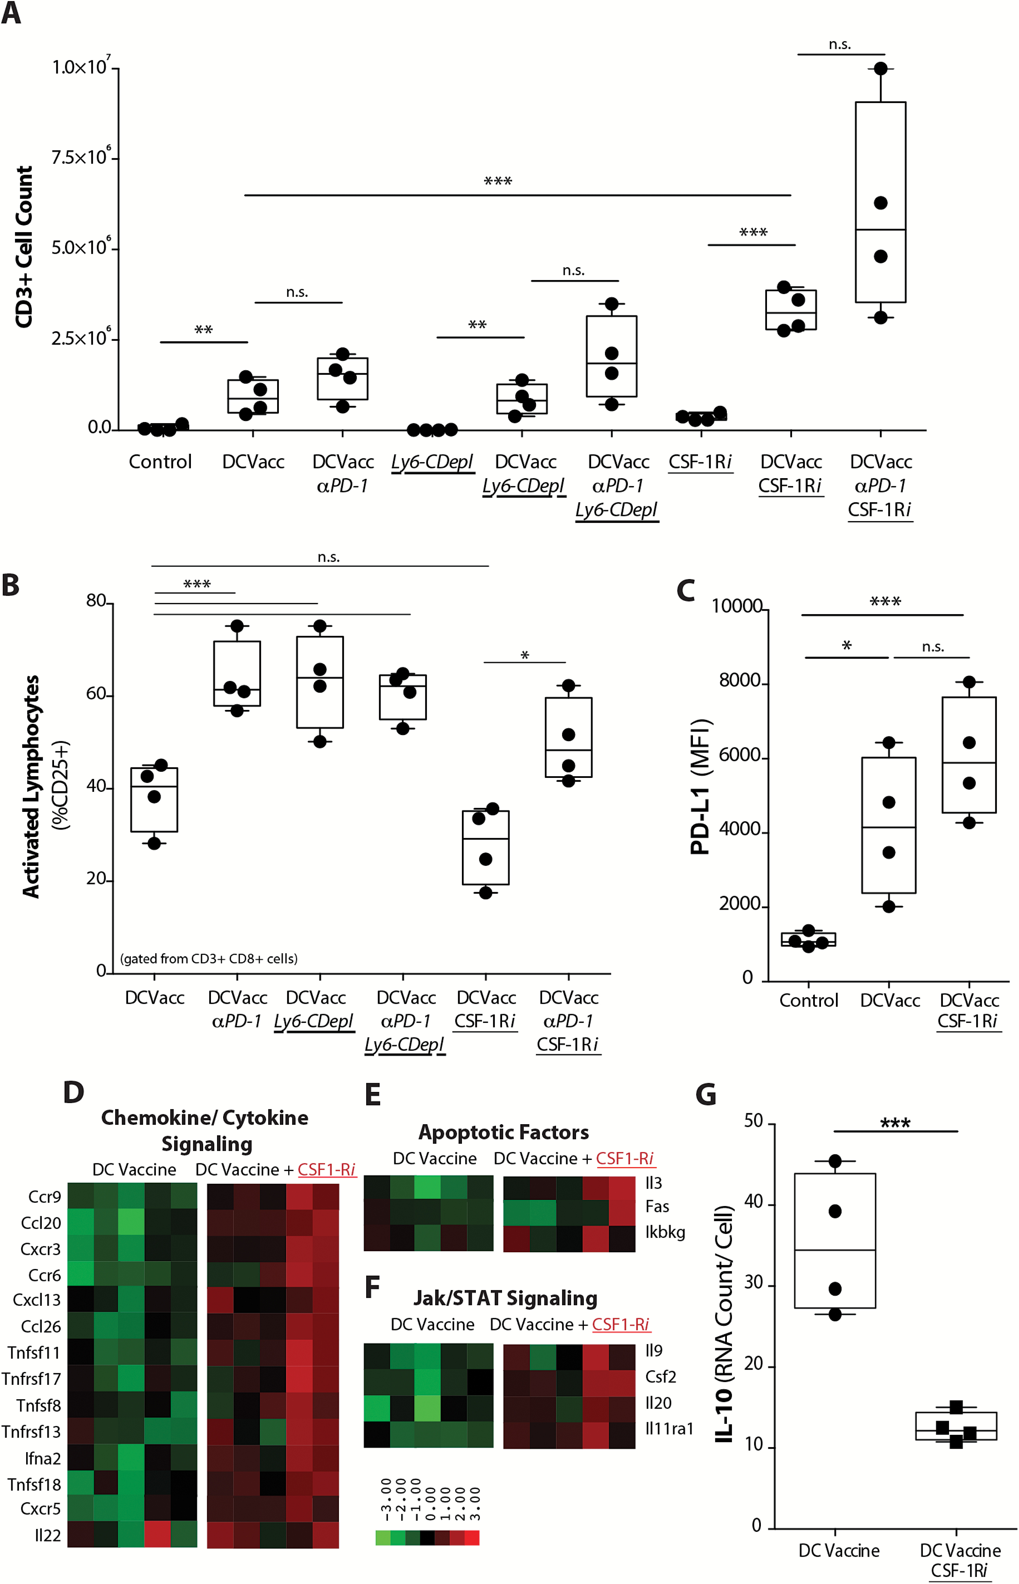
Fig. 4 TIM-mediated PD-1/PD-L1 immunoregulatory mechanism reduces T cell infiltration and activation in tumor. (A) ...
Notes:
Fig. 4 TIM-mediated PD-1/PD-L1 immunoregulatory mechanism reduces T cell infiltration and activation in tumor. (A) Absolute TIL count (CD3+) and (B) TIL activation (%CD8+ CD3+ CD25+) in tumors from mice treated with DC vaccine and PD-1 mAb, along with Ly6-C depleting mAb (Ly6-C Depl) or CSF-1Ri (n = 4/ group) (*P < .05, **P < .01, ***P < .001, ****P < .0001). (C) PD-L1 expression across treatment groups (n = 5/group) (**P < .01, ***P < .001). Unbiased heatmap ranking and quantification of (D) chemokine/cytokine signaling, (E) apoptotic factors, and (F) Jak/STAT pathway signaling factors on CD11b+ TIMs from tumor-bearing mice receiving DC vaccination alone or with adjuvant CSF-1Ri treatment (n = 5/group). (G) Quantification of IL-10 expression by CD11b+ TIMs from tumor-bearing mice treated with DC vaccine or DC vaccine + CSF-1Ri is shown. (n = 4/group) (***P < .001).
Unless provided in the caption above, the following copyright applies to the content of this slide: © The Author(s) 2017. Published by Oxford University Press on behalf of the Society for Neuro-Oncology. All rights reserved. For permissions, please e-mail: journals.permissions@oup.com

Slide 5
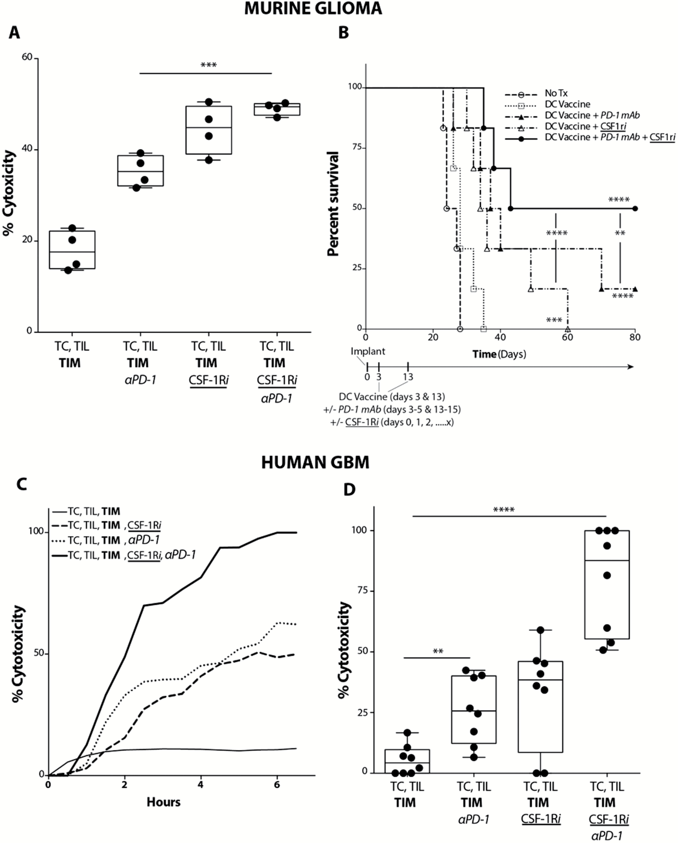
Fig. 5 Combination treatment with PD-1 mAb and CSF-1Ri maximally enhances vaccination-induced immune responses in ...
Notes:
Fig. 5 Combination treatment with PD-1 mAb and CSF-1Ri maximally enhances vaccination-induced immune responses in both murine glioma and ex vivo human GBM. (A) Murine GL261-hgp100 glioma cell (TC) cytolysis at 4 hours following co-culture of TC, Pmel-1 T cells, and TIMs FACS-subjected from intracranial tumor-bearing mice treated with DC vaccination. PD-1 mAb or CSF-1Ri were added to Pmel-1 T cells or TIM ex vivo, respectively (n = 4/ group) (***P < .001). (B) Mice were randomized into control (tumor-bearing, no treatment), DC vaccine, DC vaccine + PD-1 mAb, DC vaccine + CSF-1Ri, and DC vaccine + PD-1 mAb + CSF-1Ri treatment groups. Graph depicts comparison of survival using method of Kaplan–Meier (n = 6/group) (**P < .01, ***P < .001, ****P < .0001) (P values indicate statistical difference from no treatment control unless otherwise indicated). (C) Human GBM tumor cell (TC) cytolysis over time following co-culture of TC, TIL, and TIM for representative GBM patient. PD-1 mAb or CSF-1Ri were added to autologous TIL or TIM ex vivo, respectively. (D) Compilation of human GBM tumor cell (TC) cytolysis at 4 hours following co-culture of TC, TIL, and TIM. PD-1 mAb or CSF-1Ri were added to TIL and TIM ex vivo, respectively (n = 8 patient samples/group) (**P < .01, ****P < .0001).
Unless provided in the caption above, the following copyright applies to the content of this slide: © The Author(s) 2017. Published by Oxford University Press on behalf of the Society for Neuro-Oncology. All rights reserved. For permissions, please e-mail: journals.permissions@oup.com

Slide 6
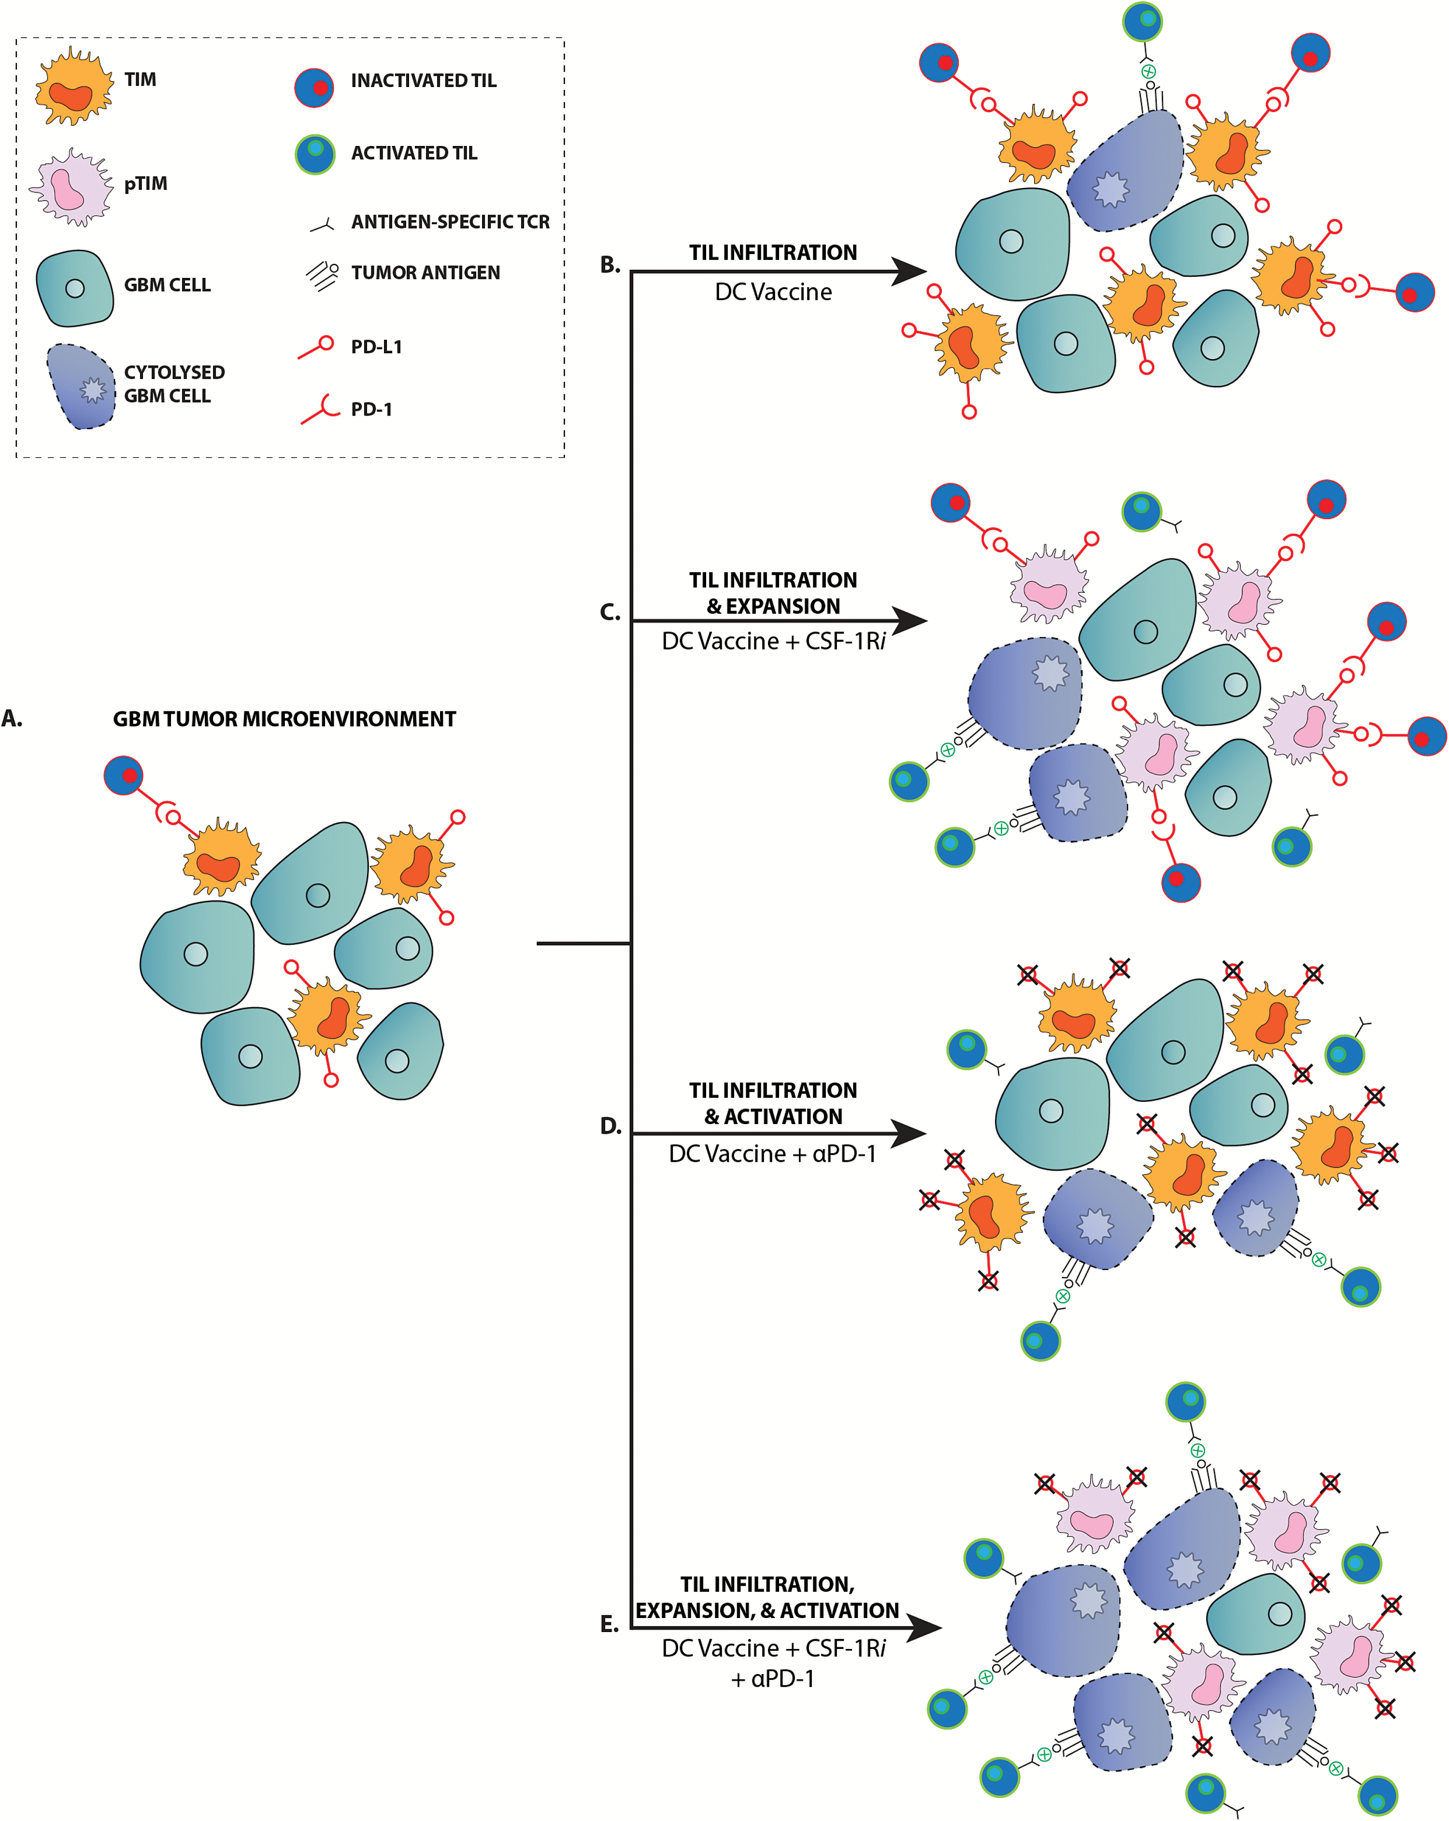
Fig. 6 PD-1 mAb blockade and CSF-1R inhibitors enhance vaccine-induced immune responses by distinct mechanisms. (A) ...
Notes:
Fig. 6 PD-1 mAb blockade and CSF-1R inhibitors enhance vaccine-induced immune responses by distinct mechanisms. (A) Malignant gliomas lack a significant antitumor immune response in the nontreatment setting. (B) DC vaccination elicits an infiltrating TIL response, but is largely ineffective due to inactivation of TILs via the PD-1/PD-L1 signaling mechanism. (C) Treatment with CSF-1Ri alters the TIM population to become pro-inflammatory TIM (pTIM) and results in the expansion of the TIL population, increasing the potential for TIL-tumor cell interaction and tumor cytolysis. (D) While PD-1 mAb treatment does not increase the TIL population over what is generated by DC vaccination, it does promote activation of TILs and subsequent tumor cytolysis. (E) PD-1 mAb and CSF-1Ri together promote the expansion and activation of the DC vaccine-generated TIL population such that there is a maximal tumor cytolysis.
Unless provided in the caption above, the following copyright applies to the content of this slide: © The Author(s) 2017. Published by Oxford University Press on behalf of the Society for Neuro-Oncology. All rights reserved. For permissions, please e-mail: journals.permissions@oup.com

