Slide 1
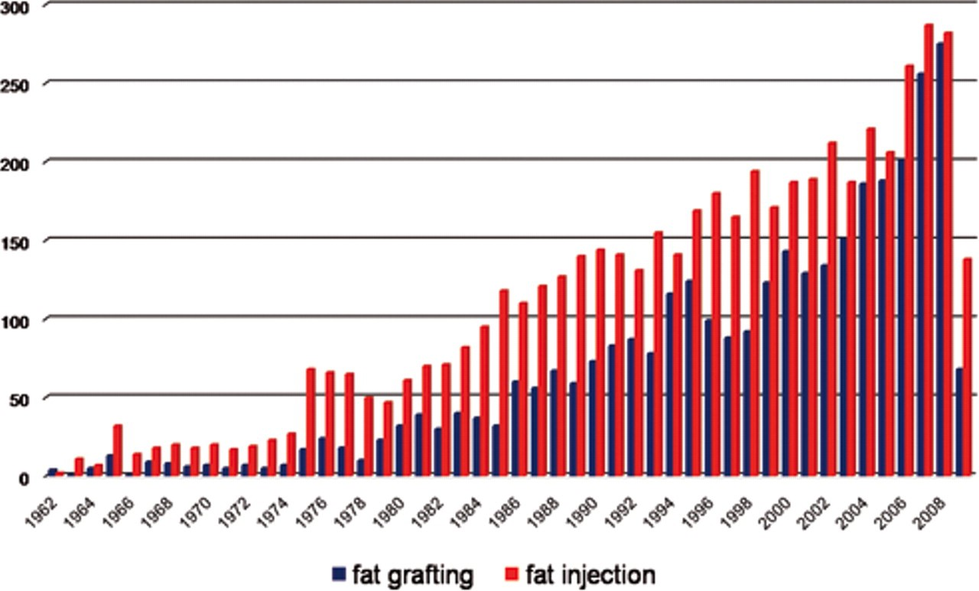
Figure 1. The number of scientific articles by year in the PubMed database that contain the search terms fat grafting ...
Notes:
Figure 1. The number of scientific articles by year in the PubMed database that contain the search terms fat grafting and fat injection.
Unless provided in the caption above, the following copyright applies to the content of this slide: © 2010 The American Society for Aesthetic Plastic Surgery, Inc.

Slide 2
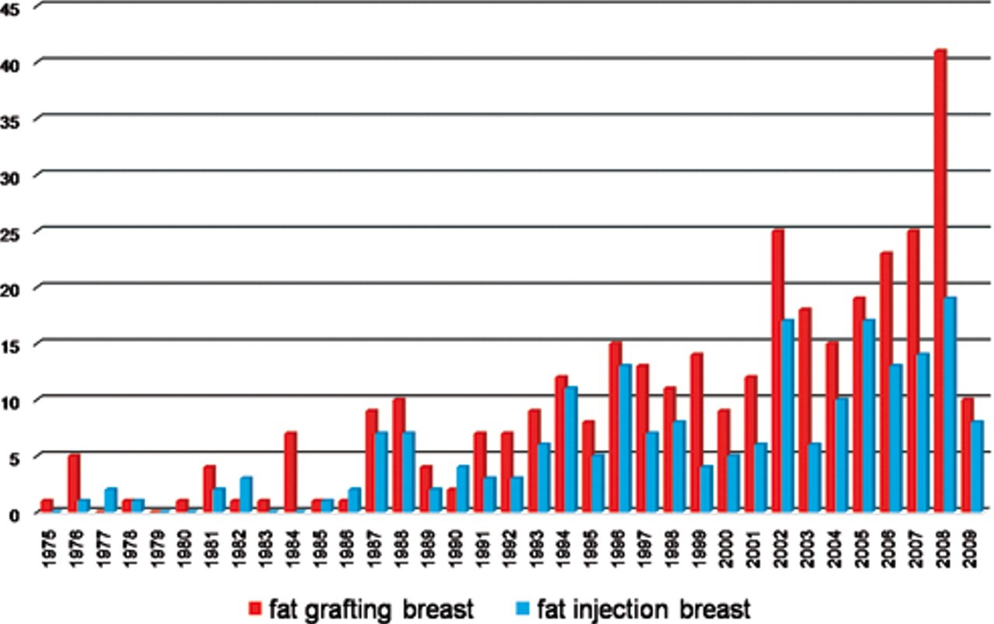
Figure 2. The number of scientific articles by year in the PubMed database that contain the search terms fat grafting, ...
Notes:
Figure 2. The number of scientific articles by year in the PubMed database that contain the search terms fat grafting, breast and fat injection, breast.
Unless provided in the caption above, the following copyright applies to the content of this slide: © 2010 The American Society for Aesthetic Plastic Surgery, Inc.

Slide 3
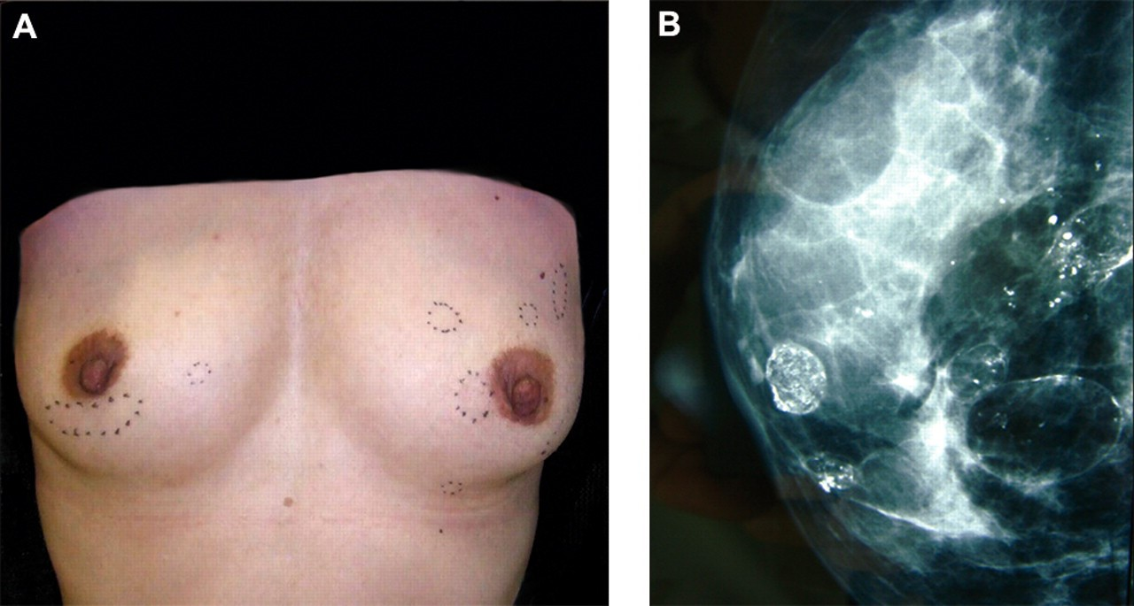
Figure 3. Representative case of complications of fat grafting to the breast. (A) A 40-year-old woman who underwent fat ...
Notes:
Figure 3. Representative case of complications of fat grafting to the breast. (A) A 40-year-old woman who underwent fat grafting for breast augmentation one year previously exhibited several subcutaneous indurations. (B) Mammography showed multiple calcifications and evidence of cyst formation.
Unless provided in the caption above, the following copyright applies to the content of this slide: © 2010 The American Society for Aesthetic Plastic Surgery, Inc.

Slide 4
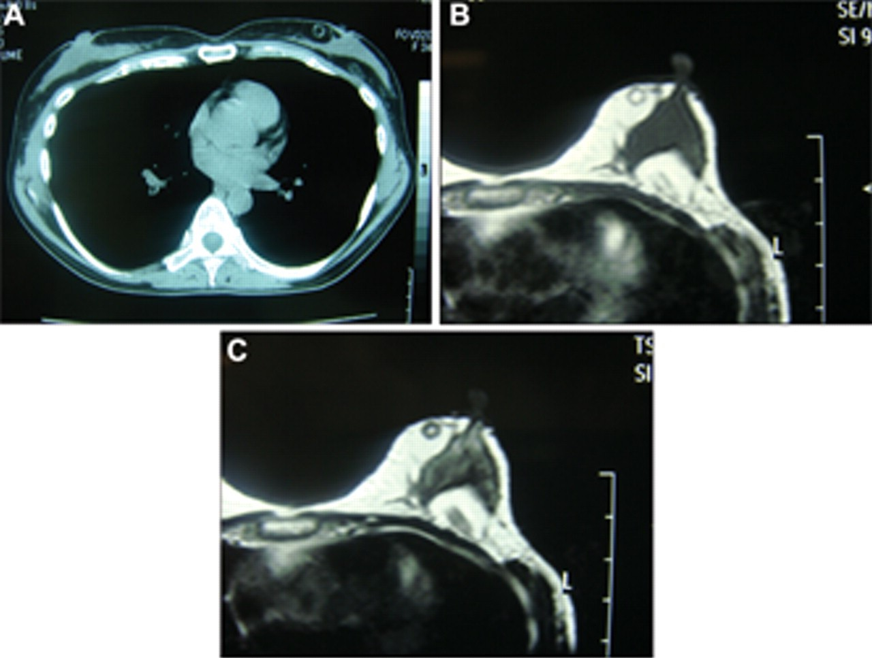
Figure 4. Computed tomography (CT) and magnetic resonance imaging (MRI) analysis. (A) CT image shows round-shaped ...
Notes:
Figure 4. Computed tomography (CT) and magnetic resonance imaging (MRI) analysis. (A) CT image shows round-shaped calcifications and resorption of the grafted fat in the subcutaneous fat tissue and retromammary space. (B) MRI-T1 and (C) MRI-T2 images show high-intensity areas that correspond to the findings in the CT image.
Unless provided in the caption above, the following copyright applies to the content of this slide: © 2010 The American Society for Aesthetic Plastic Surgery, Inc.

