Slide 1
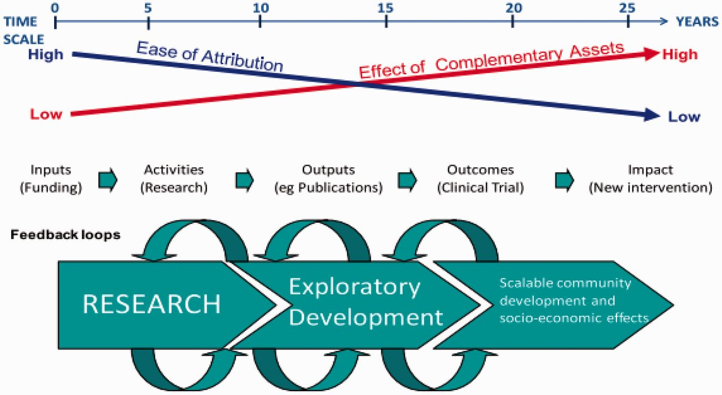
Figure 1. Time, attribution, impact. Replicated from (Hughes and Martin 2012).
Notes:
Figure 1. Time, attribution, impact. Replicated from (Hughes and Martin 2012).
Unless provided in the caption above, the following copyright applies to the content of this slide: © The Author 2013. Published by Oxford University Press.This is an Open Access article distributed under the terms of the Creative Commons Attribution License (http://creativecommons.org/licenses/by/3.0/), which permits unrestricted reuse, distribution, and reproduction in any medium, provided the original work is properly cited.

Slide 2
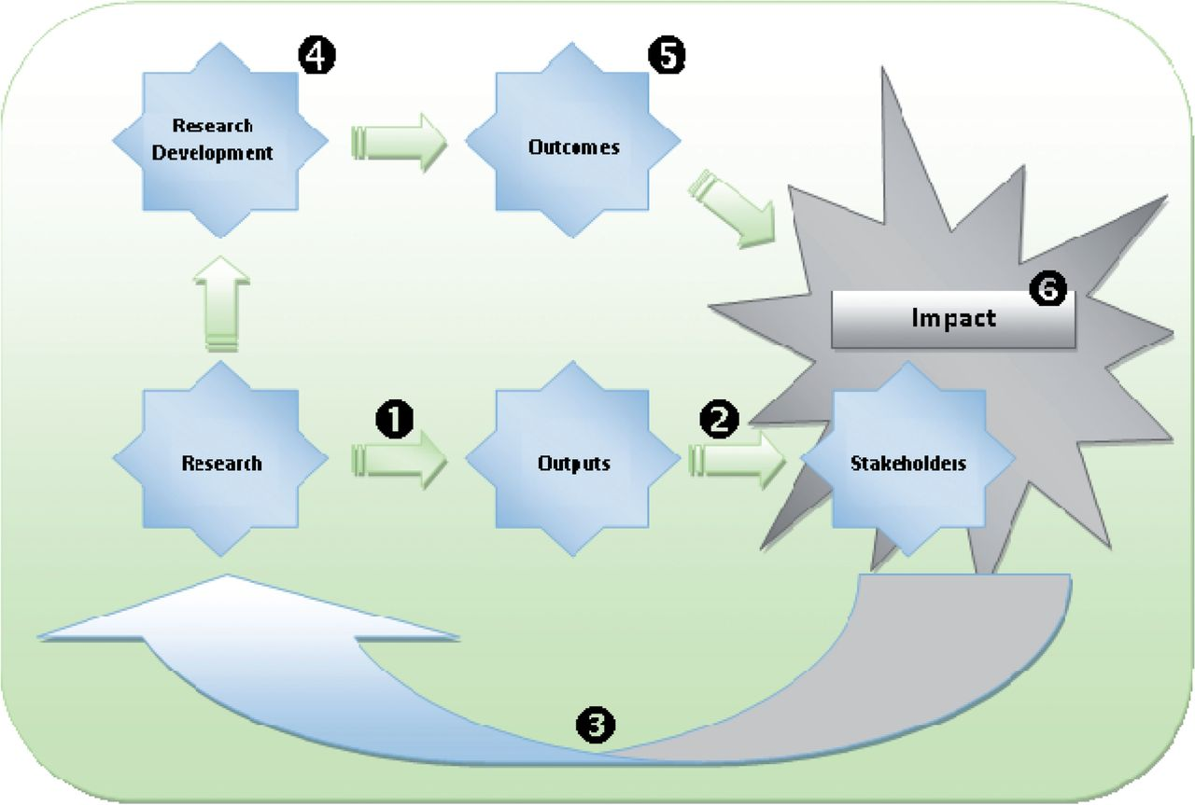
Figure 2. Overview of the types of information that systems need to capture and link.
Notes:
Figure 2. Overview of the types of information that systems need to capture and link.
Unless provided in the caption above, the following copyright applies to the content of this slide: © The Author 2013. Published by Oxford University Press.This is an Open Access article distributed under the terms of the Creative Commons Attribution License (http://creativecommons.org/licenses/by/3.0/), which permits unrestricted reuse, distribution, and reproduction in any medium, provided the original work is properly cited.

