Slide 1
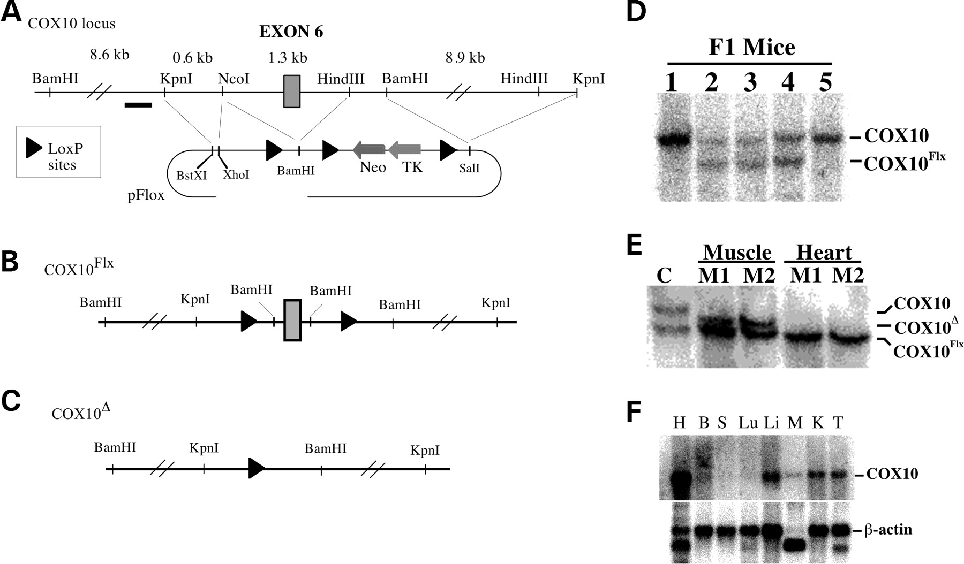
Figure 1. Creation of muscle-specific COX10 knockout mice using the Cre–loxP system. ( A ) A Kpn I fragment ...
Notes:
Figure 1. Creation of muscle-specific COX10 knockout mice using the Cre–loxP system. ( A ) A Kpn I fragment from a BAC clone containing only exon 6 from COX10 was cloned into a pFlox vector. The construct was linearized and electroporated into ES cells. Homologous recombinant clones were transiently transfected with a plasmid expressing Cre recombinase to delete the selection cassette neomycin–thimidine kinase and to obtain the floxed COX10Flx allele. ( B ) Cells with the floxed allele were injected into blastocysts to produce chimeric mice. ( C ) The deletion allele ( COX10Δ) was obtained after the floxed allele was exposed to cre recombinase. ( D ) COX10 Southern blot [using probe indicated as a black bar in (A)] of F1 mice from the chimera were crossed with C57Bl/6 mice: lanes 1–5 represent DNA from different mice. Mice 1 and 5 are homozygous for the wild-type allele of COX10. Mice 2–4 are heterozygous, carrying the wild-type allele and the COX10 floxed allele. ( E ) Southern blot showing a tissue-specific deletion of exon 6: lane C, control heterozygous mouse, COX10/COX10Flx . Lanes M1 and M2, homozygous knockout mice, COX10Flx/COX10Flx , expressing cre recombinase in skeletal muscle. The deletion allele is present only in skeletal muscle tissue, but not in heart tissue from the same mice. ( F ) Northern blot with RNA from different tissues of wild-type mice probed for COX10 and β-actin.
Unless provided in the caption above, the following copyright applies to the content of this slide: © The Author 2005. Published by Oxford University Press. All rights reserved. For Permissions, please email: journals.permissions@oupjournals.org

Slide 2
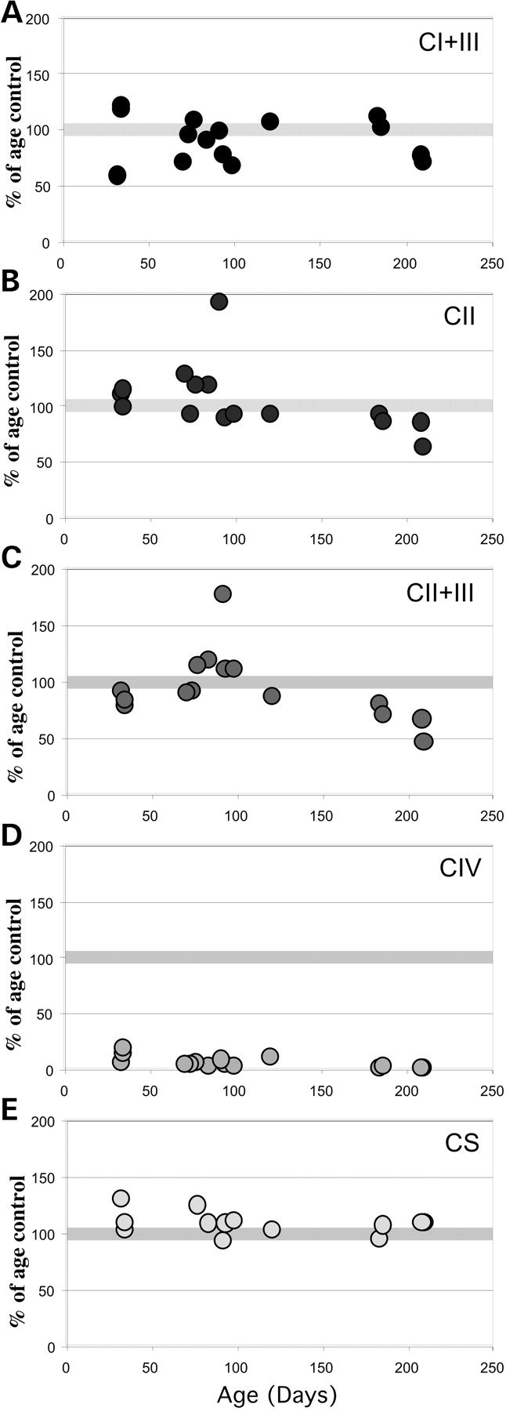
Figure 2. Respiratory complexes activities of control and COX10 KO mice. Mitochondrial enzyme activities in ...
Notes:
Figure 2. Respiratory complexes activities of control and COX10 KO mice. Mitochondrial enzyme activities in hind limb muscles of different aged control and KO mice were determined spectrophotometrically (as described in 9). ( A ) NADH-cytochrome c oxidoreductase activity or complex I+III activity. ( B ) Succinate decylubiquinone DCPIP reductase or complex II activity. ( C ) Succinate cytochrome c reductase or complex II+III activity. ( D ) COX or complex IV activity. ( E ) Citrate synthase activity. Enzyme activities for tissue from each KO mouse were expressed as a percentage of mean values obtained from control animals performed on the same days. Each symbol corresponds to one KO mouse. Ten male and 4 female KO mice (and respective age- and gender-matched controls) were used in this experiment.
Unless provided in the caption above, the following copyright applies to the content of this slide: © The Author 2005. Published by Oxford University Press. All rights reserved. For Permissions, please email: journals.permissions@oupjournals.org

Slide 3
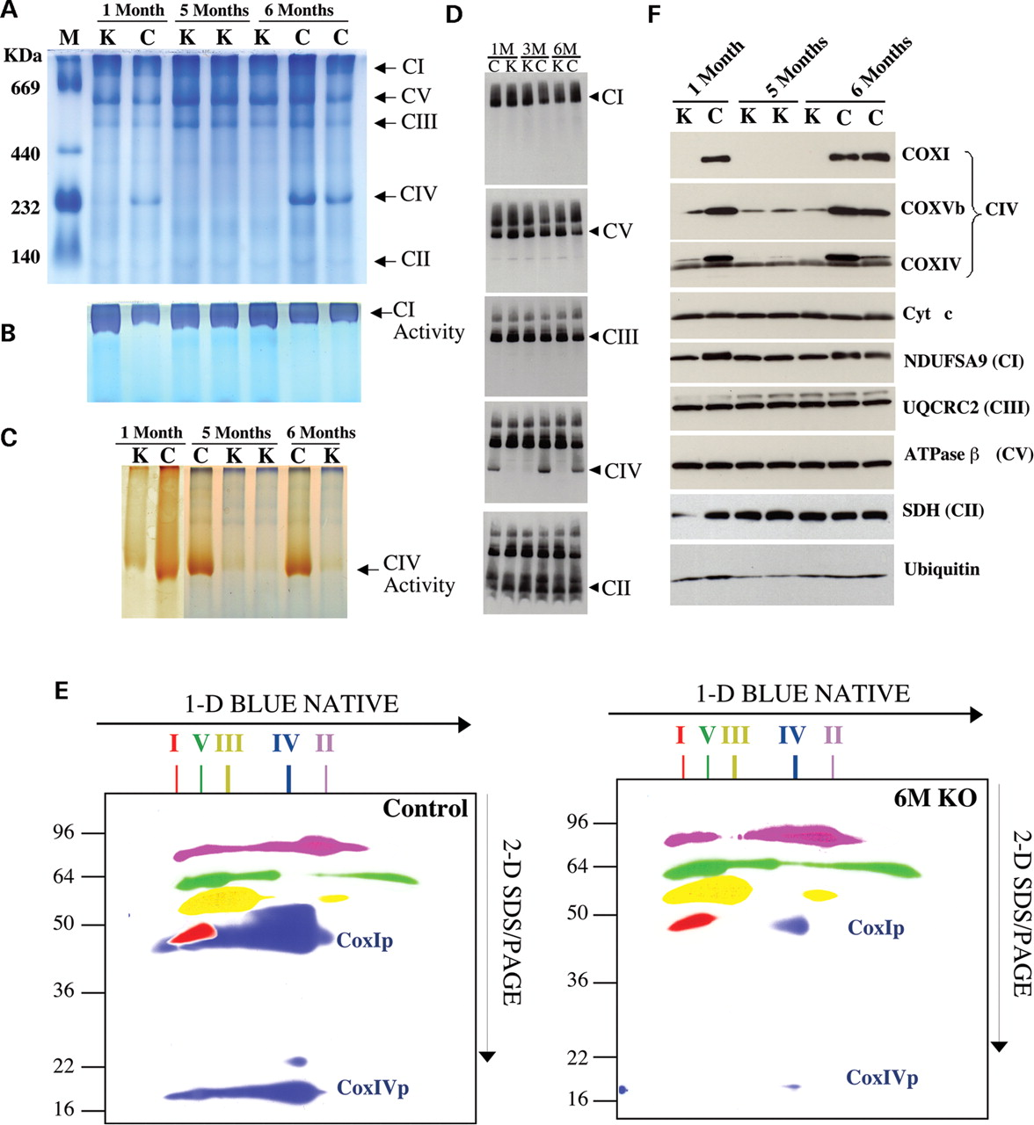
Figure 3. Steady-state levels of respiratory complexes in control and COX10 KO mice. Respiratory complexes in ...
Notes:
Figure 3. Steady-state levels of respiratory complexes in control and COX10 KO mice. Respiratory complexes in muscle mitochondria (40 µg) from control and KO mice were separated by BN-PAGE. ( A ) Coomassie-stained BN gel. Lane M, high molecular weight markers for native electrophoresis; C, control; K, KO mice of 1, 5 and 6 months of age. ( B ) Complex I in gel activity assay of BN gel samples used in (A). ( C ) Complex IV in gel activity assay of samples used in (A). ( D ) Immunoblots of BN gel of muscle mitochondria (40 µg) taken from 1-, 3- and 6-month-old mice using antibodies against NDUFSA9 (subunit of complex I), ATPaseβ (subunit of complex V), UQCRC2 (subunit of complex III), Cox1p (subunit of complex IV) and SDH-Fp (subunit of complex II). The same blot was incubated successively with these antibodies without striping the membrane. ( E ) Mitochondria (40 µg) from 6-month-old control and KO mice were analyzed by BN-PAGE and 2D-SDS-PAGE immunoblots. The same blots were incubated successively with different antibodies. Control and KO blots were treated and exposed in parallel. The images were colored and superimposed to facilitate comparison. Complex I is represented in red, complex II in magenta, complex III in yellow, complex IV in blue (two antibodies used against CoxIp and CoxIVp) and complex V in green. ( F ) Mitochondrial proteins (25 µg) from 1-, 5- and 6-month-old control and KO mice were separated by SDS-PAGE. Membranes were blotted with several antibodies against subunits of complex IV, cytochrome c , complex I, III, V, II and ubiquitin.
Unless provided in the caption above, the following copyright applies to the content of this slide: © The Author 2005. Published by Oxford University Press. All rights reserved. For Permissions, please email: journals.permissions@oupjournals.org

Slide 4
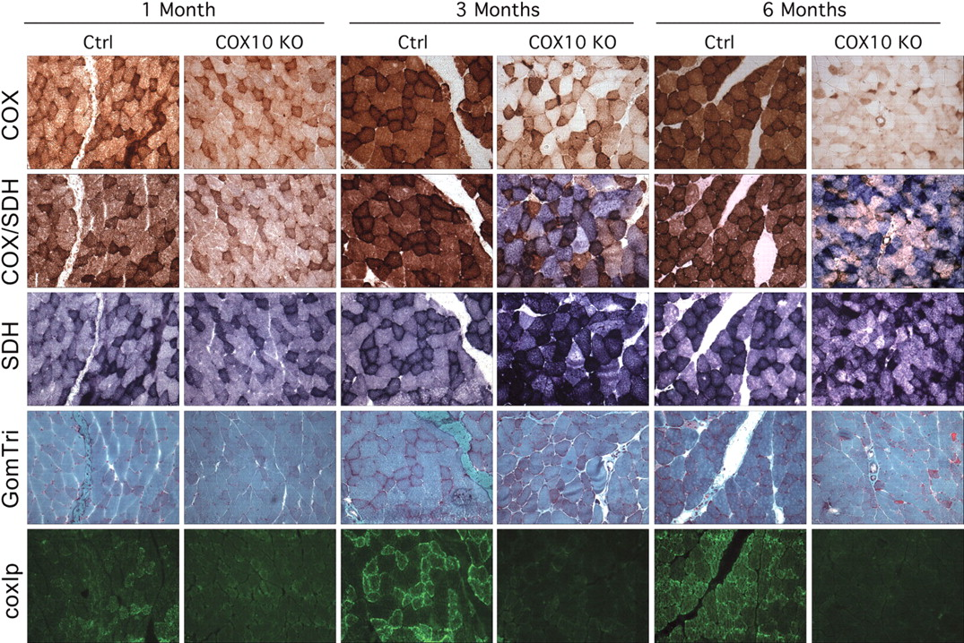
Figure 4. Histopathology of muscle from COX10 KO mice at different ages. Triceps surae muscle from 1-, 3- and ...
Notes:
Figure 4. Histopathology of muscle from COX10 KO mice at different ages. Triceps surae muscle from 1-, 3- and 6-month-old mice was snap frozen in isopentane cooled in liquid nitrogen. Serial cross-sections of 8 µm thickness were stained for COX activity, combined COX and succinate dehydrogenease activity and SDH activity. They were stained with Gomori trichrome and immunostained with Alexa-conjugated Cox1p monoclonal antibody to show the progressive COX deficiency and mitochondrial proliferation in muscles of the COX10 knockout mice.
Unless provided in the caption above, the following copyright applies to the content of this slide: © The Author 2005. Published by Oxford University Press. All rights reserved. For Permissions, please email: journals.permissions@oupjournals.org

Slide 5
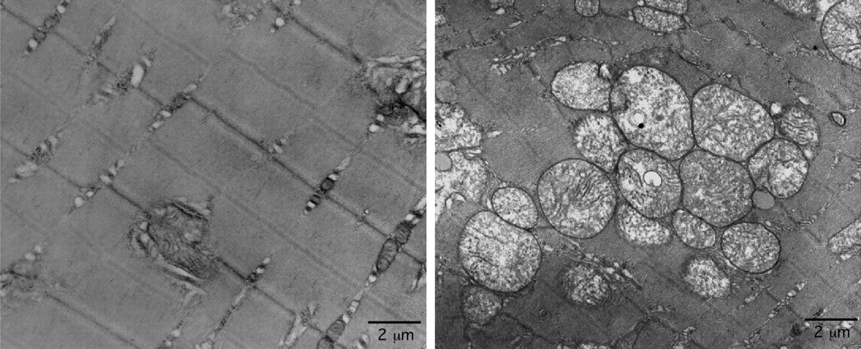
Figure 5. Electron microscopy of COX10 KO skeletal muscle. Skeletal muscle (triceps surae) from 3-month-old ...
Notes:
Figure 5. Electron microscopy of COX10 KO skeletal muscle. Skeletal muscle (triceps surae) from 3-month-old control and KO mice was fixed in 2.5% glutharaldehyde, and 2% paraformaldehyde in phosphate buffer, and then analyzed by transmission electron microscopy. The micrographs show accumulation of enlarged, abnormal mitochondria in tissue from a KO mouse (right panel) when compared with a control (left panel). Scale bar: 2 µm.
Unless provided in the caption above, the following copyright applies to the content of this slide: © The Author 2005. Published by Oxford University Press. All rights reserved. For Permissions, please email: journals.permissions@oupjournals.org

Slide 6
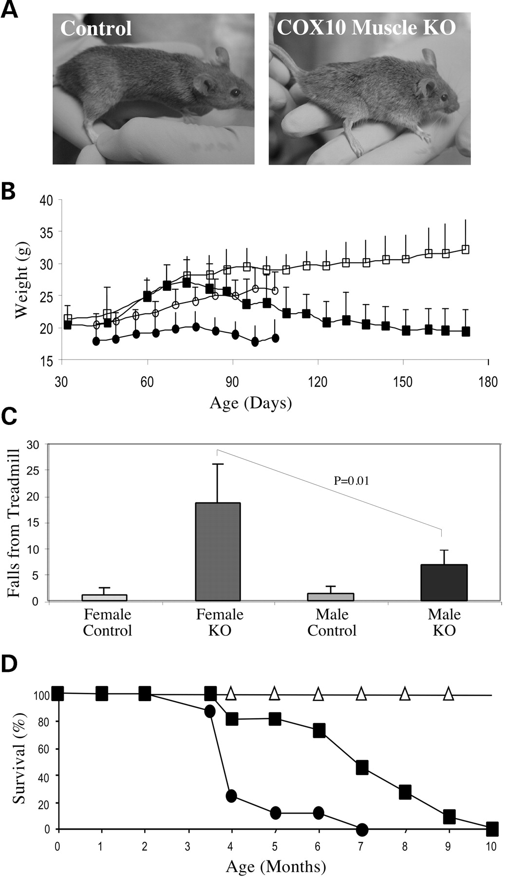
Figure 6. Phenotype of COX10 KO Mice. ( A ) Comparison of body size for 5-month-old control and KO ...
Notes:
Figure 6. Phenotype of COX10 KO Mice. ( A ) Comparison of body size for 5-month-old control and KO littermates. At a young age, control and KO mice were indistinguishable, but after 3–4 months, KO mice start to lose muscle mass, develop kyphosis and show less spontaneous activity. These symptoms deteriorated progressively. ( B ) Growth curve of control and COX10 KO mice [open squares, control male mice ( n =9); closed squares, KO male mice ( n =7); open circles, control female mice ( n =6); closed circles, KO female mice ( n =6)]. ( C ) Treadmill performance test: 2-month-old male and female control and KO mice were exercised on a treadmill at 7 m/min. The number of times they fell onto the electrified grid was recorded. Bars represent mean and standard deviation of two tests performed ( n =5 mice for each group). KO mice had difficulty in performing the task. Females fell onto the grid more frequently than males. Older KO animals could not perform this task. They were unable to run. ( D ) Survival curve for female ( n =9) and male ( n =11) KO mice. Fifty percent of the female population died at ∼4 months of age, whereas 50% of the male population died at ∼7 month of age. Triangles represent data for control mice.
Unless provided in the caption above, the following copyright applies to the content of this slide: © The Author 2005. Published by Oxford University Press. All rights reserved. For Permissions, please email: journals.permissions@oupjournals.org

Slide 7
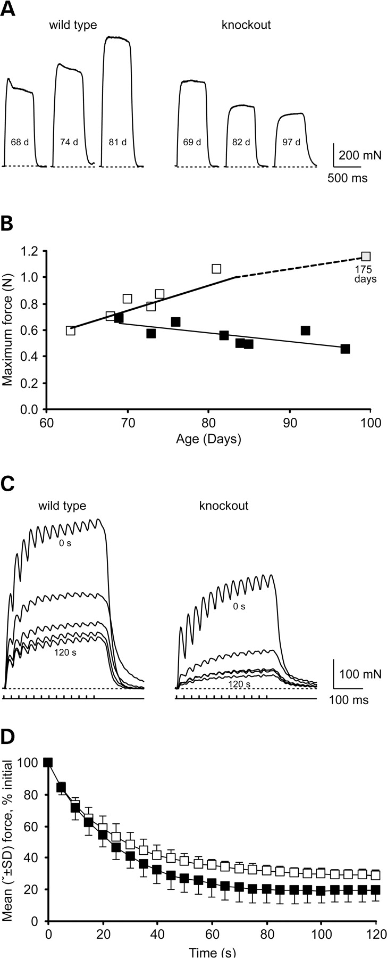
Figure 7. Physiological characterization of medial gastrocnemius muscle. ( A ) Maximal forces evoked in ...
Notes:
Figure 7. Physiological characterization of medial gastrocnemius muscle. ( A ) Maximal forces evoked in medial gastrocnemius muscles of three different aged control and KO male mice in response to supramaximal stimulation of the sciatic nerve at 100 Hz for 0.5 s. ( B ) Relationship between maximal muscle force and age for control and KO animals (control: open squares, y =0.025 x −0.9911, r2 =0.9811, P =0.002; KO: closed squares, y =-0.0064 x +1.0887, r2 =0.534, P =0.039). ( C ) Forces evoked in medial gastrocnemius muscles of a control and KO animal (both 73 days old) in response to 13 pulses every second at 40 Hz for 2 min. Traces shown were recorded at 0, 30, 60, 90 and 120 s (top to bottom). ( D ) Mean (±SD) relative force declines for control and KO mice ( n =5 animals/group) every 5 s during the 2 min of stimulation at 40 Hz.
Unless provided in the caption above, the following copyright applies to the content of this slide: © The Author 2005. Published by Oxford University Press. All rights reserved. For Permissions, please email: journals.permissions@oupjournals.org

