Slide 1
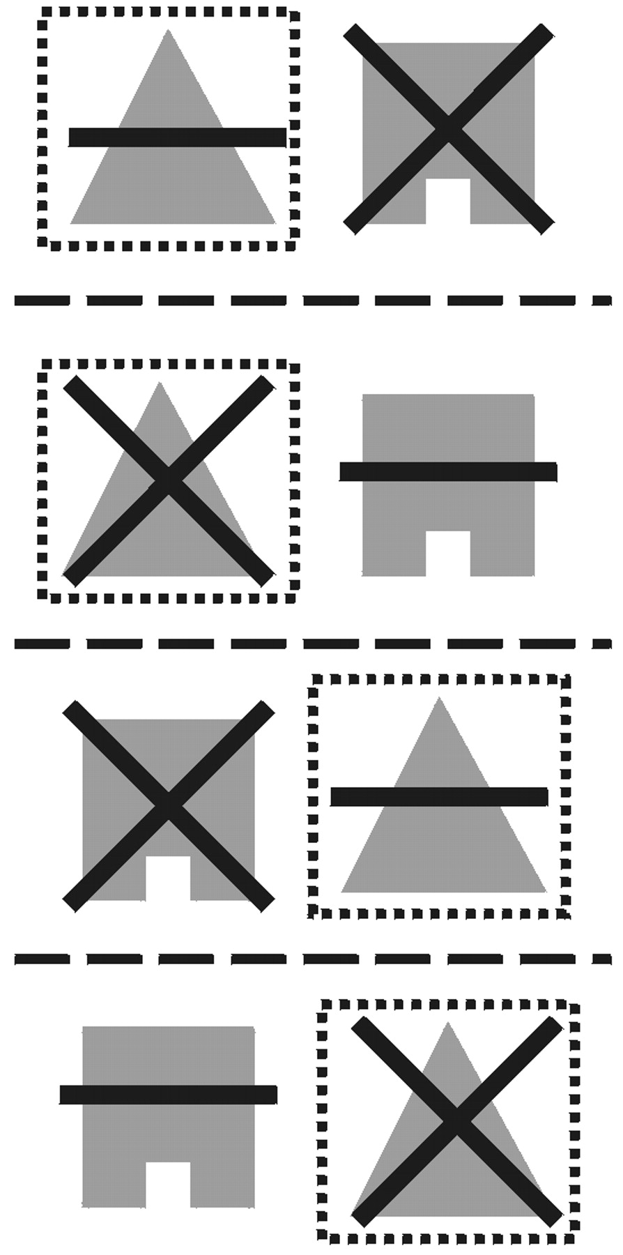
Figure 1. Example stimuli from the feature and dimension switching categorizationtask studied by Dias et al. (Dias et ...
Notes:
Figure 1. Example stimuli from the feature and dimension switching categorizationtask studied by Dias et al. (Dias et al., 1997). Each row represents one trial. Subjectswere rewarded for choosing the target (indicated by the surrounding box, which wasnot presented to the subjects). The stimuli were created by combining one of twopossible line-shapes and one of two possible filled-shapes (all four possible testcombinations are shown for these line-shape and filled-shape dimensions). The targetwas determined by one feature from one dimension, in this case, the triangle featurefrom the filled-shape dimension.
Unless provided in the caption above, the following copyright applies to the content of this slide: © Oxford University Press

Slide 2
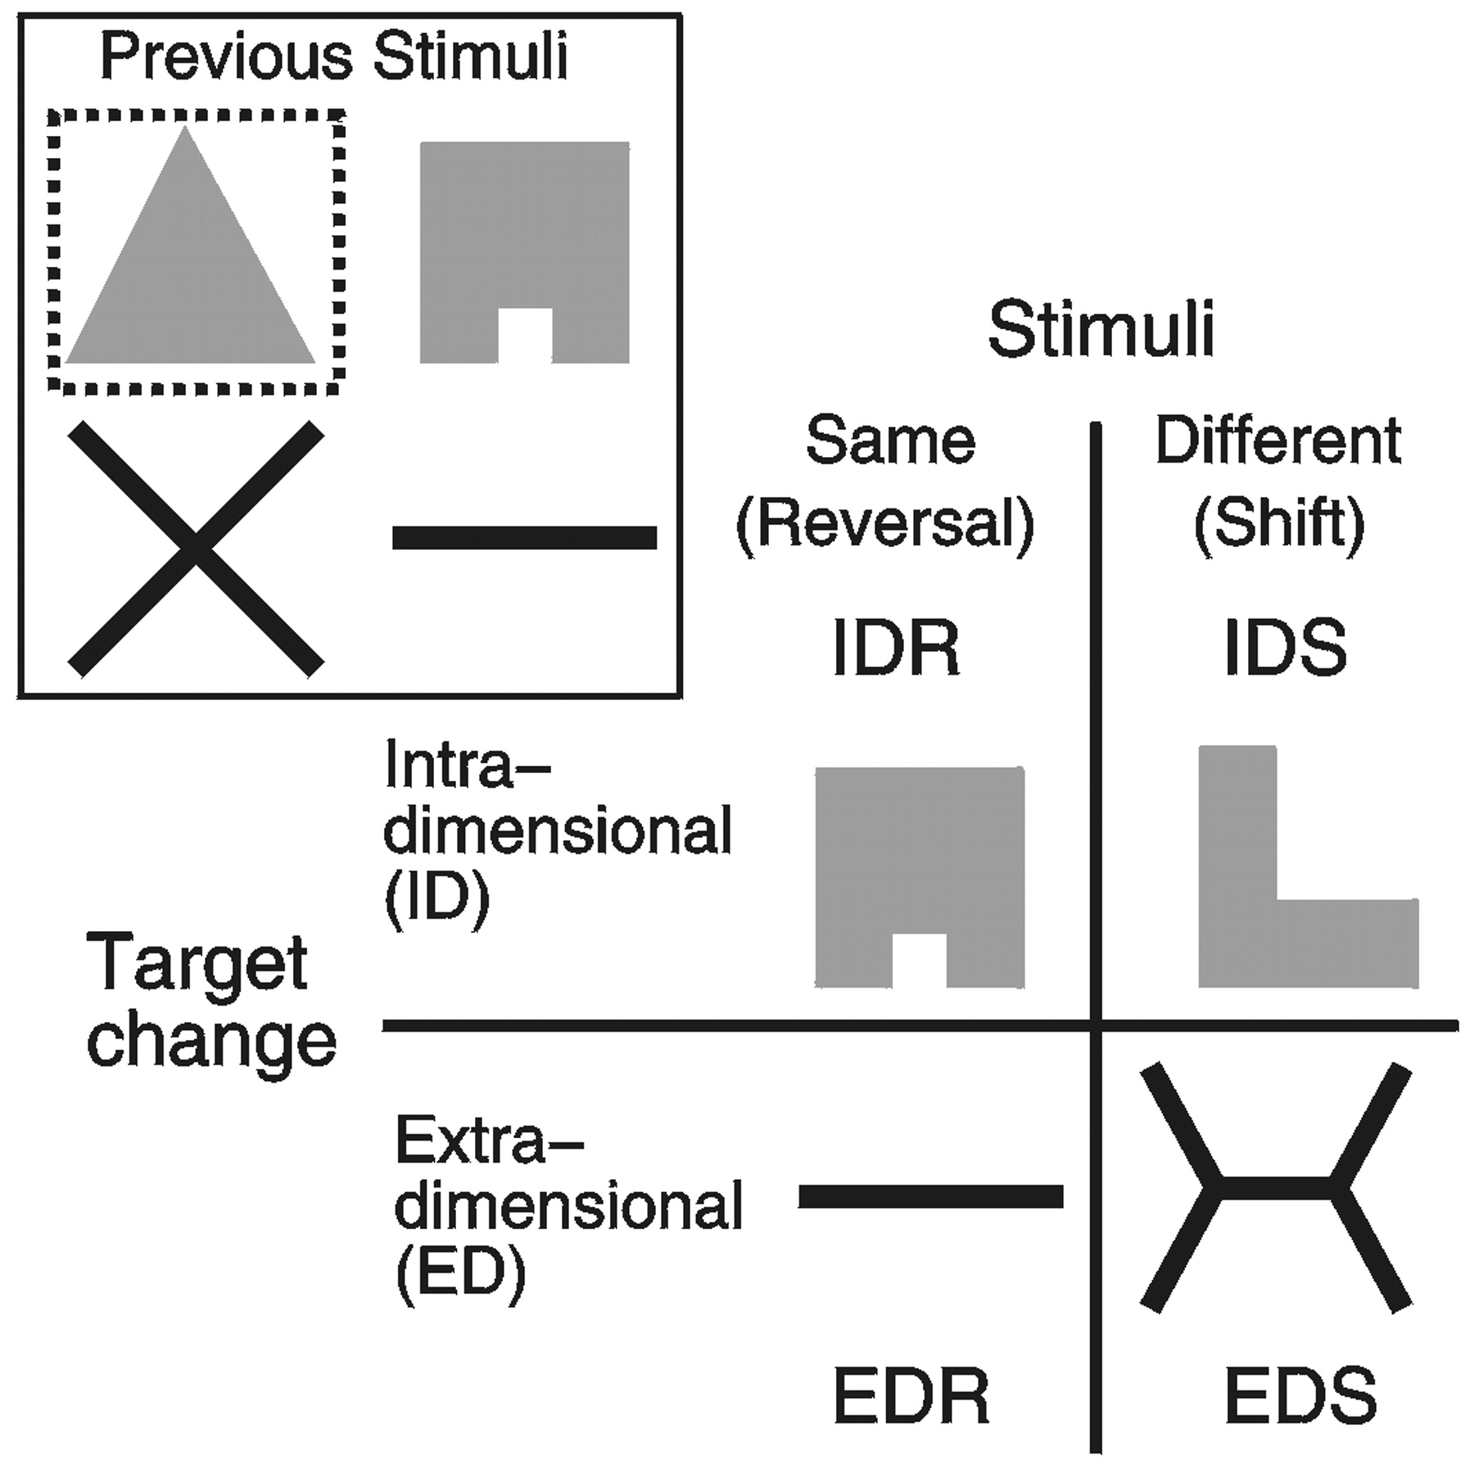
Figure 2. Types of changes in categorization rule following criterion performance onthe original rule (Fig. 1 ), ...
Notes:
Figure 2. Types of changes in categorization rule following criterion performance onthe original rule (Fig. 1 ), organized by same versus different stimuli across the rulechange, and intradimensional or extradimensional target change. The target stimulus isagain indicated by the surrounding box.
Unless provided in the caption above, the following copyright applies to the content of this slide: © Oxford University Press

Slide 3
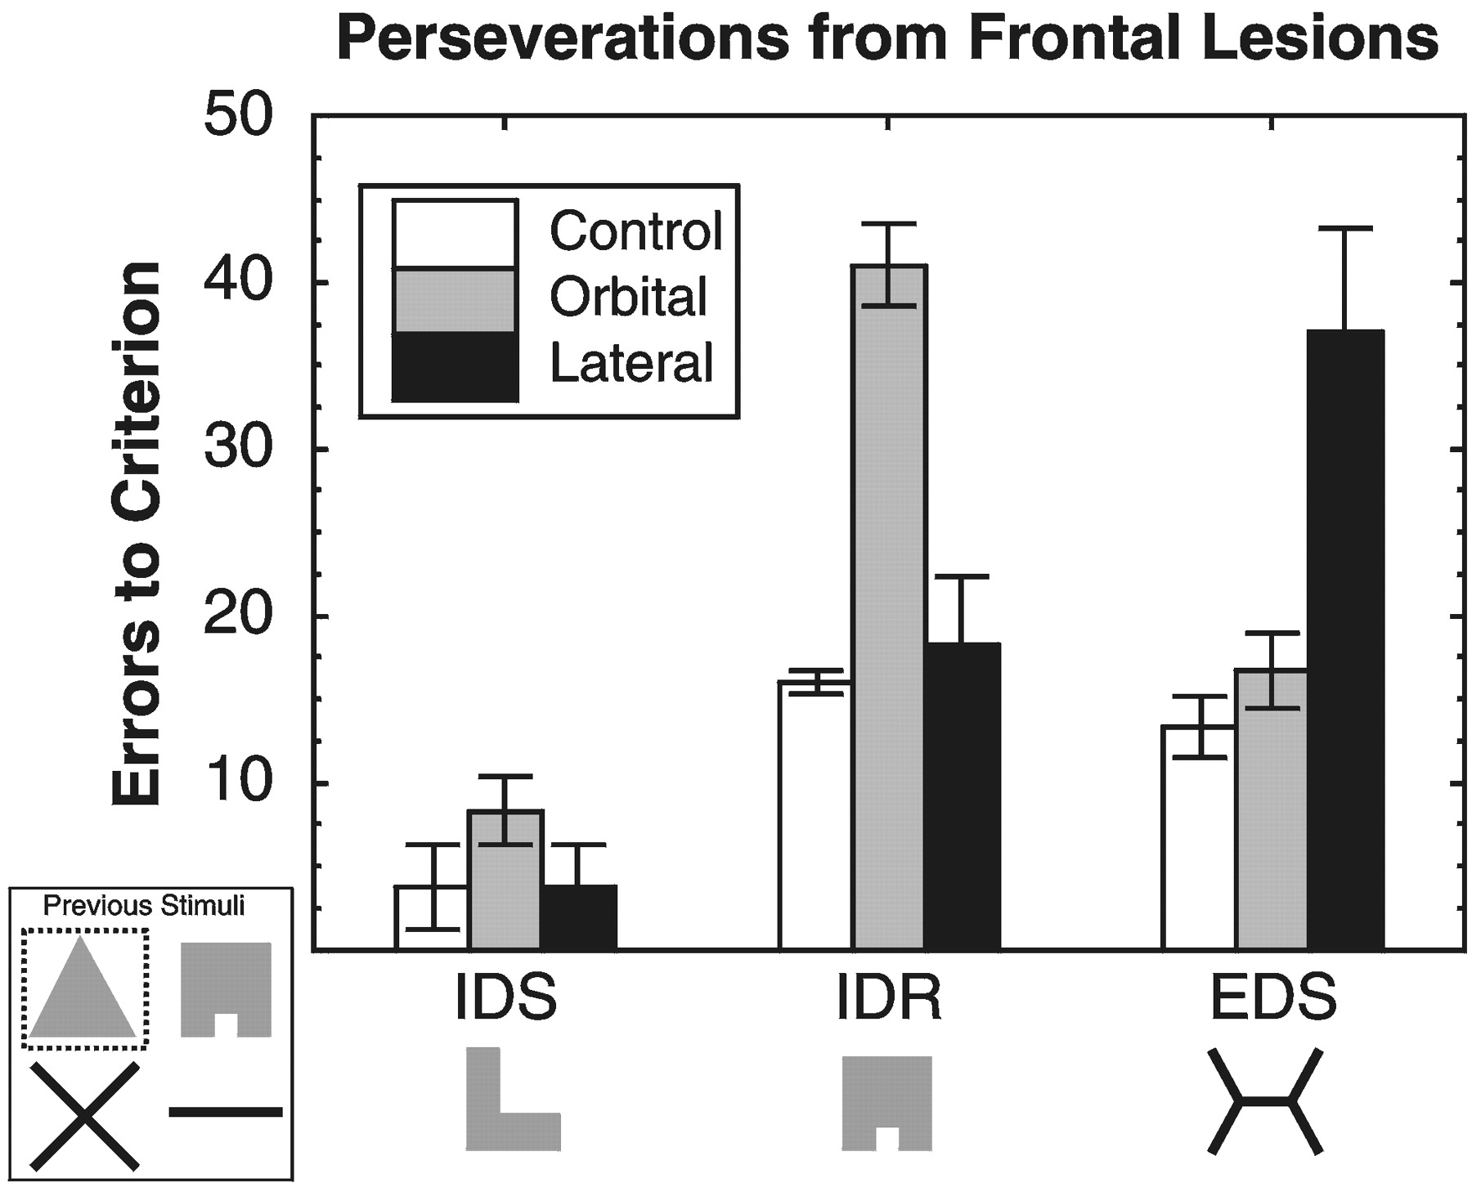
Figure 3. Perseverations from different types of frontal lesions in the WCST-like taskstudied by Dias et al. (Dias et ...
Notes:
Figure 3. Perseverations from different types of frontal lesions in the WCST-like taskstudied by Dias et al. (Dias et al., 1997), reflected in number of errors made beforereaching training criterion. Orbital lesions (ventromedial) selectively impair IDRs,whereas lateral lesions selectively impair EDSs (which are actually reversals to apreviously ignored dimension). IDSs are never impaired. Data from Dias et al. (Dias et al., 1997).
Unless provided in the caption above, the following copyright applies to the content of this slide: © Oxford University Press

Slide 4
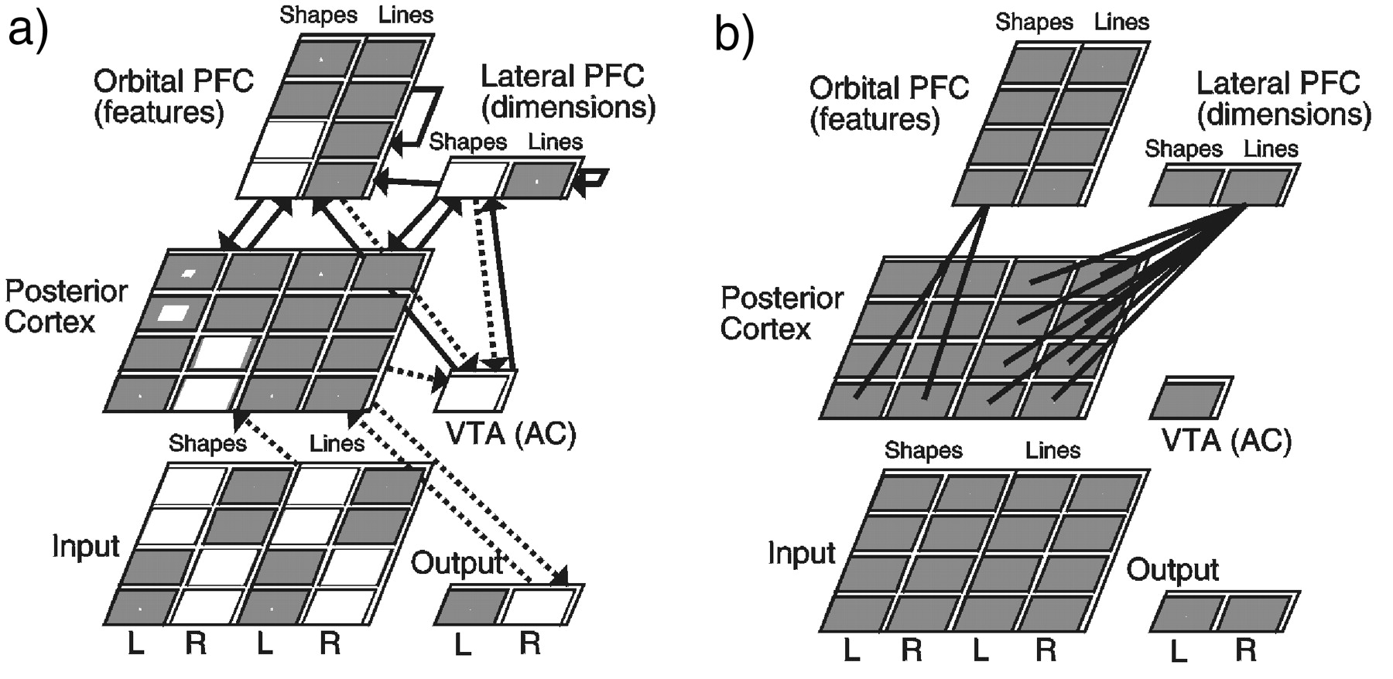
Figure 4. (a) Dynamic categorization network with typical activation state (higher activation = larger white square): ...
Notes:
Figure 4. (a) Dynamic categorization network with typical activation state (higher activation = larger white square): the input contains two stimuli (left = L and right = R), and thenetwork must choose one. The stimuli differ along two dimensions (shapes and lines); features within a dimension are represented by two active units within a column. The Inputand Posterior Cortex layers encode these features separately. Response (Output) is generated by learned associations from the posterior cortex (weights subject to learning are shownwith dotted lines). The posterior cortex layer cannot represent all of the input features simultaneously; learning activates relevant features while suppressing irrelevant ones. Thus,learning is impaired when the irrelevant features become relevant. The PFC layers (representing feature-level and dimension-level information) help by more rapidly focusing posteriorcortex layer processing on previously irrelevant features. The VTA acts like an adaptive critic (AC), stabilizing and destabilizing PFC units in response to errors. Connectivityis bidirectional except VTA only controls PFC, and the more abstract dimensional PFC unidirectionally projects to featural PFC (input is fixed and thus receives no back-projection).(b) Each dimensional (lateral) PFC unit projects reciprocally to the entire set of hidden units representing that dimension; the featural (orbital) PFC units project reciprocally to individualsets of features. Thus, dimensional PFC is more effective at dimensional switching even though featural units are also dimension-specific.
Unless provided in the caption above, the following copyright applies to the content of this slide: © Oxford University Press

Slide 5
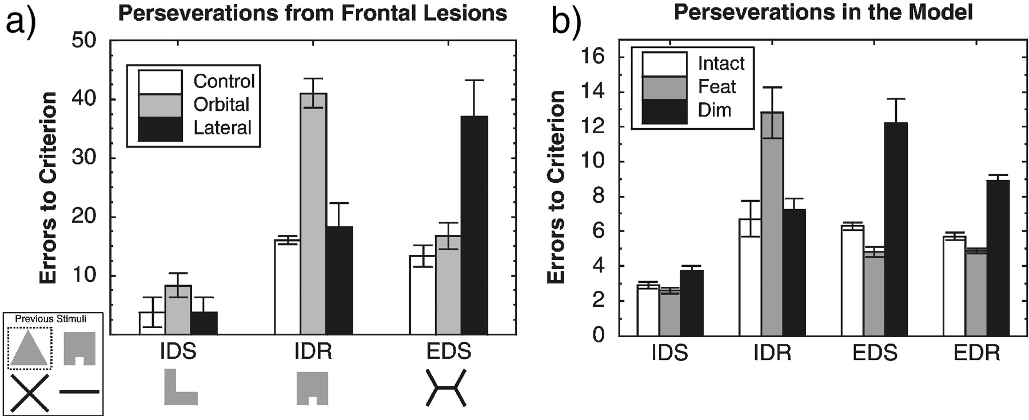
Figure 5. Perseverations from different types of simulated frontal lesions in the model (b), showing number of errors ...
Notes:
Figure 5. Perseverations from different types of simulated frontal lesions in the model (b), showing number of errors made before criterion performance was reached, as compared with data from monkeys shown previously in Figure 3 (a). Feat is lesions of the feature-level PFC representations, which correspond to the orbital lesions (ventromedial) in the Diaset al. (Dias, et al., 1997) monkeys _intradimensional reversals (IDR) are selectively impaired. Dim is lesions of the dimension-level PFC representations, which correspond to thelateral lesions in monkeys _extradimensional shift/reversals (EDS) are selectively impaired. IDSs are never impaired. A novel prediction of the model is that dimensional (lateral)lesions should selectively impair EDRs. Error bars represent standard error of the mean across 10 different simulation runs.
Unless provided in the caption above, the following copyright applies to the content of this slide: © Oxford University Press

Slide 6
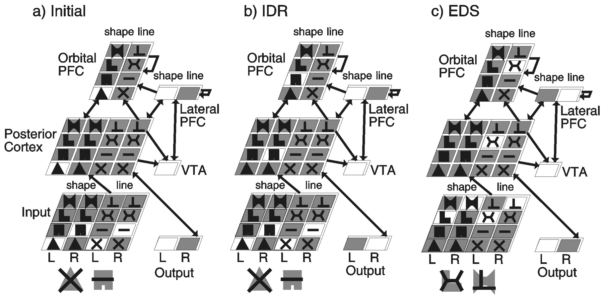
Figure 6. Schematic of ID/ED network performance using localist representations instead of the distributed ones present ...
Notes:
Figure 6. Schematic of ID/ED network performance using localist representations instead of the distributed ones present in the actual network (active units shown in white). (a) Thestate of the network after learning the initial problem (target = triangle-like filled shape). (b) The network after undergoing an IDR, where the target is now the box-like shape. Theorbital (feature) PFC units switch rapidly under activation-based control, and then provide top-down support for the corresponding representation in the posterior cortex. (c) Thenetwork after undergoing an EDS, where the new target is the new X-like line shape (with a horizontal bar in the middle). Again, the PFC units rapidly switch, this time triggered bythe lateral (dimensional) area, facilitating attention for the units in the new line dimension.
Unless provided in the caption above, the following copyright applies to the content of this slide: © Oxford University Press

Slide 7
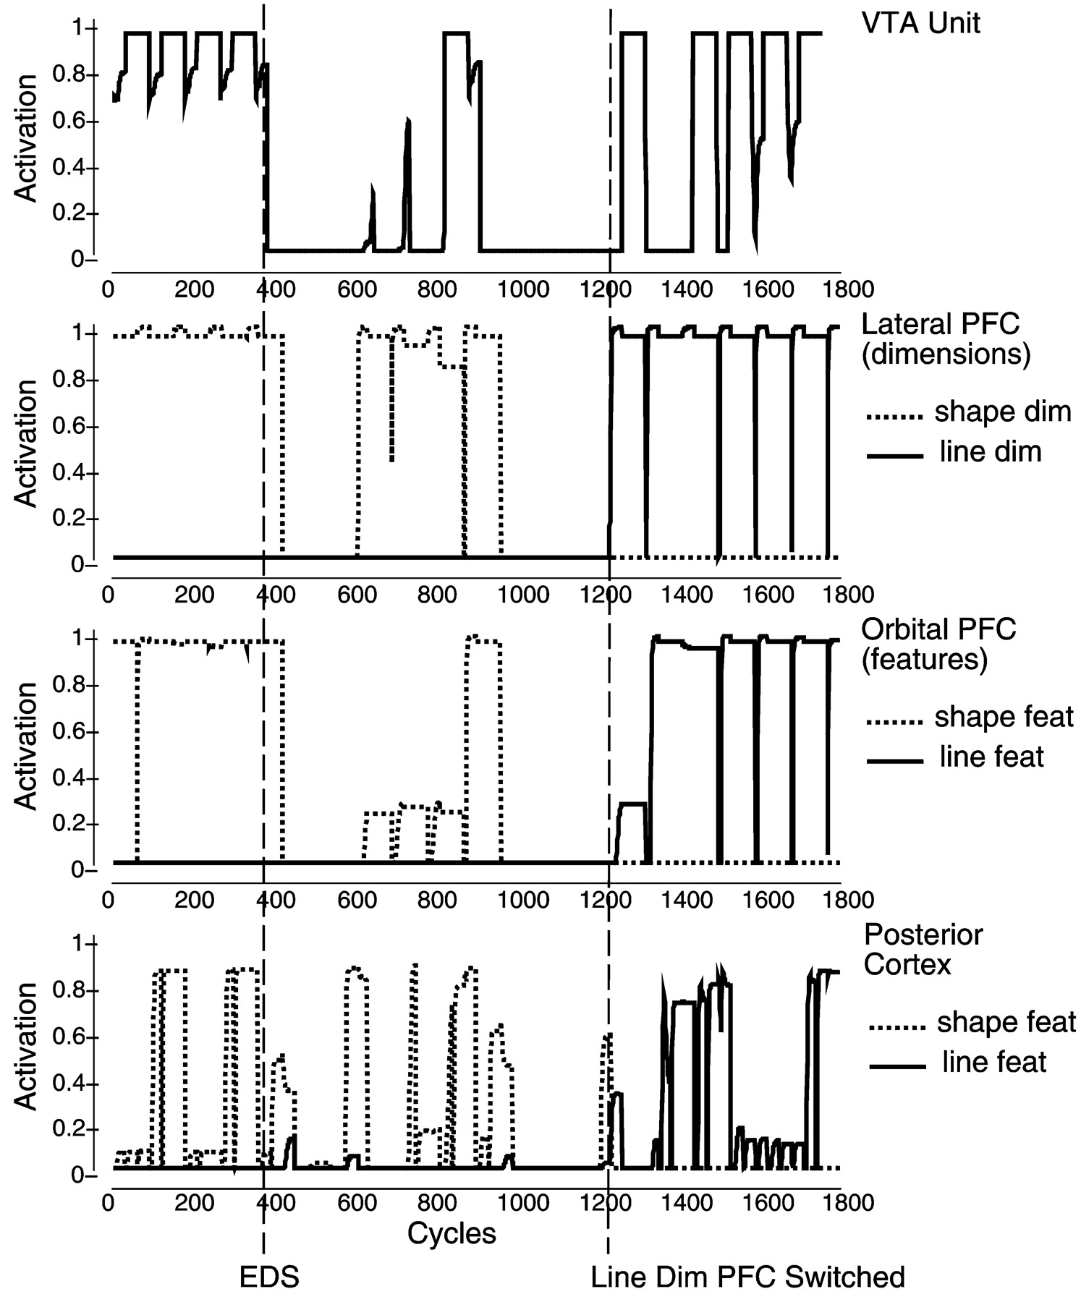
Figure 7. Time course of activations for key units in the VTA (dopamine gating), lateral (dimensional) PFC, orbital ...
Notes:
Figure 7. Time course of activations for key units in the VTA (dopamine gating), lateral (dimensional) PFC, orbital (featural) PFC, and posterior cortex layers of the intact model duringan EDS trial (dimensional reversal). Prior to the EDS, shape-coding units in each layer are appropriately active (dotted lines), and the VTA unit is consistently predicting rewards (i.e.it is consistently active). Shortly after the onset of the EDS, the network makes errors, which results in deactivation of the VTA and consequently a negative dopamine change, causingboth PFC layers to become deactivated via the dopamine-based gating mechanism. Although the shape units are subsequently reactivated for a bit, the resulting errors shut themdown again, and then the lateral PFC unit for the line dimension becomes activated, which produces good performance by causing line representations to become activated in orbitalPFC and posterior cortex. The resulting good performance causes the VTA to become activated (producing a positive dopamine burst), and this stabilizes the PFC representations. Notethat while the PFC units are constantly active, the posterior units plotted are only relevant for a subset of trials, as is evident in the graph. Trials are 60 cycles long (one cycle = oneactivation update; see Appendix).
Unless provided in the caption above, the following copyright applies to the content of this slide: © Oxford University Press

