Slide 1
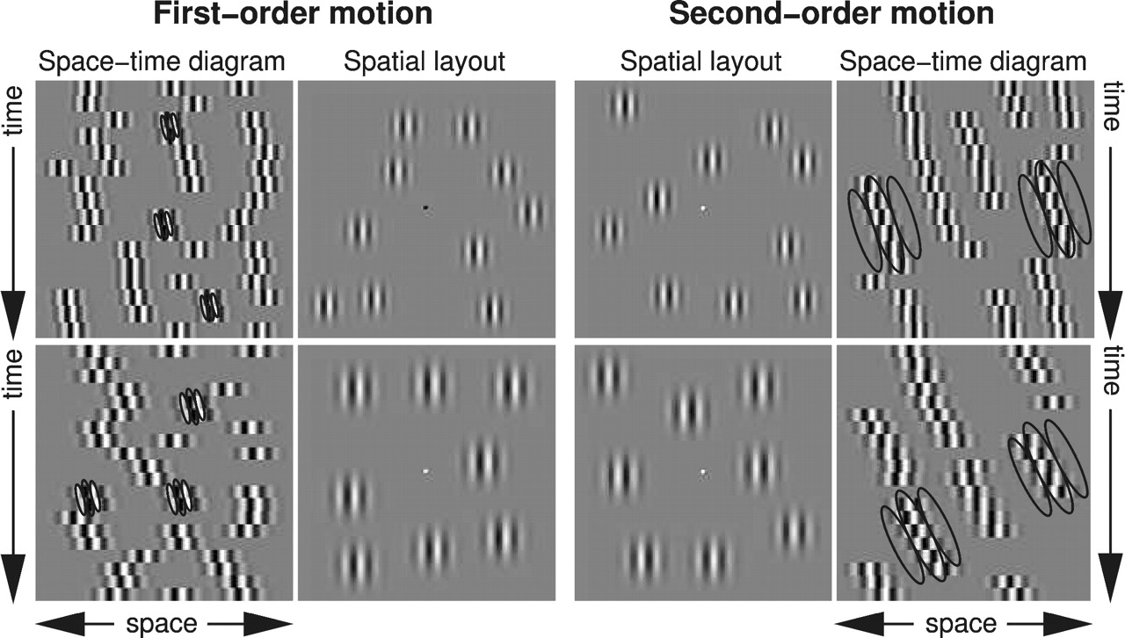
Figure 1. Spatial layout and space–time diagrams of the four conditions of the visual stimulus. The top and ...
Notes:
Figure 1. Spatial layout and space–time diagrams of the four conditions of the visual stimulus. The top and bottom rows differ only in stimulus parameters controlling velocity. The central four panels show four representative spatial layouts, flanked by corresponding examples of space–time diagrams having an overall direction of motion (displacement direction) to the right. The left four panels are examples of the first-order stimulus conditions whereas the right four panels illustrate second-order stimulus configurations. The spatial and temporal properties of both first- and second-order stimulus conditions are virtually identical. A few hypothetical filters are drawn on top of the space-time diagrams illustrating that on the left panels first-order mechanisms underlie the perceptual judgments, whereas in the right panels the overall direction of motion can only be determined by second-order mechanisms. In the first-order configurations (left side) a displacement of quadrature phase, a lifetime of 1 and a lower coherence (50%) was used, parameters known to favor processing by first-order mechanisms. In the second-order conditions (right side) the carrier-phase was randomized on each exposure, forcing the perceptual judgments by a second-order mechanism. The first- and second-order conditions have slightly different velocities (different displacements with identical temporal properties). As a control condition, the spatial and temporal properties of the top and bottom stimulus versions were chosen in such a way that the second-order (top-right) condition has the same velocity as the first-order (bottom-left) condition, allowing for a velocity-matched control. The contrast of the Gabor micropatterns is higher than in the actual stimulus (30%) for illustration purposes.
Unless provided in the caption above, the following copyright applies to the content of this slide:

Slide 2
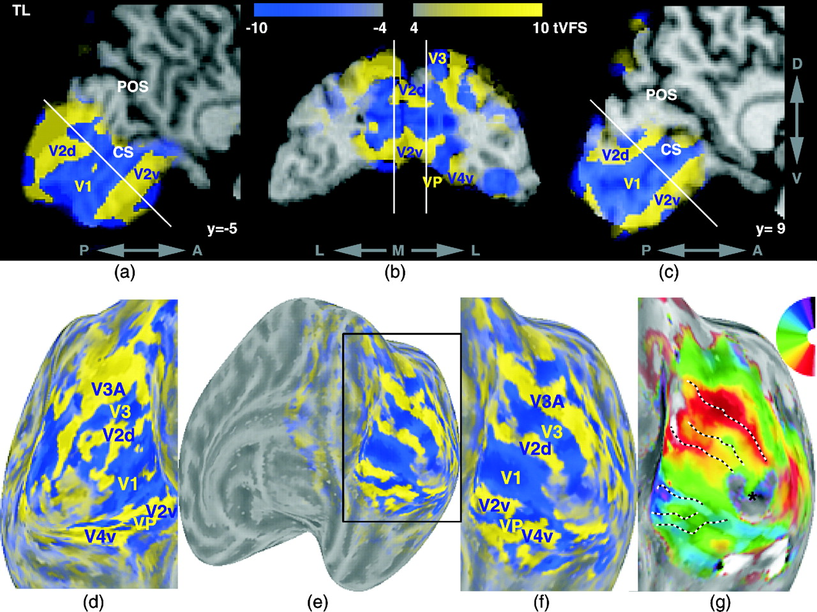
Figure 2. Example of volumetric visual area identification (Dumoulin et al., 2003) for one subject (TL). The ...
Notes:
Figure 2. Example of volumetric visual area identification (Dumoulin et al., 2003) for one subject (TL). The top row (a–c) shows the volumetric visual field sign maps (VFS) weighted by t-statistical maps (tVFS). On the saggital slices (a,c) the parietal-occipital sulcus (POS) and calcarine sulcus (CS) have been identified. The bottom row shows the same data (same colormap range) on unfolded cortical surfaces of the left (d) and right (e,f) hemisphere. The bottom row also shows an example of the polar-angle phase map (g), where the borders of the areas are drawn based on the tVFS-changes. The polar-angle map is used in combination with the eccentricity map and the surface-normals to compute the VFS.
Unless provided in the caption above, the following copyright applies to the content of this slide:

Slide 3
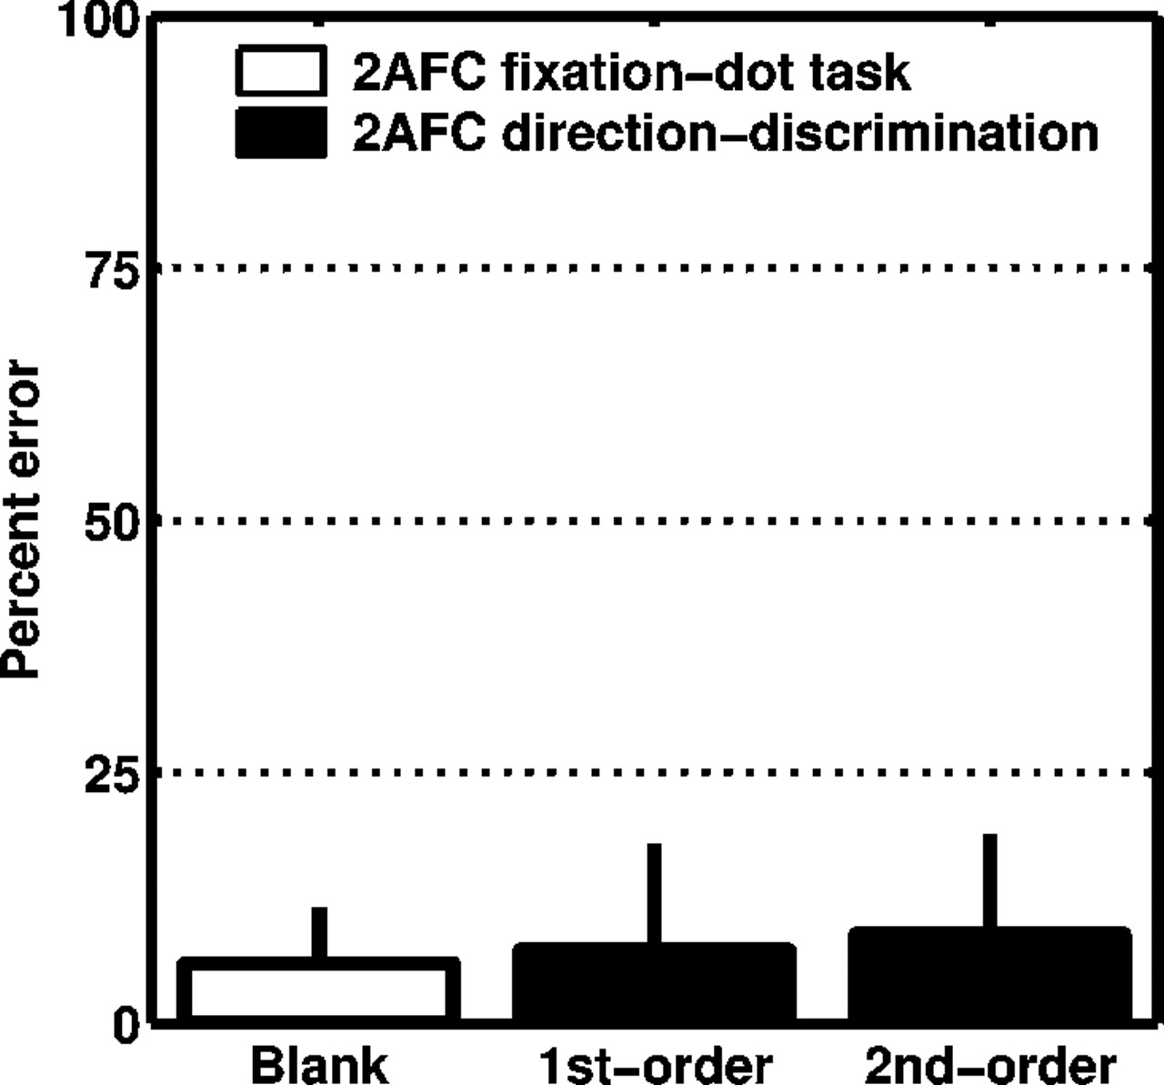
Figure 3. Subjects’ psychophysical performance during the MR scans. Percent error and standard deviations of ...
Notes:
Figure 3. Subjects’ psychophysical performance during the MR scans. Percent error and standard deviations of the subjects’ performance during the fMRI scans are plotted for three conditions. All tasks comprised psychophysical two-alternative forced choice (2AFC) judgments. During the blank periods, the subjects judged the fixation-dot polarity (black-white). When the Gabor-stimuli, either first- or second-order version, were presented the subjects performed a direction-discrimination (left-right) task. The results show that the subjects were able to do either task and that the responses to first- and second-order stimulus conditions were statistically indistinguishable (P > 0.2), indicating that the conditions were equated for their psychophysical performance.
Unless provided in the caption above, the following copyright applies to the content of this slide:

Slide 4
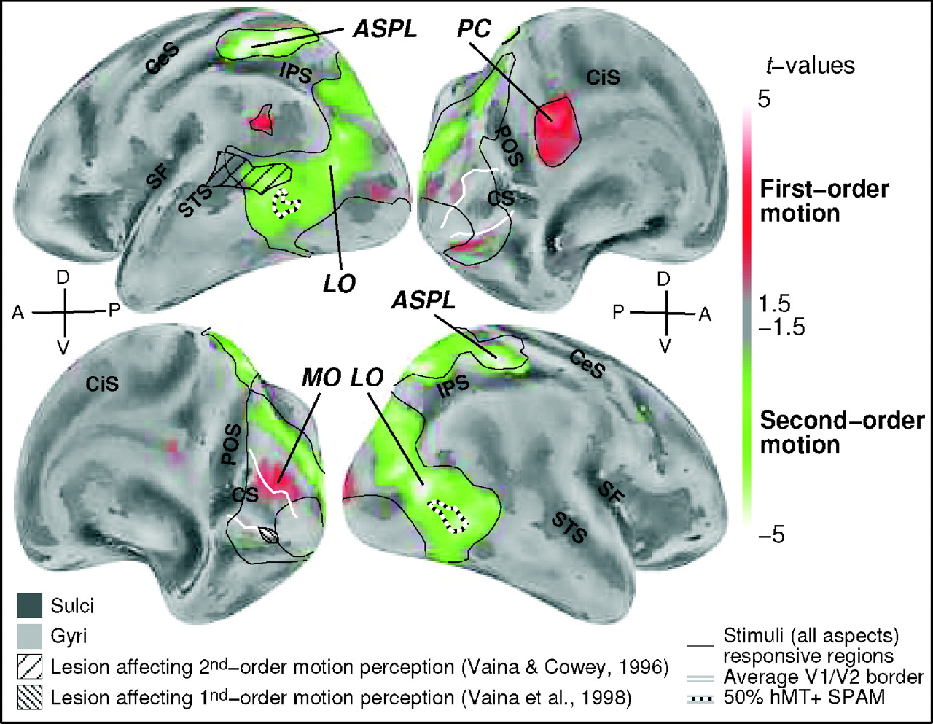
Figure 4. Average t-statistical map (n = 8) comparing first- and second-order motion conditions displayed on ...
Notes:
Figure 4. Average t-statistical map (n = 8) comparing first- and second-order motion conditions displayed on their average unfolded cortical surfaces. The oblique lateral and medial views (left and right) of the left hemisphere are shown in the top row whereas the oblique medial and lateral views (left and right) of the right hemisphere are shown in the bottom row. On their averaged surfaces major anatomical structures can be identified (MacDonald et al., 2000) and some are labeled to facilitate orientation on the surfaces. On the lateral views the central sulcus (CeS), Sylvian fissure (SF), superior temporal sulcus (STS) and intraparietal sulcus (IPS) are labeled. On the medial side the locations of the cingulate sulcus (CiS), parietal-occipital sulcus (POS) and calcarine sulcus (CS) are indicated. Relevant regions are indicated (for t and P-values see Table 1). Significant stronger responses to second-order motion is found both in the anterior superior parietal lobule (ASPL) and in lateral occipital regions (LO). Areas responding more to first-order motion are found in the precuneus (PC) and medial occipital cortex (MO). The MO-activation show a trend that is disclosed significantly in the VOI-analysis (Fig. 5). Regions responding to all stimulus and task aspects are delineated with black lines (corresponding to t = 1.96, uncorrected P = 0.05); in early visual areas this indicates the eccentricity range where the stimuli were presented. On the medial views the average V1/V2 border is indicated with white lines. The average location of hMT+ is indicated by black-white iso-probability lines (50%) of the hMT+ statistical probabilistic anatomical map (SPAM) on the lateral views. The hMT+ iso-probability lines suggest that the main second-order LO-activation peak is most likely not MT. Also, the lesion locations of subjects RA (bottom left) and FD (top left) are indicated, who were selectively impaired in first- and second-order motion perception, respectively (Vaina and Cowey, 1996; Vaina et al., 1998). The lesion data was provided by Dr Vaina.
Unless provided in the caption above, the following copyright applies to the content of this slide:

Slide 5
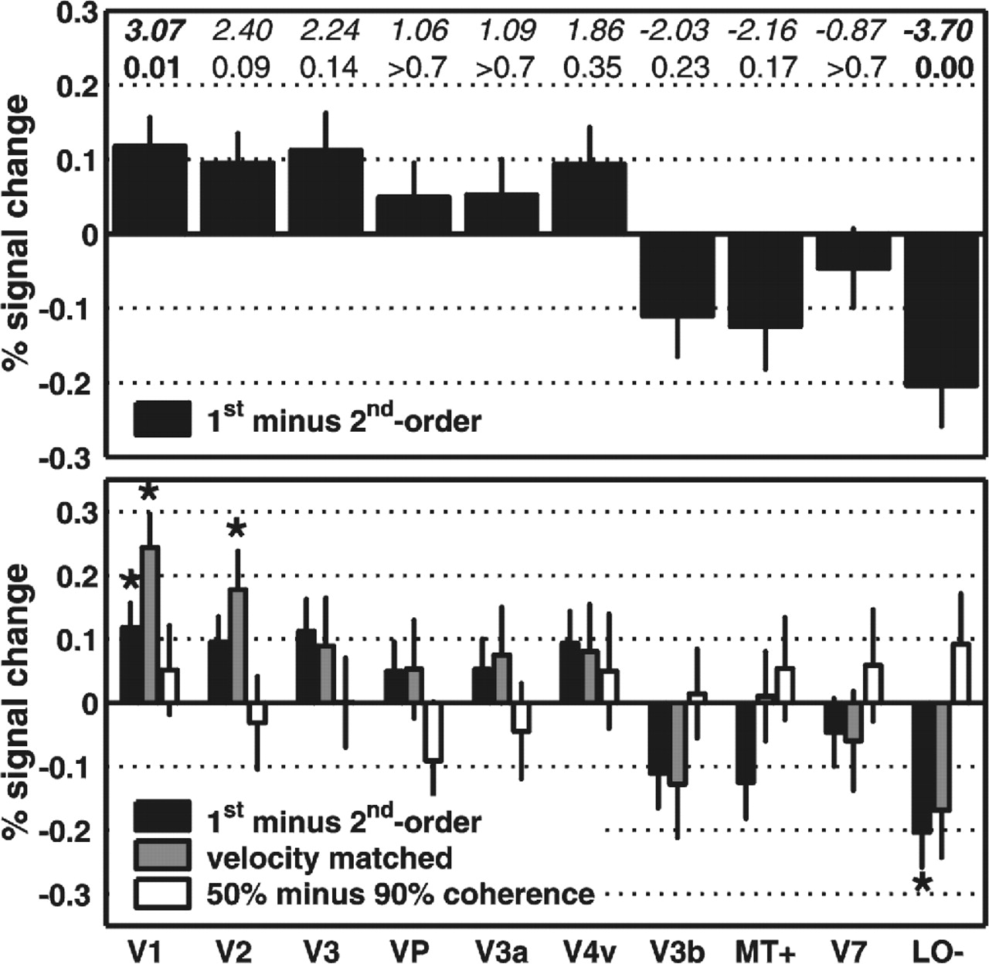
Figure 5. Comparison of activation to first- and second-order motion in occipital visual areas. The ...
Notes:
Figure 5. Comparison of activation to first- and second-order motion in occipital visual areas. The LO-activation that was not covered by the identified visual areas is plotted as area LO–. Average fMRI percent signal changes and standard deviations for comparing first- and second-order stimulus conditions are plotted for the identified visual areas. The top part shows the results for each visual area comparing first- versus second-order motion (see Fig. 4). The results reveal the general trend that first-order motion is processed relatively more in early visual areas, a trend that disappears and then reverses in higher visual areas. The t-statistical (top) and corresponding Bonferroni-corrected p-values (bottom) comparing first- and second-order stimulus conditions for each area are shown as well. These t- and P-values indicate a significantly (P < 0.05) stronger response to first-order motion in V1 and significantly stronger response to second-order in the undefined LO regions (LO–). These MR signal changes are relatively small, which can be attributed to the following facts. Firstly, all stimulus conditions contain first- and second-order noise, only the net-direction of motion can be determined by one mechanism. Secondly, this is a relative difference since all areas respond to all stimuli (but to a different degree). The bottom part shows the same results (black) with the results for two control conditions (gray and white). Significant values (P < 0.05, corrected) are indicated with stars. The first control (gray bars) addressed whether the activation pattern can be explained by velocity differences present between the first- and second-order conditions. To this aim, first- and second-order conditions were compared where the velocities were equal (see Fig. 1). The pattern is similar to the original results indicating that velocity differences cannot explain the first- and second-order activation pattern. The second comparison, white bars, shows a control for coherence, which was used to equate the psychophysical performances for the first- and second-order conditions. In this control condition coherence was varied for a first-order stimulus version, taking coherence levels used in the first- and second-order comparison. A different pattern is found than for the first- and second-order activations illustrating that different coherence levels cannot explain the patterns found.
Unless provided in the caption above, the following copyright applies to the content of this slide:

