Slide 1
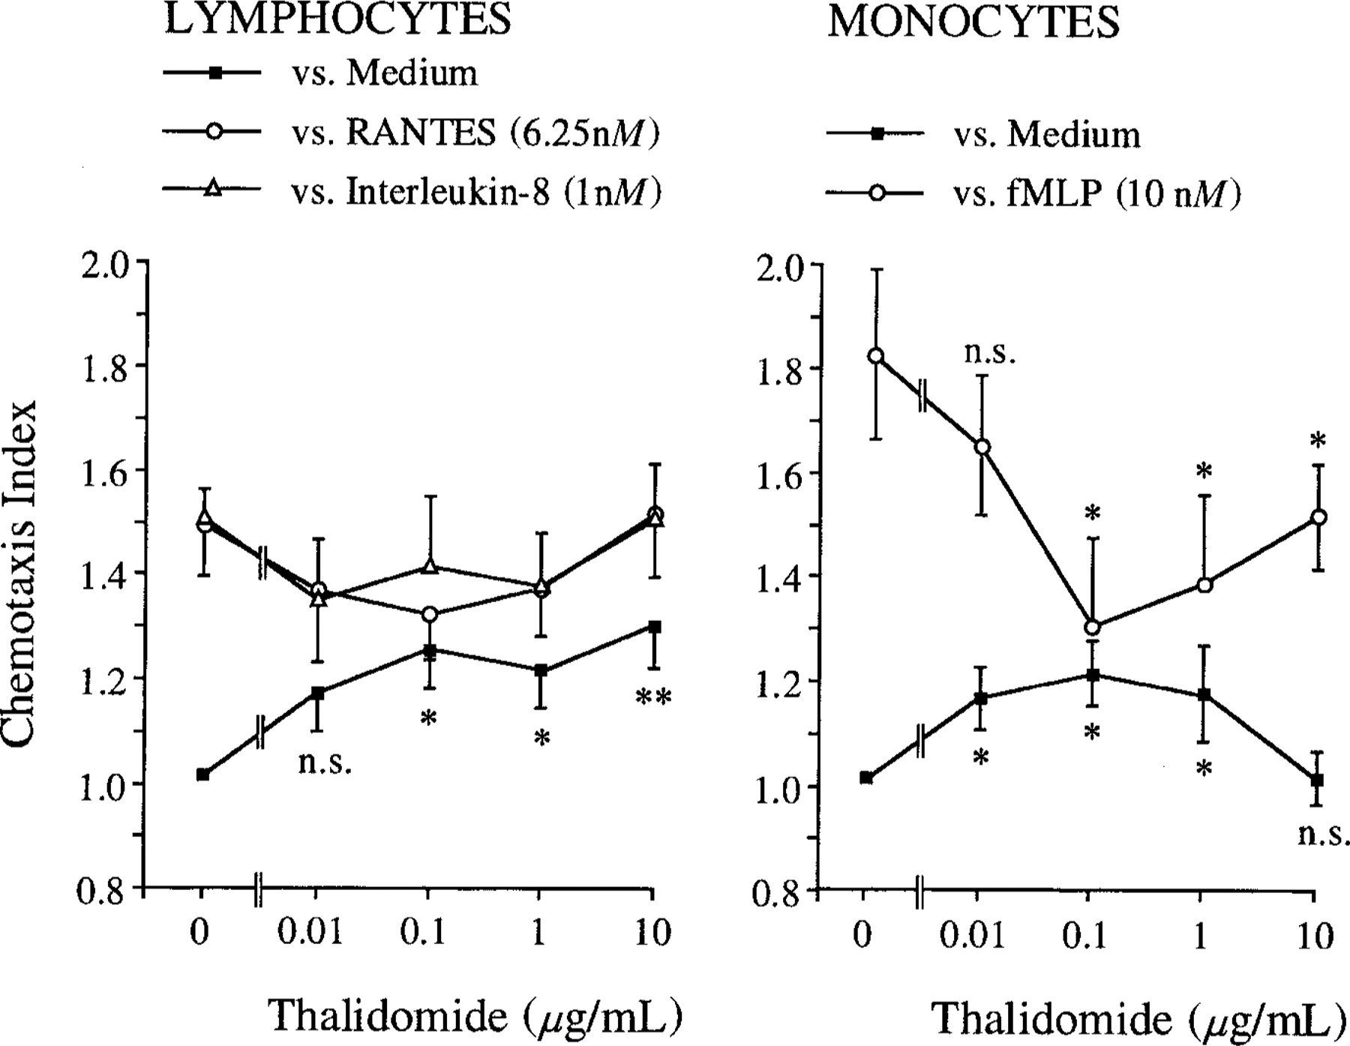
Figure 1 Migration of lymphocytes and monocytes into cellulose nitrate. Cells were pretreated with various ...
Notes:
Figure 1 Migration of lymphocytes and monocytes into cellulose nitrate. Cells were pretreated with various concentrations of thalidomide or vehicle for 30 min. Migration depth was quantified microscopically. Data are mean ± SE of chemotaxis index (ratio of directed divided by undirected migration): n = 5 for lymphocytes; n = 6 for monocytes. Statistical analysis: Mann-Whitney U test after Kruskal Wallis analysis of variance; * P < .05; ** P < .01; n.s., not significant.
Unless provided in the caption above, the following copyright applies to the content of this slide: © 1999 by the Infectious Diseases Society of America

Slide 2
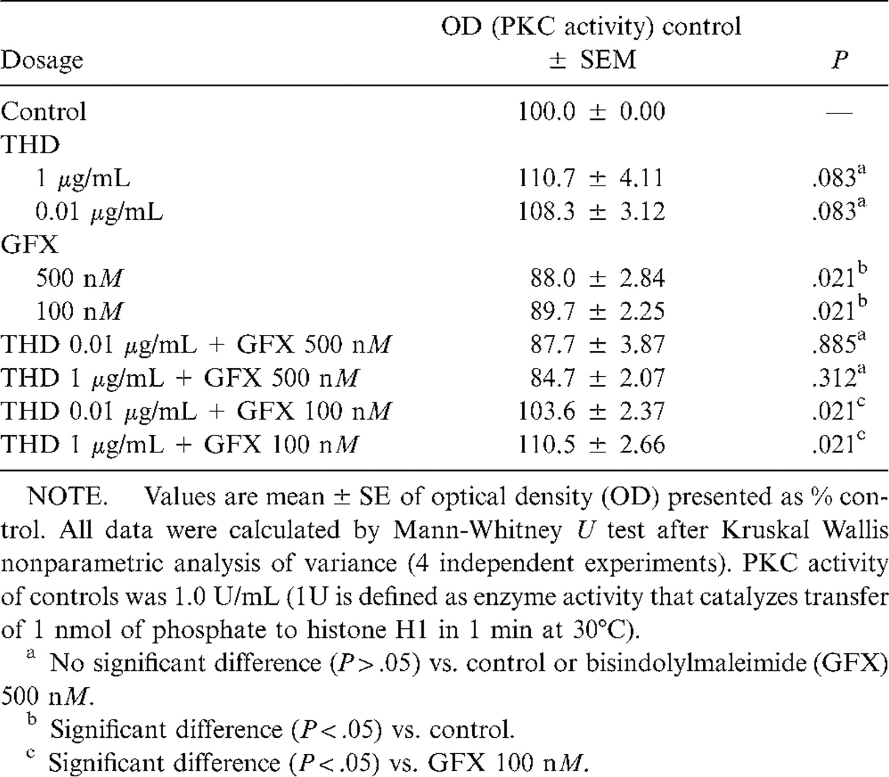
Table 1 Effects of thalidomide (THD) and bisindolylmaleimide on a purified enzyme preparation of protein kinase C ...
Notes:
Table 1 Effects of thalidomide (THD) and bisindolylmaleimide on a purified enzyme preparation of protein kinase C (PKC).
Unless provided in the caption above, the following copyright applies to the content of this slide: © 1999 by the Infectious Diseases Society of America

