Slide 1
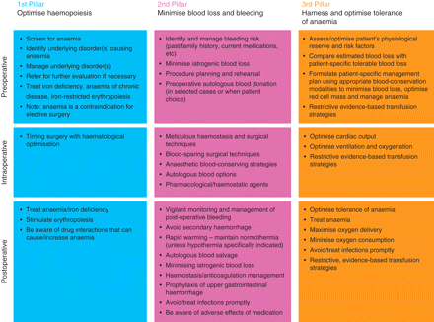
Fig 1 A multimodal approach to PBM (or blood conservation). Adapted from Hofmann and colleagues⁶² with ...
Notes:
Fig 1 A multimodal approach to PBM (or blood conservation). Adapted from Hofmann and colleagues62 with permission. ESA, erythropoiesis-stimulating agents.
Unless provided in the caption above, the following copyright applies to the content of this slide: © The Author [2012]. Published by Oxford University Press on behalf of the British Journal of Anaesthesia. All rights reserved. For Permissions, please email: journals.permissions@oup.comThis is an Open Access article distributed under the terms of the Creative Commons Attribution Non-Commercial License (http://creativecommons.org/licenses/by-nc/2.5/uk/) which permits unrestricted non-commercial use, distribution, and reproduction in any medium, provided the original work is properly cited

Slide 2
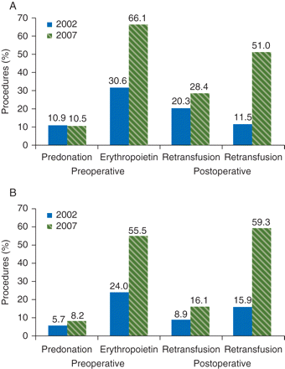
Fig 2 Results of a national survey of rates of autologous preoperative blood donation, erythropoietin use, and ...
Notes:
Fig 2 Results of a national survey of rates of autologous preoperative blood donation, erythropoietin use, and autologous retransfusion in patients undergoing (a) hip or (b) knee arthroplasty in 2002 and 2007 in the Netherlands.91
Unless provided in the caption above, the following copyright applies to the content of this slide: © The Author [2012]. Published by Oxford University Press on behalf of the British Journal of Anaesthesia. All rights reserved. For Permissions, please email: journals.permissions@oup.comThis is an Open Access article distributed under the terms of the Creative Commons Attribution Non-Commercial License (http://creativecommons.org/licenses/by-nc/2.5/uk/) which permits unrestricted non-commercial use, distribution, and reproduction in any medium, provided the original work is properly cited

Slide 3
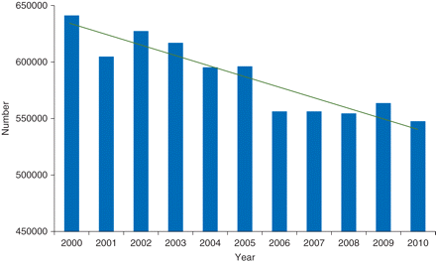
Fig 3 Number of allogeneic transfusions in the Netherlands from 2000 to 2010.⁹⁶
Notes:
Fig 3 Number of allogeneic transfusions in the Netherlands from 2000 to 2010.96
Unless provided in the caption above, the following copyright applies to the content of this slide: © The Author [2012]. Published by Oxford University Press on behalf of the British Journal of Anaesthesia. All rights reserved. For Permissions, please email: journals.permissions@oup.comThis is an Open Access article distributed under the terms of the Creative Commons Attribution Non-Commercial License (http://creativecommons.org/licenses/by-nc/2.5/uk/) which permits unrestricted non-commercial use, distribution, and reproduction in any medium, provided the original work is properly cited

