Slide 1
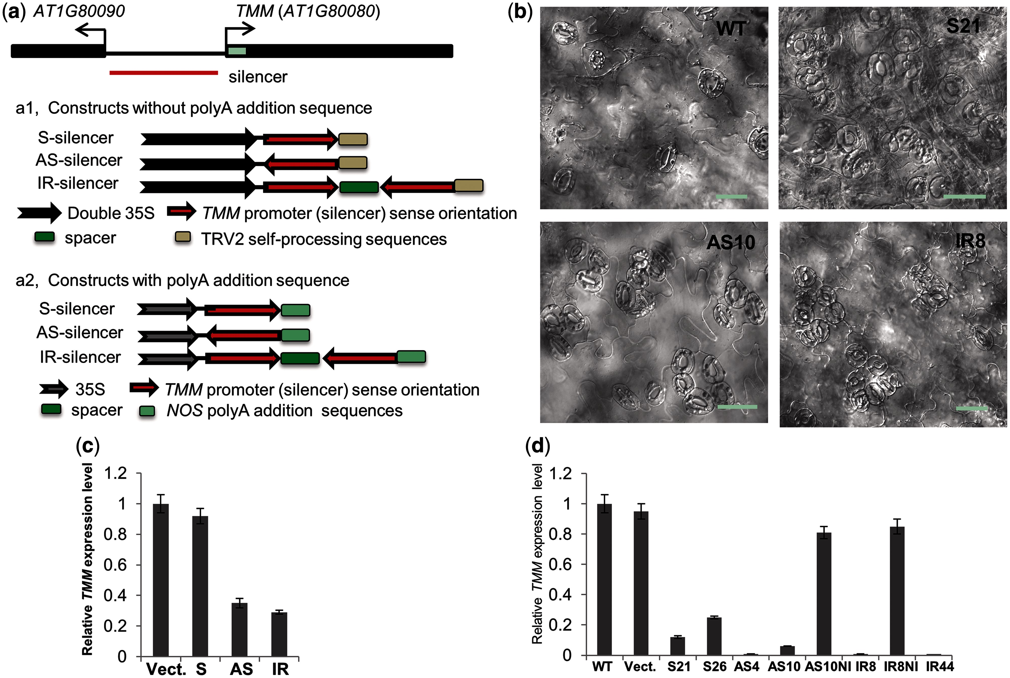
Fig. 1 Both single-stranded silencers and the IR silencer can induce TGS at the TMM promoter. (a) Schematic ...
Notes:
Fig. 1 Both single-stranded silencers and the IR silencer can induce TGS at the TMM promoter. (a) Schematic representations of silencer constructs. A 475 bp (−483 to −9) fragment of the TMM promoter region was used as a silencer. (a1) Silencers without a poly(A) addition sequence. A double 35S was used to transcribe the silencer in the sense (S, sense silencer) or antisense (AS, antisense silencer) directions, or to transcribe an inverted repeat (IR) silencer with IR sequences. All 3′ ends of constructs carried a TRV2 self-processing sequence. (a2) Silencers with a NOS poly(A) addition sequence. Silencers (S, AS and IR) were transcribed from a 35S promoter. All 3′ ends of constructs carried a NOS poly(A) addition sequence. (b) Typical clustering of stomata seen in the sense silencer line, S21, the antisense silencer line, AS10, and the IR silencer line, IR8. WT, wild type Col-0. Scale bar = 10 µm. (c and d) Relative TMM transcript levels in WT and transgenic lines expressing the three different types of silencers. (c) Relative TMM transcript levels in T1 transgenic plants. For each silencer construct, a pool of 50–100 T1 transgenic plants was analyzed. (d) Relative TMM transcript levels in representative S silencer lines (S21 and S26), AS silencer lines (AS4 and AS10) and IR silencer lines (IR8 and IR44). AS10NI and IR8NI were progeny plant lines which did not carry any transgene from a T2 segregating population of AS10 and IR8, respectively. Vect., vector control. Data shown are means of three technical repeats ± SD. Similar results were obtained in another independent experiment (Supplementary Fig. S2).
Unless provided in the caption above, the following copyright applies to the content of this slide: © The Author 2014. Published by Oxford University Press on behalf of Japanese Society of Plant Physiologists. All rights reserved. For permissions, please email: journals.permissions@oup.com

Slide 2
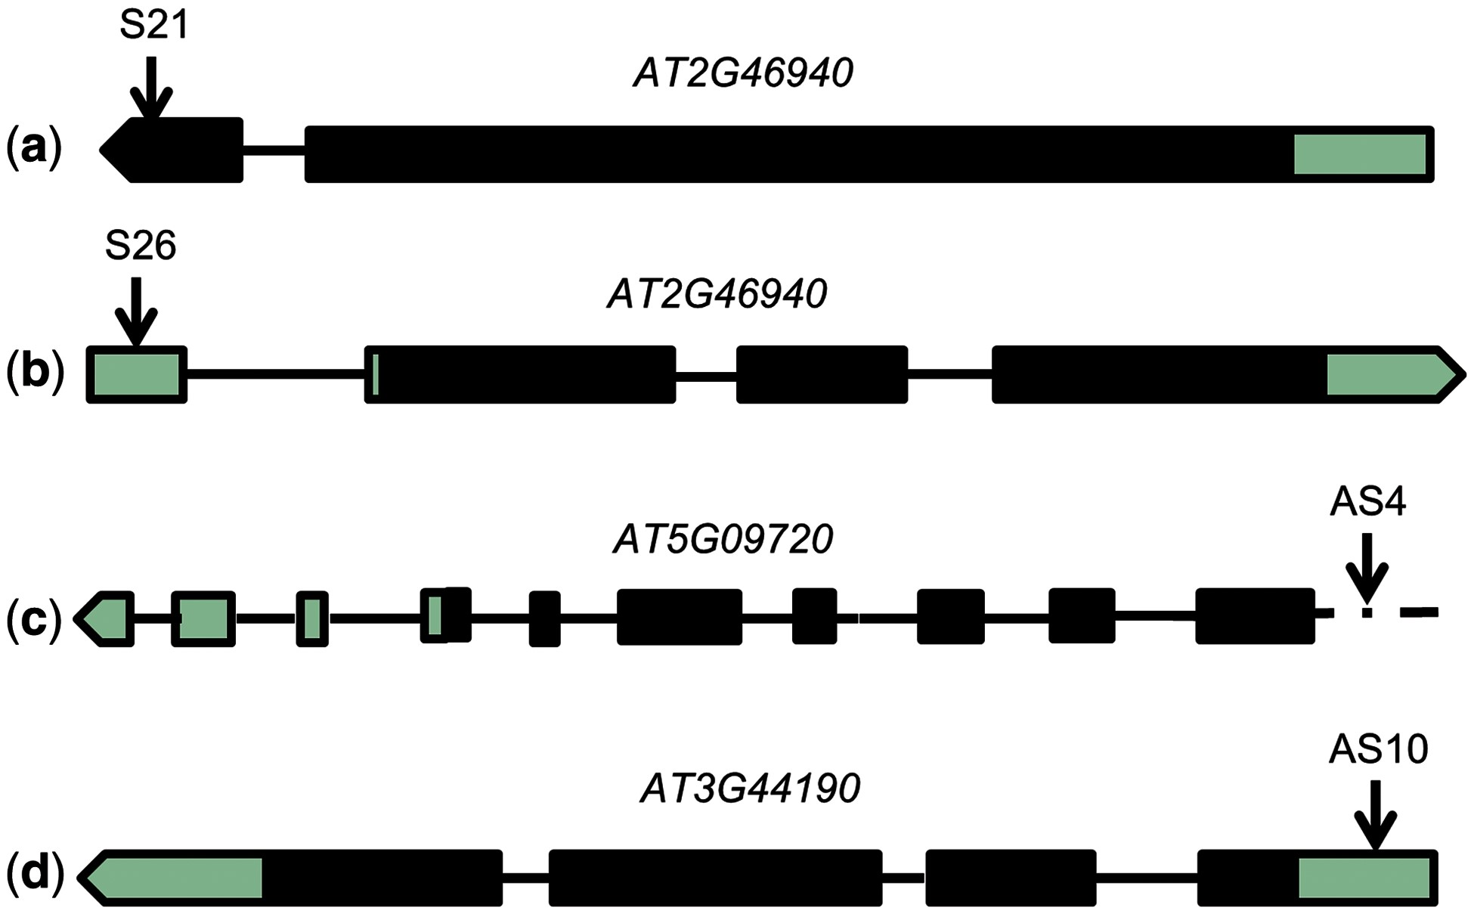
Fig. 2 Genomic insertion locations of T-DNA in Arabidopsis transgenic lines carrying single-stranded silencers. The ...
Notes:
Fig. 2 Genomic insertion locations of T-DNA in Arabidopsis transgenic lines carrying single-stranded silencers. The schematic diagram shows disrupted Arabidopsis genes. In each line, the T-DNA insertion position is indicated by an arrow. White box, UTR; black box, exon coding region; black line, intron region; dotted line, intergenic region. Note that the intergenic and genic regions are not on the same scale in (c). S21 and S26 are sense silencer lines and AS4 and AS10 are antisense silencer lines.
Unless provided in the caption above, the following copyright applies to the content of this slide: © The Author 2014. Published by Oxford University Press on behalf of Japanese Society of Plant Physiologists. All rights reserved. For permissions, please email: journals.permissions@oup.com

Slide 3
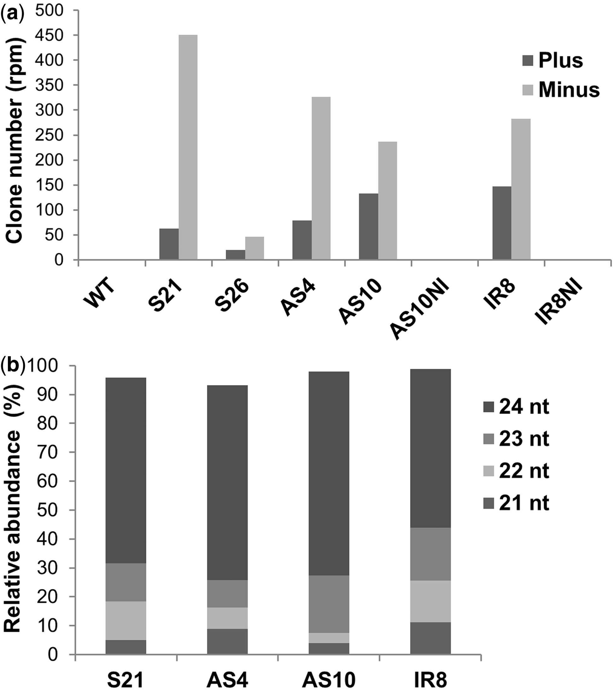
Fig. 3 Clone number and size distribution of smRNAs mapped to the TMM promoter region. (a) Normalized clone numbers ...
Notes:
Fig. 3 Clone number and size distribution of smRNAs mapped to the TMM promoter region. (a) Normalized clone numbers of smRNAs mapped to the TMM promoter. The TMM promoter-related smRNAs were normalized to the total number of 21–24 nt smRNAs that can be mapped to the Arabidopsis genome. (+) and (−) refer to the sense strand and antisense strand, respectively; rpm denotes read per million reads. (b) Size distribution of smRNAs mapped to the TMM promoter. S21 and S26, sense silencer lines; AS4 and AS10, antisense silencer lines; IR8, IR silencer line; AS10NI and IR8NI were progeny plant lines which did not carrying any transgene from a T2 segregating population of AS10 and IR8, respectively.
Unless provided in the caption above, the following copyright applies to the content of this slide: © The Author 2014. Published by Oxford University Press on behalf of Japanese Society of Plant Physiologists. All rights reserved. For permissions, please email: journals.permissions@oup.com

Slide 4
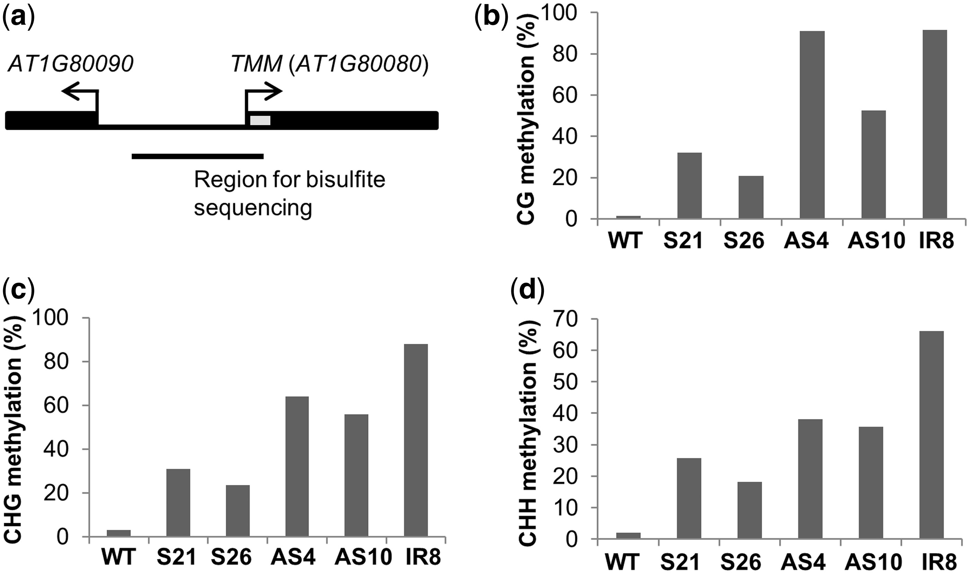
Fig. 4 DNA methylation profile at the endogenous TMM promoter region. (a) The region of endogenous TMM promoter ...
Notes:
Fig. 4 DNA methylation profile at the endogenous TMM promoter region. (a) The region of endogenous TMM promoter analyzed by sequencing of bisulfite-treated DNA. (b–d) DNA methylation levels at CG, CHG (H = A, C or T) and CHH types of cytosine, respectively. S21 and S26, sense silencer lines; AS4 and AS10, antisense silencer lines; IR8, IR silencer line.
Unless provided in the caption above, the following copyright applies to the content of this slide: © The Author 2014. Published by Oxford University Press on behalf of Japanese Society of Plant Physiologists. All rights reserved. For permissions, please email: journals.permissions@oup.com

Slide 5
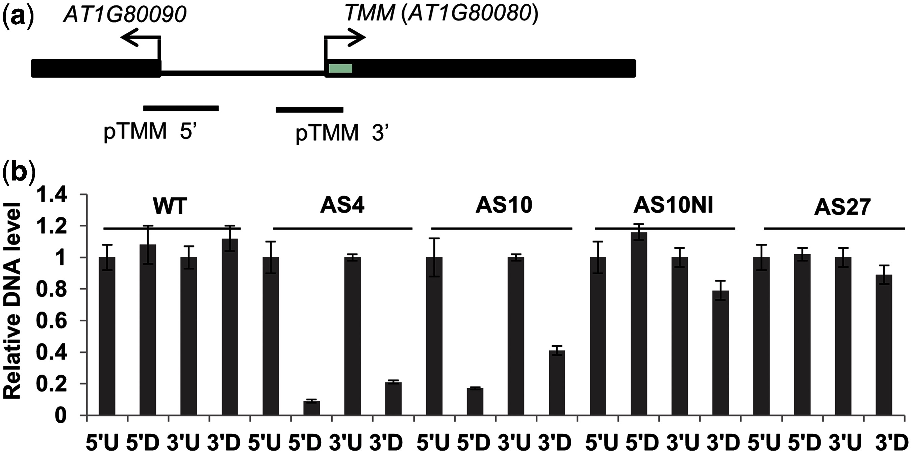
Fig. 5 DNA methylation at the TMM promoter region is silencer dependent. Endonuclease McrBC cleaves DNA containing ...
Notes:
Fig. 5 DNA methylation at the TMM promoter region is silencer dependent. Endonuclease McrBC cleaves DNA containing (G/A)mC(N40–3,000) (G/A)mC. (a) 5′ and 3′ regions of the TMM promoter interrogated for DNA methylation. (b) qPCR results with or without digestion with McrBC. WT, wild type Col-0. AS4, AS10 and AS27, antisense silencer lines. AS10NI plants were derived from selfing of heterozygous AS10 and contained no transgenic silencer. U, without McrBC treatment; D, with McrBC treatment.
Unless provided in the caption above, the following copyright applies to the content of this slide: © The Author 2014. Published by Oxford University Press on behalf of Japanese Society of Plant Physiologists. All rights reserved. For permissions, please email: journals.permissions@oup.com

Slide 6
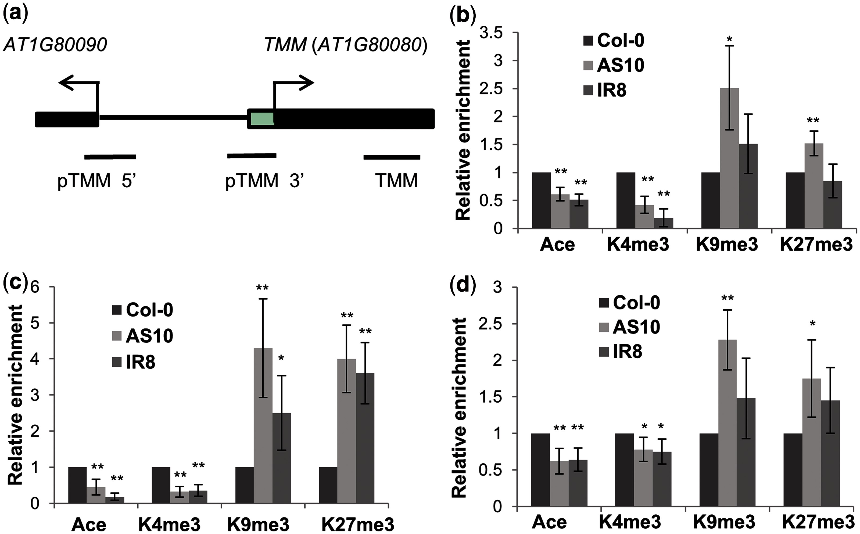
Fig. 6 Histone H3 modification patterns on the TMM promoter and coding region in plants silenced by the AS or IR ...
Notes:
Fig. 6 Histone H3 modification patterns on the TMM promoter and coding region in plants silenced by the AS or IR silencer. (a) qPCR primers designed to amplify DNA fragments (around 100 bp) corresponding to three different regions of the TMM promoter and coding sequences as indicated. (b–d) Histone H3 modification patterns at the TMM promoter 5′ region, 3′ region and the TMM coding region. Ace, H3K9/14 acetylation; K4me3, H3K4 trimethylated form; K9me3, H3K9 trimethylated form; K27me3, histone H3K27 trimethylated form. Histograms show average values ± SD (n = 3 biological replicates). Significant differences in histone modifications between transgenic lines and Col-0 WT are denoted with asterisks: *P < 0.05; **P < 0.01.
Unless provided in the caption above, the following copyright applies to the content of this slide: © The Author 2014. Published by Oxford University Press on behalf of Japanese Society of Plant Physiologists. All rights reserved. For permissions, please email: journals.permissions@oup.com

Slide 7
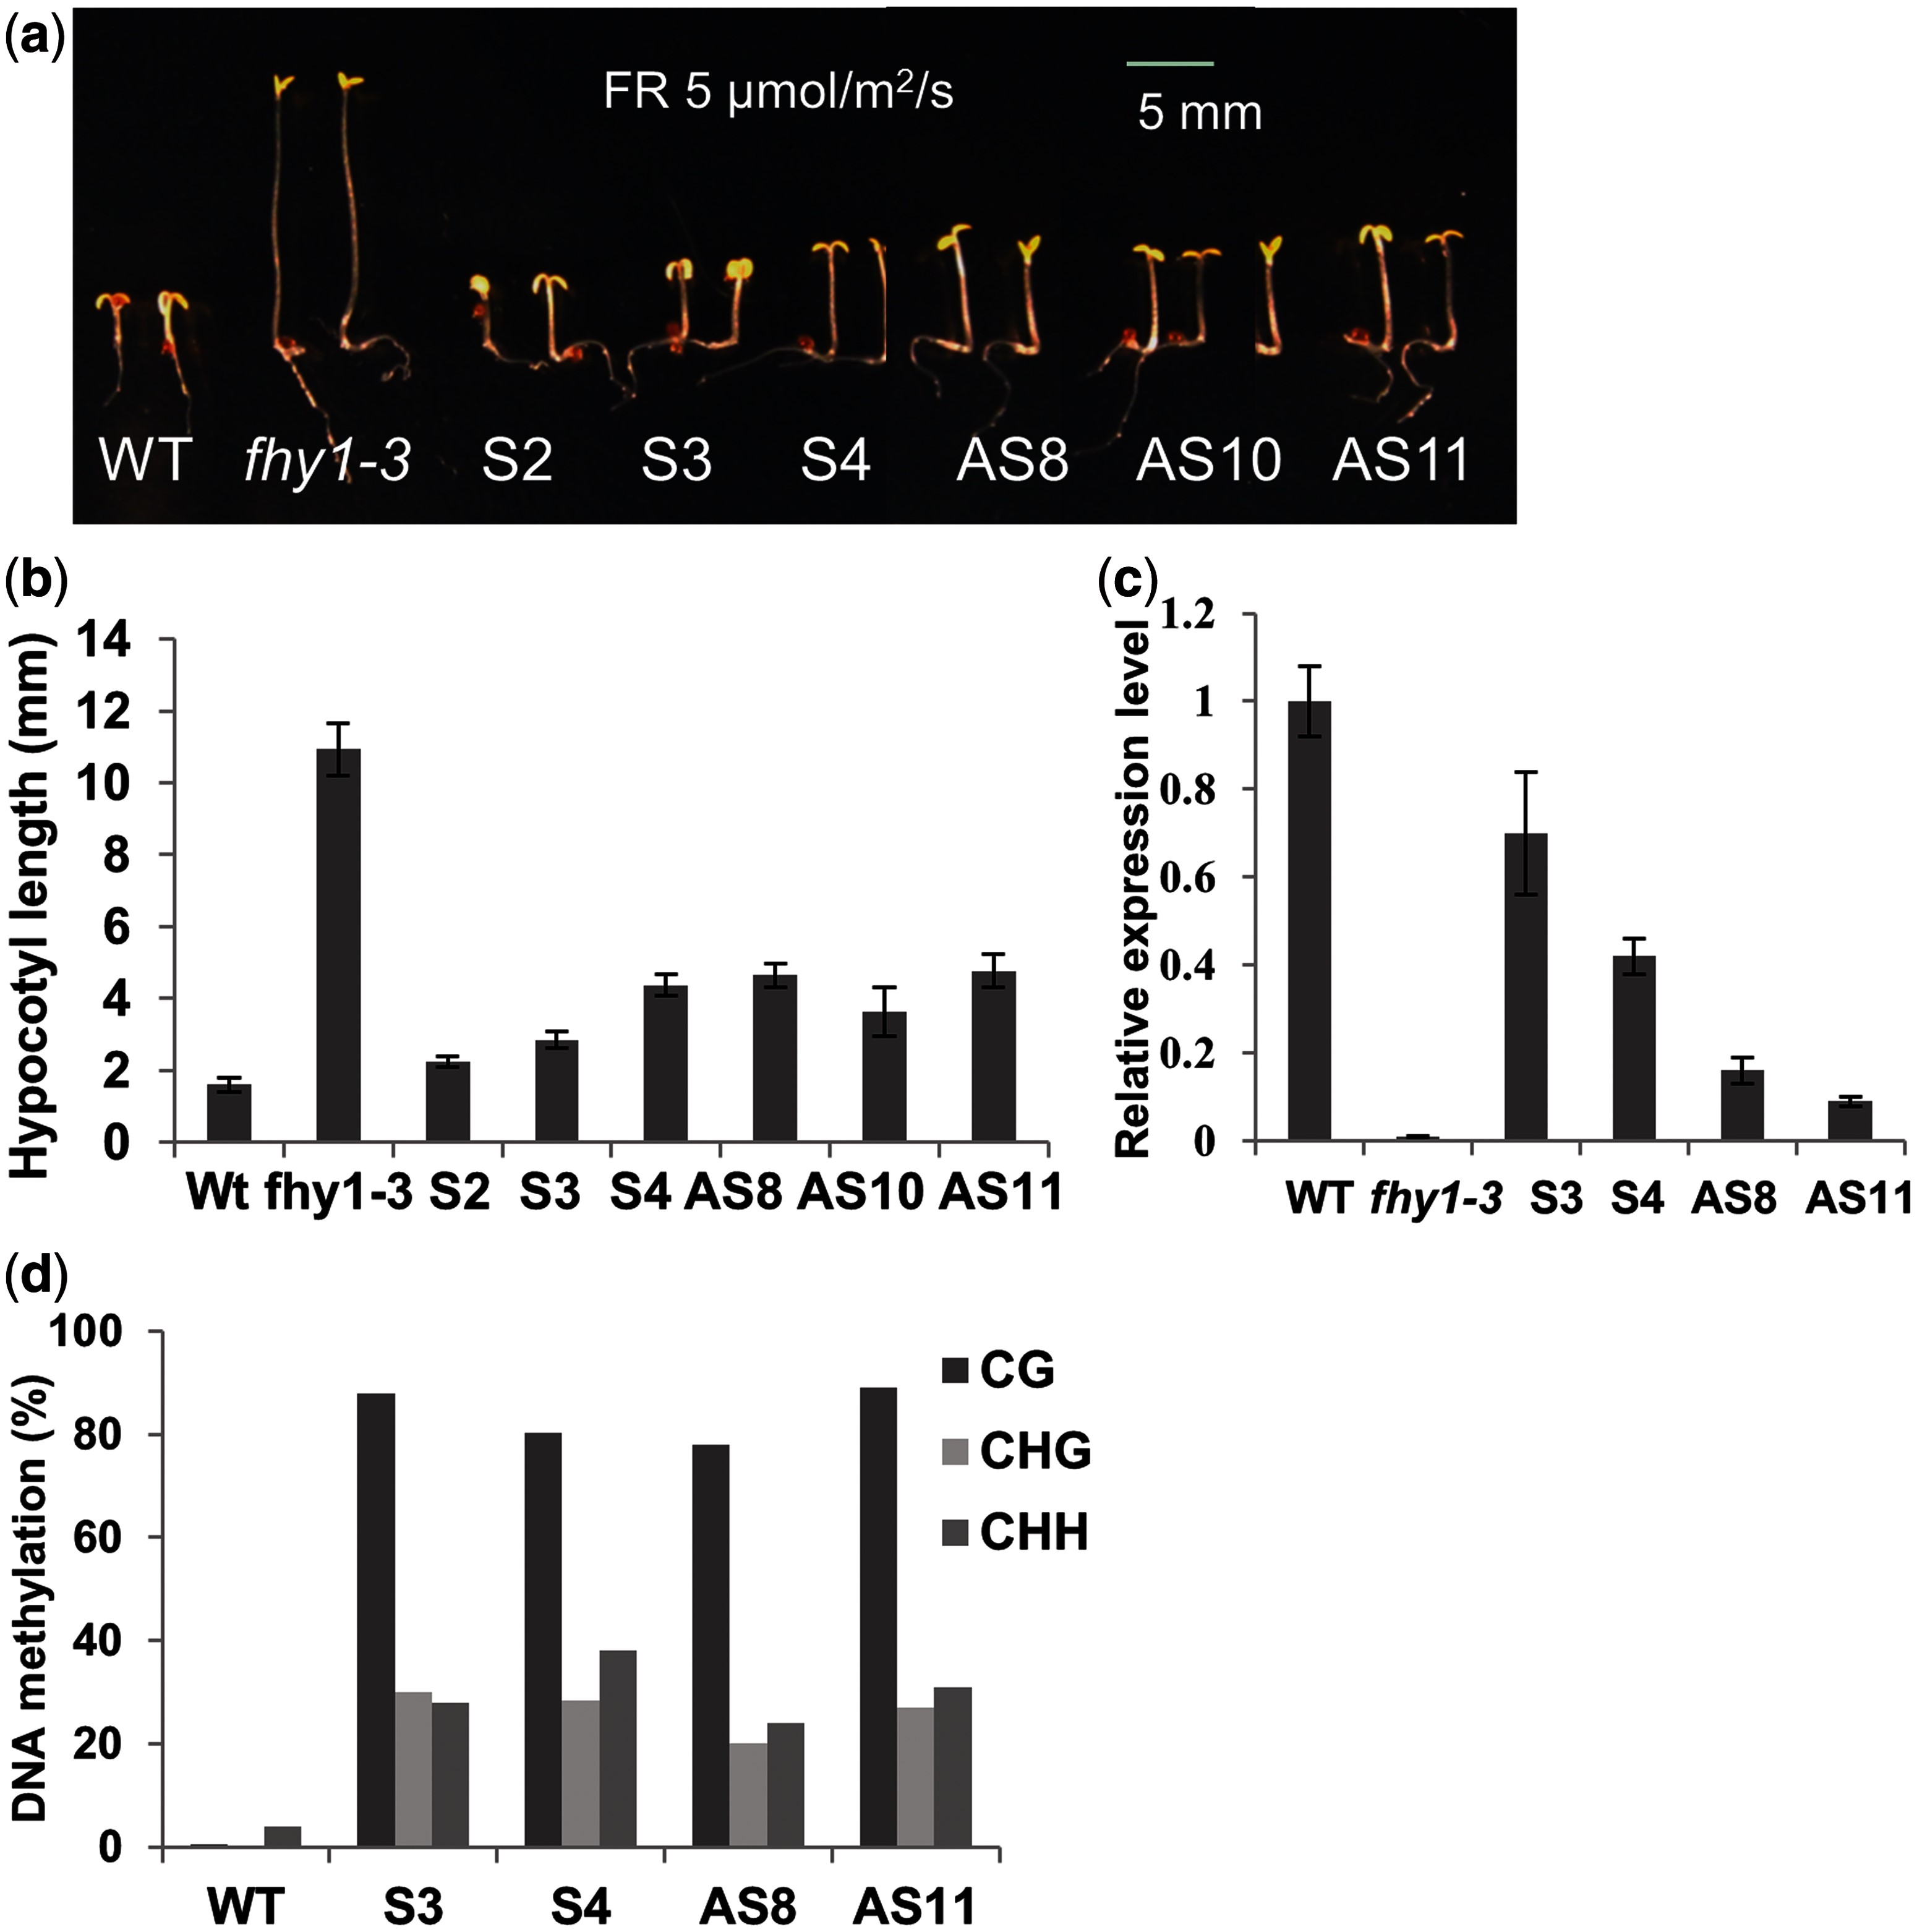
Fig. 7 The single-stranded FHY1 silencer targeting the FHY1 promoter can induce the fhy1 mutant phenotype. (a) ...
Notes:
Fig. 7 The single-stranded FHY1 silencer targeting the FHY1 promoter can induce the fhy1 mutant phenotype. (a) Hypocotyl lengths of S silencer lines (S3 and S4) and antisense silencer lines (AS8 and AS11) were greater than those of the wild type (WT, Col-0) under 5 µmol m−2 s−1 far red light (FR) treatment for 4 d. fhy1-3, an FHY1 loss-of-function mutant. Scale bar = 5 mm. (b) Hypocotyl lengths ± SD, n = 20. (c) Relative FHY1 transcript levels detected by qRT–PCR using gene-specific primers. Histograms show average values ± SD (n = 3 technical replicates).
Unless provided in the caption above, the following copyright applies to the content of this slide: © The Author 2014. Published by Oxford University Press on behalf of Japanese Society of Plant Physiologists. All rights reserved. For permissions, please email: journals.permissions@oup.com

