Slide 1
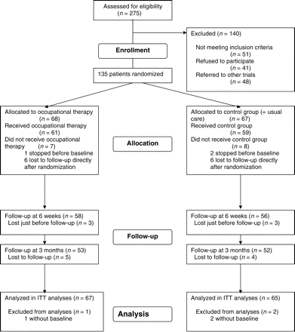
Figure 1. Trial profile. ITT = intention-to-treat
Notes:
Figure 1. Trial profile. ITT = intention-to-treat
Unless provided in the caption above, the following copyright applies to the content of this slide: Copyright 2007 by The Gerontological Society of America

Slide 2
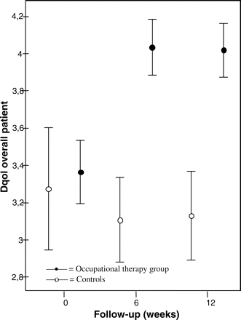
Figure 2. Means and 95% confidence intervals of Dementia Quality of Life Instrument (Dqol) overall patients at ...
Notes:
Figure 2. Means and 95% confidence intervals of Dementia Quality of Life Instrument (Dqol) overall patients at baseline, 6 weeks, and 12 weeks in occupational therapy group and control group
Unless provided in the caption above, the following copyright applies to the content of this slide: Copyright 2007 by The Gerontological Society of America

Slide 3
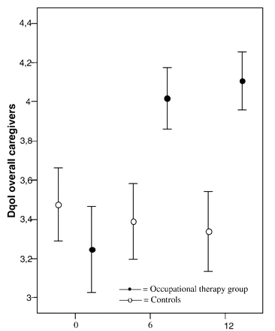
Figure 3. Means and 95% confidence intervals of Dementia Quality of Life Instrument (Dqol) overall caregivers at ...
Notes:
Figure 3. Means and 95% confidence intervals of Dementia Quality of Life Instrument (Dqol) overall caregivers at baseline, 6 weeks, and 12 weeks in occupational therapy group and control group
Unless provided in the caption above, the following copyright applies to the content of this slide: Copyright 2007 by The Gerontological Society of America

