Slide 1
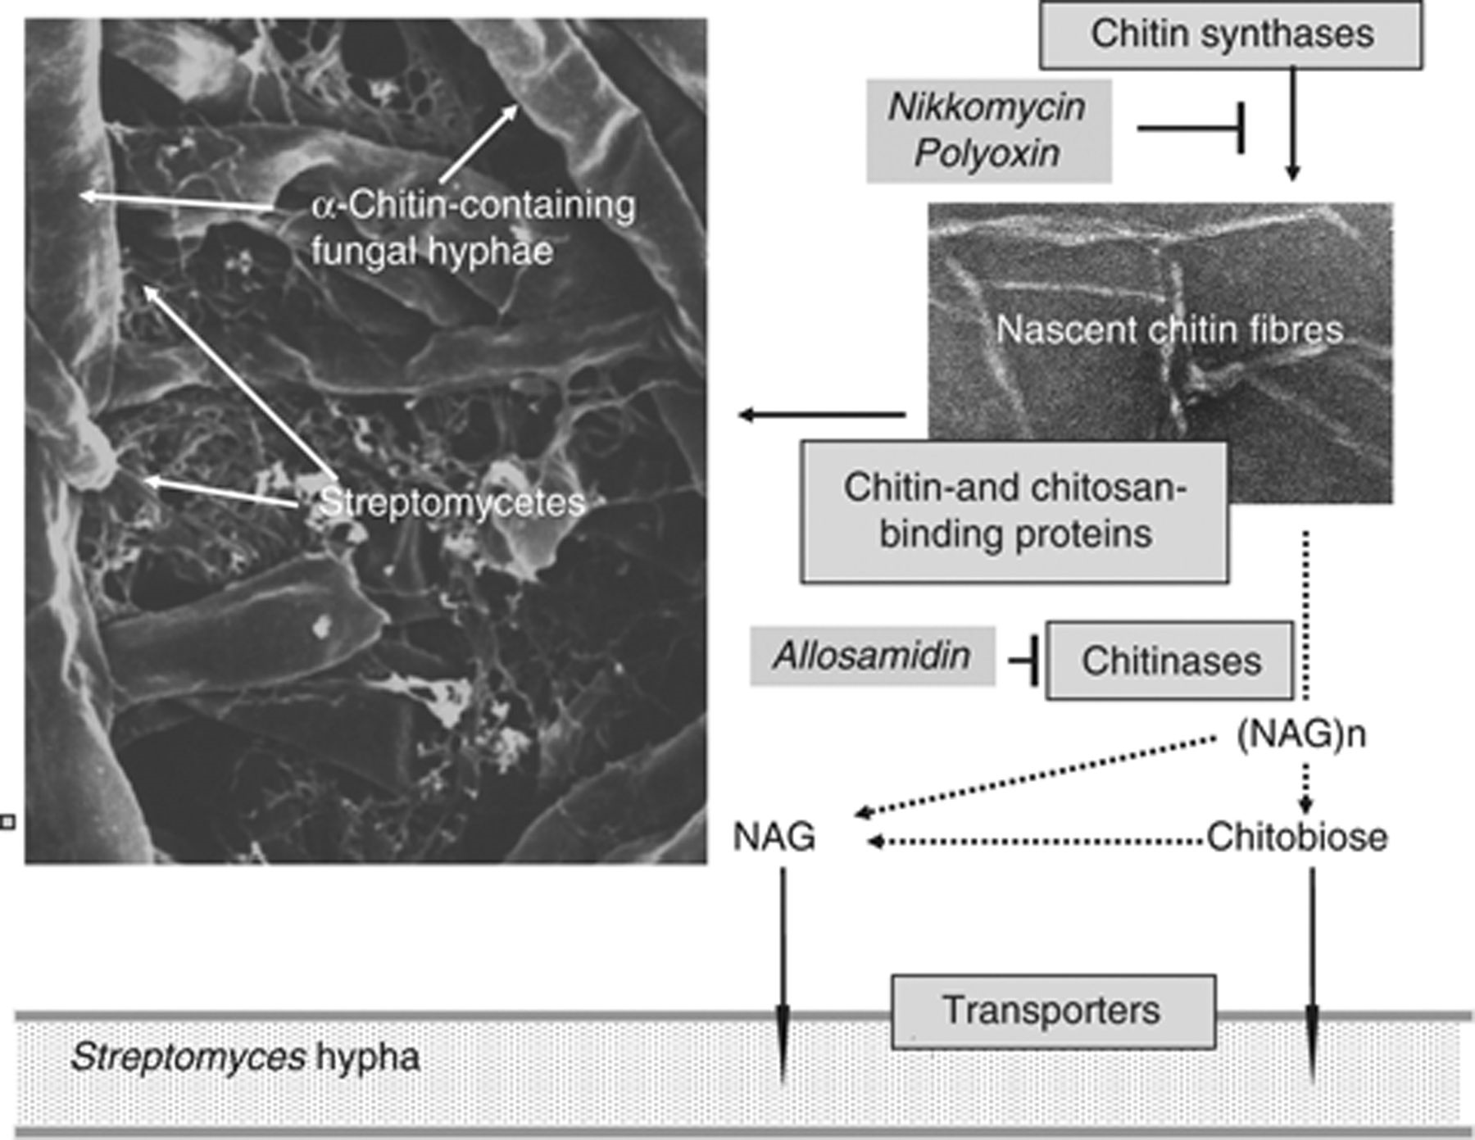
Figure 1 Survey of the chitinolytic system. Some streptomycetes produce nikkomycin or polyoxin (right, top), which ...
Notes:
Figure 1 Survey of the chitinolytic system. Some streptomycetes produce nikkomycin or polyoxin (right, top), which inhibit chitin synthases from fungi and other chitin-producing organisms. With a range of binding proteins, streptomycetes target chitin or chitosan, or organisms containing these polysaccharides. This process can lead to a close interaction between Streptomyces and fungal hyphae (left, top). Streptomycetes produce a range of chitinases, and those belonging to family 18 are inhibited by allosamidin. As a result of chitin degradation by chitinases (right), chito-oligomers (NAG)n, chitobiose (N,N′-diacetylchitobiose) or NAG arise. In Streptomyces olivaceoviridis NAG is taken up either via a specific PTS transport system or via the ABC transporter Ngc (in cooperation with the ATP-binding protein MsiK), which also transports chitobiose. In Streptomyces coelicolor, the ABC transporter Das is required only for the uptake of chitobiose.
Unless provided in the caption above, the following copyright applies to the content of this slide: © 2010 Federation of European Microbiological Societies.

Slide 2
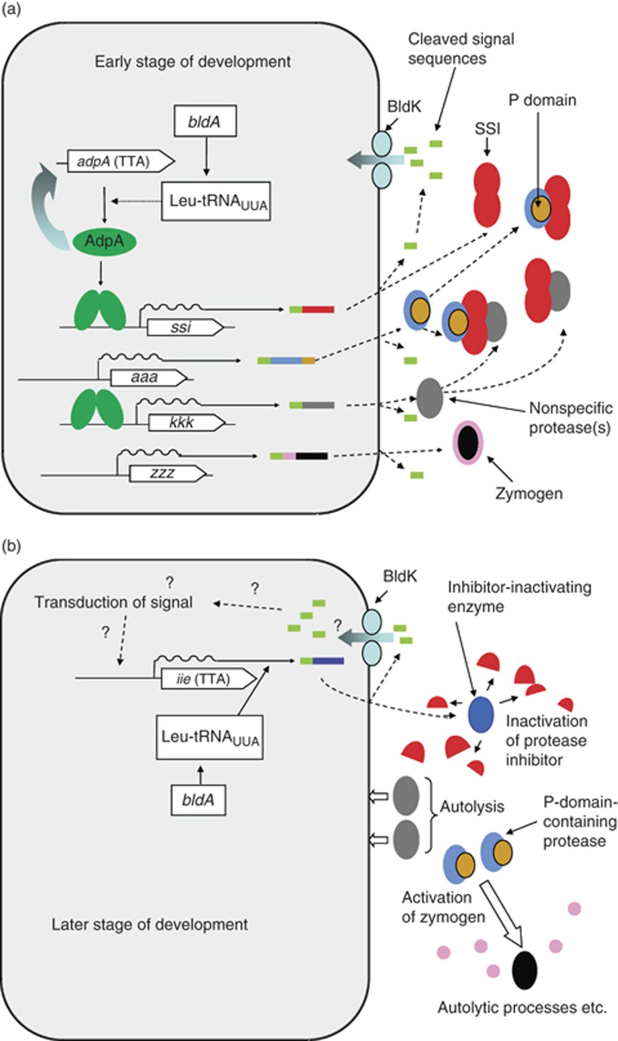
Figure 2 General model of an extracellular protease cascade that contributes to Streptomyces development. (a) The ...
Notes:
Figure 2 General model of an extracellular protease cascade that contributes to Streptomyces development. (a) The cascade held in check late in the main growth phase. Inside the hyphae various genes such as ssi, aaa, kkk and zzz are activated, some (e.g. ssi and kkk) by the action of AdpA (bright green), which depends on the UUA-reading tRNA specified by bldA and is autoactivating. Secretion of the gene products results in the release of signal peptides (leaf-green). SSI (red) dimerizes to form a two-headed protease inhibitor, which binds the P-domain (ochre) of certain proteases as well as some other proteases (grey) to hold them inactive. As long as the P-domain-containing protease is inactive, the prosequence (pink) of zymogens is uncleaved, and the zymogens therefore remain inactive. (b) Release of the cascade in stationary phase, activating autolysis. An inhibitor-inactivating enzyme (IIE, bright blue) is secreted (in Streptomyces coelicolor, the production of IIE requires the translation of a UUA codon). We speculate that induction of IIE may depend on the uptake of some specific oligopeptide by the BldK oligopeptide transporter, and that this oligopeptide (leaf-green) may be derived from the secretion signal sequence of a component of the protease cascade. The IIE inactivates SSI, thereby releasing the bound proteases. The nonspecific protease participates in a general manner in autolysis, while the P-domain-containing protease activates zymogens to yield enzymes (black) that play more specific developmental or autolytic roles, such as transglutaminases of some species.
Unless provided in the caption above, the following copyright applies to the content of this slide: © 2010 Federation of European Microbiological Societies.

Slide 3
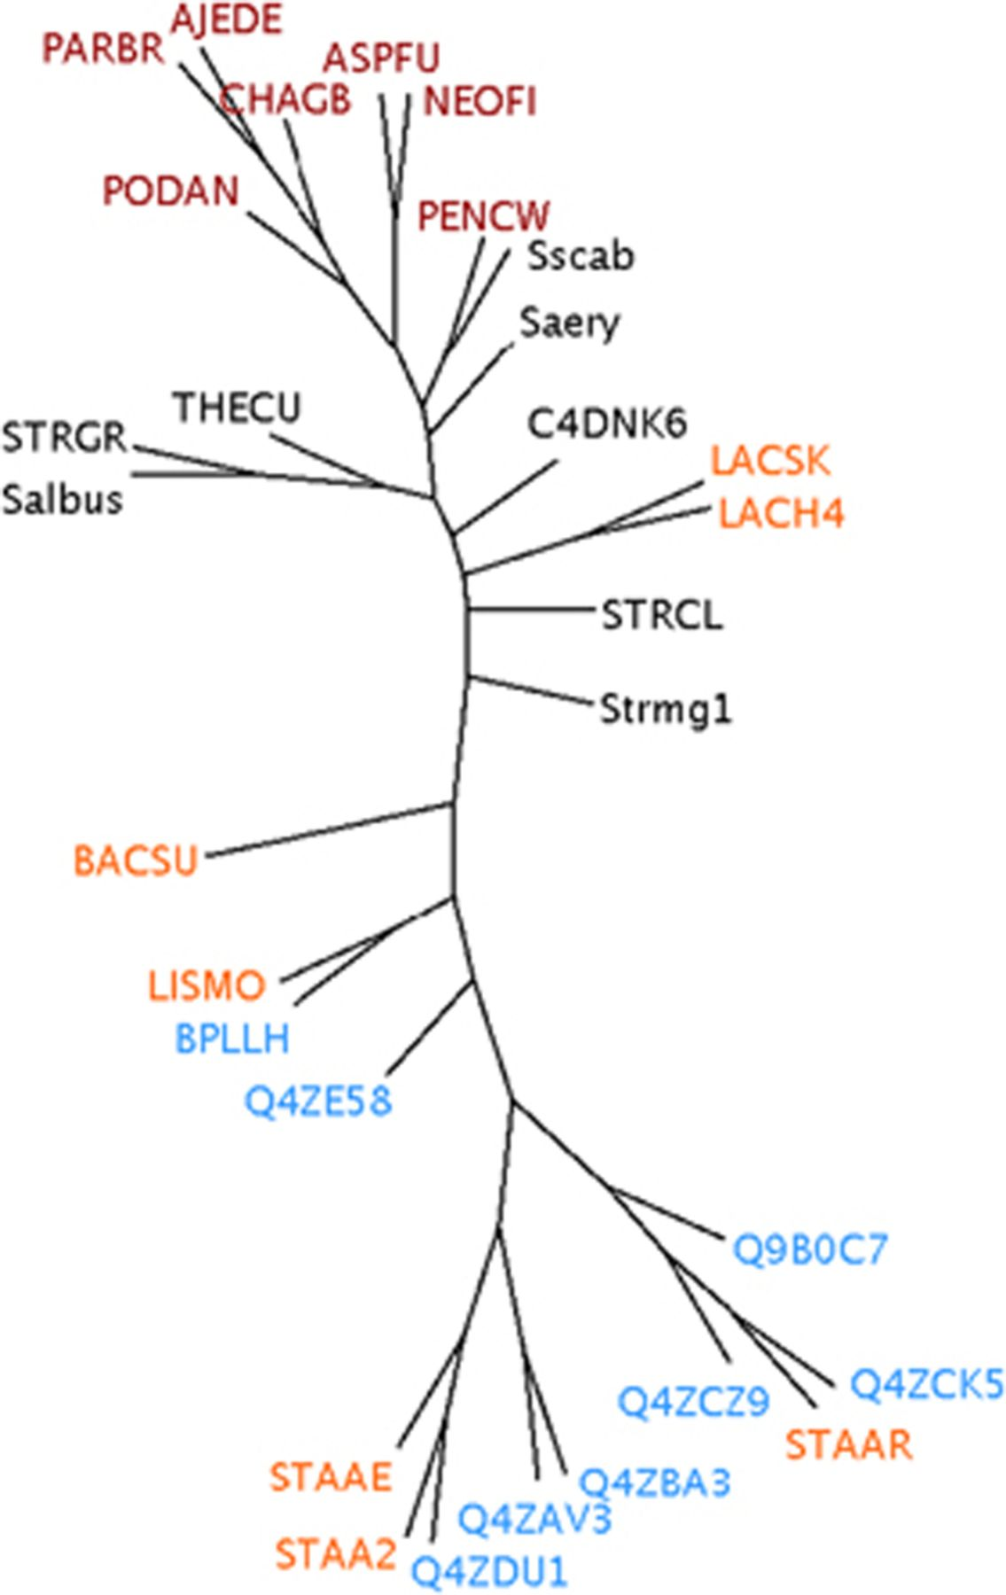
Figure 3 Phylogenetic tree of proteins related to factor C. The sources of the proteins are colour-coded as follows: ...
Notes:
Figure 3 Phylogenetic tree of proteins related to factor C. The sources of the proteins are colour-coded as follows: black, streptomycetes and other mycelial actinomycetes; dark red, mycelial fungi; blue, phages of Firmicutes; light red, firmicute bacteria. The factor C protein sequences from different species were selected to be representative of a larger collection. The Bacillus subtilis‘TagC’ protein was used as the outgroup in phylogenetic analysis. The protein sequences were aligned using the program t-coffee with default settings (Notredame et al., 2000). Tools from the phylip package version 3.67 (Felsenstein et al., 1989, 2005) were used for various phylogenetic tasks (all tools were used with their default settings): seqboot, for bootstrapping the alignment into 100 datasets; protdist, to calculate distances between sequences; neighbor, to calculate trees from the distance data; consense, to arrive at a consensus tree from the trees produced by neighbor. A dendroscope (Huson et al., 2007) was used to view the consensus tree in different ways. Key: Fungi: AJEDE, Ajellomyces dermatitidis; ASPFU, Aspergillus fumigatus; CHAGB, Chaetomium globosum; NEOFI, Neosartorya fischeri; PARBR, Paracoccidioides brasiliensis; PENCW, Penicillium chrysogenum; PODAN, Podospora anserina. Firmicutes: BACSU, B. subtilis; LACH4, Lactobacillus helveticus Helveticin; LACSK, Lactobacillus sakei ssp. carnosus Helveticin; LISMO, Listeria monocytogenes; Staphylococcus aureus strains: STAAE, strain Newman; STAA2, strain JH1; STAAR, strain MRSA252. Staphylococcus phages: Q4ZDU1, phage 69; Q4ZAV3, phage 52A; Q4ZBA3, phage 55; Q4ZCZ9, phage 42E; Q4ZCK5, phage 47; Q9BOC7, phage phiSLT; Q4ZE58, phage 66. Actinomycetes: Saery, Saccharopolyspora erythraea; Salbus, Streptomyces albus G; Sscab, Streptomyces scabies; STRGR, Streptomyces griseus; STRCL, Streptomyces clavuligerus; Strmg1, streptomyces_sp._mg1; THECU, Thermomonospora curvata DSM 43183.
Unless provided in the caption above, the following copyright applies to the content of this slide: © 2010 Federation of European Microbiological Societies.

Slide 4
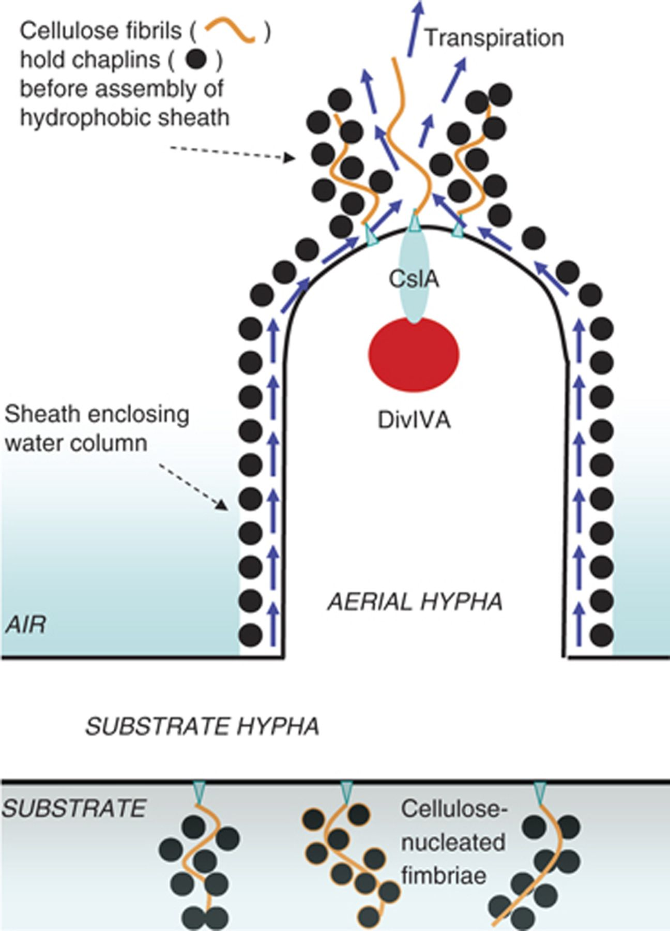
Figure 4 Roles of surface-active proteins in surface adherence of vegetative hyphae and growth of aerial hyphae. At ...
Notes:
Figure 4 Roles of surface-active proteins in surface adherence of vegetative hyphae and growth of aerial hyphae. At points of contact between substrate hyphae and a hydrophobic surface, cellulose fibrils (orange) are extruded and act as nucleators for the assembly of amyloid complexes of chaplins (black dots) to form fimbriae, which serve as attachment organelles (De Jong et al., 2009b). Cellulose fibrils are also extruded at aerial hyphal tips, where a complex of cellulose synthase (CslA, pale blue) with the polarity determinant DivIVA (dark red) is located (Li et al., 2007). Because the tip-located cellulose appears to help chaplins to form the hydrophobic sheath of aerial hyphae, the model tentatively assumes that this is via the formation of fimbria-related structures. Once formed, the hydrophilic inner face of the sheath is predicted to hold a water column (presumably largely a water-saturated cell wall) in a kind of periplasmic compartment. On the further assumption that the sheath is open at the growing tip, we speculate that the evaporation of water from the tip will bring about transpiration, and hence carry nutrients from the base to the upper parts of the aerial hypha, while maintaining hydration of the aerial hypha.
Unless provided in the caption above, the following copyright applies to the content of this slide: © 2010 Federation of European Microbiological Societies.

