Slide 1
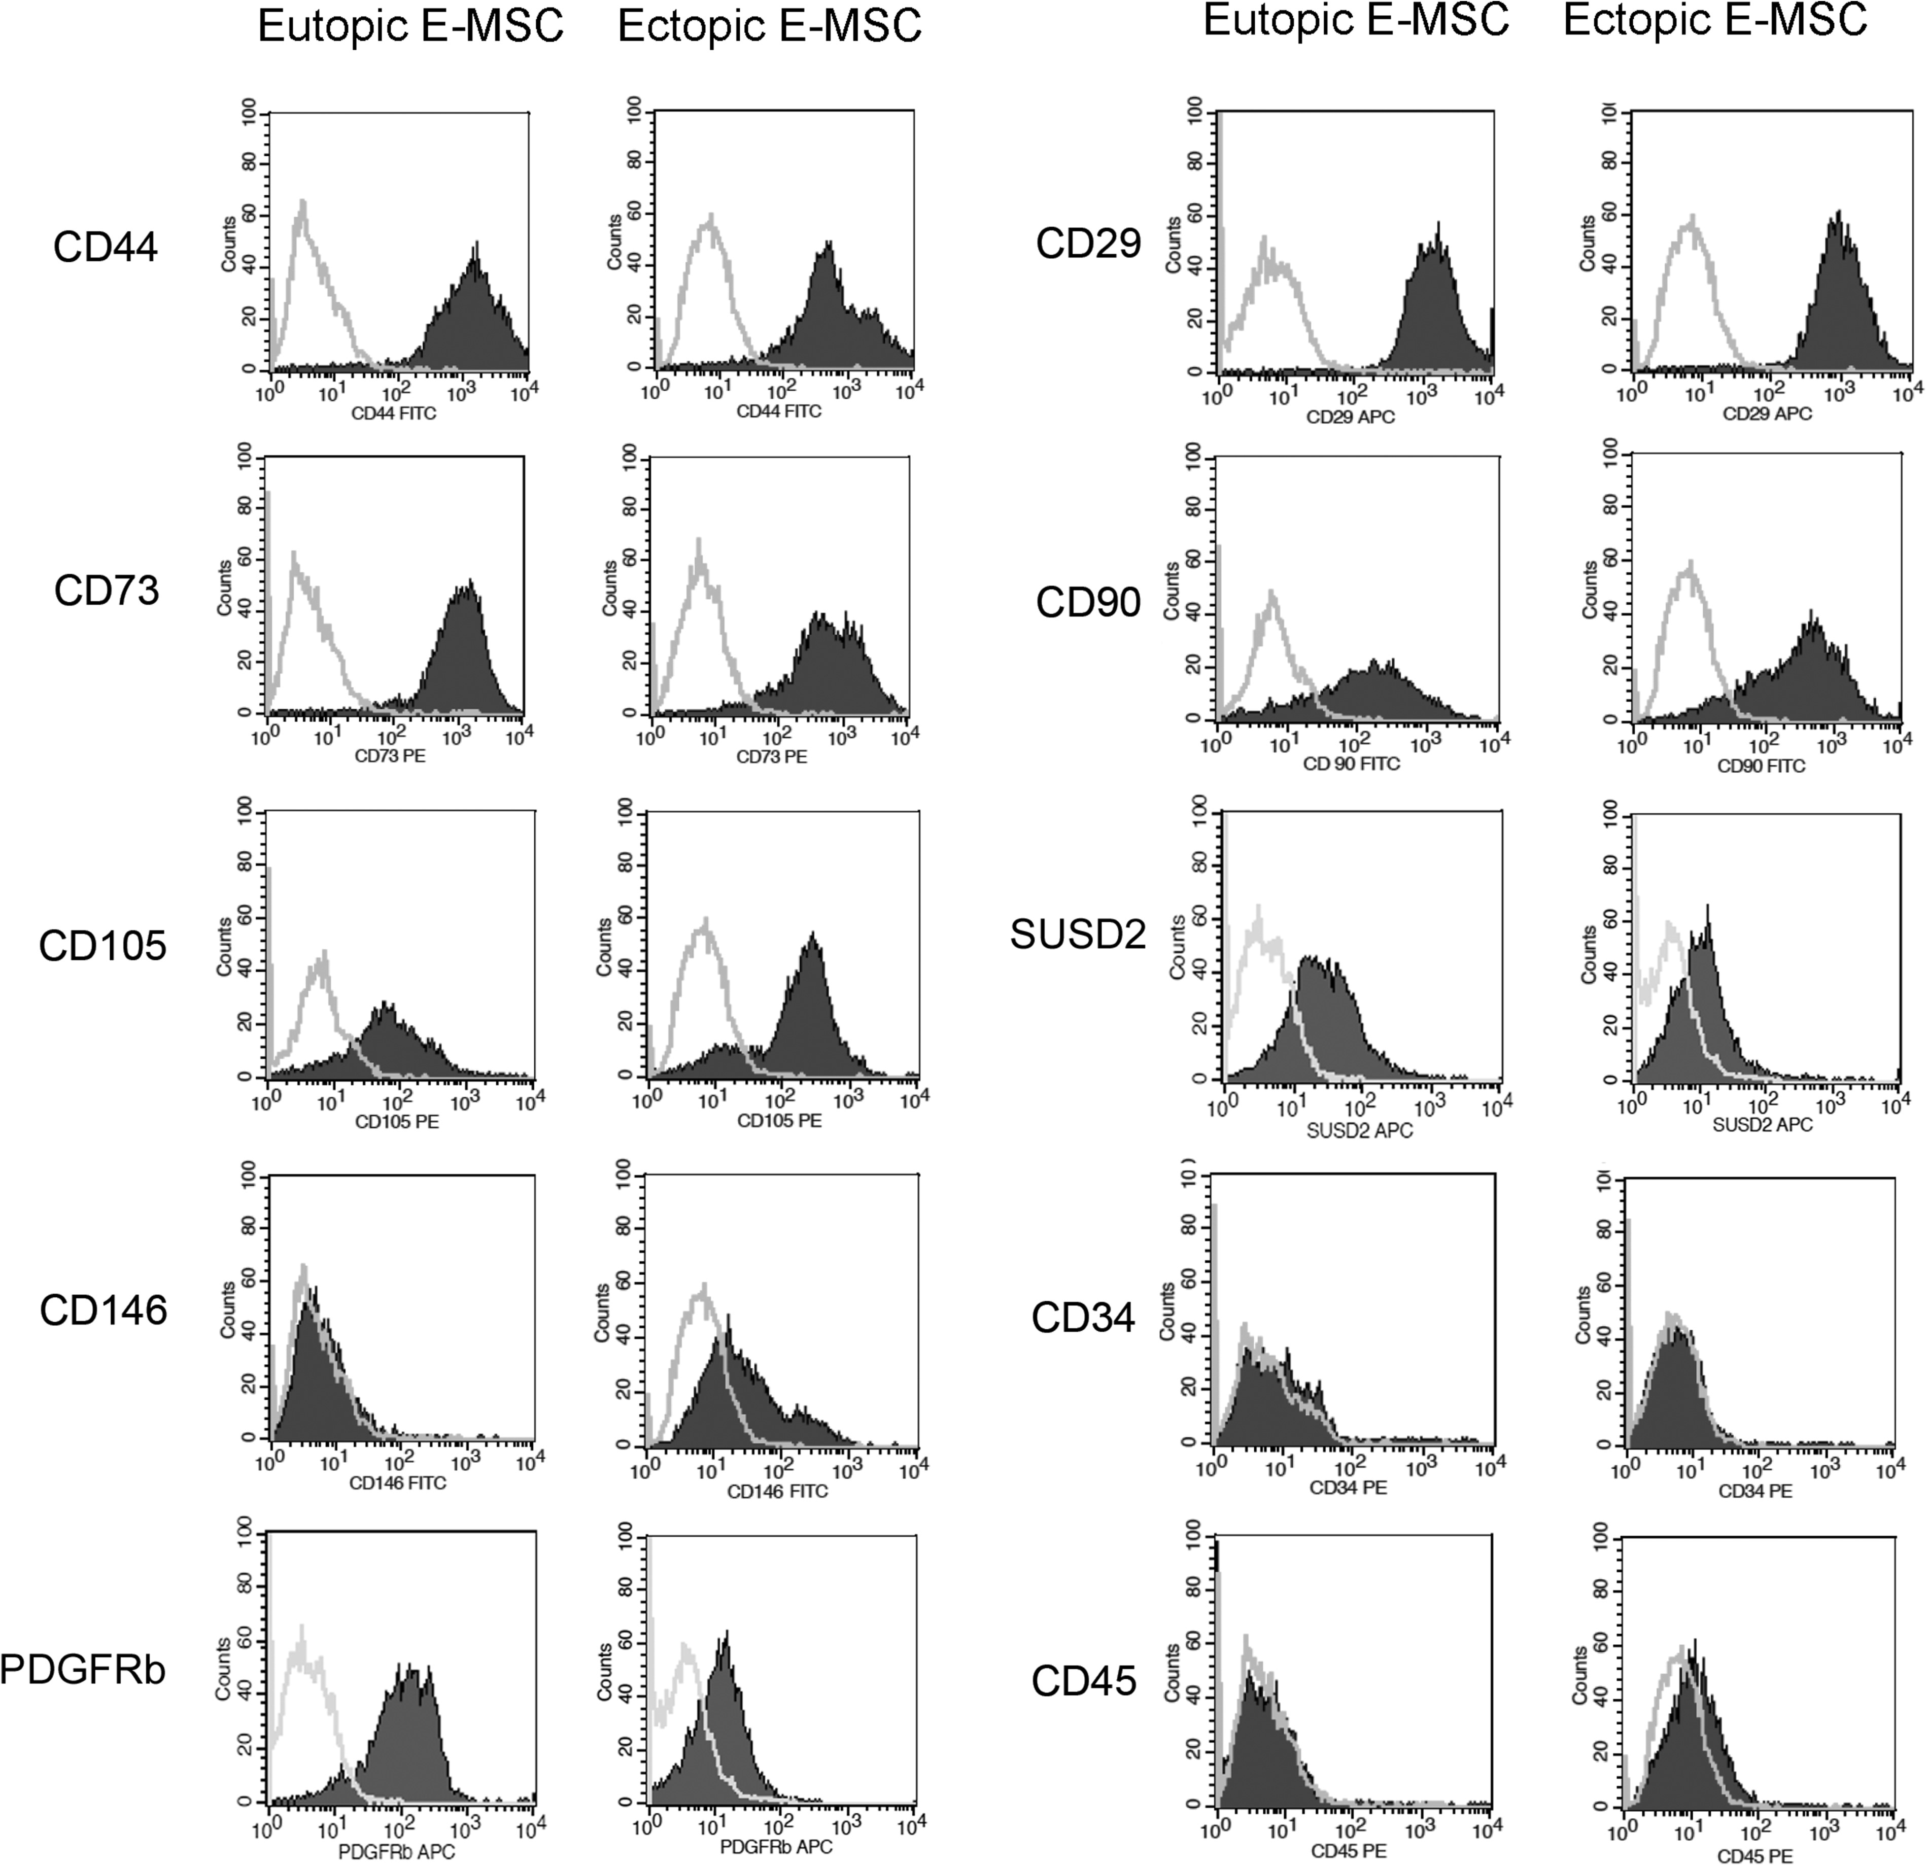
Figure 1 Expression of mesenchymal and hematopoietic markers by human eutopic and ectopic E-MSCs. Representative FACS ...
Notes:
Figure 1 Expression of mesenchymal and hematopoietic markers by human eutopic and ectopic E-MSCs. Representative FACS analysis of eutopic and ectopic endometrial mesenchymal stromal cells (E-MSCs) are shown. The filled area shows binding of the specific antibody, and the grey line shows the isotypic control. All ectopic and eutopic E-MSC lines, obtained from each patient (n = 9), were characterized and showed similar marker expression. The clinical characteristics of patients in a study in vitro of the angiogenic properties of endometrial mesenchymal stromal cells. Patient #Endometrial samplesAge (years)Previous pregnanciesAverage menstrual cycle length (days)Other diseases1Eutopic/Ectopic34No28No2Eutopic/Ectopic28No28–30No3Eutopic/Ectopic38One miscarriage at 8 weeks gestational age27No4Eutopic/Ectopic40One live birth28–30No5Eutopic/Ectopic25No25No6Eutopic/Ectopic32One miscarriage at 7 weeks gestational age28–30No7Eutopic/Ectopic34No28No8Eutopic/Ectopic29No28–30No9Eutopic/Ectopic41No28NoTable IICytofluorimetric evaluation of surface marker expression by eutopic and ectopic E-MSCs and HUVECs. Eutopic E-MSCs N = 9 (%)Ectopic E-MSCs N = 9 (%)HUVECs N = 3 (%)CD4497.0 ± 1.997.4 ± 2.072.4 ± 2.3CD7396.8 ± 3.294.9 ± 4.397.0 ± 0.4CD10577.8 ± 20.587.3 ± 10.395.7 ± 0.7CD1462.6 ± 3.323.0 ± 6.3*98.5 ± 1.3CD2999.0 ± 1.097.3 ± 2.099.7 ± 0.3CD9068.2 ± 21.086.7 ± 16.70.6 ± 0.1CD341.1 ± 0.82.7 ± 1.00.7 ± 0.2CD450.4 ± 0.30.5 ± 0.20.2 ± 0.1CD310.2 ± 0.10.5 ± 0.398.6 ± 1.0VEGFR21.7 ± 0.50.8 ± 0.580.6 ± 9.6Tie20.9 ± 0.21.3 ± 0.39.8 ± 0.1Ve-Cadherin0.2 ± 0.21.0 ± 0.386.9 ± 2.3SUSD256.1 ± 7.343.3 ± 9.71.7 ± 0.2PDGFRb71.1 ± 6.952.8 ± 13.01.6 ± 2.3EPCAM0.2 ± 0.10.5 ± 0.20.8 ± 0.2E-MSCs, endometrial mesenchymal stromal cells; HUVECs, human umbilical vein endothelial cells; VEGFR2, vascular endothelial growth factor receptor 2; Tie2, TEK receptor tyrosine kinase; Ve-Cadherin, vascular endothelial Cadherin; SUSD2, sushi domain containing 2; PDGFRb, platelet-derived growth factor receptor beta; EPCAM, epithelial cell adhesion molecule. Quantitative expression of mesenchymal, hematopoietic and endothelial markers assessed by FACS analysis. Values represent the percentage of positive cells and are expressed as mean ± SD of all nine lines used in the study of eutopic and ectopic E-MSCs. Three different HUVEC cell lines were tested as the control. *P < 0.001 ectopic versus eutopic E-MSCs (Wilcoxon test).
Unless provided in the caption above, the following copyright applies to the content of this slide: © The Author 2017. Published by Oxford University Press on behalf of the European Society of Human Reproduction and Embryology. All rights reserved. For Permissions, please email: journals.permissions@oup.com

Slide 2
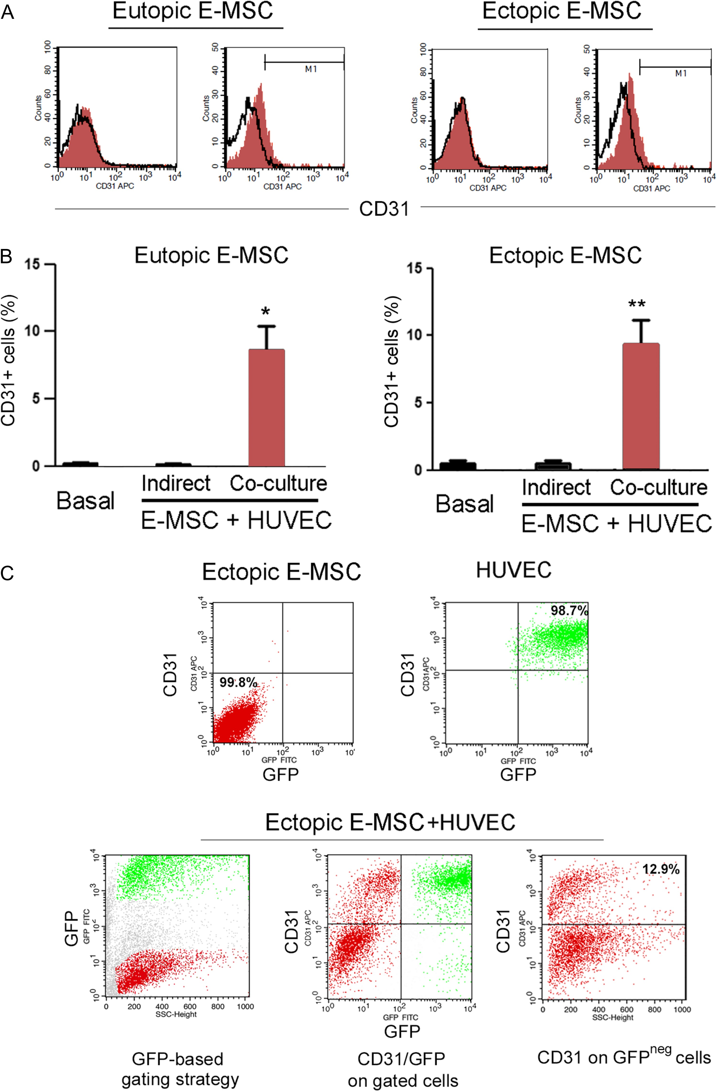
Figure 2 Characterization of CD31 acquisition after endothelial differentiating conditions. Human eutopic and ectopic ...
Notes:
Figure 2 Characterization of CD31 acquisition after endothelial differentiating conditions. Human eutopic and ectopic E-MSCs were cultured for 14 days in in vitro endothelial differentiation medium (A), or were cultured with human umbilical vein endothelial cells (HUVECs) in indirect culture setting (Indirect), or in direct cell-to-cell contact (Co-culture) (B). (A) Representative FACS analysis showing the acquirement of CD31 expression (red filled area) by eutopic and ectopic E-MSCs after 14 days incubation in endothelial differentiation medium. The black line is the isotypic control. (B) Percentage of CD31 expressing cells by E-MSCs in indirect culture with HUVECs and of green fluorescent protein (GFP)neg E-MSCs in co-culture conditions with HUVECs. Data are the mean ± SD of four independent experiments. *P < 0.05; **P < 0.001 versus Basal (Wilcoxon test). (C) Upper panels are the representative two-colour flow cytometry traces of CD31 and GFP expression by ectopic E-MSCs (red, 99.8% GFPneg/CD31neg) and HUVECs (green, 98.7% GFP+/CD31+). Lower panels show the gating strategy of cells in co-culture: gates were performed on the GFPneg cell population (red) and GFP+ population (green), and the expression of CD31 was evaluated in the GFPneg gate only to avoid contamination of the GFP+/CD31+ cell population.
Unless provided in the caption above, the following copyright applies to the content of this slide: © The Author 2017. Published by Oxford University Press on behalf of the European Society of Human Reproduction and Embryology. All rights reserved. For Permissions, please email: journals.permissions@oup.com

Slide 3
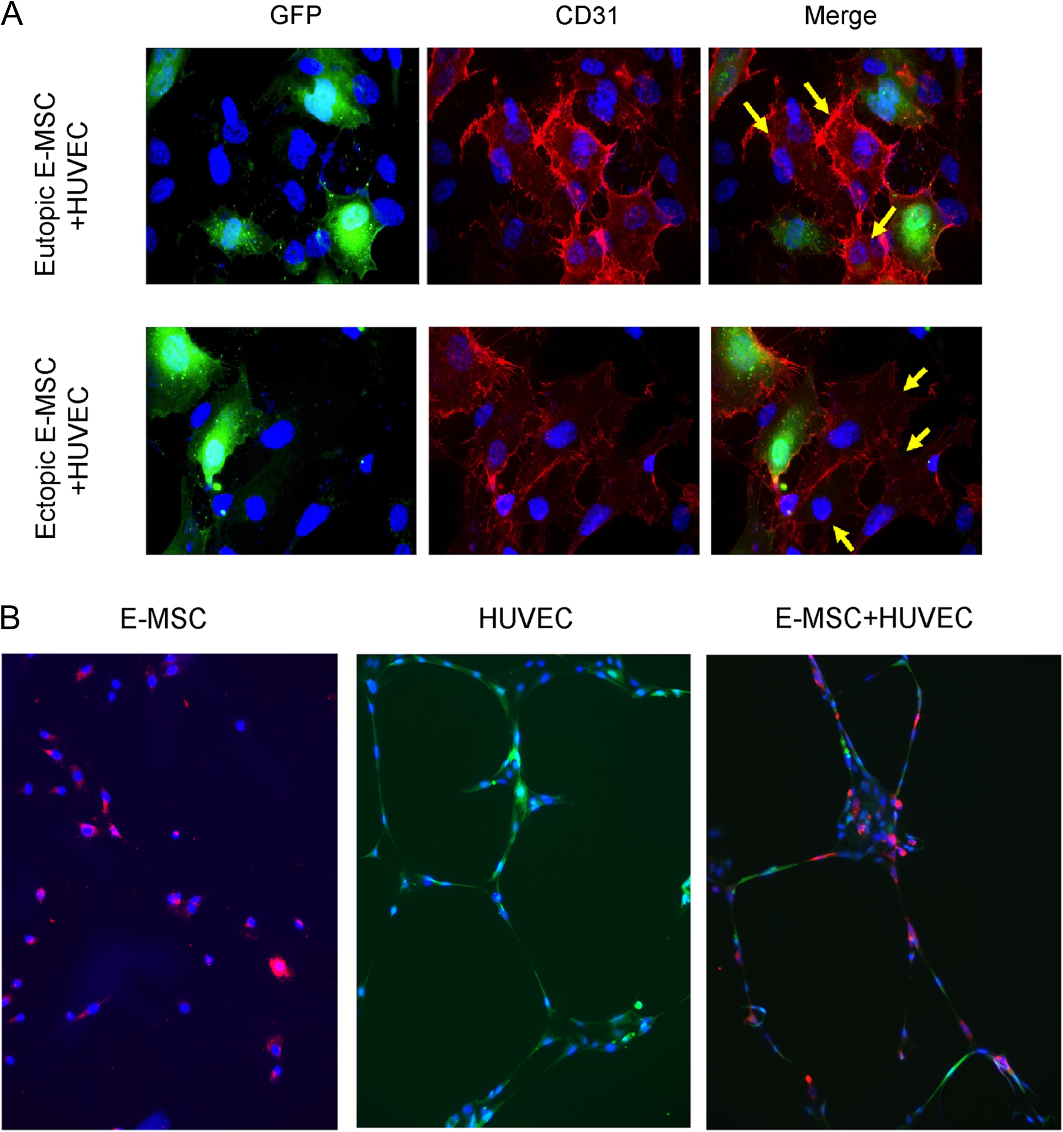
Figure 3 Endothelial differentiation and tubular-like organization of human E-MSCs after co-culture with HUVECs. (A) ...
Notes:
Figure 3 Endothelial differentiation and tubular-like organization of human E-MSCs after co-culture with HUVECs. (A) Representative immunofluorescence images showing CD31 expression (red) by GFP+ HUVEC cells and GFP negative E-MSCs 48 h after direct co-culture. In merged pictures GFPneg/CD31+cells are indicated by yellow arrows. (B) Representative micrographs of the tubular-like networks formed by ectopic E-MSCs (red), HUVEC cells (green) or co-cultured cells. When co-cultured with HUVECs, E-MSCs functionally organized within the elongated structures formed by HUVECs. Nuclei were stained with Hoechst dye 33 258. Three experiments were performed with similar results. Original magnification: (A) ×400, (B) ×200.
Unless provided in the caption above, the following copyright applies to the content of this slide: © The Author 2017. Published by Oxford University Press on behalf of the European Society of Human Reproduction and Embryology. All rights reserved. For Permissions, please email: journals.permissions@oup.com

Slide 4
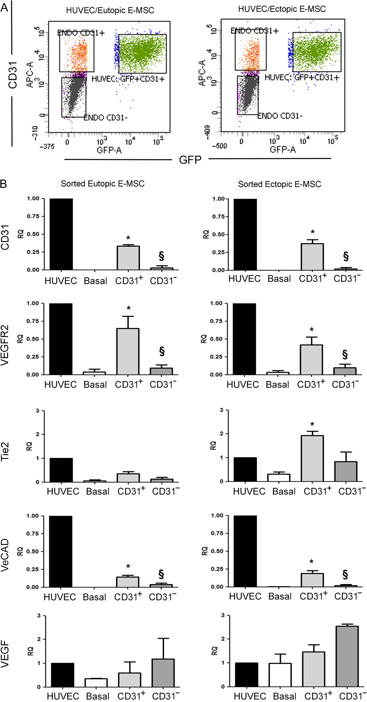
Figure 4 Isolation and characterization of human endothelial differentiated CD31⁺ E-MSCs. (A) ...
Notes:
Figure 4 Isolation and characterization of human endothelial differentiated CD31+ E-MSCs. (A) Representative dot plots showing flow cytometric analysis of direct co-culture experiments in which three cell populations were sorted: GFP+/CD31+ HUVECs, GFPneg/CD31+E-MSCs and GFPneg/CD31neg E-MSCs. (B) Quantitative RT-PCR analysis showing the expression of endothelial markers CD31, vascular endothelial growth factor receptor 2 (VEGFR2), TEK receptor tyrosine kinase (Tie2), vascular endothelial Cadherin (Ve-Cadherin) and vascular endothelial growth factor (VEGF) in E-MSCs (basal), and in sorted GFP neg/CD31+ and GFP neg/CD31neg E-MSCs after direct co-culture with HUVECs. HUVECs were used as positive control. Data were normalized to TATA binding protein (TBP) mRNA and to 1 for HUVECs and expressed as relative quantification (RQ). Data are mean ± SD of four different cell lines. *P < 0.05 Basal versus CD31+; §P < 0.05 CD31+ versus CD31− (Kruskal–Wallis test).
Unless provided in the caption above, the following copyright applies to the content of this slide: © The Author 2017. Published by Oxford University Press on behalf of the European Society of Human Reproduction and Embryology. All rights reserved. For Permissions, please email: journals.permissions@oup.com

Slide 5
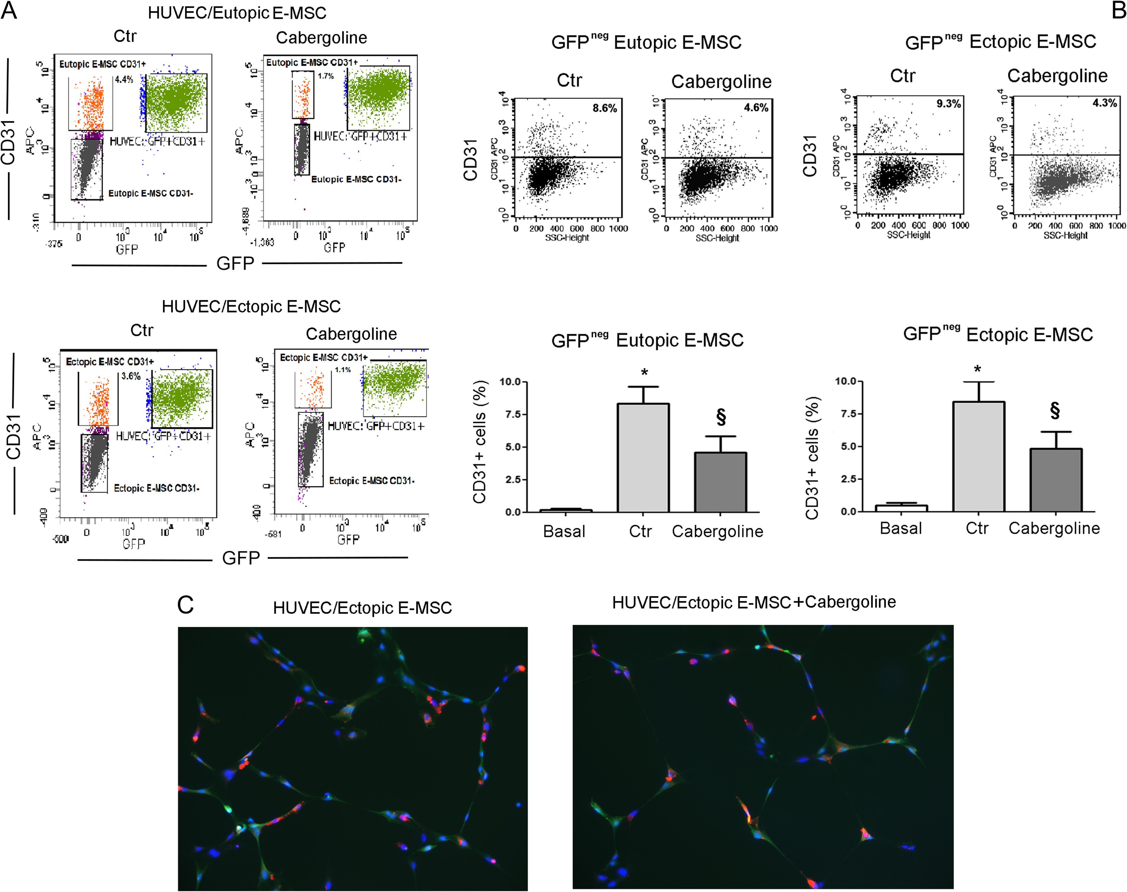
Figure 5 Effect of Cabergoline treatment on endothelial differentiation of E-MSCs. The anti-angiogenic agent ...
Notes:
Figure 5 Effect of Cabergoline treatment on endothelial differentiation of E-MSCs. The anti-angiogenic agent Cabergoline was added to the 48 h co-culture experiments of E-MSCs and HUVECs. (A and B) Representative dot plots and quantification of the CD31+ cells analyzed by cytofluorimetric analysis in the GFP+ HUVECs and GFPneg E-MSCs. Data are mean ± SD of four different cell lines. *P < 0.05 Basal versus Ctr; §P < 0.05 Ctr versus Cabergoline (Wilcoxon test). (C) Representative micrographs of the tubular-like networks formed by co-cultured ectopic E-MSCs (red) and HUVECs (green) in the absence or presence of Cabergoline. No difference was observed. Nuclei were stained with Hoechst dye 33 258. Three experiments were performed with similar results. Original magnification: ×200.
Unless provided in the caption above, the following copyright applies to the content of this slide: © The Author 2017. Published by Oxford University Press on behalf of the European Society of Human Reproduction and Embryology. All rights reserved. For Permissions, please email: journals.permissions@oup.com

