Slide 1
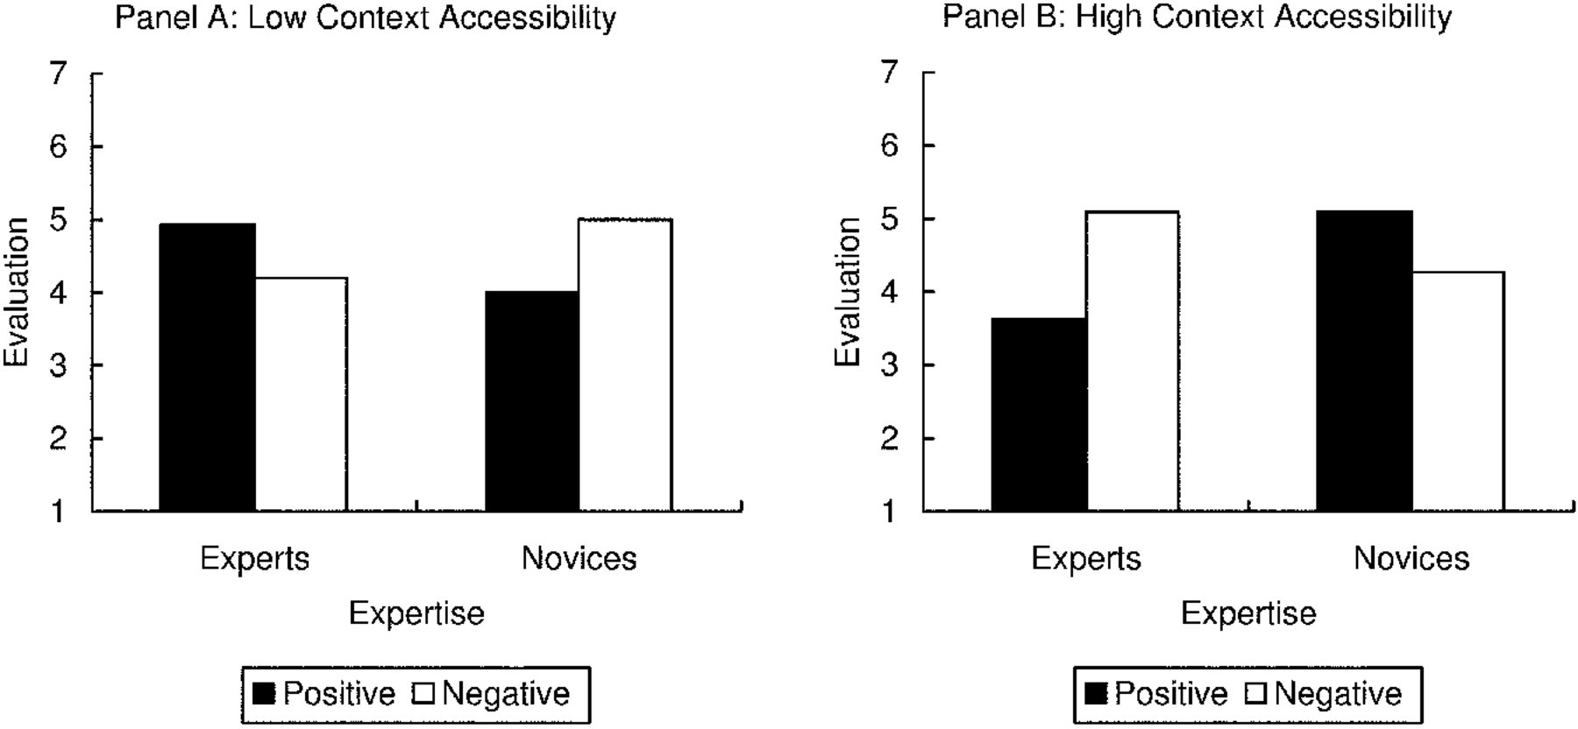
Figure 1 Target Brand Evaluation for Study 1
Notes:
Figure 1 Target Brand Evaluation for Study 1
Unless provided in the caption above, the following copyright applies to the content of this slide: © 2008 by JOURNAL OF CONSUMER RESEARCH, Inc.

Slide 2
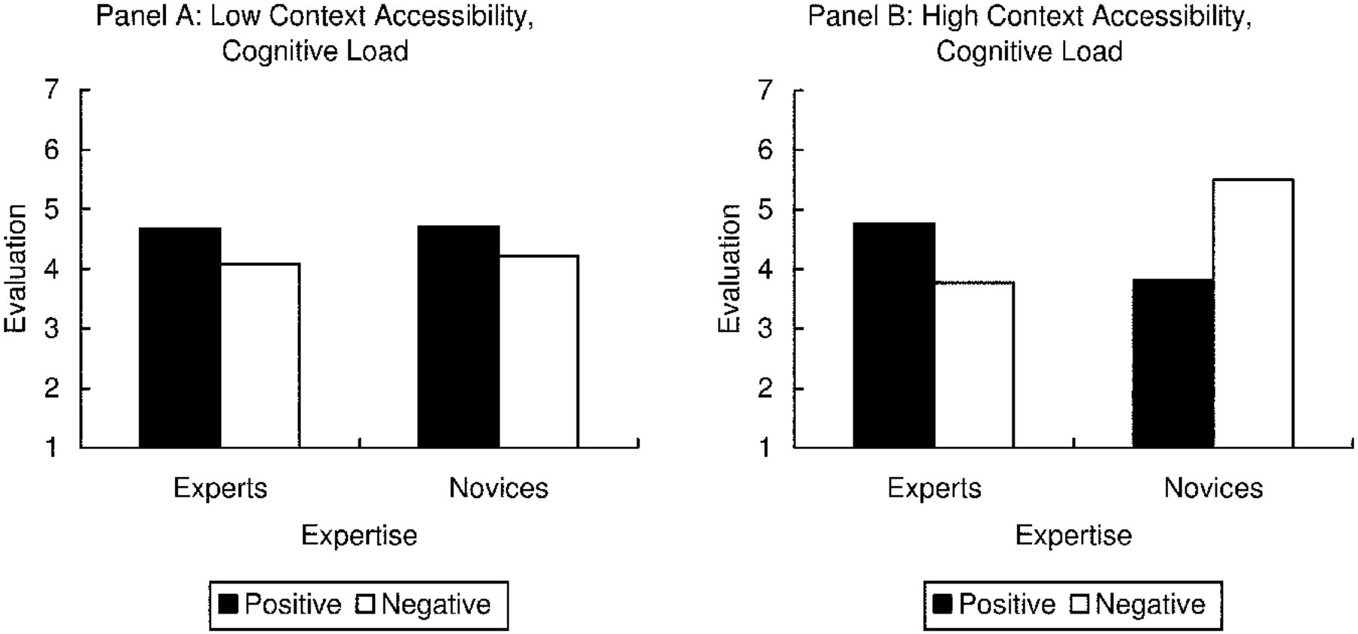
Figure 2 Target Brand Evaluation for Study 2
Notes:
Figure 2 Target Brand Evaluation for Study 2
Unless provided in the caption above, the following copyright applies to the content of this slide: © 2008 by JOURNAL OF CONSUMER RESEARCH, Inc.

