Slide 1
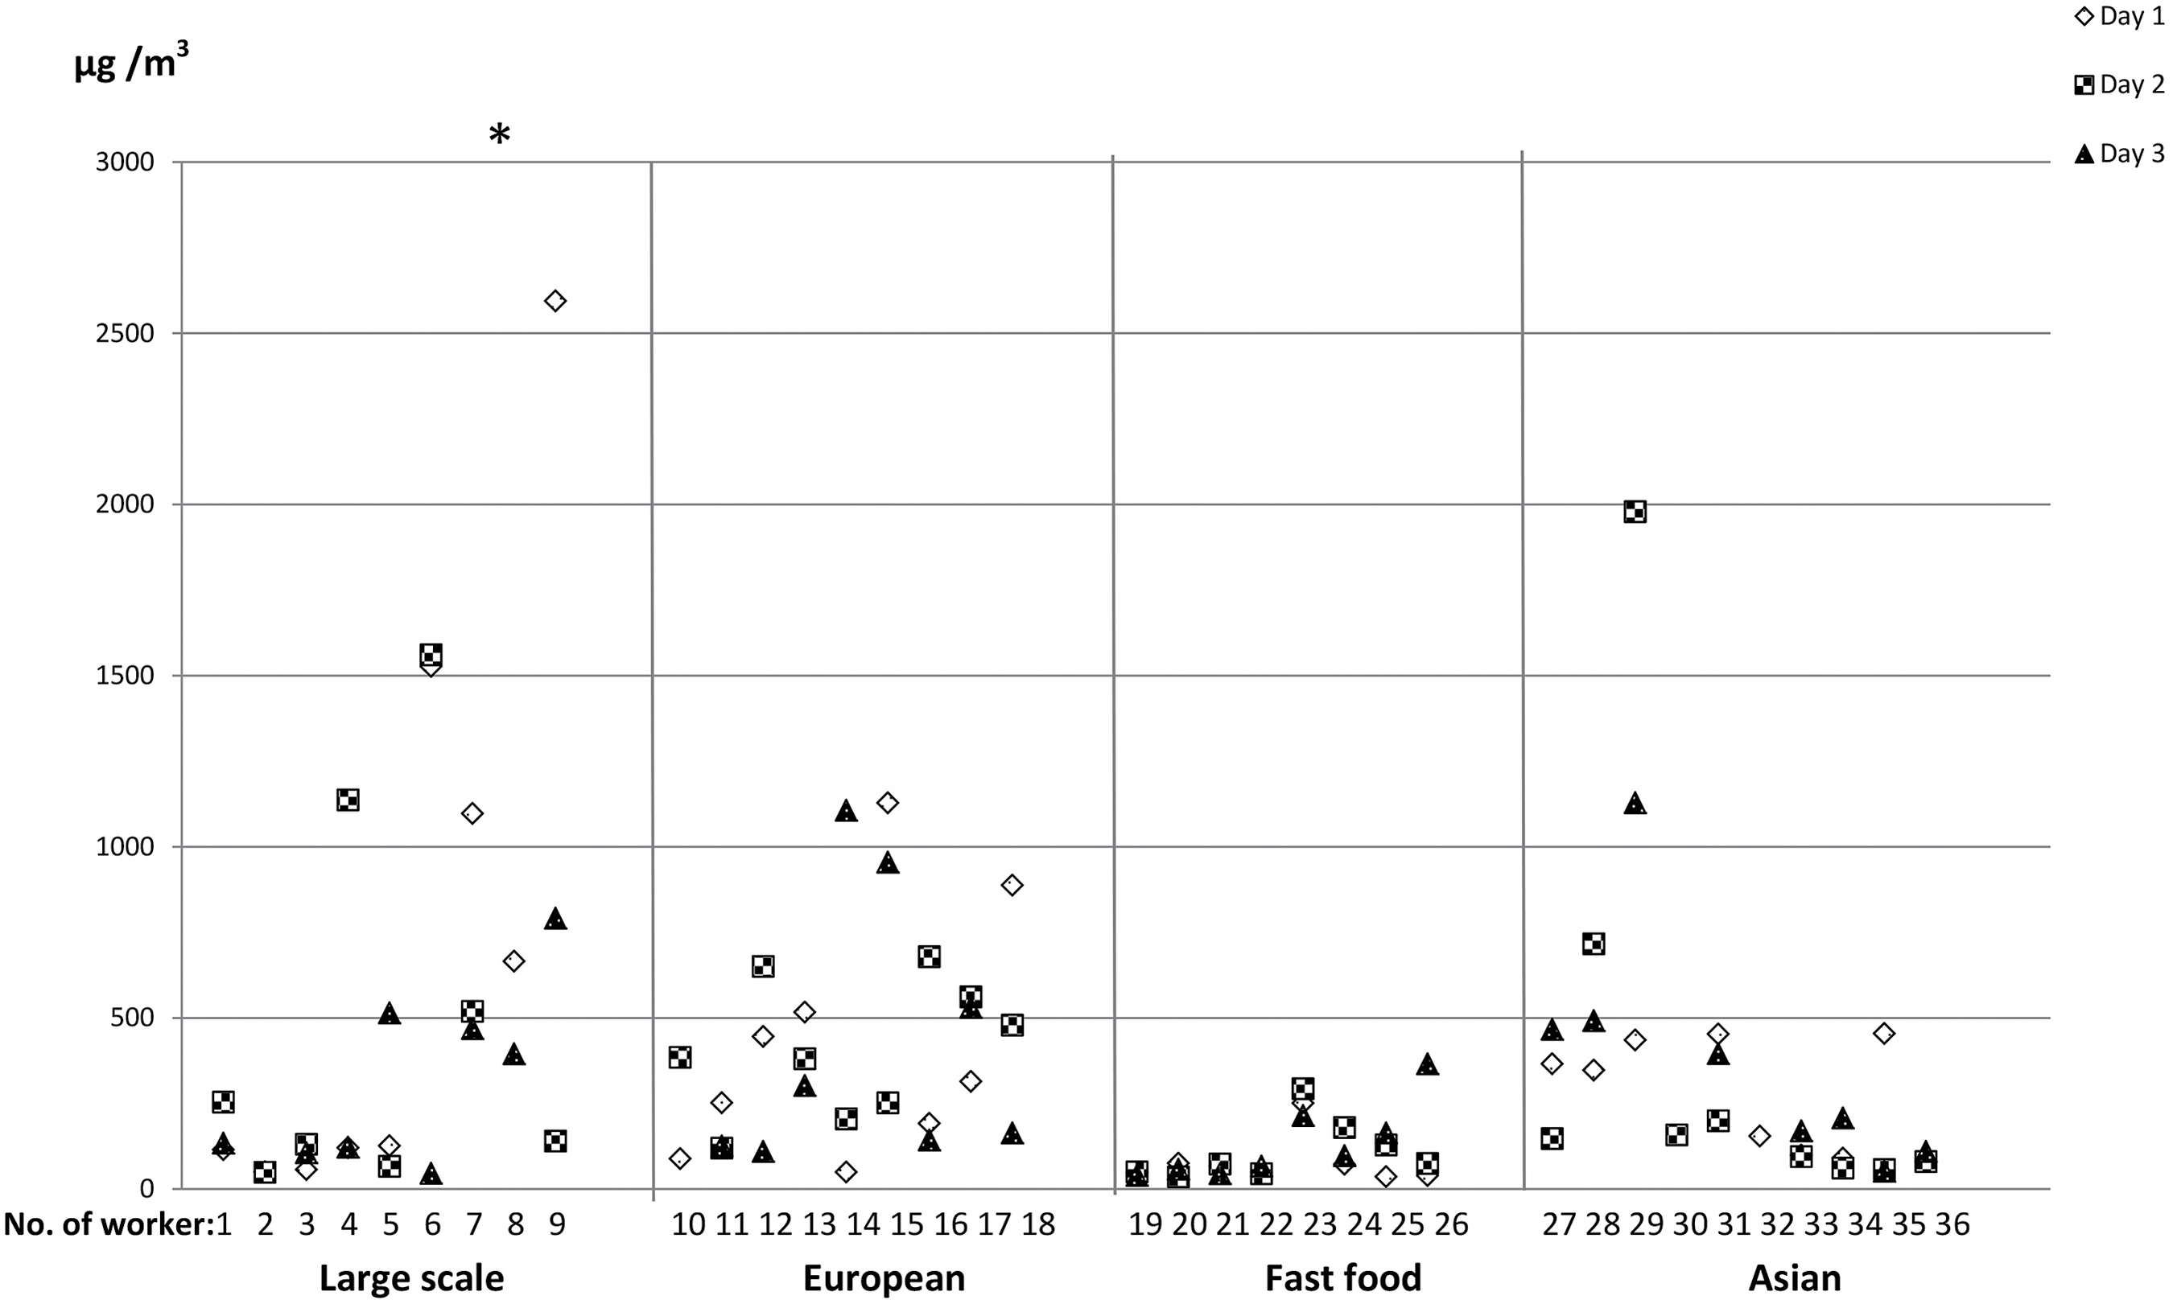
Figure 1. Personal exposure samples of total dust, individual values day 1, 2, and 3, for the four kitchen types. *One ...
Notes:
Figure 1. Personal exposure samples of total dust, individual values day 1, 2, and 3, for the four kitchen types. *One outlier excluded for person number 8, day 2 (3890 µg m−3).
Unless provided in the caption above, the following copyright applies to the content of this slide: © The Author 2017. Published by Oxford University Press on behalf of the British Occupational Hygiene Society.

Slide 2
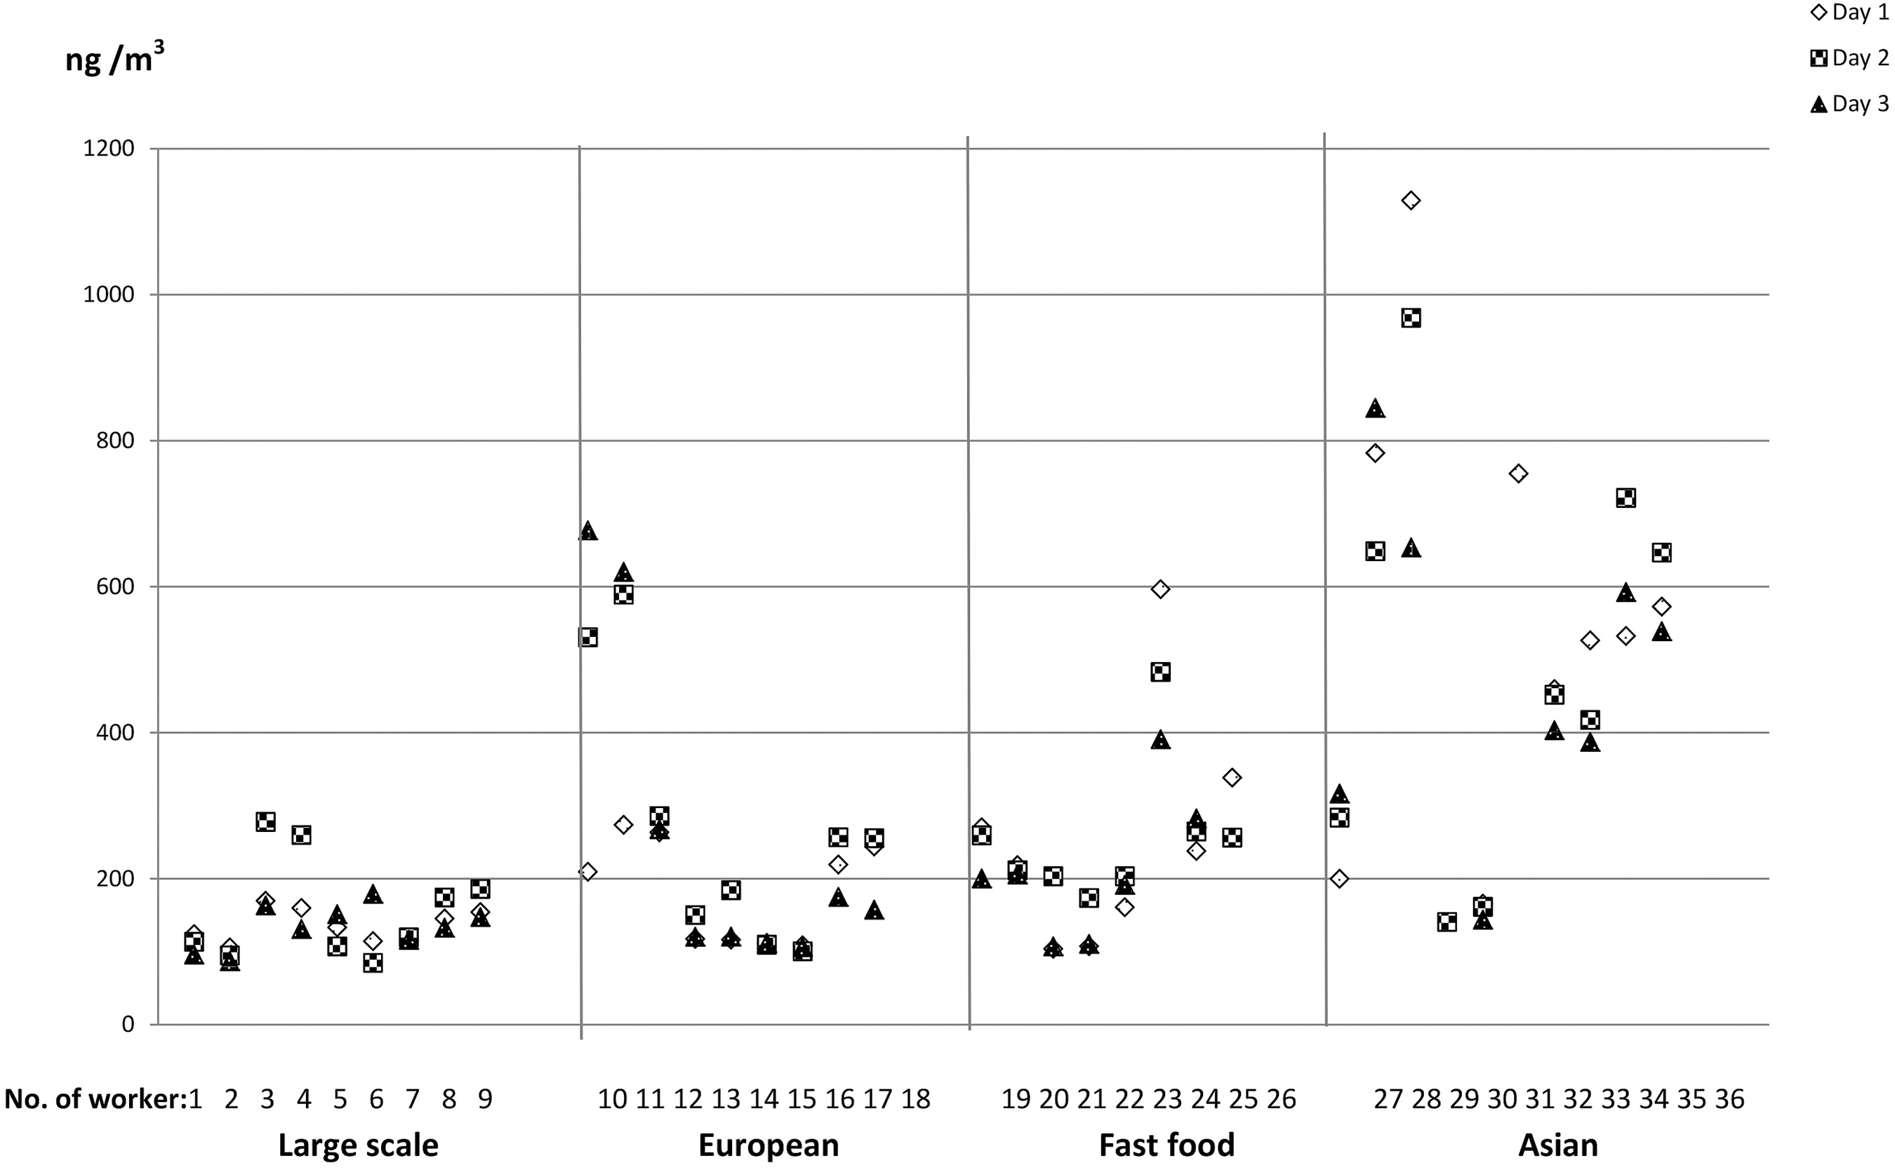
Figure 2. Personal exposure samples of total PAH, individual values day 1, 2, and 3, for the four kitchen types.
Notes:
Figure 2. Personal exposure samples of total PAH, individual values day 1, 2, and 3, for the four kitchen types.
Unless provided in the caption above, the following copyright applies to the content of this slide: © The Author 2017. Published by Oxford University Press on behalf of the British Occupational Hygiene Society.

