Slide 1
Figure 1. High throughput screening results. Occurrence distribution of compound screening activity (A). The bin width ...
Notes:
Figure 1. High throughput screening results. Occurrence distribution of compound screening activity (A). The bin width was set to +3 standard deviations. The grey dotted line represents the best fitted Gaussian distribution. Dose response of the β-gal activity for compound A (B) and vitamin B12 (C). The percentage of induction was calculated with relative to the average DMSO levels (0% induction).
Unless provided in the caption above, the following copyright applies to the content of this slide: © The Author 2016. Published by Oxford University Press.This is an Open Access article distributed under the terms of the Creative Commons Attribution Non-Commercial License (http://creativecommons.org/licenses/by-nc/4.0/), which permits non-commercial re-use, distribution, and reproduction in any medium, provided the original work is properly cited. For commercial re-use, please contact journals.permissions@oup.com

Slide 2
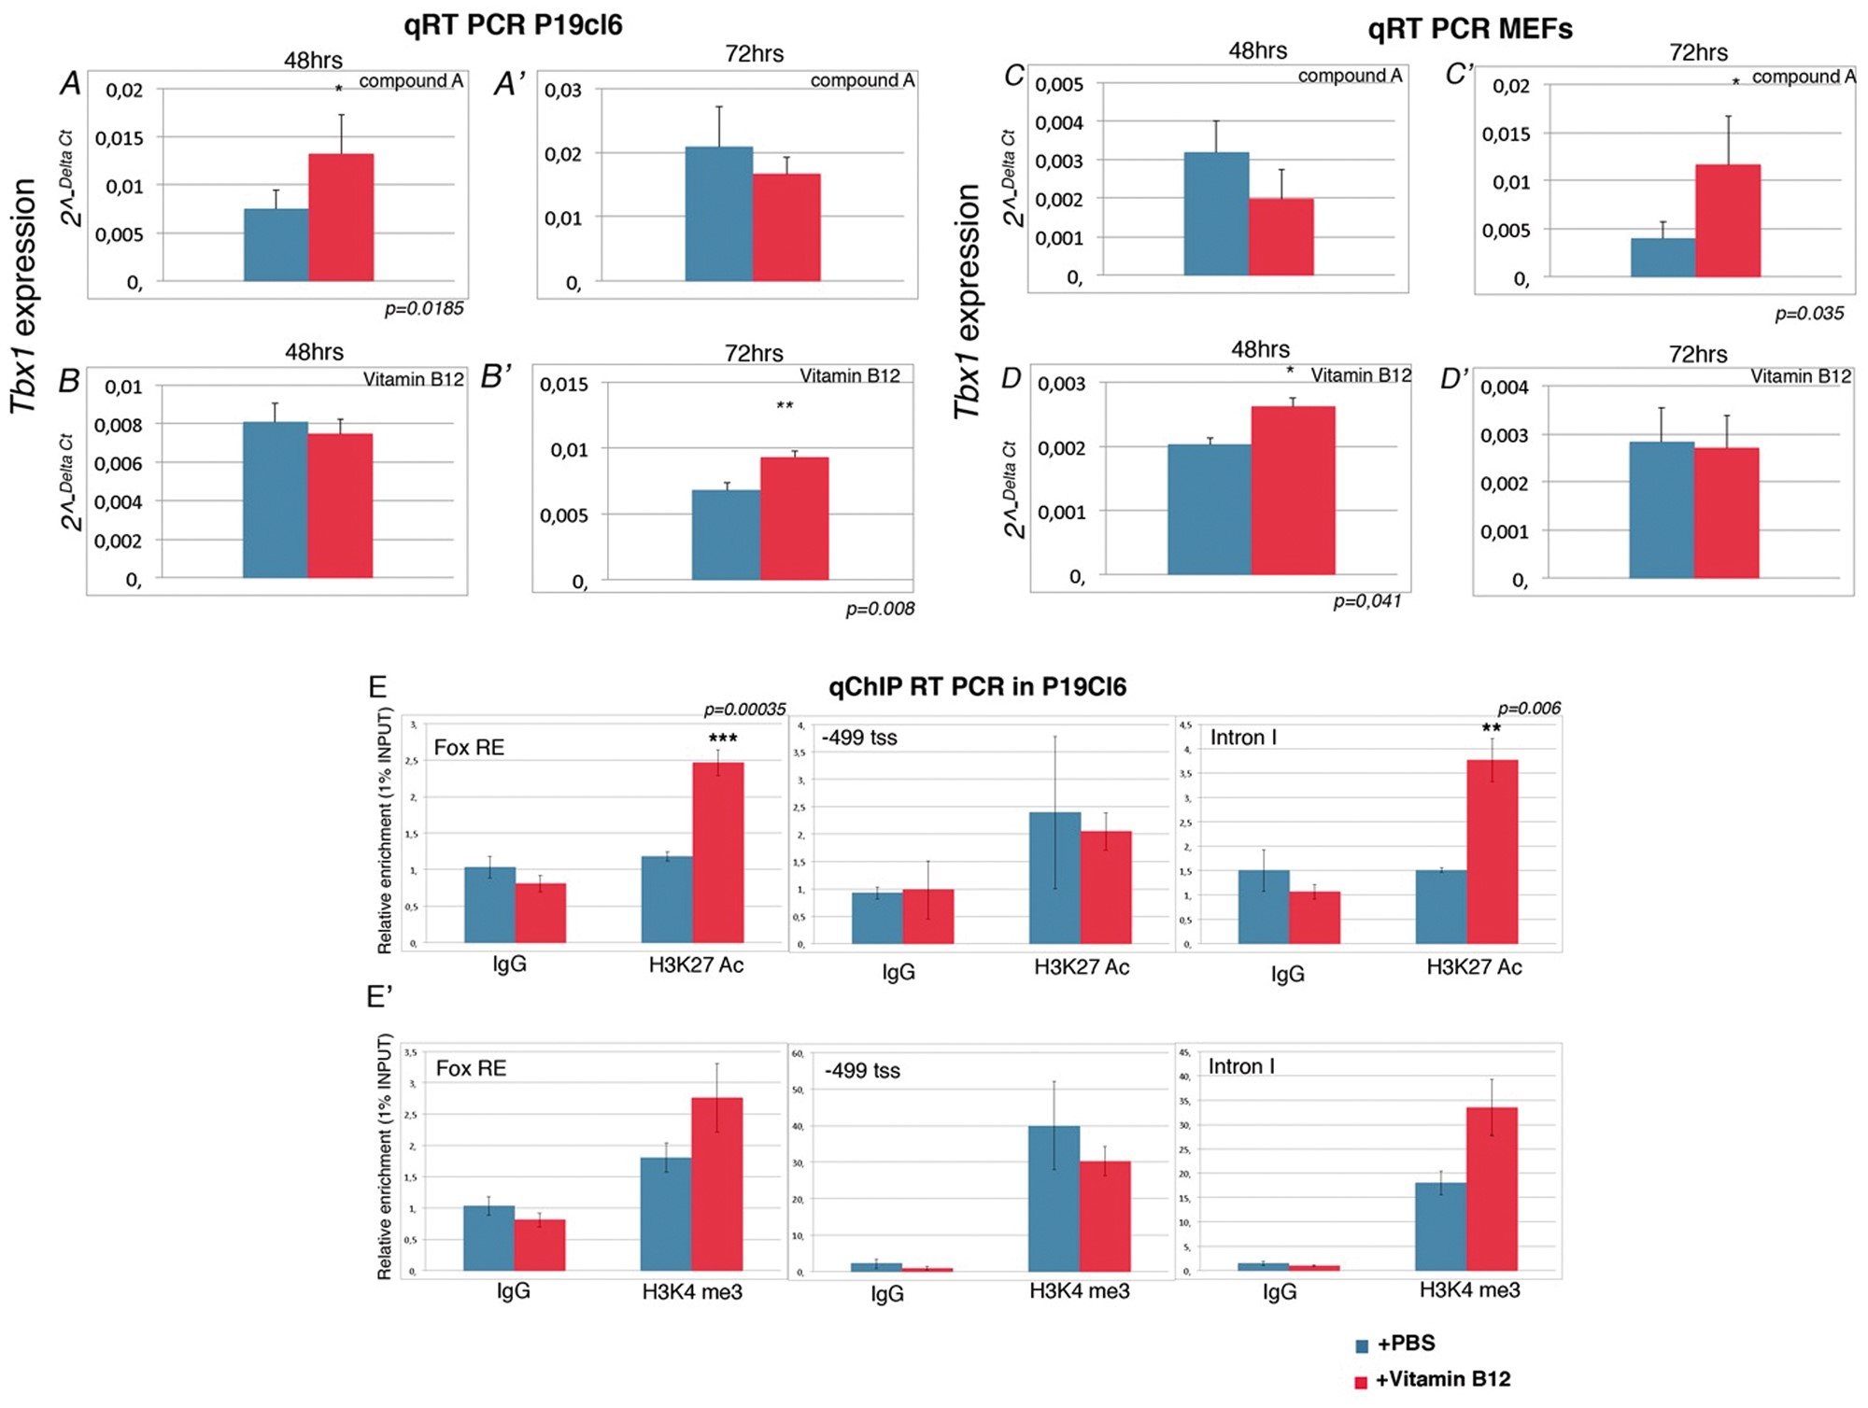
Figure 2. Compound A and vitamin B12 enhance Tbx1 expression in P19Cl6 and MEF cells. (A-D') Quantitative RT-PCR ...
Notes:
Figure 2. Compound A and vitamin B12 enhance Tbx1 expression in P19Cl6 and MEF cells. (A-D') Quantitative RT-PCR evaluation of Tbx1 expression in P19Cl6 cells treated for 48h and 72h with the compound A (A-A’) and vitamin B12 (B-B’). Quantitative RT-PCR evaluation of Tbx1 expression in MEFs cells treated for 48h and 72h with chemical Compound A (C-C’) and vitamin B12 (D-D’). (E-E') Quantitative ChIP (qChIP) results for three loci, Fox responsive element (FOX-RE) (mm9 chr16:18601587-18601697), promoter (-499 fro transcription start site; mm9 chr16:18587346-18587459), and intron I of Tbx1 gene (mm9 chr16:18587346-18587459). qChIP assays were performed on P19Cl6 cells with and without vitamin B12 treatment. The histograms represent the mean of 6 independent experiments. Data are presented as mean ± SEM. *P < 0.05; ** P < 0.01; *** P < 0.001.
Unless provided in the caption above, the following copyright applies to the content of this slide: © The Author 2016. Published by Oxford University Press.This is an Open Access article distributed under the terms of the Creative Commons Attribution Non-Commercial License (http://creativecommons.org/licenses/by-nc/4.0/), which permits non-commercial re-use, distribution, and reproduction in any medium, provided the original work is properly cited. For commercial re-use, please contact journals.permissions@oup.com

Slide 3
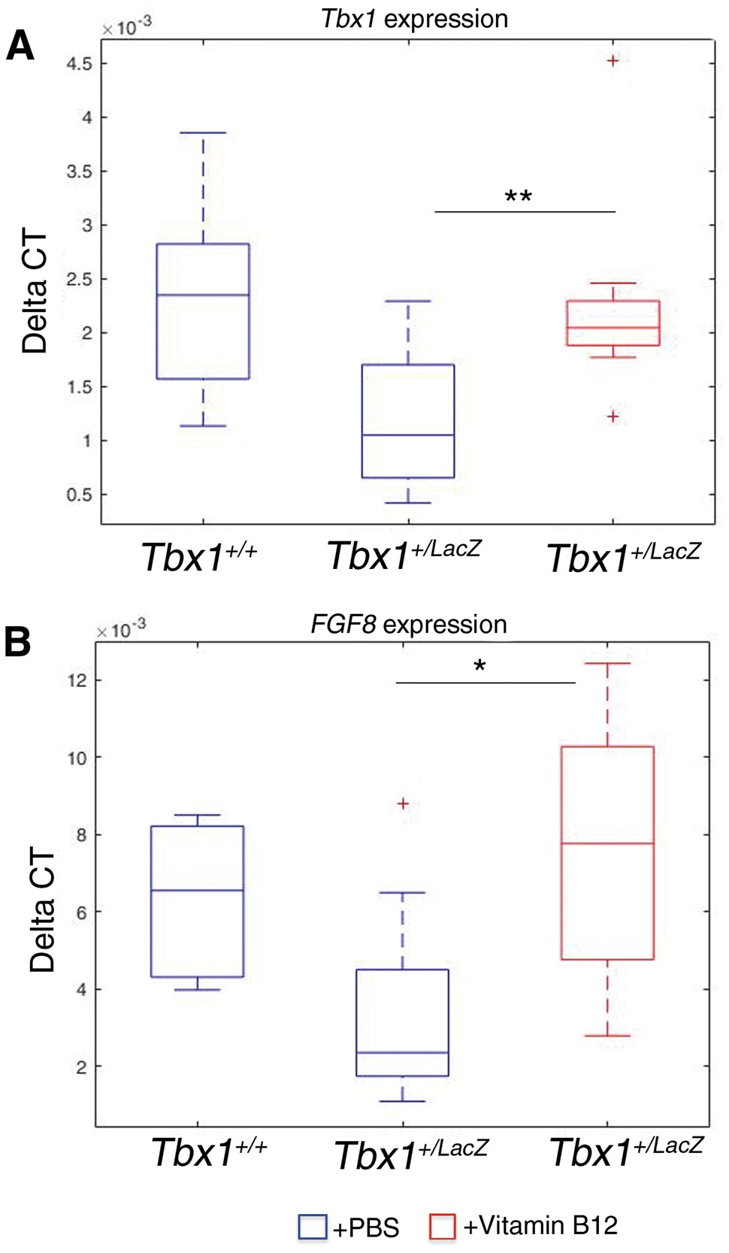
Figure 3. Tbx1 and Fgf8 gene expression is upregulated by vitamin B12 in vivo. Box plots of qRT-PCR evaluation of Tbx1 ...
Notes:
Figure 3. Tbx1 and Fgf8 gene expression is upregulated by vitamin B12 in vivo. Box plots of qRT-PCR evaluation of Tbx1 (A) and Fgf8 (B) gene expression in E9.5 embryos (n = 11 for each point), with or without vitamin B12 treatment. The error bars represent the minimal and maximal values of relative expression. *** P = 0.0045; * P = 0.031.
Unless provided in the caption above, the following copyright applies to the content of this slide: © The Author 2016. Published by Oxford University Press.This is an Open Access article distributed under the terms of the Creative Commons Attribution Non-Commercial License (http://creativecommons.org/licenses/by-nc/4.0/), which permits non-commercial re-use, distribution, and reproduction in any medium, provided the original work is properly cited. For commercial re-use, please contact journals.permissions@oup.com

Slide 4
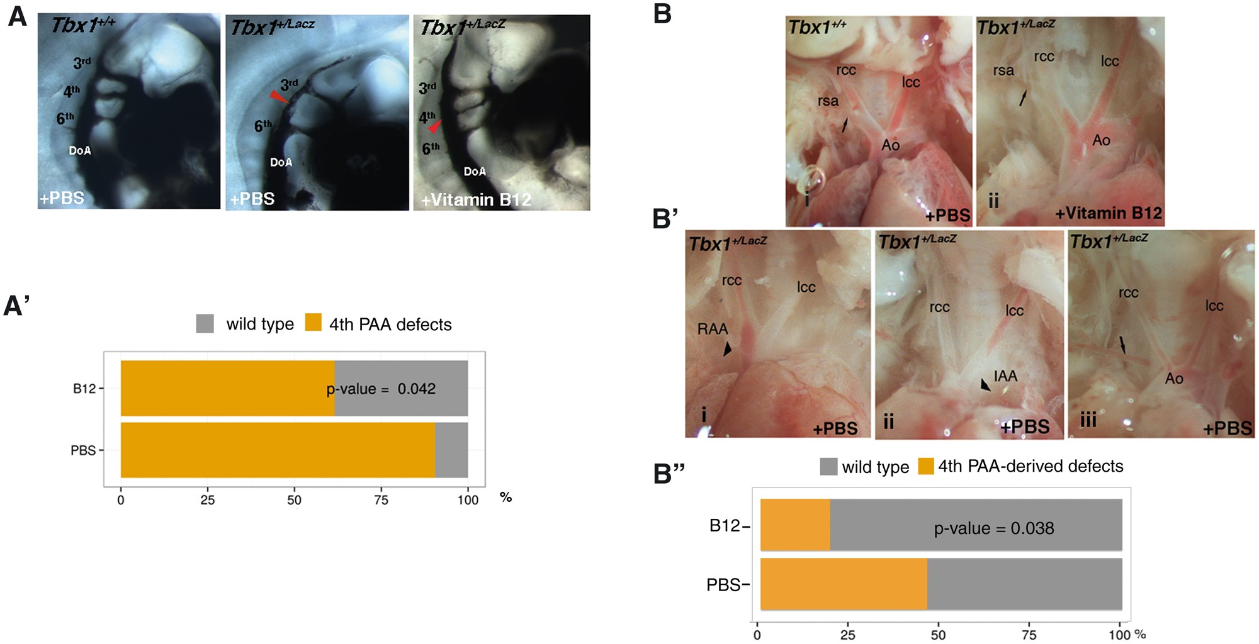
Figure 4. Vitamin B12 treatment partially rescues the Tbx1 haploinsufficiency phenotype. (A) Pharyngeal arch arteries ...
Notes:
Figure 4. Vitamin B12 treatment partially rescues the Tbx1 haploinsufficiency phenotype. (A) Pharyngeal arch arteries of E10.5 embryos visualised by ink injection. Lateral view of PBS-treated WT (left panel), PBS-treated Tbx1lacZ/+ (centre), and vitamin B12-treated Tbx1lacZ/+ (right) embryos. (A’) Graphic representation of the percentage of embryos with 4th PAA defects (PBS sample n = 21; vitamin B12-treated sample n = 26). (B) Representative immages of aortic arch and great vessels of E17.5 fetuses. (i) WT pattern; (ii) normal pattern in a vitamin B12-treated Tbx1lacZ/+ fetus; (B’) Examples of aortic arch patterning defects in Tbx1lacZ/+ fetuses: (i) right aortic arch (RAA), the arrowhead indicates the retropositioned arch; (ii) interrupted arch aortic (IAA) type B, the arrowhead indicates the interruption; (iii) retroesophageal right subclavian artery. Arrows indicate the right subclavian artery. Ao: aorta; lcc: left common carotid artery; rcc: right common carotid artery; rsa: right subclavian artery. (B'') Graphic representation of the percentage of fetuses with aortic arch patterning abnormalities derived from 4th PAA defects (PBS sample n = 26; vitamin B12-treated sample n = 26).
Unless provided in the caption above, the following copyright applies to the content of this slide: © The Author 2016. Published by Oxford University Press.This is an Open Access article distributed under the terms of the Creative Commons Attribution Non-Commercial License (http://creativecommons.org/licenses/by-nc/4.0/), which permits non-commercial re-use, distribution, and reproduction in any medium, provided the original work is properly cited. For commercial re-use, please contact journals.permissions@oup.com

