Slide 1
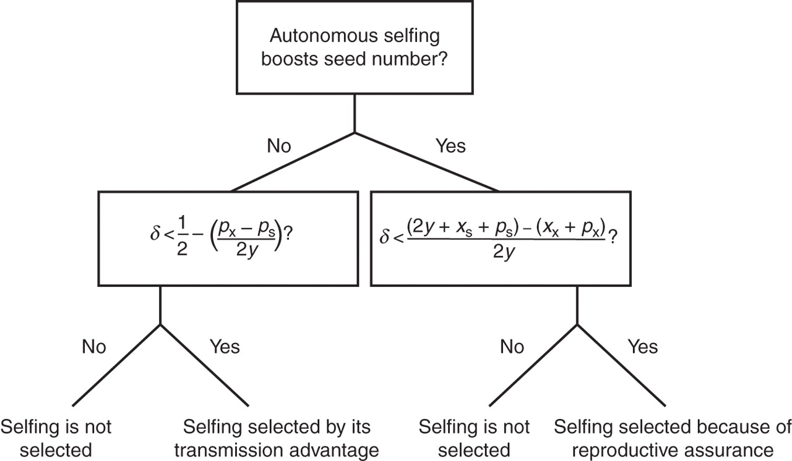
Fig. 1. The conceptual framework shared by two hypotheses for the evolution of selfing. Selfing will evolve by its ...
Notes:
Fig. 1. The conceptual framework shared by two hypotheses for the evolution of selfing. Selfing will evolve by its gene-level transmission advantage if it is not erased by pollen discounting (px – ps) or inbreeding depression (δ). If selfing increases seed production, selfing will be selected if the number of alleles passed on by plants capable of selfing (2y + xs + ps) is greater than the number transmitted by outcrossers (xx + px), and exceeds a threshold inbreeding depression. Pollen and seed discounting (xx – xs) may both counter selection of selfing in this case.
Unless provided in the caption above, the following copyright applies to the content of this slide: © The Author 2011. Published by Oxford University Press on behalf of the Annals of Botany Company. All rights reserved. For Permissions, please email: journals.permissions@oup.com

