Slide 1
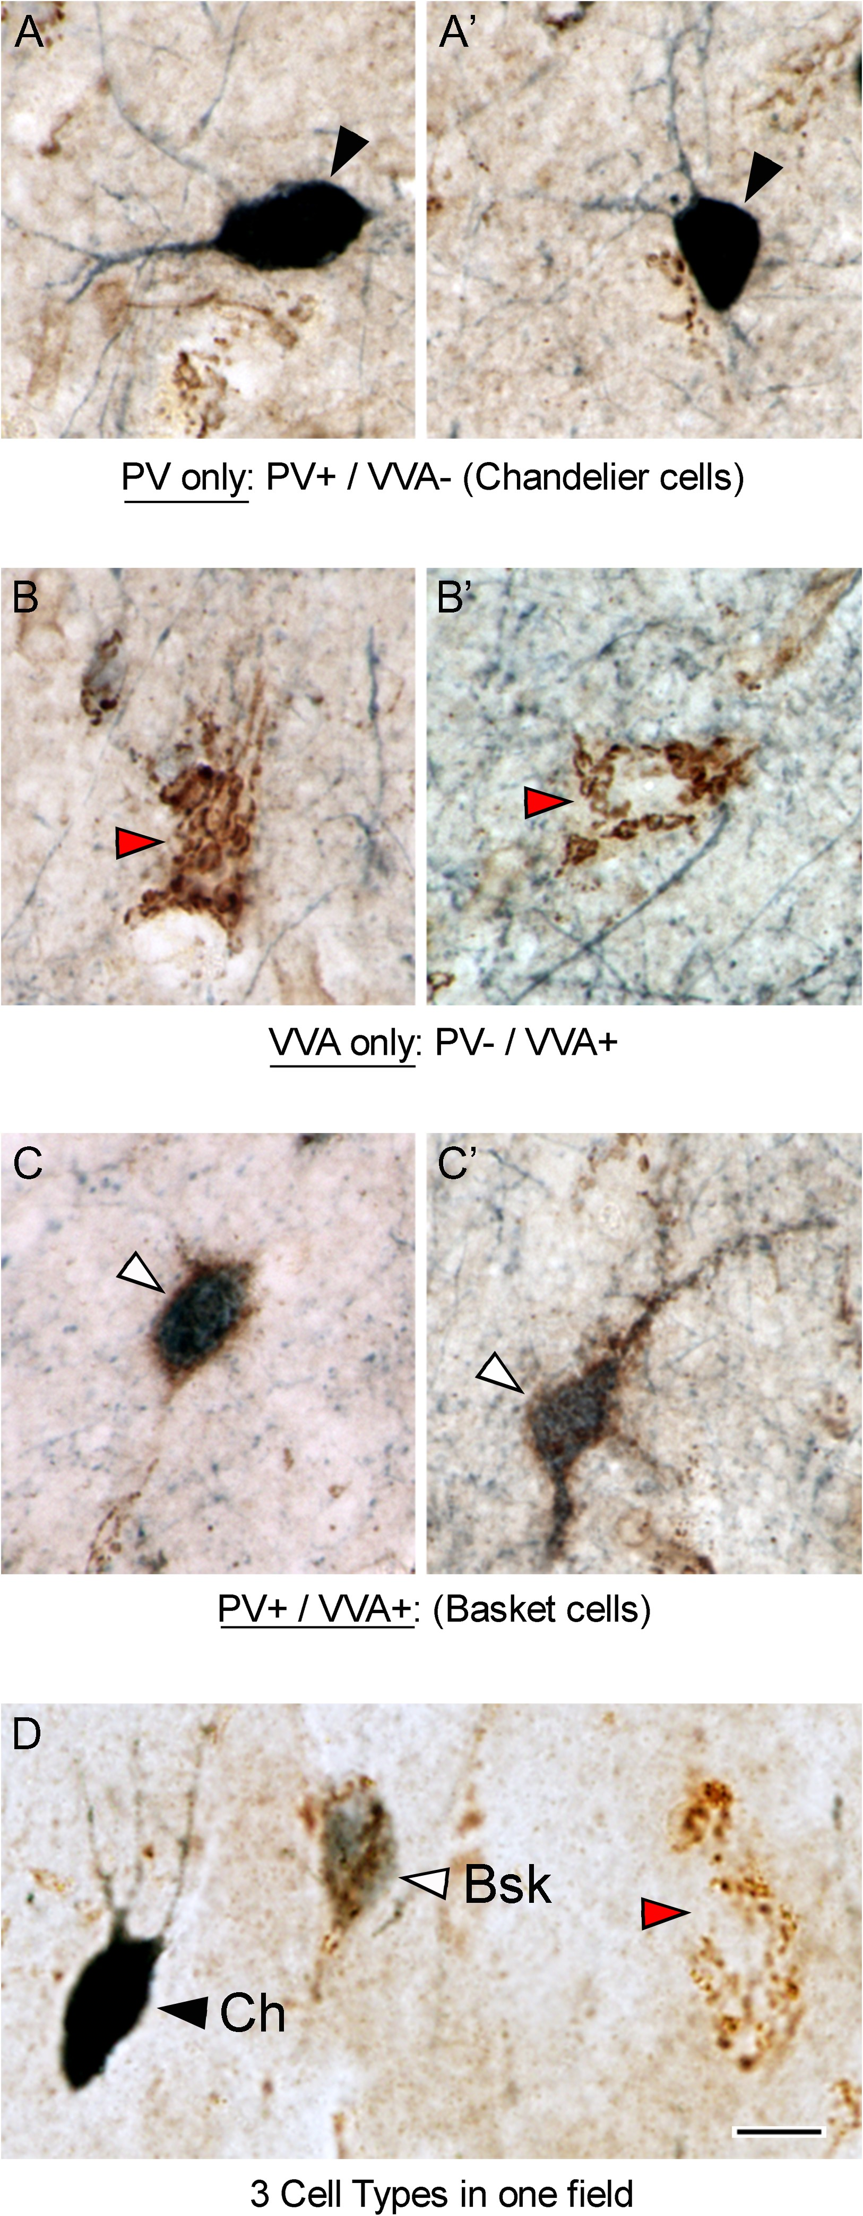
Figure 1. Prefrontal cortical tissue from BA9 stained with anti-PV antibodies (dark blue) and VVA lectin (brown). PV ...
Notes:
Figure 1. Prefrontal cortical tissue from BA9 stained with anti-PV antibodies (dark blue) and VVA lectin (brown). PV antibodies label the soma and proximal processes of PV-expressing interneurons. VVA binds to the carbohydrate N-acetylgalactosamine, which is present in the perineuronal net surrounding Bsk cells, but not Ch cells. (A, A’) Ch cells are PV+ / VVA−. Ch cells exhibit a dark blue PV-reaction product that fills the soma and proximal dendrites (black arrowheads). (B, B’) PV− / VVA+ cells present with a brown mesh-like puncta over the soma and proximal dendrites (red arrowheads). (C, C’) Bsk cells are PV+ / VVA+ and present with a dark blue PV-reaction product in the cytoplasm and proximal dendrites, and with a brown mesh-like puncta of VVA staining over the soma and proximal dendrites (white arrowheads). (D) All 3 cell types were present in the prefrontal cortical areas we analyzed. Scale bar: 5 µm.
Unless provided in the caption above, the following copyright applies to the content of this slide: © The Author 2016. Published by Oxford University Press. All rights reserved. For Permissions, please e-mail: journals.permissions@oup.com

Slide 2
Figure 2. PV-expressing cartridges were associated with the PV+/VVA-negative cells. Vertically oriented PV+ cartridges ...
Notes:
Figure 2. PV-expressing cartridges were associated with the PV+/VVA-negative cells. Vertically oriented PV+ cartridges were not labeled with VVA. (A) Ch cell soma (black arrowhead) and cartridges (small arrows) were stained with dark blue anti-PV reaction product, but not with VVA lectin. VVA+ cells (brown) are visible, as well as VVA+ capillaries (asterisks), but VVA does not label the Ch cell body or cartridges. (B) Neurolucida reconstruction of PV staining in the image shown in panel A. (C, D) Golgi stained tissue showing the structure of boutons that comprise each PV-expressing Ch cell cartridge. Scale bar: A,B. 15 µm., C,D: 1 µm.
Unless provided in the caption above, the following copyright applies to the content of this slide: © The Author 2016. Published by Oxford University Press. All rights reserved. For Permissions, please e-mail: journals.permissions@oup.com

Slide 3
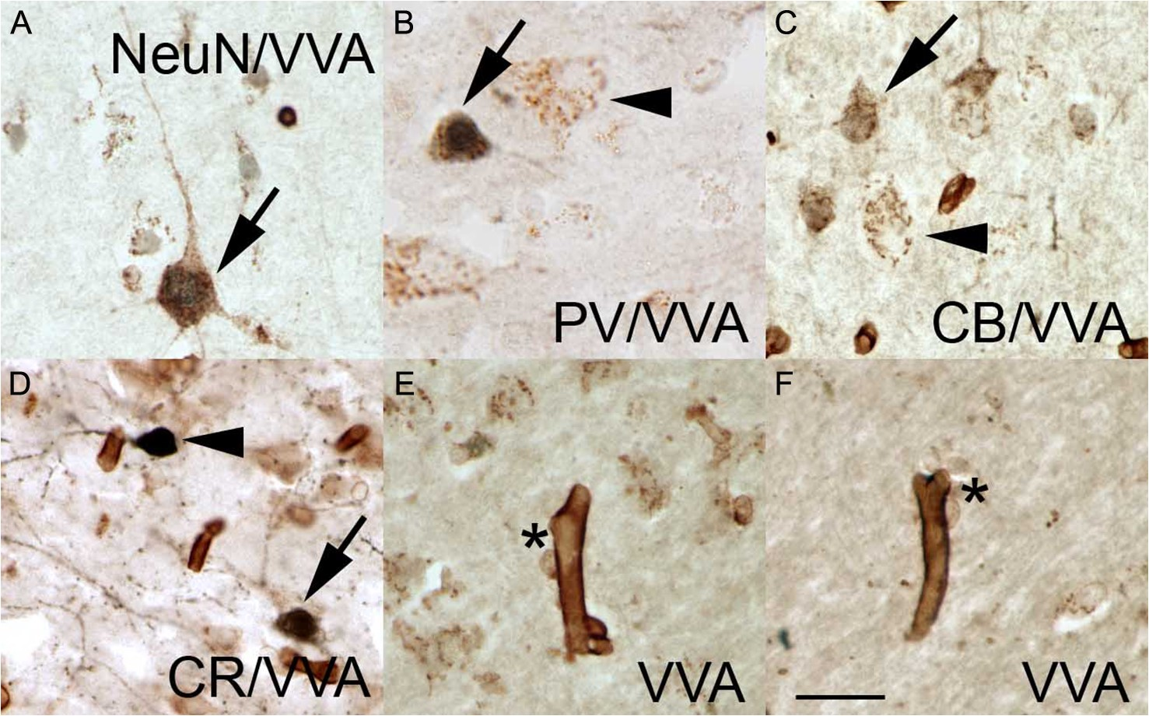
Figure 3. VVA lectin labeled pyramidal neurons, interneurons, and astrocytes. (A) NeuN+ pyramidal cell (dark blue ...
Notes:
Figure 3. VVA lectin labeled pyramidal neurons, interneurons, and astrocytes. (A) NeuN+ pyramidal cell (dark blue nucleus) with a VVA+ perineural net outlining the soma and proximal dendrites (brown puncta). (B) Some VVA+ cells express PV (arrow) while other VVA+ cells do not (arrowhead). (C) Some VVA+ cells express CB (arrow), while other VVA+ cells do not (arrowhead). (D) CR+ cells that express VVA (arrow) and that do not express VVA (arrowhead). (E, F) VVA+ cells (asterisk) associated with VVA+ capillaries. Scale bars: 15 µm.
Unless provided in the caption above, the following copyright applies to the content of this slide: © The Author 2016. Published by Oxford University Press. All rights reserved. For Permissions, please e-mail: journals.permissions@oup.com

Slide 4
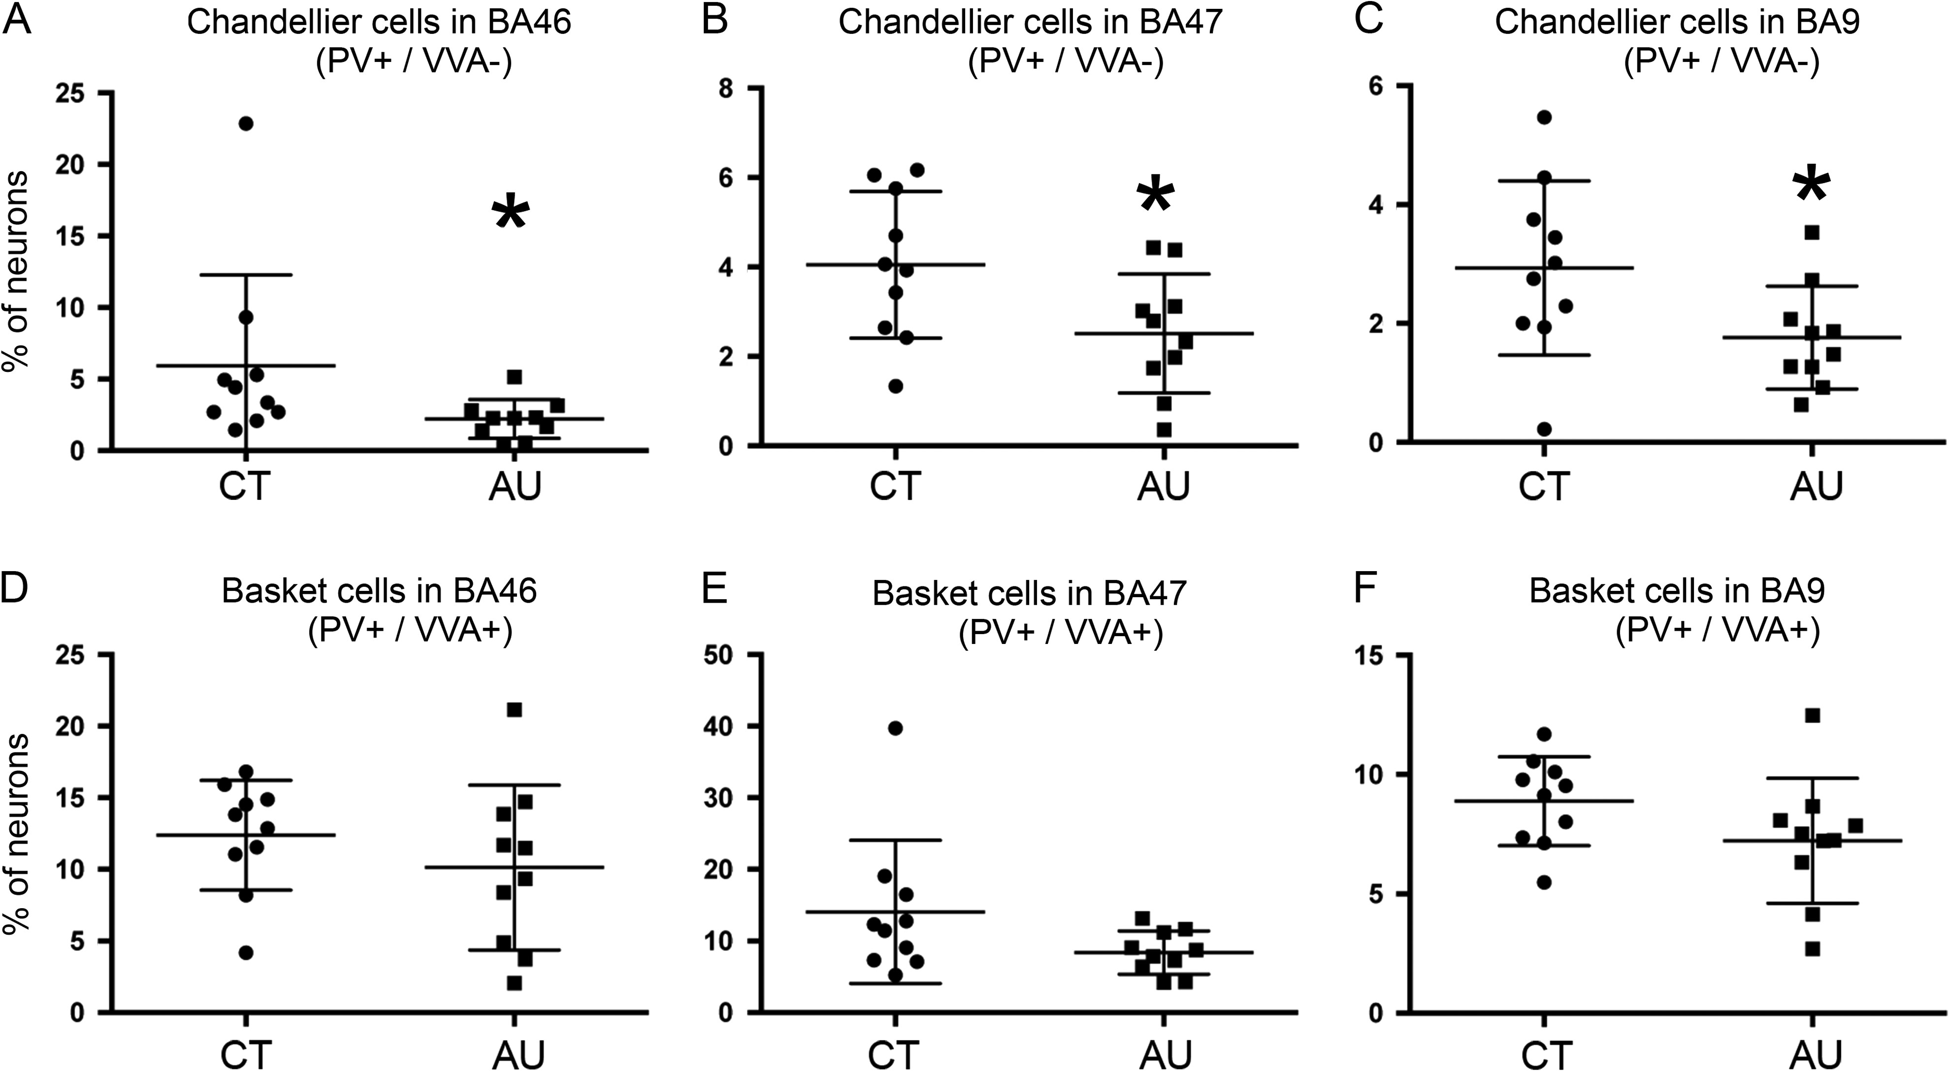
Figure 4. (A–C) The number of Ch cells in Brodmann Area (BA)46, BA47, and BA9 of prefrontal cortex is significantly ...
Notes:
Figure 4. (A–C) The number of Ch cells in Brodmann Area (BA)46, BA47, and BA9 of prefrontal cortex is significantly lower in the autism cases (AU) than in control cases (CT). (D–F) The number of Bsk cells in BA46, BA47, and BA9 did not statistically differ between groups.
Unless provided in the caption above, the following copyright applies to the content of this slide: © The Author 2016. Published by Oxford University Press. All rights reserved. For Permissions, please e-mail: journals.permissions@oup.com

