Slide 1
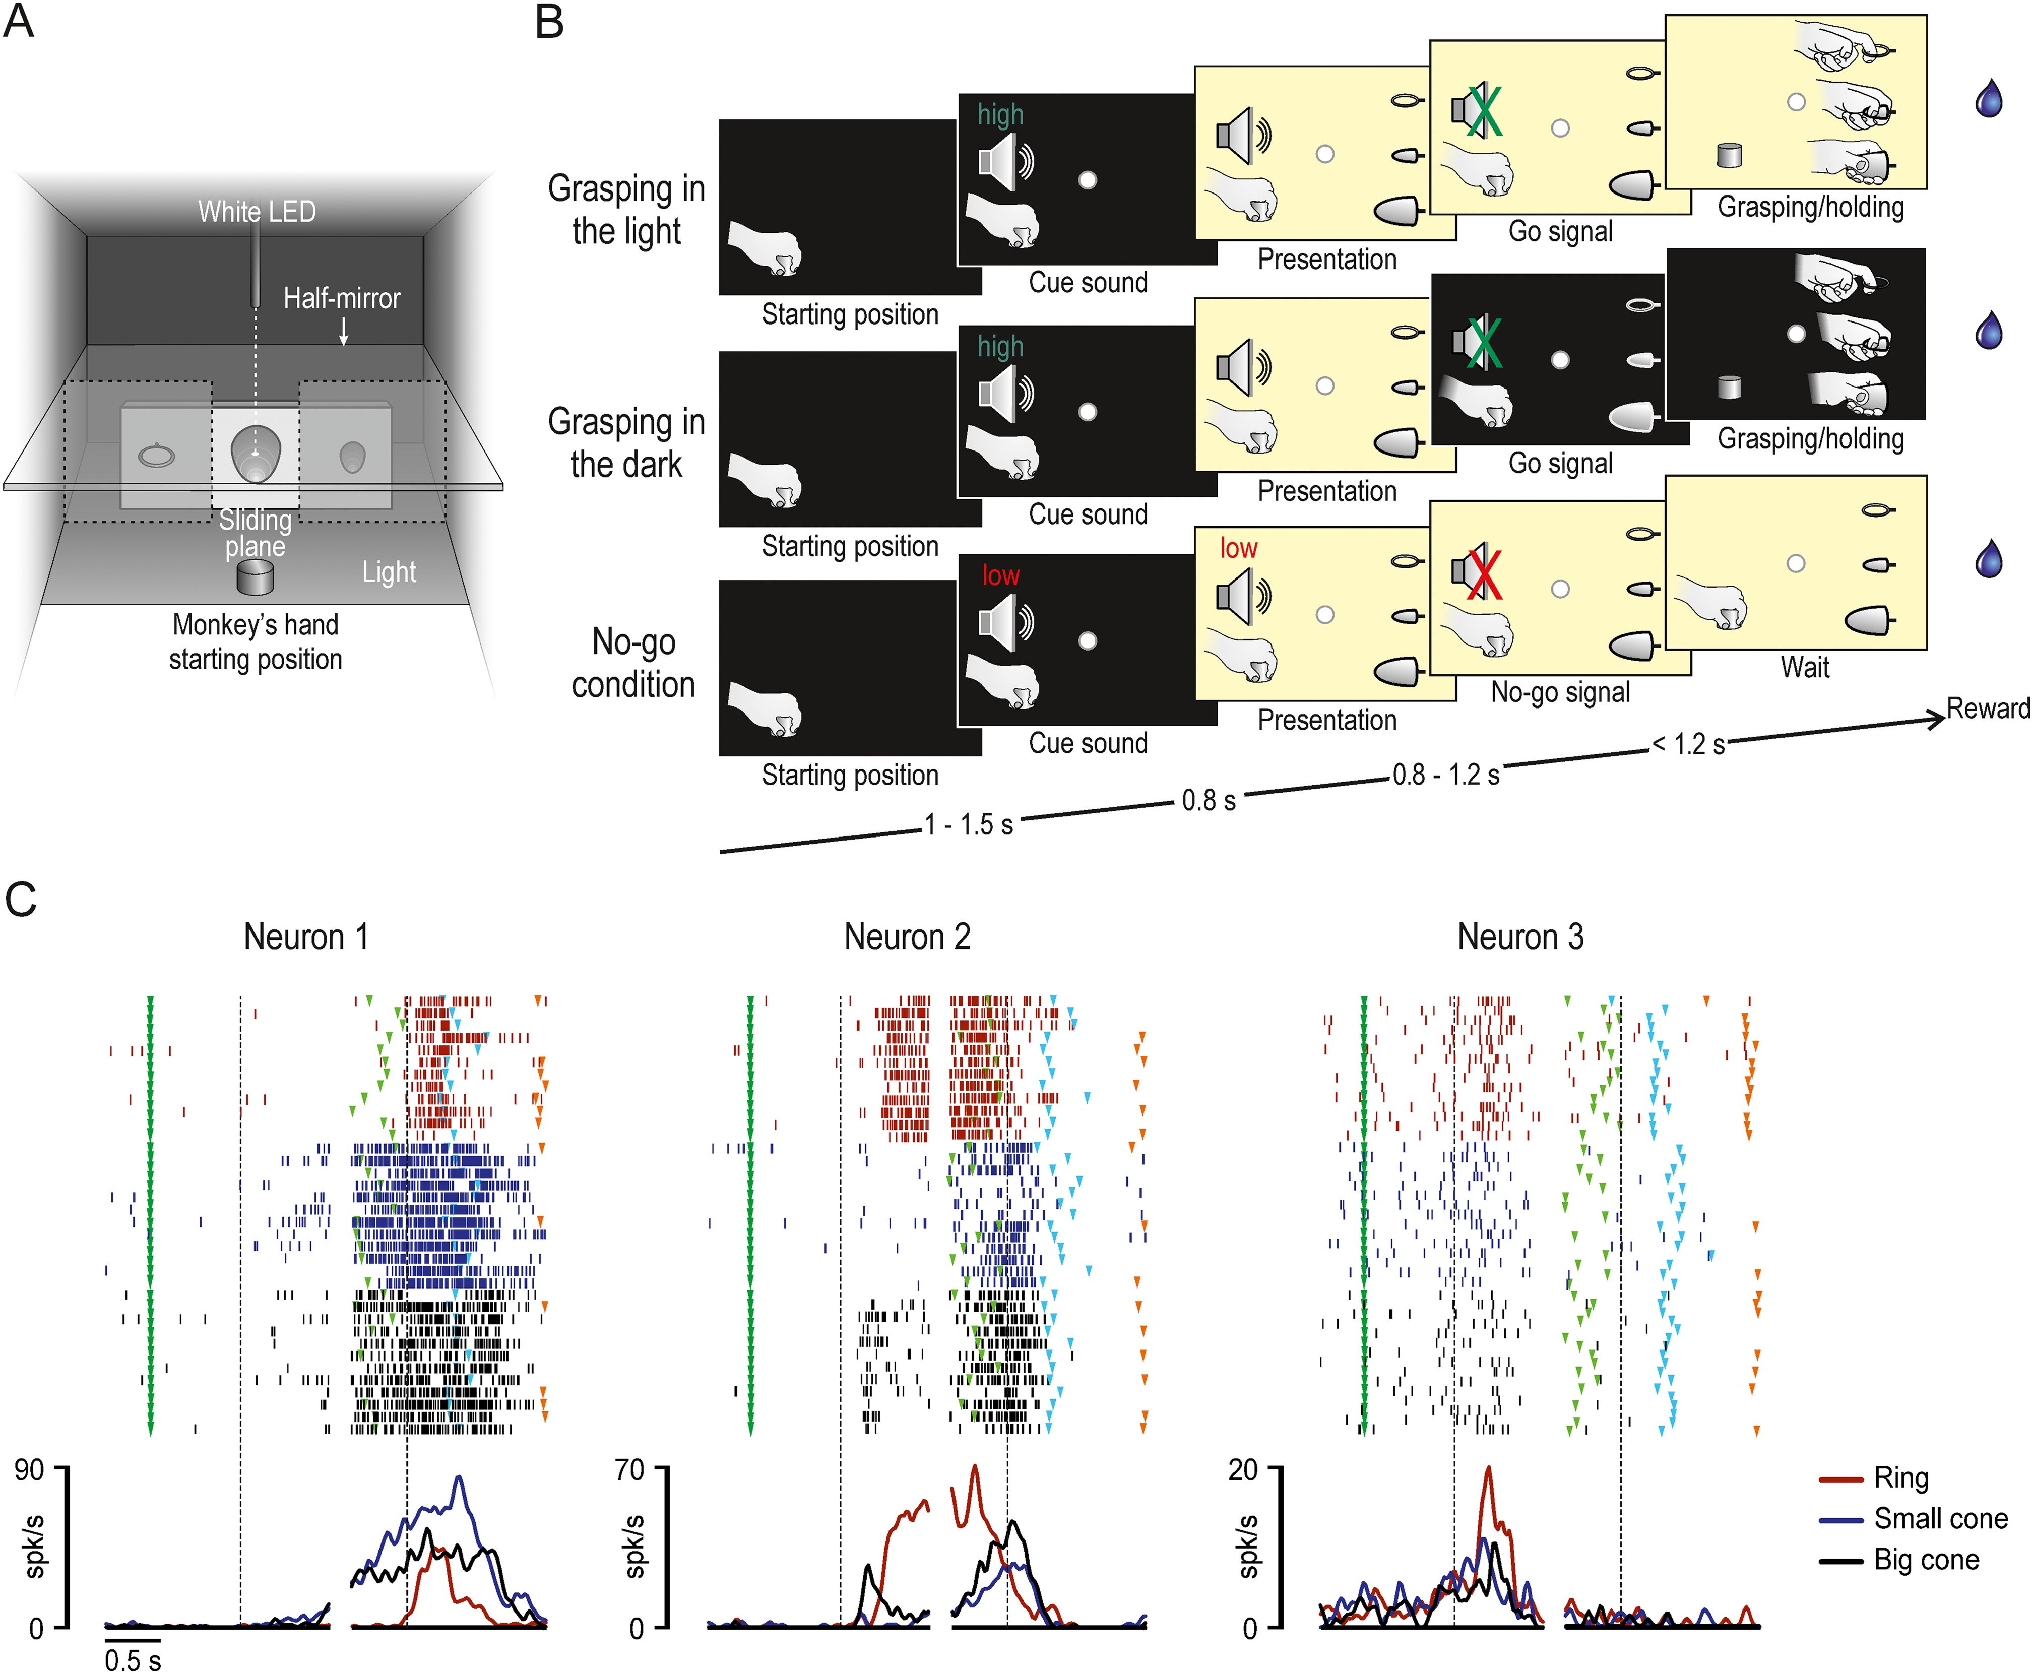
Figure 1. Behavioral task and example neurons. (A) Box and task apparatus seen from the monkey's point of view. (B) ...
Notes:
Figure 1. Behavioral task and example neurons. (A) Box and task apparatus seen from the monkey's point of view. (B) Stages of the three main conditions of the task: grasping in the light, grasping in the dark, and no-go condition. (C) Examples of the three main types of neurons recorded during task execution in the light. For each neuron rasters and spike density function are aligned (dashed lines) on object presentation (left part) and, after the gap, on the moment when the monkey's hand detached from the starting position (right part). Markers: dark green, cue sound onset (beginning of the trial); light green, end of the cue sound (go-signal); light blue, object pulling onset; orange, end of the trial and reward delivery.
Unless provided in the caption above, the following copyright applies to the content of this slide: © The Author 2016. Published by Oxford University Press.This is an Open Access article distributed under the terms of the Creative Commons Attribution Non-Commercial License (http://creativecommons.org/licenses/by-nc/4.0/), which permits non-commercial re-use, distribution, and reproduction in any medium, provided the original work is properly cited. For commercial re-use, please contact journals.permissions@oup.com

Slide 2
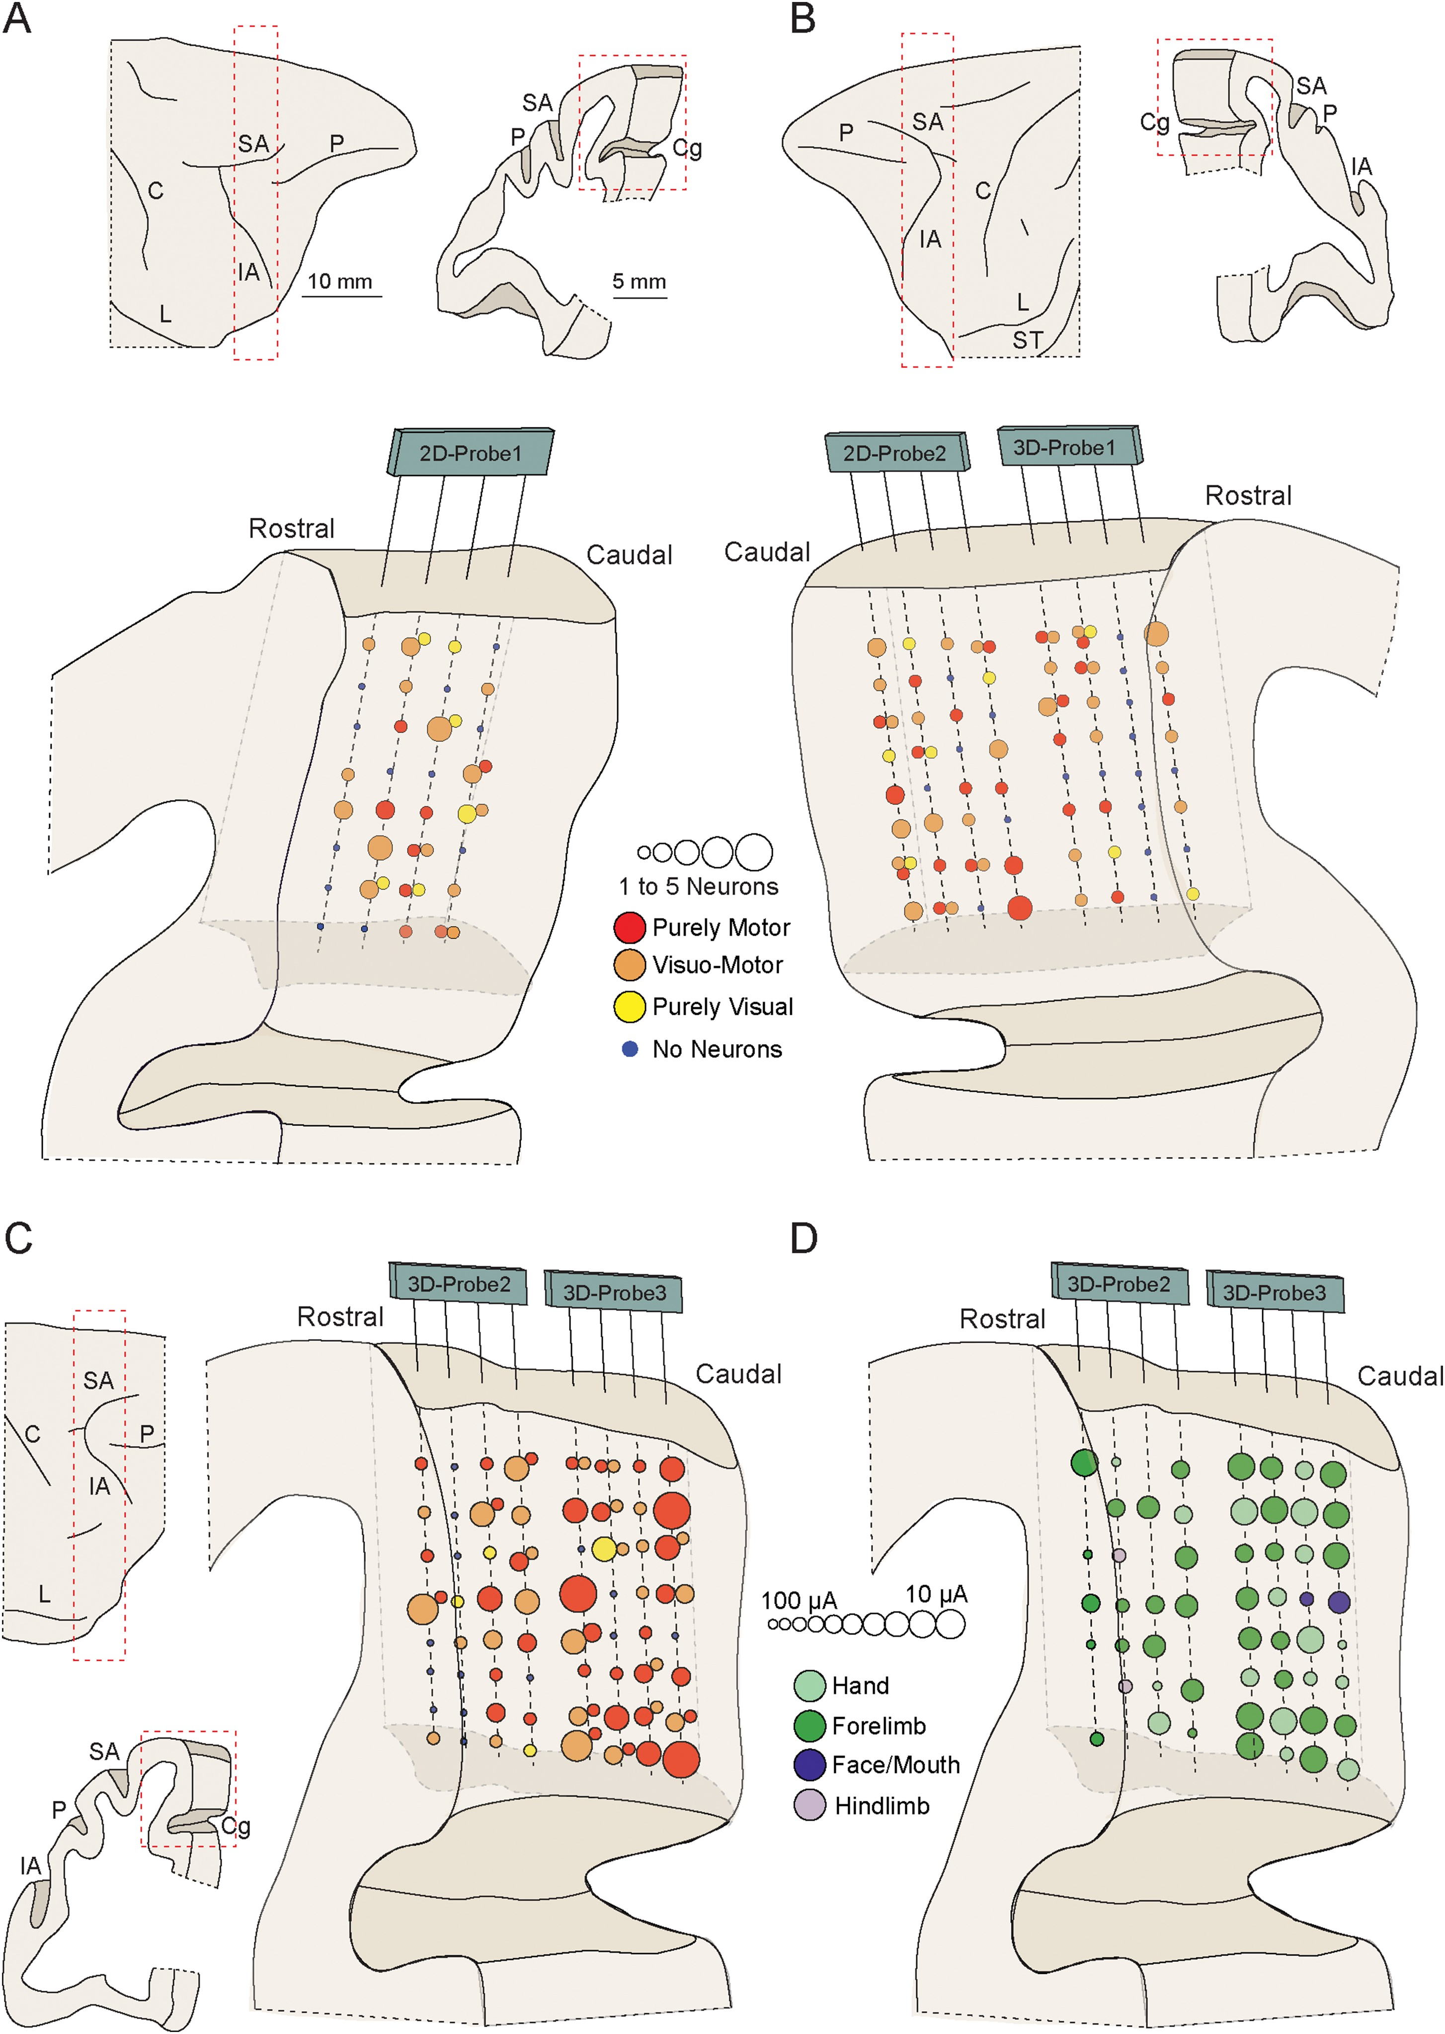
Figure 2. Reconstruction of the recorded regions and functional maps. Anatomical reconstruction of the right (A) and ...
Notes:
Figure 2. Reconstruction of the recorded regions and functional maps. Anatomical reconstruction of the right (A) and left (B) hemispheres of MK1, with superimposed number and class of neurons recorded from each site. In (B), each “site” of the (rostral) 3D probe (see Materials and Methods) includes neurons recorded from pairs of adjacent electrodes (not shown) spaced by 300 µm (see also Supplementary Fig. S1). (C) Anatomical reconstruction of the right hemisphere of MK2, with superimposed number and class of neurons recorded from each site of the 3D probes. Conventions as in panel (B). (D) Results of an ICMS mapping study carried out on MK2 at the end of the recordings. Note that 2 sites on the most caudal part of the recorded region were associated with face–mouth movement, which is known to correspond to the functional border between areas F3 (caudally) and F6 (rostrally) (see Luppino et al. 1991). The size of the circles corresponds to the current intensity threshold (see Materials and Methods). Scale bars in (A) also applies to (B) and (C). C, central sulcus; Cg, cingulate sulcus; IA, inferior arcuate sulcus; L, Lateral sulcus; SA, superior arcuate sulcus; ST, superior temporal sulcus.
Unless provided in the caption above, the following copyright applies to the content of this slide: © The Author 2016. Published by Oxford University Press.This is an Open Access article distributed under the terms of the Creative Commons Attribution Non-Commercial License (http://creativecommons.org/licenses/by-nc/4.0/), which permits non-commercial re-use, distribution, and reproduction in any medium, provided the original work is properly cited. For commercial re-use, please contact journals.permissions@oup.com

Slide 3
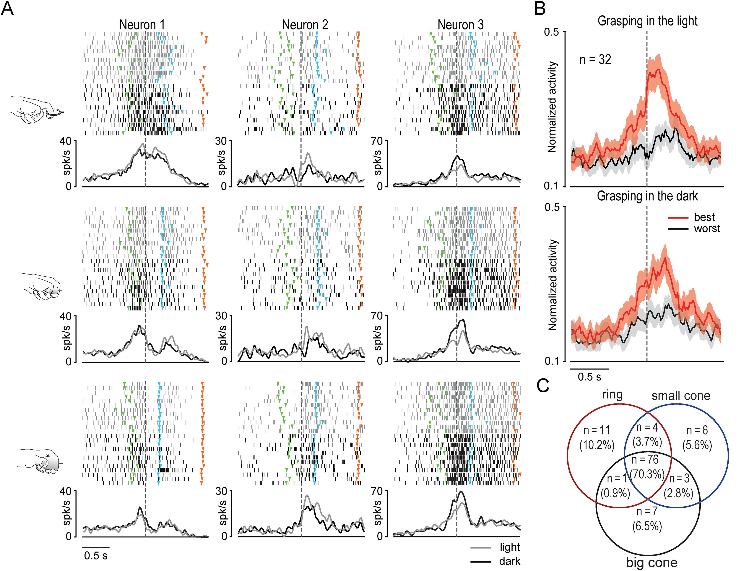
Figure 3. Functional properties of F6 purely motor neurons. (A) Examples of three F6 purely motor neurons showing ...
Notes:
Figure 3. Functional properties of F6 purely motor neurons. (A) Examples of three F6 purely motor neurons showing selectivity for the target object. The image on the left of each line of the panel shows the type of grip employed by the monkey in that trials. Other conventions and markers as in Figure 1. (B) Population activity of purely motor neurons with object selectivity. As for single-neuron examples, the activity is aligned to the movement onset, and shows the averaged population response to the preferred and non-preferred target established on the basis of each neurons response during grasping in the light. The colored shaded area around each curve represents 1 standard error. By means of 2 × 3 repeated measures ANOVAs (factors: Object and Epoch) applied to each condition (light and dark), separately, we observed that this neuronal population responded and showed object selectivity during both premovement and reaching–grasping in the dark (P < 0.001) as well as in the light (P < 0.001). Furthermore, the population response to each object (best and worst) in the light was not significantly different from that to the same object grasped in the dark, neither during the premovement (best t = 0.076, P = 0.94; worst t = 0.40, P = 0.69) nor in the reaching–grasping (best t = 2.01, P = 0.052; worst t = 0.61, P = 0.55) epoch. (C) Number of purely motor neurons with selectivity for 1 or 2 of the target objects, or with no object selectivity.
Unless provided in the caption above, the following copyright applies to the content of this slide: © The Author 2016. Published by Oxford University Press.This is an Open Access article distributed under the terms of the Creative Commons Attribution Non-Commercial License (http://creativecommons.org/licenses/by-nc/4.0/), which permits non-commercial re-use, distribution, and reproduction in any medium, provided the original work is properly cited. For commercial re-use, please contact journals.permissions@oup.com

Slide 4
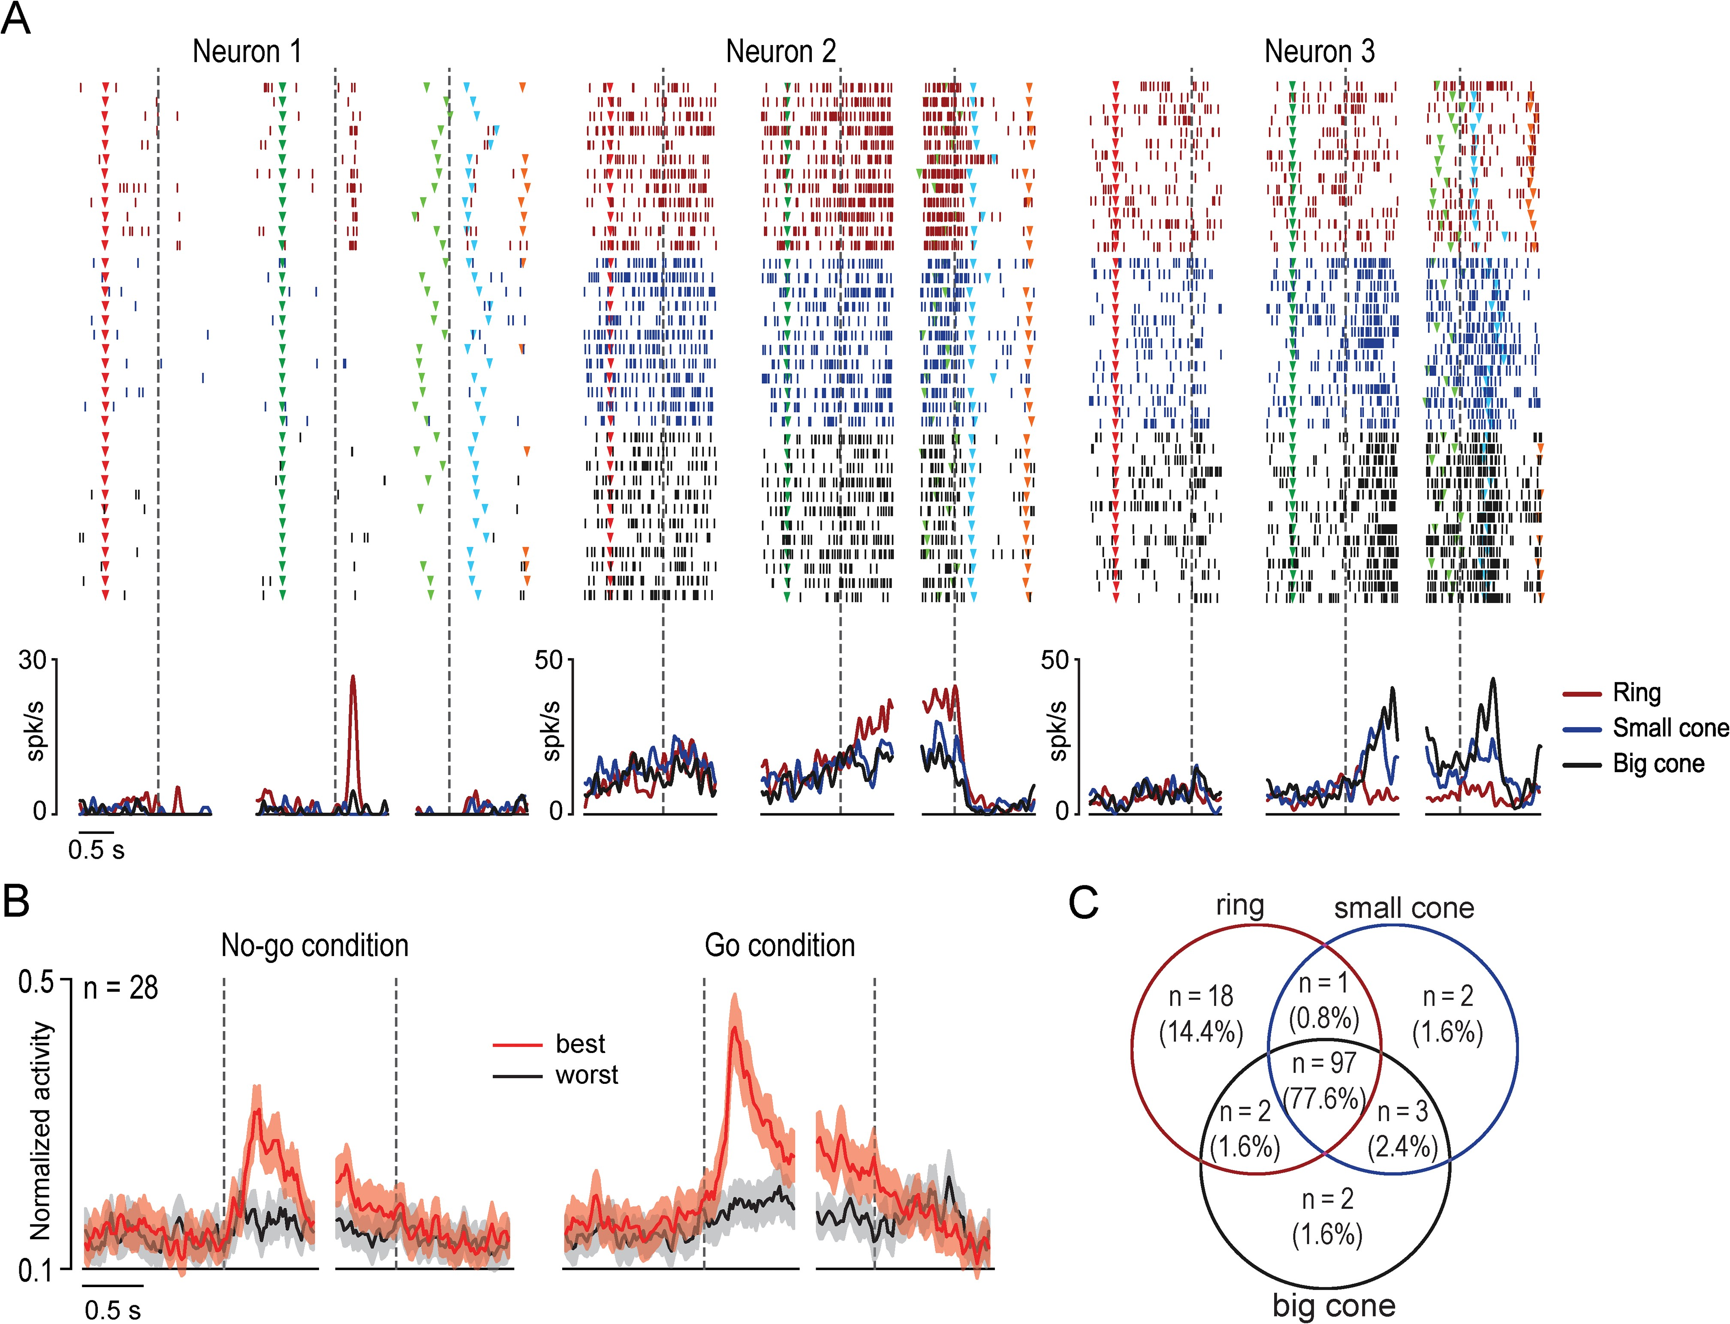
Figure 4. Functional properties of F6 visually-triggered neurons. (A) Examples of three F6 visually-triggered neurons ...
Notes:
Figure 4. Functional properties of F6 visually-triggered neurons. (A) Examples of three F6 visually-triggered neurons showing visual selectivity for the target object. For each neuron, rasters and spike density function have been aligned (dashed lines) to three different events, separated by a gap: 1) object presentation during no-go trials (on the left); 2) object presentation during go trials (on the center); 3) movement onset (on the right). Red triangular marker, no-go cue sound onset (beginning of the trial). Other conventions as in Figure 1. (B) Population activity of visually-triggered neurons with object selectivity. Best (red) and worst (gray) objects have been selected, for each neuron, based on the visual response during go-trials. In the no-go condition, the activity is aligned to the object presentation (dashed line on the left) and, after the gap, to the no-go signal (dashed line on the right). In the go condition, the activity is aligned to the object presentation (dashed line on the left) and, after the gap, to the movement onset (dashed line on the right). The population responses to object presentation during the go and no-go conditions have been analyzed separately by means of a 2 × 2 repeated measures ANOVA (factors: Object and Epoch). In both conditions, there was a stronger visual presentation response for the best relative to the worst object (P < 0.001), and the population response to this latter did not even reach significance during the no-go condition (P = 0.18). Furthermore, the population response to the presentation of the best object was stronger when it occurred during go relative to no-go trials (t = 4.77, P < 0.001). Another 2 × 3 repeated measures ANOVA (factors: Object and Epoch) has been performed on the movement-related population activity, as well as on the population response aligned to the no-go signal. Interestingly, we found a significant response only for the best object relative to baseline during the premovement epoch (P < 0.001) as well as during the epoch preceding the no-go signal (P < 0.001), but not during the reaching–grasping epoch. Furthermore, the population activity preceding movement onset and the no-go signal did not differ significantly from each other (t = 1.85, P = 0.075). (C) Number of visually-triggered neurons with visual selectivity for 1 or 2 of the target objects, or with no object selectivity.
Unless provided in the caption above, the following copyright applies to the content of this slide: © The Author 2016. Published by Oxford University Press.This is an Open Access article distributed under the terms of the Creative Commons Attribution Non-Commercial License (http://creativecommons.org/licenses/by-nc/4.0/), which permits non-commercial re-use, distribution, and reproduction in any medium, provided the original work is properly cited. For commercial re-use, please contact journals.permissions@oup.com

Slide 5
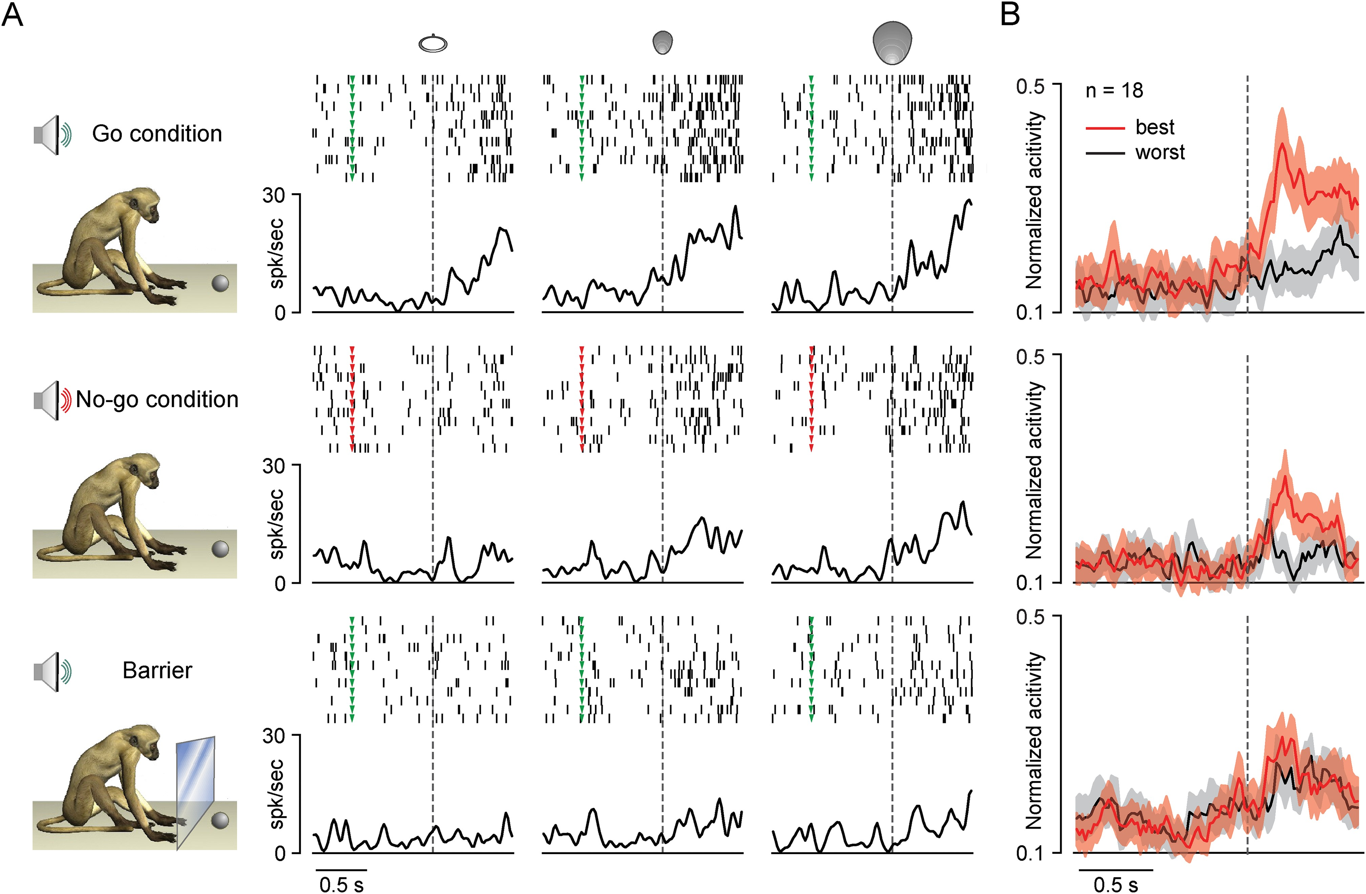
Figure 5. Visual responses of F6 neurons to object presentation in different contexts. (A) Example of an F6 ...
Notes:
Figure 5. Visual responses of F6 neurons to object presentation in different contexts. (A) Example of an F6 visually-triggered neuron showing visual selectivity for the small and the big cone and reduced response and selectivity when tested with a plastic barrier interposed between monkey's hand and the target. Conventions as in Figure 1. (B) Population activity of all F6 visually-triggered neurons tested in the three conditions. The population responses to object presentation have been analyzed separately by means of 2 × 2 repeated measures ANOVAs (factors: Object and Epoch). The visual presentation response was stronger for the best relative to the worst object during both go and no-go conditions (P < 0.001 for both post hoc comparisons), but not during the barrier test (P = 0.32). Furthermore, the population response to the presentation of the best object was stronger when it occurred during go relative to no-go trials (t = 3.09, P < 0.001), while it was not different between no-go trials and those during the barrier test (t = 0.015, P = 0.99). The population response to the presentation of the worst object did not differ significantly among any of the compared conditions (go vs. no-go trials: t = 0.82, P = 0.42; go vs. barrier: t = –1.09, P = 0.29; no-go vs. barrier: t = –1.99, P = 0.063).
Unless provided in the caption above, the following copyright applies to the content of this slide: © The Author 2016. Published by Oxford University Press.This is an Open Access article distributed under the terms of the Creative Commons Attribution Non-Commercial License (http://creativecommons.org/licenses/by-nc/4.0/), which permits non-commercial re-use, distribution, and reproduction in any medium, provided the original work is properly cited. For commercial re-use, please contact journals.permissions@oup.com

Slide 6
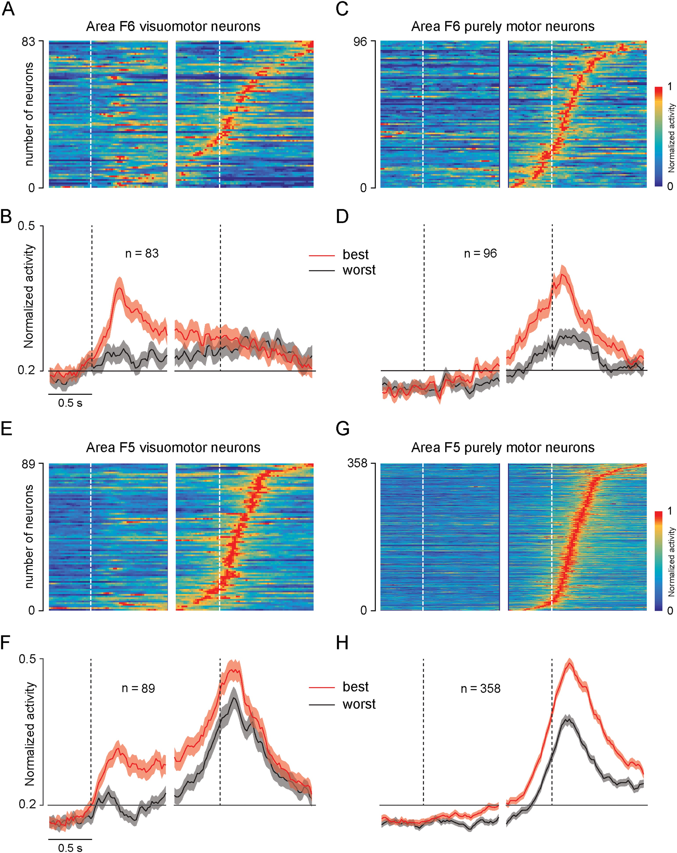
Figure 6. Comparison of neuronal dynamic and object selectivity between F5 and F6 visuomotor and purely motor neurons. ...
Notes:
Figure 6. Comparison of neuronal dynamic and object selectivity between F5 and F6 visuomotor and purely motor neurons. Normalized activity of (A) visuomotor and (C) purely motor neurons of area F6 ordered based on the timing of their peak of motor activity (earliest on bottom). Each row represents a single neuron. White dashed lines represent the different alignment events: first (on the left, before the gap) object presentation, second (on the right, after the gap) hand movement onset. (B and D) Averaged population activity of the visuomotor (B) and purely motor (D) neurons of area F6 shown in (A) and (C). Black dashed lines correspond to the same alignment events described in (A) and (C). Other conventions as in Figure 4B. (E–H) Normalized single neuron (E and G) and population (F and H) activity of visuomotor and purely motor neurons recorded from area F5 of the same animals and with the same task. All conventions as in (A–D).
Unless provided in the caption above, the following copyright applies to the content of this slide: © The Author 2016. Published by Oxford University Press.This is an Open Access article distributed under the terms of the Creative Commons Attribution Non-Commercial License (http://creativecommons.org/licenses/by-nc/4.0/), which permits non-commercial re-use, distribution, and reproduction in any medium, provided the original work is properly cited. For commercial re-use, please contact journals.permissions@oup.com

Slide 7
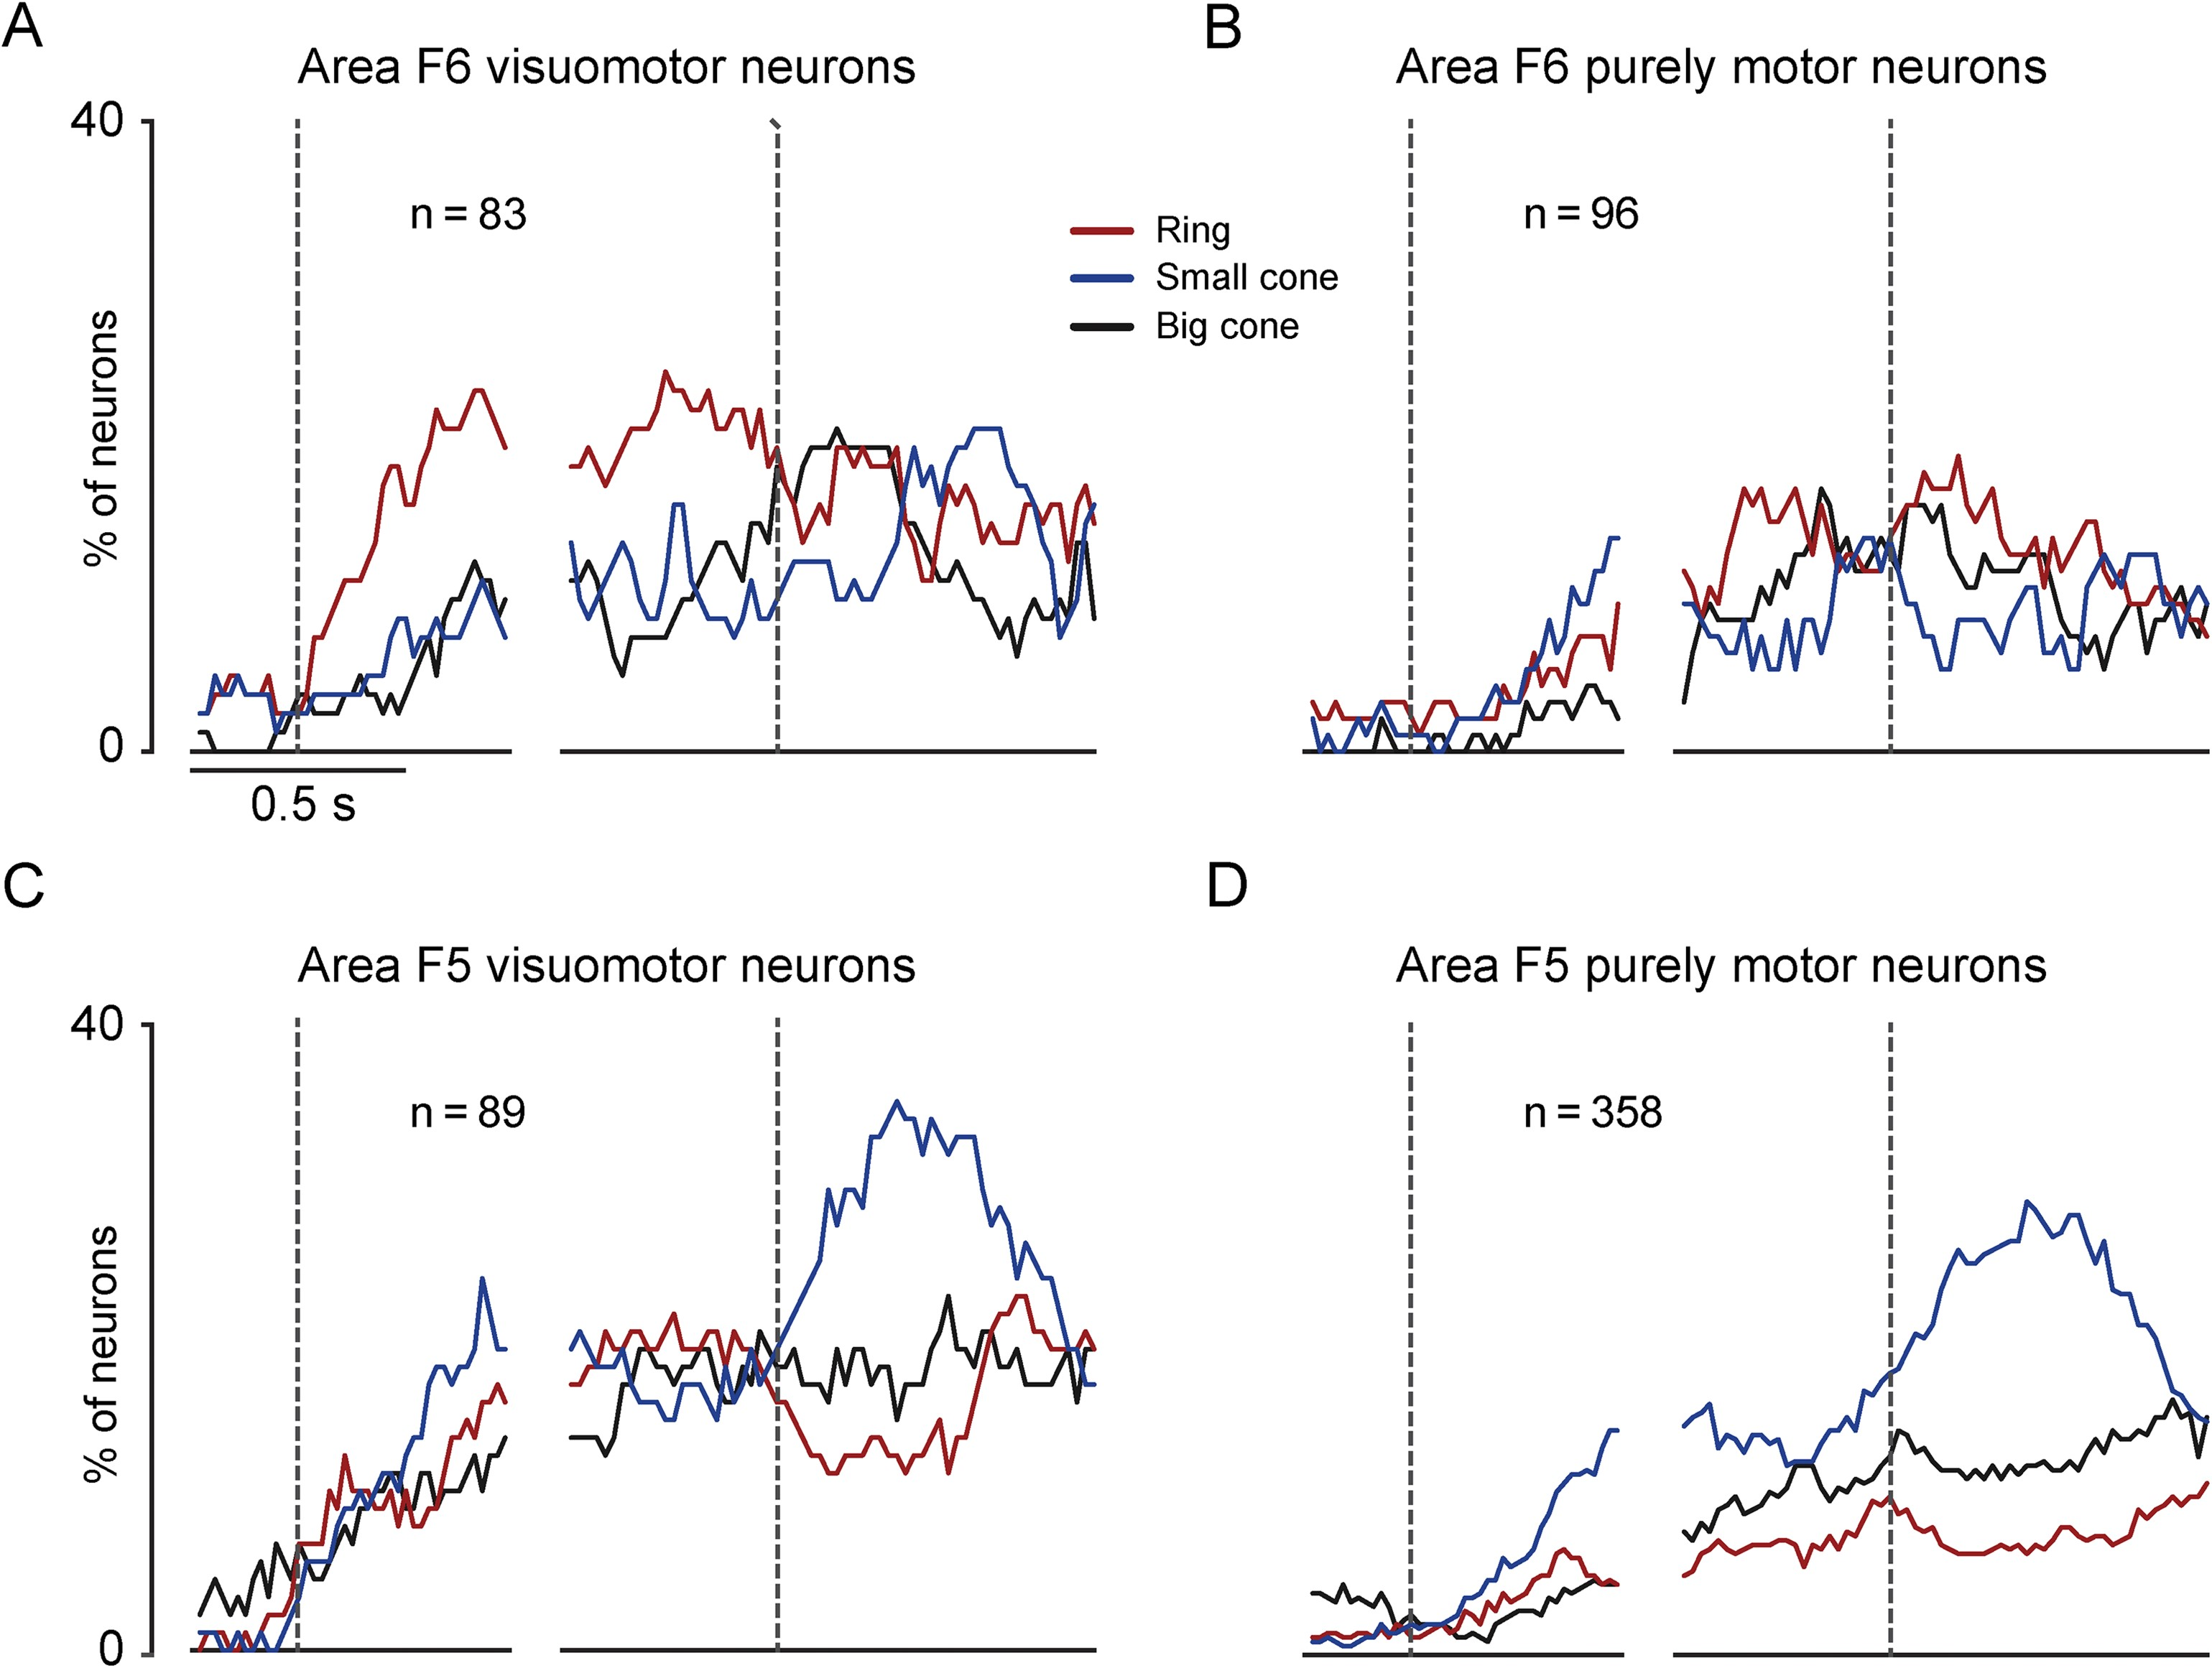
Figure 7. Comparison of object visual and motor selectivity of F5 and F6 neurons. (A–D) Each plot shows the percentage ...
Notes:
Figure 7. Comparison of object visual and motor selectivity of F5 and F6 neurons. (A–D) Each plot shows the percentage of neurons of each category and in each area exhibiting selectivity for one of the three tested objects during go-trials in the light (sliding 1-way repeated measures ANOVA, factor: Object, P < 0.05 uncorrected: see Materials and Methods).
Unless provided in the caption above, the following copyright applies to the content of this slide: © The Author 2016. Published by Oxford University Press.This is an Open Access article distributed under the terms of the Creative Commons Attribution Non-Commercial License (http://creativecommons.org/licenses/by-nc/4.0/), which permits non-commercial re-use, distribution, and reproduction in any medium, provided the original work is properly cited. For commercial re-use, please contact journals.permissions@oup.com

