Slide 1
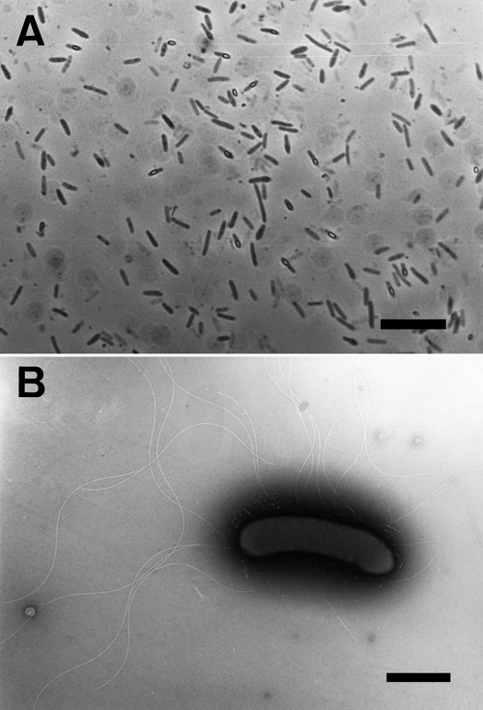
1 Phase-contrast and transmission electron micrographs of strain HTE831. A: Phase-contrast micrograph. Bar, 10 ...
Notes:
1 Phase-contrast and transmission electron micrographs of strain HTE831. A: Phase-contrast micrograph. Bar, 10 μm. B: Transmission electron micrograph. Bar, 1 μm. The strain was grown aerobically at pH 9.5 in PY medium containing 3% NaCl. For negative staining, one drop of culture was placed on a copper grid coated with 1% potassium phosphotungstic acid adjusted to pH 6.5 with potassium hydroxide.
Unless provided in the caption above, the following copyright applies to the content of this slide: © 2001 Federation of European Microbiological Societies

Slide 2
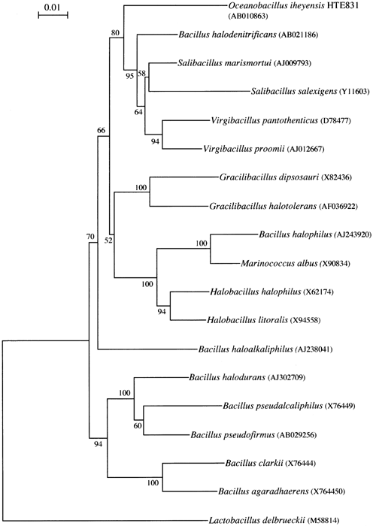
2 Unrooted phylogenetic tree based on 16S rDNA sequence comparison showing the relationship of strain HTE831 ...
Notes:
2 Unrooted phylogenetic tree based on 16S rDNA sequence comparison showing the relationship of strain HTE831 and other related strains. The numbers next to nodes indicate the percentages of bootstrap samples, derived from 1000 samples, which supported the internal branches [15]. Bootstrap probability values less than 50% were omitted from this figure. Five strains (Bacillus halodurans, B. pseudofirmus, B. pseudalkaliphilus, B. clarkii, and B. agaradhaerens) are alkaliphile and others are halophilic or halotolerant and alkaliphilic strains. The sequence of Lactobacillus delbrueckii has been included to serve as an outgroup. Bar, 0.01 Knuc unit
Unless provided in the caption above, the following copyright applies to the content of this slide: © 2001 Federation of European Microbiological Societies

Slide 3
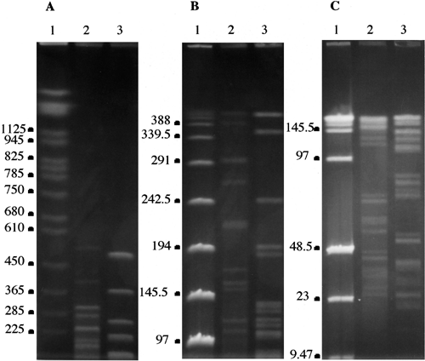
3 Digestion patterns of the chromosomal DNA of strain HTE831 obtained with Sse8387I and ApaI. A: Separation of ...
Notes:
3 Digestion patterns of the chromosomal DNA of strain HTE831 obtained with Sse8387I and ApaI. A: Separation of fragments ranging in size from 200 to 1000 kb. B: Separation of fragments ranging in size from 100 to 400 kb. C: Separation of fragments ranging in size from 5 to 75 kb. Lanes: 1, Molecular size marker; 2, complete ApaI digestion; 3, complete Sse8387I digestion
Unless provided in the caption above, the following copyright applies to the content of this slide: © 2001 Federation of European Microbiological Societies

