Slide 1
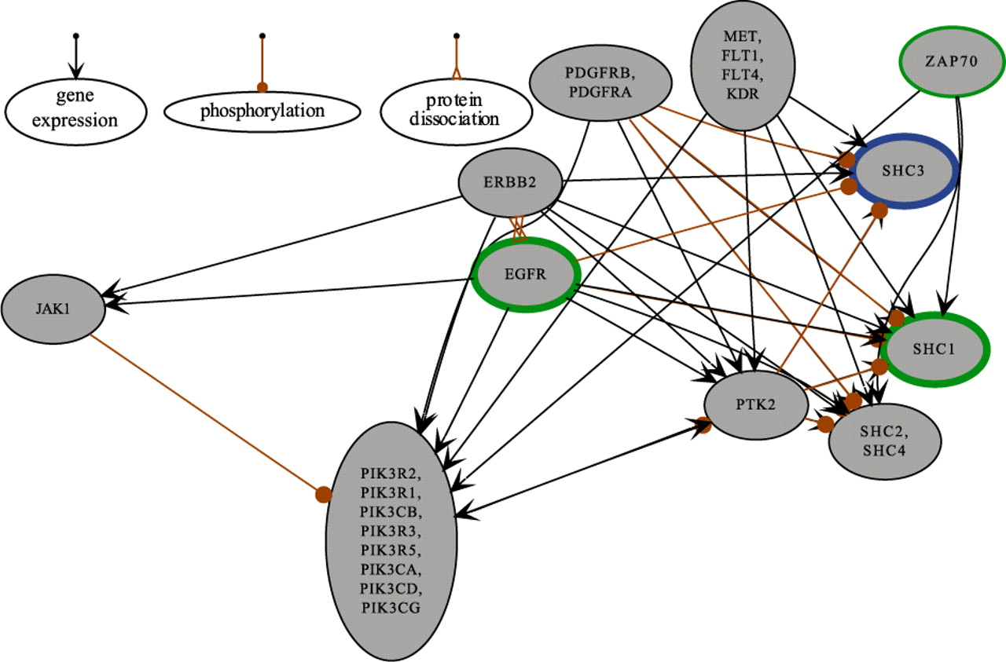
Fig. 1. A snapshot of a Moksiskaan network constructed with 124 survival-associated genes. Edge colors and end point ...
Notes:
Fig. 1. A snapshot of a Moksiskaan network constructed with 124 survival-associated genes. Edge colors and end point shapes distinguish between the connection types as described in the upper left corner. Green and blue borders refer to up- and downregulated genes (absolute fold-change > 2), respectively. Measured gene expressions are shown with bold borders while predictions made by Moksiskaan are thin.
Unless provided in the caption above, the following copyright applies to the content of this slide: © The Author 2010. Published by Oxford University Press. All rights reserved. For Permissions, please email: journals.permissions@oxfordjournals.org

