Slide 1
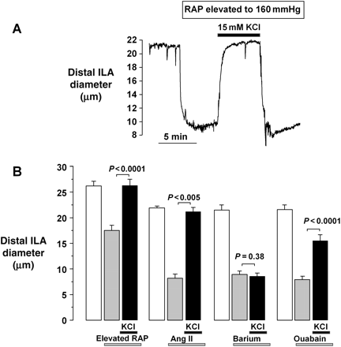
Figure 1 K⁺-induced dilation of distal ILA. (A) Tracing illustrating vasoconstriction elicited by elevating ...
Notes:
Figure 1 K+-induced dilation of distal ILA. (A) Tracing illustrating vasoconstriction elicited by elevating RAP from 80 to 160 mmHg and the vasodilation seen upon elevating [K+]o from 5 to 15 mmol/L (KCl, black bar). Note that the vasoconstriction was restored when [K+]o was returned to 5 mmol/L. (B) Mean data comparing distal ILA response to elevated [K+]o in the presence of vasoconstriction elicited by elevated pressure (n= 26), Ang II (n= 4), 100 µmol/L Ba2+ (n= 6), and 3 mmol/L ouabain (n= 11, 10 µmol/L propranolol and phentolamine present). Vasodilation was blocked by Ba2+, but not by ouabain.
Unless provided in the caption above, the following copyright applies to the content of this slide: Published on behalf of the European Society of Cardiology. All rights reserved. © The Author 2011. For permissions please email: journals.permissions@oup.com.

Slide 2
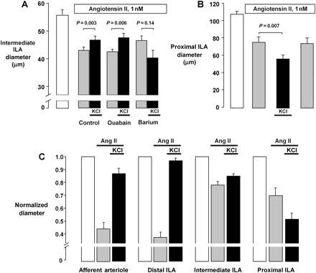
Figure 2 Responses of intermediate and proximal ILA to elevated [K⁺]_{o}. (A) Intermediate ILA ...
Notes:
Figure 2 Responses of intermediate and proximal ILA to elevated [K+]o. (A) Intermediate ILA pre-constricted with Ang II (grey bars) exhibited significant vasodilation when [K+]o was elevated from 5 to 15 mmol/L (black bars). This response was preserved in the presence of ouabain [3 mmol/L, with 10 µmol/L propranolol and phentolamine present (n= 6)], but was prevented by addition of Ba2+ (100 µmol/L). (B) Proximal ILA did not dilate in response to increased [K+]o , but rather exhibited an increased vasoconstriction (n= 6). (C) Comparison of responses of distal, intermediate and proximal responses, observed during Ang II-induced vasoconstriction. For comparative purposes, previously published data13 for the afferent arteriole under the same experimental conditions are shown.
Unless provided in the caption above, the following copyright applies to the content of this slide: Published on behalf of the European Society of Cardiology. All rights reserved. © The Author 2011. For permissions please email: journals.permissions@oup.com.

Slide 3
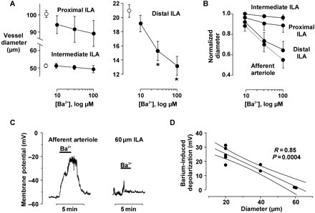
Figure 3 Segment-specific effects of Ba²⁺ on diameters (A and B, perfused kidney model) and membrane ...
Notes:
Figure 3 Segment-specific effects of Ba2+ on diameters (A and B, perfused kidney model) and membrane potential (C and D, isolated vessels). (A) Ba2+ (30 and 100 µmol/L) did not cause vasoconstriction in proximal (n= 9) or intermediate (n= 5) ILA segments, but induced significant vasoconstriction in the distal ILA (*P< 0.03 vs. basal diameter, n= 6). (B) Comparison of Ba2+ responses of ILA segments. For comparative purposes, previously published data12 for the afferent arteriole are also shown. (C) Tracings illustrating effects of Ba2+ on membrane potential of isolated renal microvessels. (D) Relationship between vessel diameter and magnitude of Ba2+-induced depolarization in nine isolated afferent arterioles and ILA segments.
Unless provided in the caption above, the following copyright applies to the content of this slide: Published on behalf of the European Society of Cardiology. All rights reserved. © The Author 2011. For permissions please email: journals.permissions@oup.com.

Slide 4
Figure 6 (A) Effect of Ba²⁺ on myogenic response. Myogenic responses were initially assessed under control ...
Notes:
Figure 6 (A) Effect of Ba2+ on myogenic response. Myogenic responses were initially assessed under control conditions for both types of treatment (filled symbols). The kidneys were then exposed to similar levels of vasoconstriction induced by Ang II (0.1 nmol/L, circles) or Ba2+ (100 µmol/L, squares). The KATP opener pinacidil (1.0 µmol/L) was then administered to partially restore basal diameters and allow myogenic reactivity to be reassessed. (B) Comparisons of the myogenic responses in Ang II (open circles) or Ba2+ (open squares) to the corresponding controls (filled symbols). Diameters were normalized to per cent of basal diameter (80 mmHg). *P< 0.05 vs. control.
Unless provided in the caption above, the following copyright applies to the content of this slide: Published on behalf of the European Society of Cardiology. All rights reserved. © The Author 2011. For permissions please email: journals.permissions@oup.com.

Slide 5
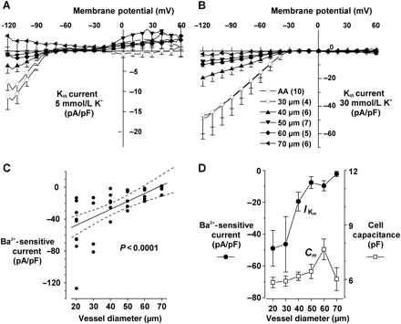
Figure 5 (A and B) Current–voltage relationships for Ba²⁺-sensitive I_{KIR} densities in the ...
Notes:
Figure 5 (A and B) Current–voltage relationships for Ba2+-sensitive IKIR densities in the myocytes isolated from afferent arterioles (AA) and ILA segments. IKIR obtained by subtracting residual currents in presence of 100 µmol/L Ba2+ from basal currents in either 5 (A) or 30 (B) mmol/L [K+]o. Numbers in parentheses correspond to the number of myocytes in each group. (C) Relationship between IKIR (measured at −120 mV) and the vessel diameter. Note significant correlation (R = −0.63, P< 0.0001). The dashed lines represent 95% confidence interval. (D) IKIR density was independent on the size of the myocyte, as estimated by cell capacitance.
Unless provided in the caption above, the following copyright applies to the content of this slide: Published on behalf of the European Society of Cardiology. All rights reserved. © The Author 2011. For permissions please email: journals.permissions@oup.com.

Slide 6
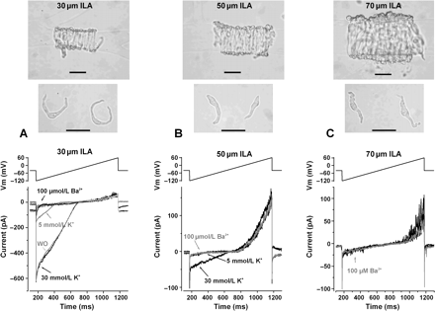
Figure 4 Top panel depicts examples of ILA segments and myocytes obtained using the gel-perfusion technique ...
Notes:
Figure 4 Top panel depicts examples of ILA segments and myocytes obtained using the gel-perfusion technique (calibration bar = 30 µm). Bottom panel depicts tracings of voltage ramp protocol and current recordings measured in 5 mmol/L and 30 mmol/L [K+]o in the absence and presence of 100 µmol/L Ba2+. The proximal (30 µm) ILA myocyte exhibited a significant Ba2+-sensitive inward current (IKIR) in 5 mmol/L [K+]o, whereas IKIR could not be detected in myocytes from larger ILA under this condition. In 30 mmol/L [K+]o , a substantially larger IKIR is seen in the distal ILA myocyte (A) and IKIR could also be detected in the intermediate (50 µm) ILA myocyte (B), but not in the proximal (70 µm) ILA myocyte (C) ILA. Trace ‘WO’ (wash out, A) shows reversibility of Ba2+ effect.
Unless provided in the caption above, the following copyright applies to the content of this slide: Published on behalf of the European Society of Cardiology. All rights reserved. © The Author 2011. For permissions please email: journals.permissions@oup.com.

