Slide 1
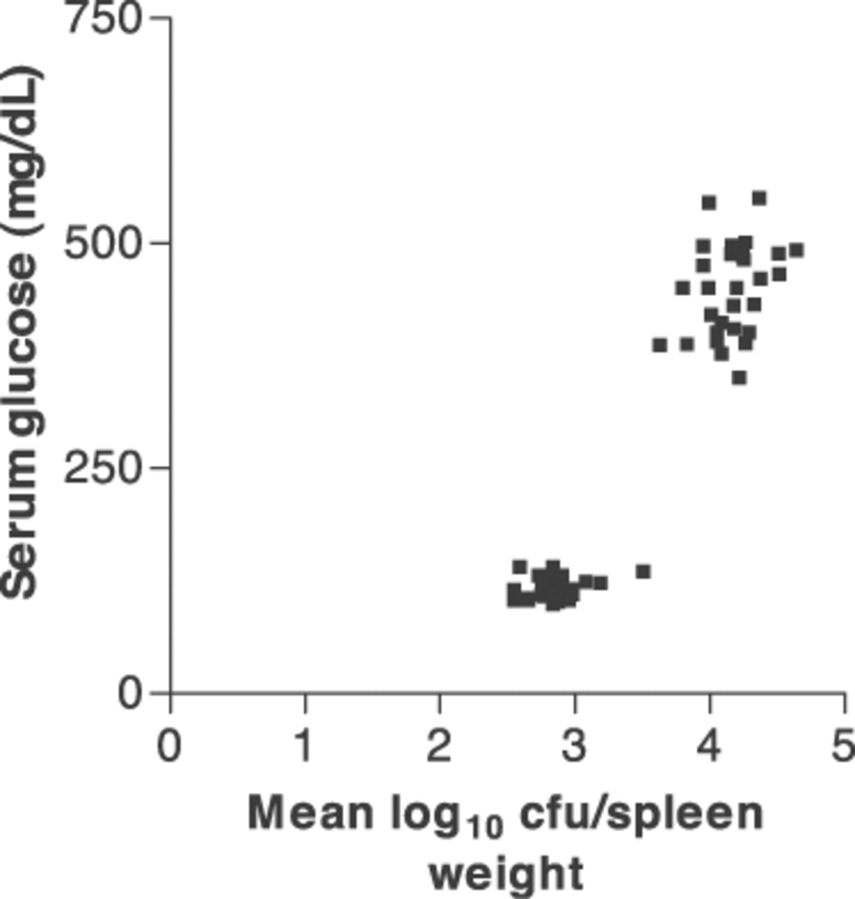
Figure 1 Relationship of streptozotocin-induced diabetes and Brucella melitensis infection of rats. Statistically ...
Notes:
Figure 1 Relationship of streptozotocin-induced diabetes and Brucella melitensis infection of rats. Statistically significant correlation (r=0.902, P<0.05) occurs between the amount of streptozotocin and severity of B. melitensis infection of rats.
Unless provided in the caption above, the following copyright applies to the content of this slide: © 2003 Federation of European Microbiological Societies.

