Slide 1
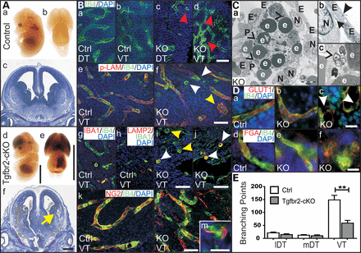
Figure 1. Conditional deletion of Tgfbr2 impaired angiogenesis and showed prominent ICH. (A) (a–f) Tgfbr2-cKO displayed ...
Notes:
Figure 1. Conditional deletion of Tgfbr2 impaired angiogenesis and showed prominent ICH. (A) (a–f) Tgfbr2-cKO displayed haemorrhages in the CNS at E14.5 compared with controls, mostly in VT (yellow arrows). (B) (a–d) IB4-positive cells appeared in clusters at E13.5 in VT of Tgfbr2-cKO (red arrow heads), but not of controls. (e–j) Some clusters contained a basal lamina (p-LAM-/IB4-positive, yellow arrow heads); some were activated microglia cells (IBA1/LAMP2-positive, white arrow heads). (k–m) NG2-positive pericytes covered vessels and EC clusters. (C) (a–c) EM of Tgfbr2-cKO (E12.5) showed phagocytic cells in VT. Phagocytosis of extravascular erythrocytes (e) was displayed by different digestion stages and vesicular structures (black hollow arrowheads, a, c). EC (E) were covered by pericytes (P) and basal lamina (black arrow). They were connected by cell junctions (black arrowheads). ECM and neural cells (N) were less dense around vessels. (D) (a–f) Discontinued GLUT1 expression (white arrow heads) and extravascular fibrinogen (FGA) in EC clusters of Tgfbr2-cKO in VT showed permeability of vessels. FGA was localized intravascular in normal vessels of Tgfbr2-cKO and control. (E) Less branching points were detected in VT of Tgfbr2-cKO compared with controls at E13.5 (n = 3). lDT: lateral dorsal telencephalon; mDT: medial DT; VT, ventral telencephalon; scale bars: 500 μm (Aa, b, d, e), 200 µm (Ac, f), 50 µm (B), 5 µm (Ca), 1 µm (Cb), 0.5 µm (Cc) and 20 µm (Bm, D).
Unless provided in the caption above, the following copyright applies to the content of this slide: © The Author 2014. Published by Oxford University PressThis is an Open Access article distributed under the terms of the Creative Commons Attribution Non-Commercial License (http://creativecommons.org/licenses/by-nc/4.0/), which permits non-commercial re-use, distribution, and reproduction in any medium, provided the original work is properly cited. For commercial re-use, please contact journals.permissions@oup.com

Slide 2
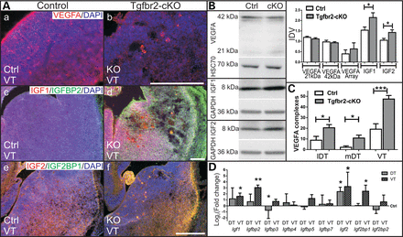
Figure 2. Altered expression of VEGFA, IGF1, -2 and IGF-binding proteins. (A) (a–b) VEGFA accumulated in E13.5 ...
Notes:
Figure 2. Altered expression of VEGFA, IGF1, -2 and IGF-binding proteins. (A) (a–b) VEGFA accumulated in E13.5 Tgfbr2-cKO compared with controls. (c–f) IGF1, -2, IGFBP2 and IGF2BP1 expression increased in Tgfbr2-cKO. (B) Immunoblot and densitometric analyses revealed unchanged VEGFA isoform (21 and 42 kDa) expression in protein extracts from forebrains of Tgfbr2-cKO compared with controls at E13.5 (n = 7). AP-array confirmed unchanged VEGFA protein levels in lysed hemispheres of E13.5 control and mutant embryos (n = 2). Immunoblots and densitometric analyses revealed increased IGF1 (n = 7) and IGF2 (n = 4) expression in Tgfbr2-cKO forebrains at E13.5 compared with control forebrain lysates. (C) Quantification revealed an increased amount of VEGFA complexes in Tgfbr2-cKO compared with controls in lDT, mDT and VT at E13.5. (D) qRTPCR of cultivated cells from E13.5 DT and VT showed increased Igf1, -bp2 and Igf2bp1 in VT and reduced Igfbp3 expression in DT (n = 3). Log2 of the fold change is given compared with control. IDV, integrated density value; scale bar: 200 µm.
Unless provided in the caption above, the following copyright applies to the content of this slide: © The Author 2014. Published by Oxford University PressThis is an Open Access article distributed under the terms of the Creative Commons Attribution Non-Commercial License (http://creativecommons.org/licenses/by-nc/4.0/), which permits non-commercial re-use, distribution, and reproduction in any medium, provided the original work is properly cited. For commercial re-use, please contact journals.permissions@oup.com

Slide 3
Figure 3. Increased ID1 expression in Tgfbr2-cKO. (A–H) Staining, immunoblot and densitometric analyses at E13.5 in ...
Notes:
Figure 3. Increased ID1 expression in Tgfbr2-cKO. (A–H) Staining, immunoblot and densitometric analyses at E13.5 in Tgfbr2-cKO (n = 5). Normal vessels and EC cluster of Tgfbr2-cKO contained ID1-positive cells. Scale bars: 200 µm (A, D) and 20 µm (B–F).
Unless provided in the caption above, the following copyright applies to the content of this slide: © The Author 2014. Published by Oxford University PressThis is an Open Access article distributed under the terms of the Creative Commons Attribution Non-Commercial License (http://creativecommons.org/licenses/by-nc/4.0/), which permits non-commercial re-use, distribution, and reproduction in any medium, provided the original work is properly cited. For commercial re-use, please contact journals.permissions@oup.com

Slide 4
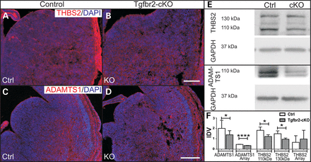
Figure 4. Decreased expression of THBS2 and ADAMTS1 in Tgfbr2-cKO. (A–D) Staining for THBS2 and ADAMTS1 showed reduced ...
Notes:
Figure 4. Decreased expression of THBS2 and ADAMTS1 in Tgfbr2-cKO. (A–D) Staining for THBS2 and ADAMTS1 showed reduced expression in forebrains of Tgfbr2-cKO at E13.5. (E and F) Immunoblots and densitometric analyses of THBS2 (n = 3) and ADAMTS1 (n = 9) confirmed reduced THBS2 and ADAMTS1 expression in Tgfbr2-cKO at E13.5. AP-array (n = 2) revealed reduced ADAMTS1. Scale bar: 200 µm.
Unless provided in the caption above, the following copyright applies to the content of this slide: © The Author 2014. Published by Oxford University PressThis is an Open Access article distributed under the terms of the Creative Commons Attribution Non-Commercial License (http://creativecommons.org/licenses/by-nc/4.0/), which permits non-commercial re-use, distribution, and reproduction in any medium, provided the original work is properly cited. For commercial re-use, please contact journals.permissions@oup.com

Slide 5
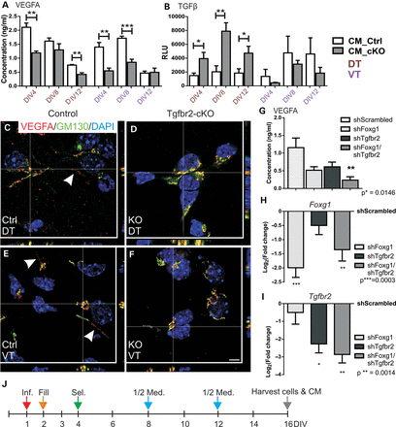
Figure 5. Altered secretion of VEGFA and TGFβ in Tgfbr2-cKO, localization of VEGFA in Golgi apparatus of Tgfbr2-cKO and ...
Notes:
Figure 5. Altered secretion of VEGFA and TGFβ in Tgfbr2-cKO, localization of VEGFA in Golgi apparatus of Tgfbr2-cKO and reduced VEGFA secretion in Tgfbr2 and Foxg1 double knock-down cortical cells. (A) E13.5-derived cultured cells of Tgfbr2-cKO (grey bars) and controls (white bars) secreted less VEGFA at DIV4 in DT and VT as well as at DIV12 in DT and DIV8 in VT, as detected by ELISA (n = 3 DT, brown; n = 4 VT, pink). (B) MLEC assay revealed increased TGFβ levels in CM of Tgfbr2-cKO in DT at DIV4–12, but not in VT (n = 4). (C–F) VEGFA was localized inside the Golgi complex in DT and VT of Tgfbr2-cKO, whereas cells of controls displayed occasional staining outside the Golgi (white arrowheads). (G) CM of E13.5 cortical cells infected with shFoxg1 and shTgfbr2 secreted less VEGFA compared with shScrambled control at DIV16 as analysed by ELISA (n = 4). (H and I) Verification of knock-down of Foxg1 and Tgfbr2 in cortical cells confirmed via qRTPCR (n = 4). Log2 of the fold change is given compared with shScrambled-infected cells. (J) Time line of infection regime of cortical cells with viral particles. On DIV1, viral particles were applied in a reduced medium volume (red arrow). Volume was increased to normal level on DIV2 (orange arrow). Selection with puromycin occurred after removal of viral particles on DIV4 (green arrow). Half medium changes followed every 4 days (blue arrows) until cells and CM were harvested on DIV16 (grey arrow). Data were analysed using unpaired student’s t-test (A, B) and one-way ANOVA, followed by Sidak post-test (G–I). Scale bar: 5 µm.
Unless provided in the caption above, the following copyright applies to the content of this slide: © The Author 2014. Published by Oxford University PressThis is an Open Access article distributed under the terms of the Creative Commons Attribution Non-Commercial License (http://creativecommons.org/licenses/by-nc/4.0/), which permits non-commercial re-use, distribution, and reproduction in any medium, provided the original work is properly cited. For commercial re-use, please contact journals.permissions@oup.com

Slide 6
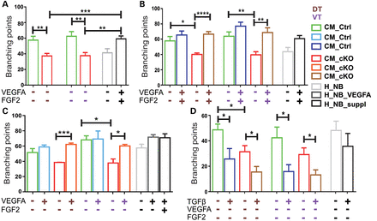
Figure 6. Impaired vascular branching of HUVEC treated with CM of Tgfbr2-cKO and rescue of the defect with VEGFA ...
Notes:
Figure 6. Impaired vascular branching of HUVEC treated with CM of Tgfbr2-cKO and rescue of the defect with VEGFA stimulation. (A) HUVEC cultured in CM_cKO (red, n = 8) had less branches compared with CM_Ctrl (green, n = 8). HUVEC showed increased branching under control condition H_NB_suppl (black) that stimulated angiogenesis, compared with unstimulated control condition H_NB (grey, n = 7). (B) VEGFA/FGF2 supplementation of CM_cKO rescued the branching defect (brown, n = 7), but only slightly increased sprouting in CM_Ctrl (blue, n = 7). Branching was increased when HUVEC were treated with VEGFA and FGF2 (H_NB_suppl) compared with the unstimulated condition (H_NB) (n = 6). (C) VEGFA supplementation rescued sprouting defects in CM_cKO (orange, n = 3) and slightly improved branching in CM_Ctrl (light blue, n = 3) like in controls (n = 2). (D) TGFβ supplementation reduced branching in CM_Ctrl (blue, n = 4), in CM_cKO (brown, n = 4) and in H_NB_suppl (grey, n = 3).
Unless provided in the caption above, the following copyright applies to the content of this slide: © The Author 2014. Published by Oxford University PressThis is an Open Access article distributed under the terms of the Creative Commons Attribution Non-Commercial License (http://creativecommons.org/licenses/by-nc/4.0/), which permits non-commercial re-use, distribution, and reproduction in any medium, provided the original work is properly cited. For commercial re-use, please contact journals.permissions@oup.com

Slide 7
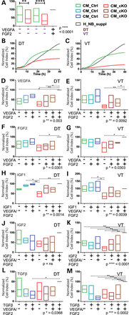
Figure 7. Impaired HUVEC migration through altered secretion of VEGFA, FGF2, IGF1, -2 and TGFβ. (A) Box-plot of ...
Notes:
Figure 7. Impaired HUVEC migration through altered secretion of VEGFA, FGF2, IGF1, -2 and TGFβ. (A) Box-plot of end-point analyses of RTCA revealed reduced migration of HUVEC towards CM_cKO (red) compared with CM_Ctrl (green) of DT and VT (n = 20). The values for H_NB_suppl were set to 100% to normalize between different experiments and are therefore represented as an invariant grey line. (B and C) Growth curves of one representative experiment from DT and VT, respectively. Red line: CM_cKO, green line: CM_ctrl, grey line: H_NB_suppl control condition. (D and E) Box-plot representation of RTCA end-point analyses after supplementation with VEGFA alone, or in combination with FGF2. Addition of VEGFA alone rescued migration towards CM_cKO in VT-derived samples, but not in DT-derived samples (dark red). This is indicated by the loss of a significant difference between the treatment and control condition. Combined addition of VEGFA and FGF2 rescued migration in DT-derived samples, but not in VT-derived samples (light brown) (n = 3 for all experiments). (F and G) Box-plot of RTCA end-point analyses after supplementation with FGF2 alone or in combination with VEGFA. Addition of FGF2 rescued migration towards both VT- and DT-derived CM_cKO (dark red and light brown), also in the presence of VEGFA (n = 3 for all experiments). (H and I) Box-plot of RTCA end-point analyses after IGF1 addition rescued migration in DT-derived medium but had no significant effect in VT-derived medium (dark red). Combined addition of IGF1 with VEGFA and FGF2 did not improve migration further (light brown) (n = 3 DT, n = 4 VT). (J and K) Box-plot of RTCA end-point analyses after IGF2 supplementation. IGF2 addition alone did not rescue migration towards CM_cKO from both sources. Combined addition of IGF2 with VEGFA and FGF2 rescued in VT-derived CM_cKO (n = 4 DT, n = 5 VT). (L–M) Box-plot of end-point analyses after TGFβ1 supplementation, which impaired migration in the CM_Ctrl conditions, most strikingly in the presence of VEGFA and FGF2 (light and dark blue, n = 4). Data in A–M were normalized to H_NB_suppl (grey) of the respective experiment. All data were analysed by one-way ANOVA, followed by Sidak post-test.
Unless provided in the caption above, the following copyright applies to the content of this slide: © The Author 2014. Published by Oxford University PressThis is an Open Access article distributed under the terms of the Creative Commons Attribution Non-Commercial License (http://creativecommons.org/licenses/by-nc/4.0/), which permits non-commercial re-use, distribution, and reproduction in any medium, provided the original work is properly cited. For commercial re-use, please contact journals.permissions@oup.com

