Slide 1
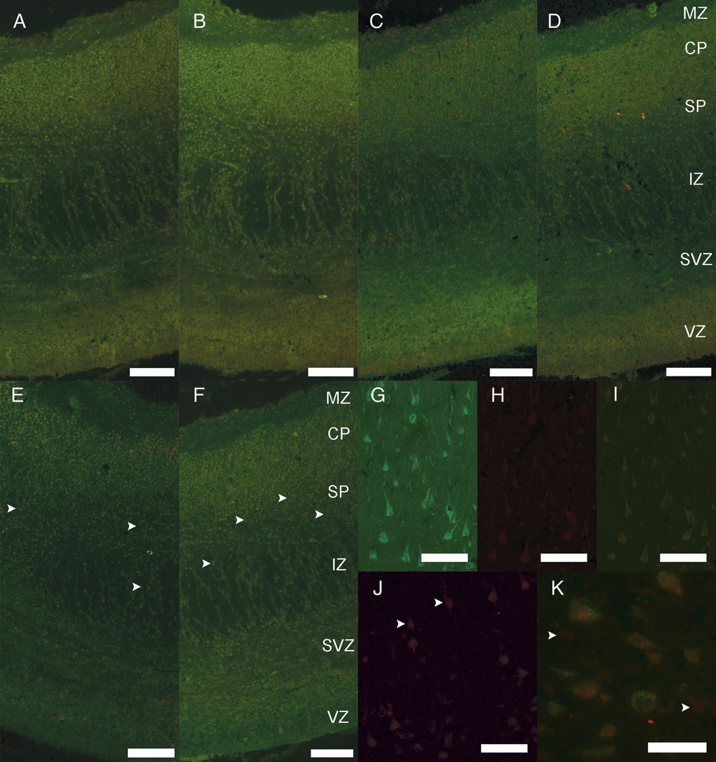
Figure 1. Double labeling of PCDH11X/Y. (A–D) Merged images showing co-localization of all PCDH11X/Y antibodies in the ...
Notes:
Figure 1. Double labeling of PCDH11X/Y. (A–D) Merged images showing co-localization of all PCDH11X/Y antibodies in the fetal cerebral cortex, 13 PCW female (A, Procad1a: green, anti-PCDH11X/Y: red; B, Procad1a: green, X11: red; C, Ex6: green, X11: red; D, Ex6: green, anti-PCDH11X/Y: red). (E and F) Merged images showing co-localization of PCDH11X/Y with DCX and NPY in the fetal cerebral cortex, 13 PCW female (E, Procad1a: green, DCX: red; F, Procad1a: green, NPY: red). Arrowheads in (E and F) highlight the co-expression of PCDH11X/Y in the SP and IZ with DCX and NPY, respectively. (G–K) Adult cerebral cortex, female (G, Procad1a: green; H, anti-PCDH11X/Y: red; I, merged image; J, calretinin: green, anti-PCDH11X/Y: red; K, calbindin: green, anti-PCDH11X/Y: red). Arrowheads in (J and K) highlight the expression of PCDH11X/Y in the absence of calretinin and calbindin, respectively. Scale bars: (A–J) 100 μm; (K): 25 μm. CP, cortical plate; IZ, intermediate zone; MZ, marginal zone; SP, subplate; SVZ, subventricular zone; VZ, ventricular zone.
Unless provided in the caption above, the following copyright applies to the content of this slide: © The Author 2012. Published by Oxford University Press.This is an Open Access article distributed under the terms of the Creative Commons Attribution Non-Commercial License (http://creativecommons.org/licenses/by-nc/3.0), which permits unrestricted non-commercial use, distribution, and reproduction in any medium, provided the original work is properly cited.

Slide 2
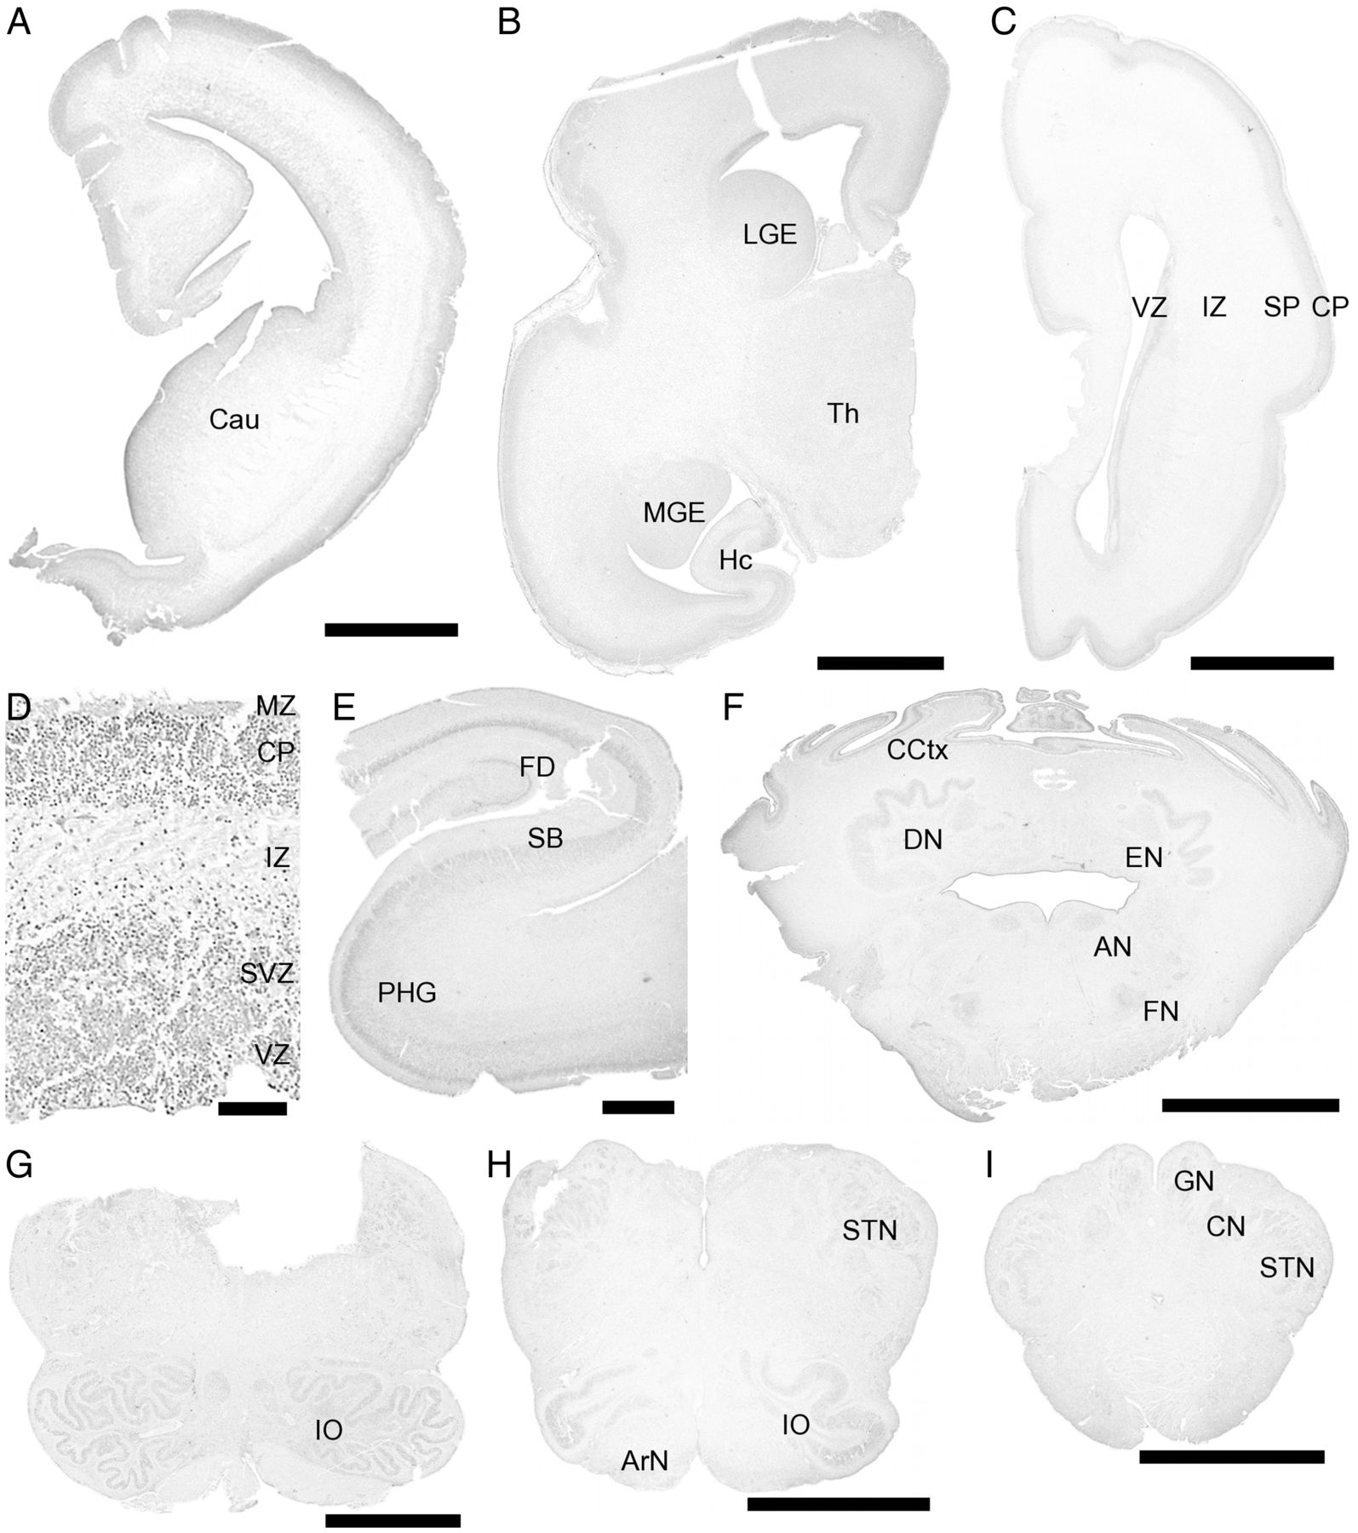
Figure 2. Expression of PCDH11X/Y in the fetal brain. Cerebral cortex (A, 14 PCW female; B, 16 PCW male; C, 19 PCW ...
Notes:
Figure 2. Expression of PCDH11X/Y in the fetal brain. Cerebral cortex (A, 14 PCW female; B, 16 PCW male; C, 19 PCW male; D, 12 PCW male), hippocampal formation (E, 18 PCW female), cerebellum and pons (F, 18 PCW female), and medulla oblongata (G, 27 PCW male; H and I, 18 PCW female). Scale bars: (A, F–I): 3000 μm; (B, C): 5000 μm; (D) 100 μm; (E) 1000 μm. AN, abducens nucleus; ArN, arcuate nucleus; Cau, caudate; CCtx, cerebellar cortex; CN, cuneate nucleus; CP, cortical plate; DN, dentate nucleus; EN, emboliform nucleus; FD, fascia dentata; FN, facial nucleus; GN, gracile nucleus; Hc, hippocampal formation; IO, inferior olivary nucleus; IZ, intermediate zone; LGE, lateral ganglionic eminence; MGE, medial ganglionic eminence; MZ, marginal zone; PHG, parahippocampal gyrus; SB, subiculum; SP, subplate; STN, spinal trigeminal nucleus; SVZ, subventricular zone; Th, thalamus; VZ, ventricular zone.
Unless provided in the caption above, the following copyright applies to the content of this slide: © The Author 2012. Published by Oxford University Press.This is an Open Access article distributed under the terms of the Creative Commons Attribution Non-Commercial License (http://creativecommons.org/licenses/by-nc/3.0), which permits unrestricted non-commercial use, distribution, and reproduction in any medium, provided the original work is properly cited.

Slide 3
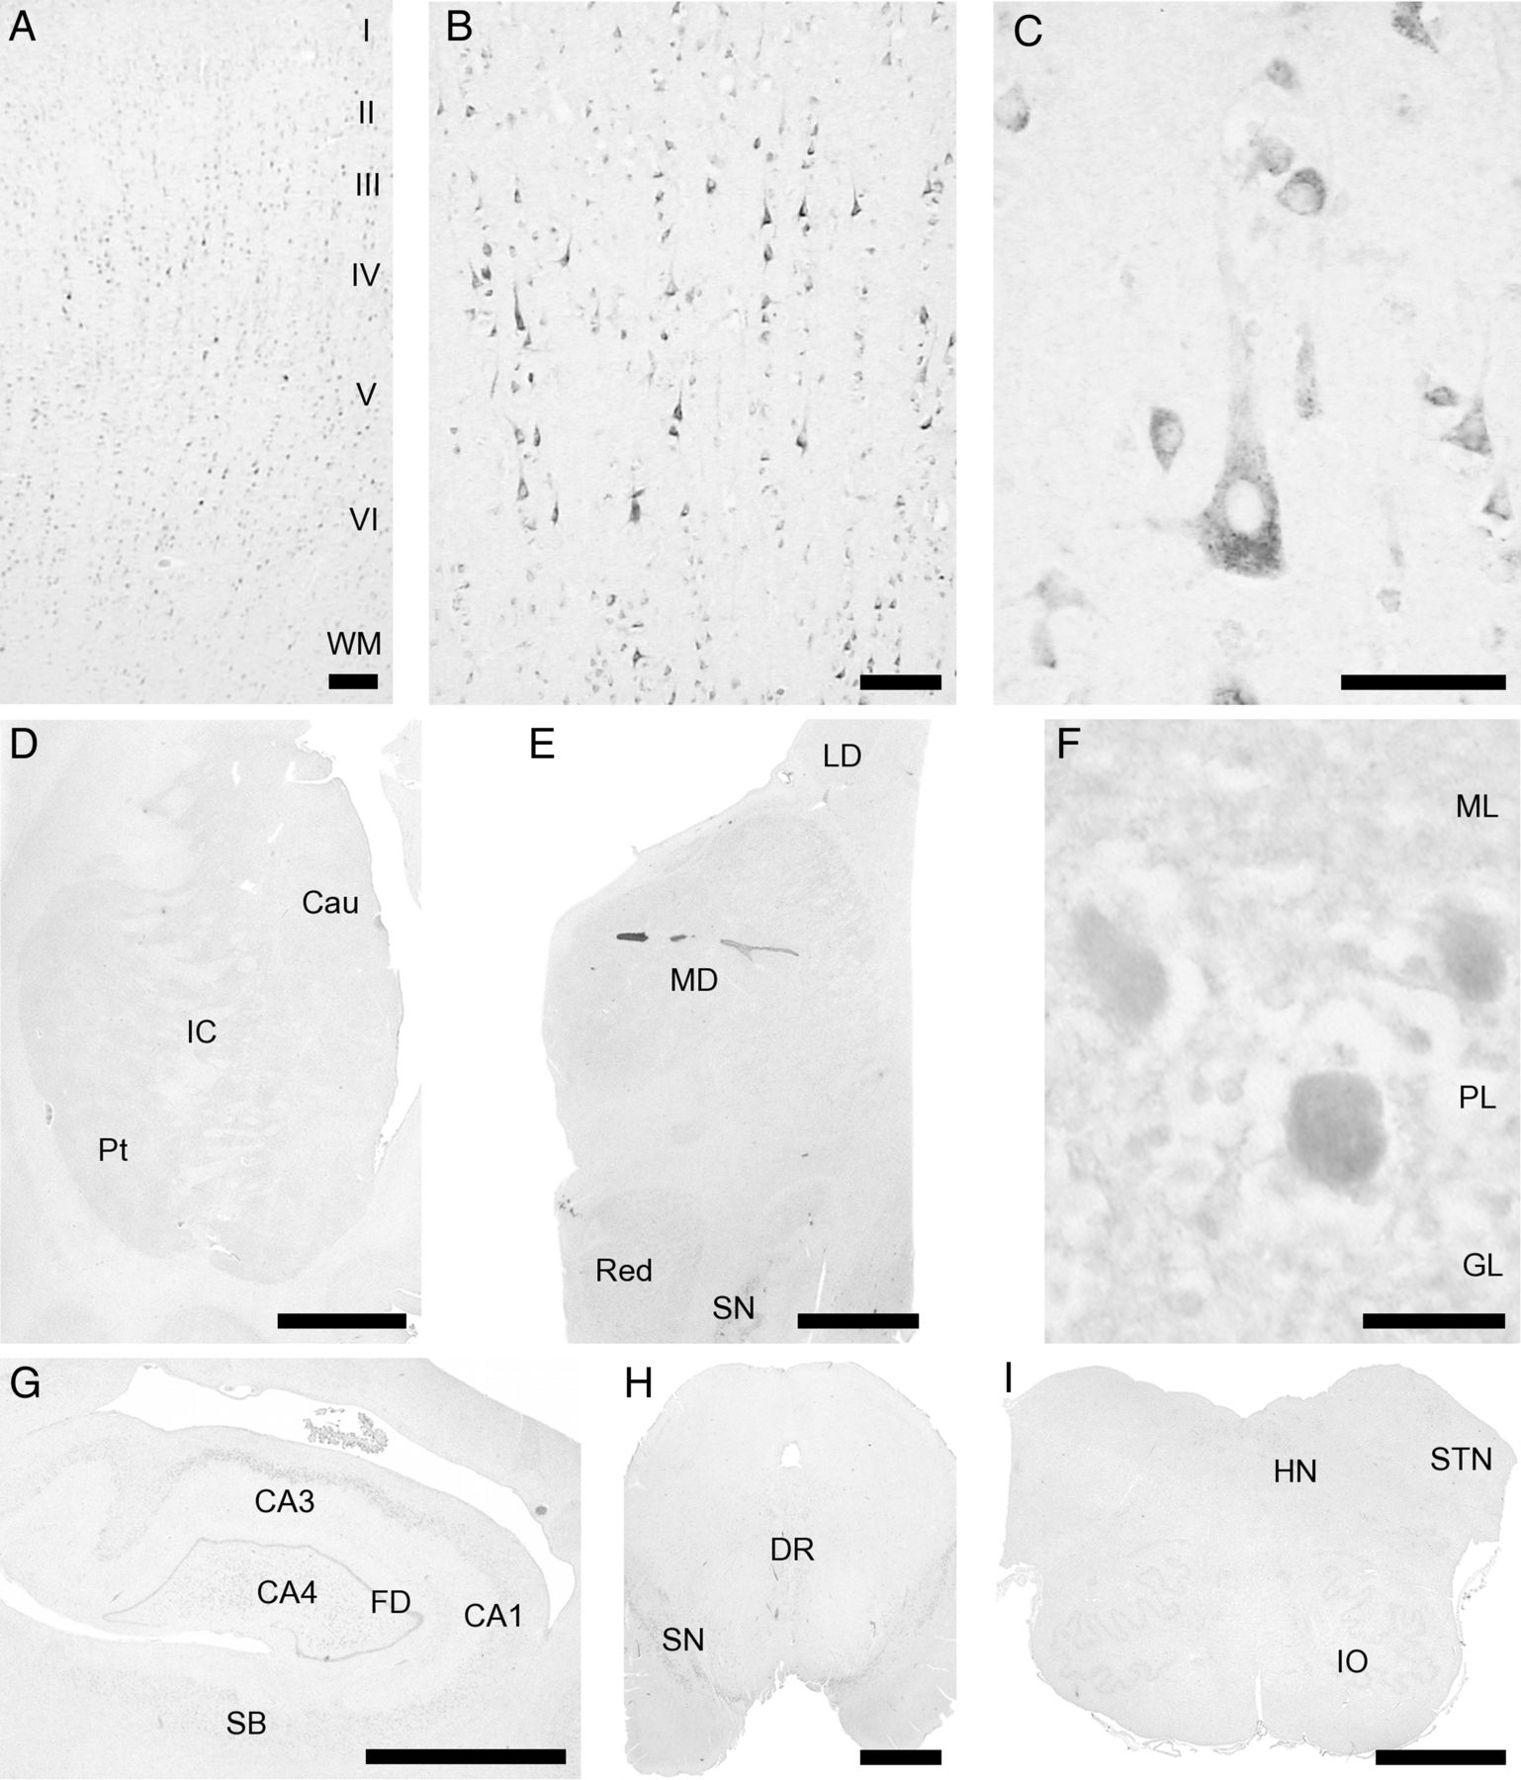
Figure 3. Expression of PCDH11X/Y in the adult brain. Frontal cortex (A, male), superior temporal gyrus (B, female) ...
Notes:
Figure 3. Expression of PCDH11X/Y in the adult brain. Frontal cortex (A, male), superior temporal gyrus (B, female) with prominent expression in pyramidal neurons (C, female), basal ganglia (D, male), thalamus (E, female), cerebellar cortex (F, male), hippocampal formation (G, female), midbrain (H, female), and medulla oblongata (I, male). Scale bars: (A) 200 μm; (B) 100 μm; (C) 50 μm; (D, E G–I) 5000 μm; (F) 25 μm. CA1-4, areas of Ammon's horn; Cau, caudate; DR, dorsal raphe; FD, fascia dentata; GL, granular layer; HN, hypoglossal nucleus; I–VI, cortical layers I–VI; IC, internal capsule; IO, inferior olivary nucleus; LD, lateral dorsal nucleus; MD, mediodorsal nucleus; ML, molecular layer; PL, Purkinje cell layer; Put, putamen; Red, red nucleus; SB, subiculum; SN, substantia nigra; WM, white matter.
Unless provided in the caption above, the following copyright applies to the content of this slide: © The Author 2012. Published by Oxford University Press.This is an Open Access article distributed under the terms of the Creative Commons Attribution Non-Commercial License (http://creativecommons.org/licenses/by-nc/3.0), which permits unrestricted non-commercial use, distribution, and reproduction in any medium, provided the original work is properly cited.

