Slide 1
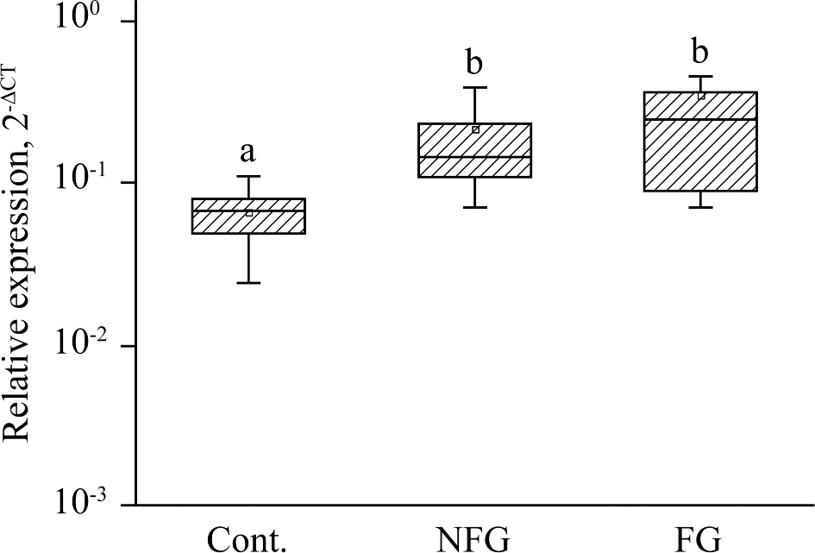
Figure 3. Expression of adiponectin (ADP) in abdominal fat tissue measured by TaqMan q-PCR. Different letters represent ...
Notes:
Figure 3. Expression of adiponectin (ADP) in abdominal fat tissue measured by TaqMan q-PCR. Different letters represent significant differences (P < 0.05; n = 6). Control: fed a basal diet; NFG: fed a basal diet + 0.3% non-fermented G. biloba; FG: fed a basal diet + 0.3% fermented G. biloba.
Unless provided in the caption above, the following copyright applies to the content of this slide: © 2017 Poultry Science Association Inc.

Slide 2
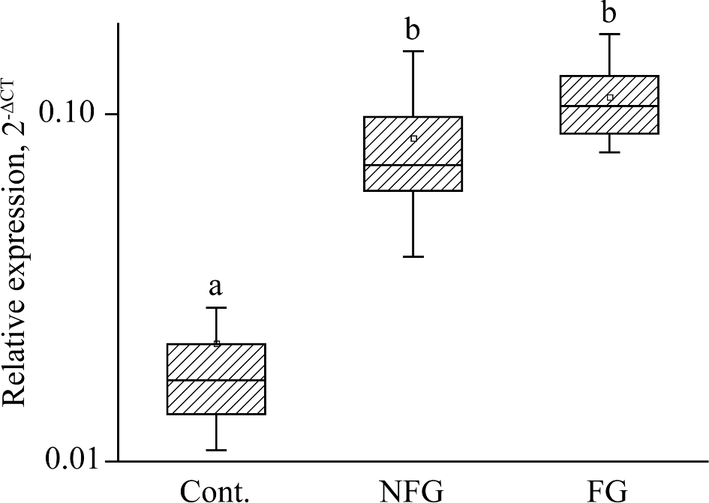
Figure 2. Expression of leptin (a marker of obese) in abdominal fat tissue measured by TaqMan q-PCR. Different letters ...
Notes:
Figure 2. Expression of leptin (a marker of obese) in abdominal fat tissue measured by TaqMan q-PCR. Different letters represent significant differences (P < 0.05; n = 6). Control: fed a basal diet; NFG: fed a basal diet + 0.3% non-fermented G. biloba; FG: fed a basal diet + 0.3% fermented G. biloba.
Unless provided in the caption above, the following copyright applies to the content of this slide: © 2017 Poultry Science Association Inc.

Slide 3
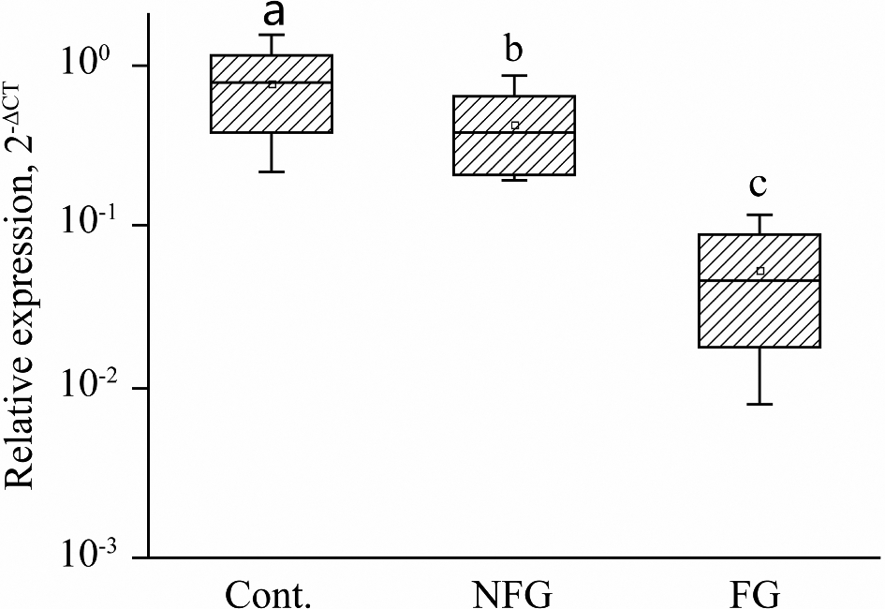
Figure 1. Expression of PPARγ in abdominal fat tissue measured by TaqMan q-PCR. Different letters represent significant ...
Notes:
Figure 1. Expression of PPARγ in abdominal fat tissue measured by TaqMan q-PCR. Different letters represent significant differences (P < 0.05; n = 6). Control: fed a basal diet; NFG: fed a basal diet + 0.3% non-fermented G. biloba; FG: fed a basal diet + 0.3% fermented G. biloba.
Unless provided in the caption above, the following copyright applies to the content of this slide: © 2017 Poultry Science Association Inc.

