Slide 1
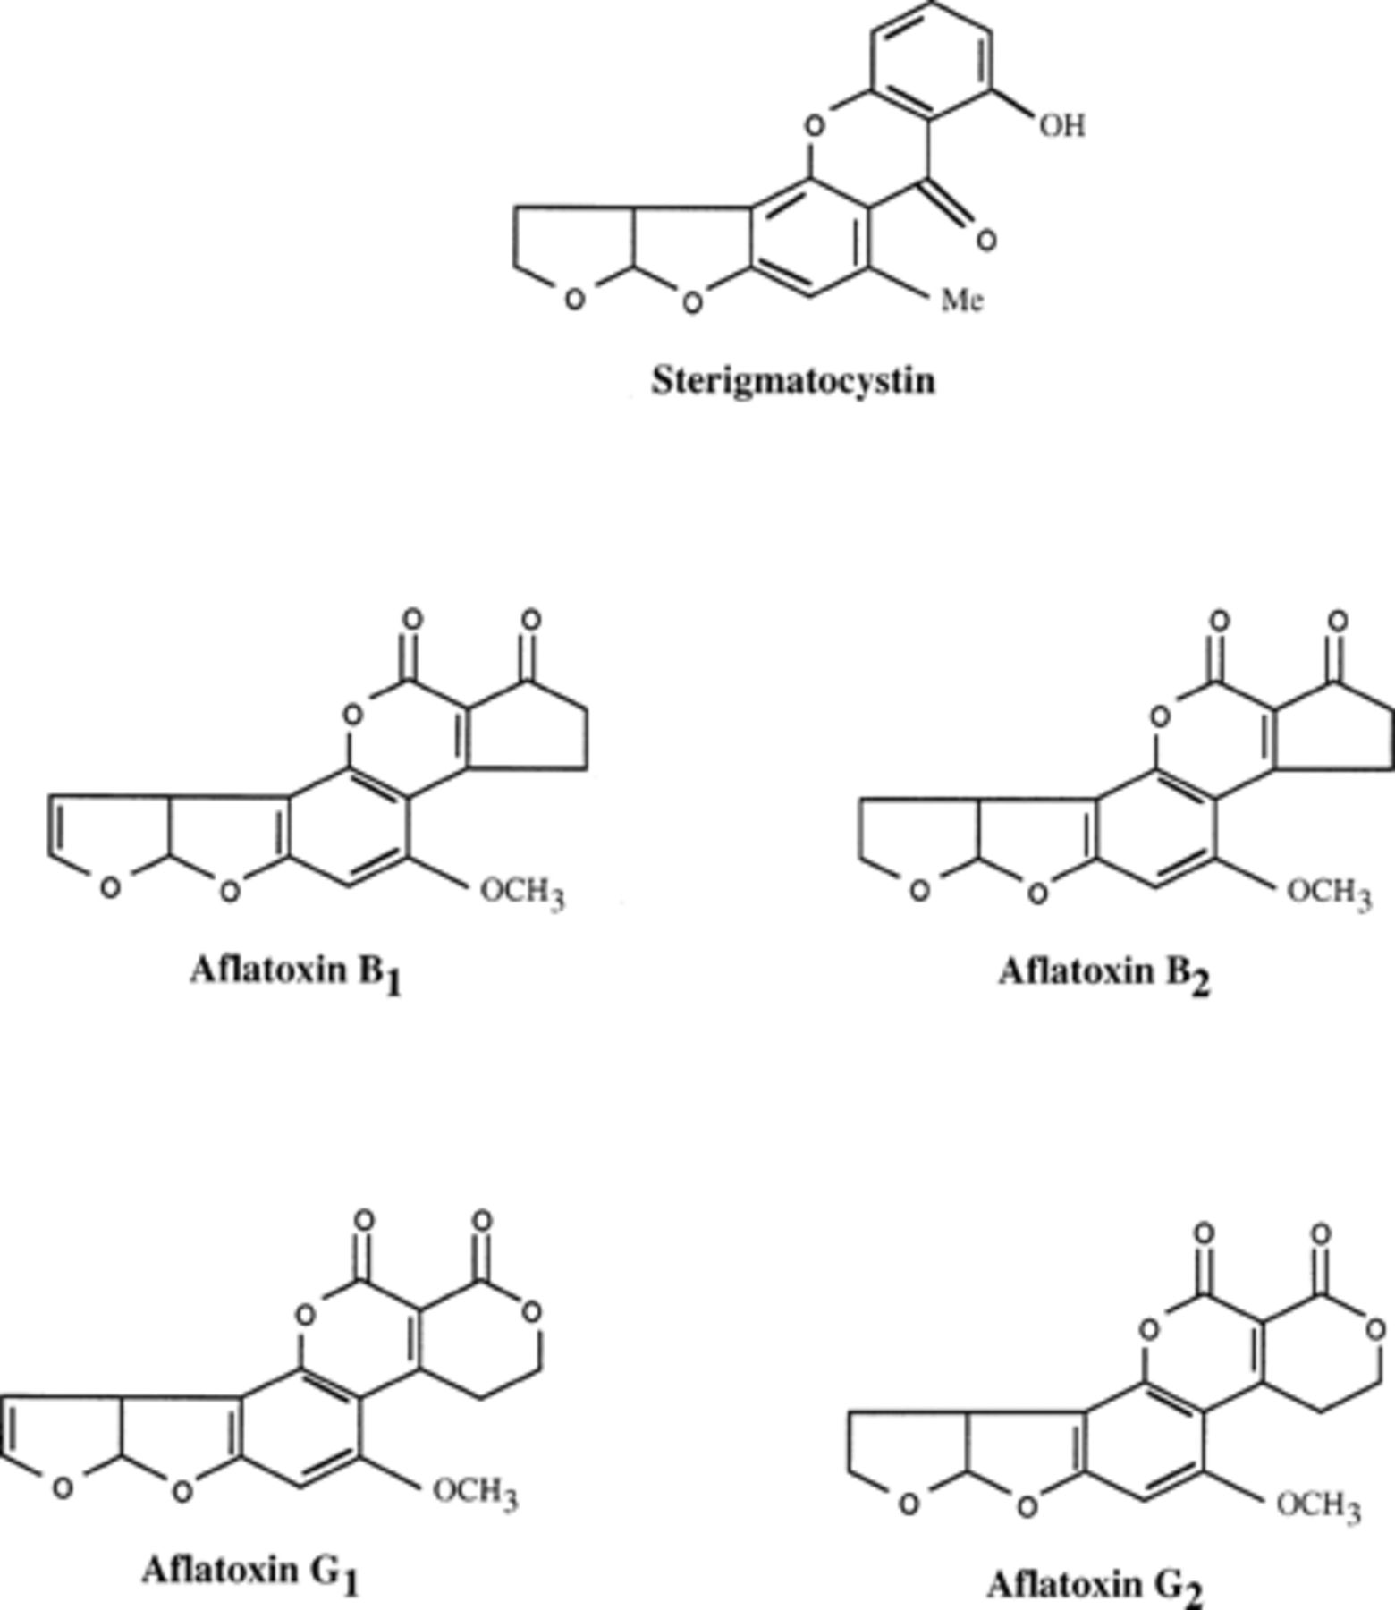
1 Common toxins produced by Aspergillus and Penicillium species.
Notes:
1 Common toxins produced by Aspergillus and Penicillium species.
Unless provided in the caption above, the following copyright applies to the content of this slide: © 1999 Federation of European Microbiological Societies. Published by Elsevier Science B.V. All rights reserved.

Slide 2
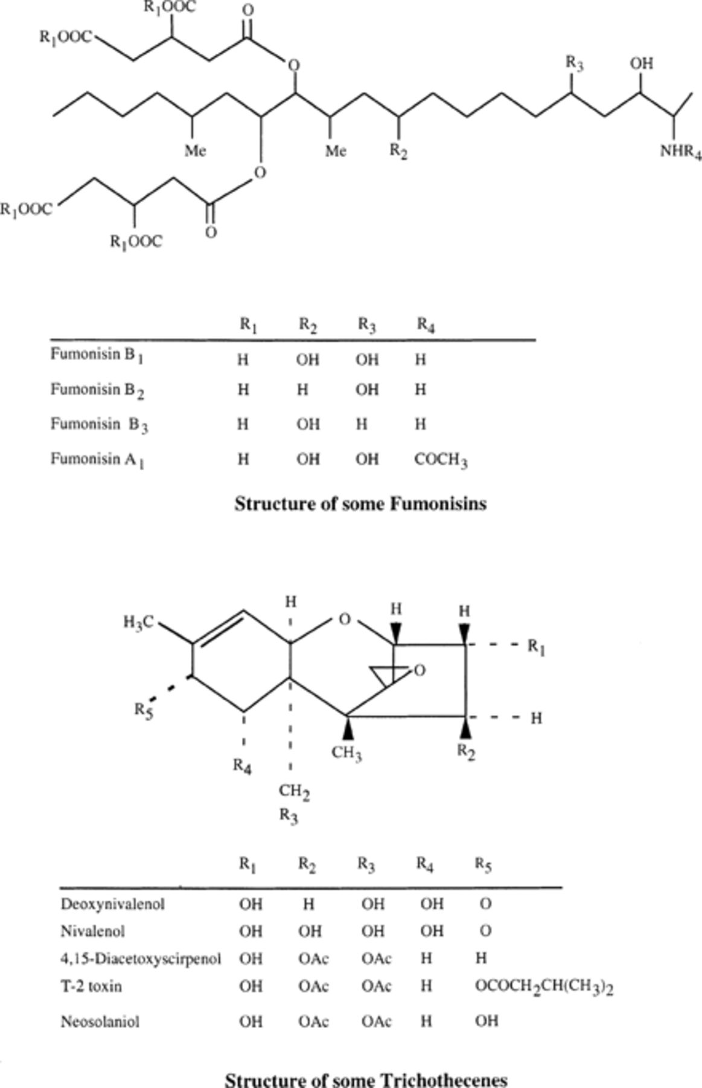
2 Important toxins produced by Fusarium species.
Notes:
2 Important toxins produced by Fusarium species.
Unless provided in the caption above, the following copyright applies to the content of this slide: © 1999 Federation of European Microbiological Societies. Published by Elsevier Science B.V. All rights reserved.

Slide 3
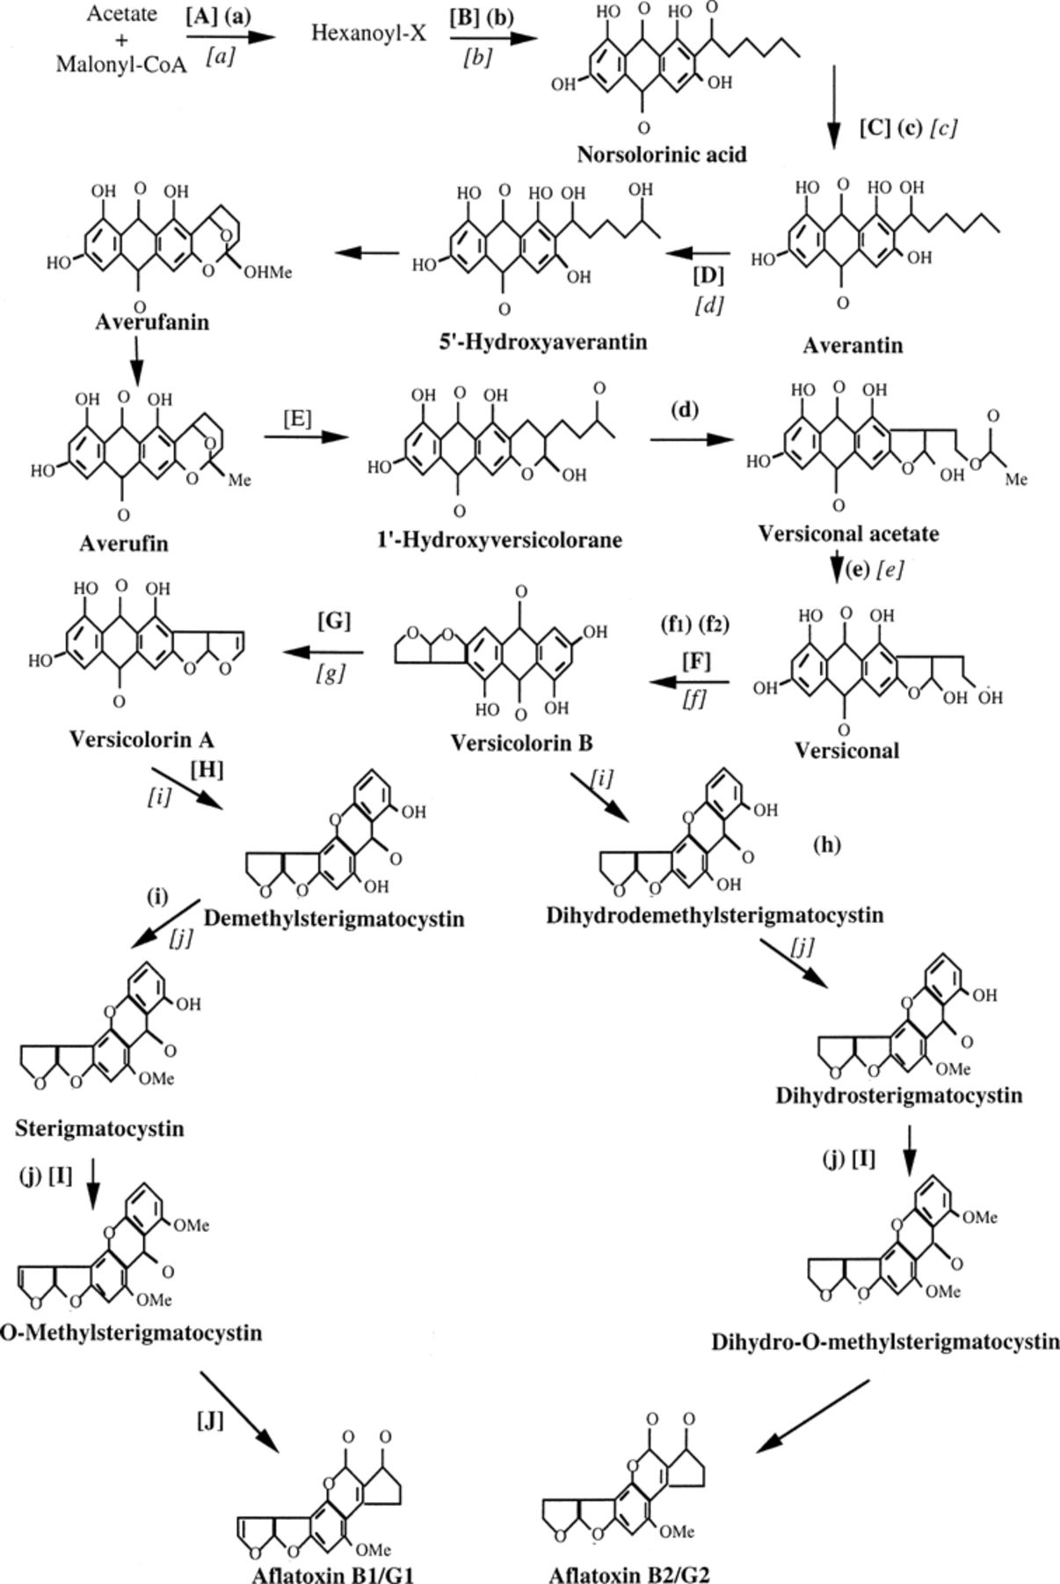
3 Aflatoxin and sterigmatocystin biosynthetic pathway. Enzymes involved: (a) fatty acid synthase, (b) ...
Notes:
3 Aflatoxin and sterigmatocystin biosynthetic pathway. Enzymes involved: (a) fatty acid synthase, (b) polyketide synthase, (c) norsolorinic acid reductase, (d) versiconal hemiacetal acetate reductase, (e) esterase, (f1) versicolorin B synthase, (f2) versiconyl cyclase, (g) desaturase, (h) O-methyltransferase (MT-II), (i) O-methyltransferase, (j) O-methyltransferase (MT-I). Genes involved in aflatoxin biosynthesis: [A] fas1A and fas2A, [B] pksA, [C] nor1, norA, [D] avnA, [E] avf1 (aflB and aflW), [F] vbs, [G] verB, [H] ver1A, aflS, [I] omtA and [J] ord1. Genes involved in sterigmatocystin biosynthesis: [a] stcJ and stcK, [b] stcA, [c] stcE, [d] stcF, [e] stcI, [f] stcN, [g] stcL, [h] stcS, [i] stcU and [j] stcP. (Compiled from [11, 18, 21, 50].)
Unless provided in the caption above, the following copyright applies to the content of this slide: © 1999 Federation of European Microbiological Societies. Published by Elsevier Science B.V. All rights reserved.

Slide 4
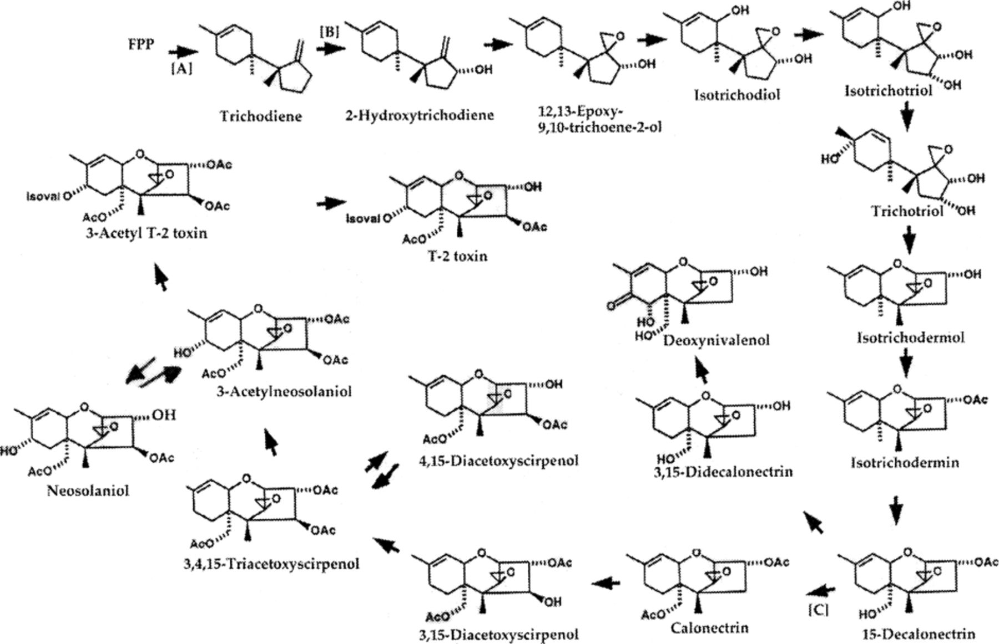
4 Trichothecene biosynthetic pathway in Fusarium species. Genes involved: [A] Tri 5, [B] Tri 4 and [C] Tri 3. ...
Notes:
4 Trichothecene biosynthetic pathway in Fusarium species. Genes involved: [A] Tri 5, [B] Tri 4 and [C] Tri 3. (Taken from [44].)
Unless provided in the caption above, the following copyright applies to the content of this slide: © 1999 Federation of European Microbiological Societies. Published by Elsevier Science B.V. All rights reserved.

Slide 5
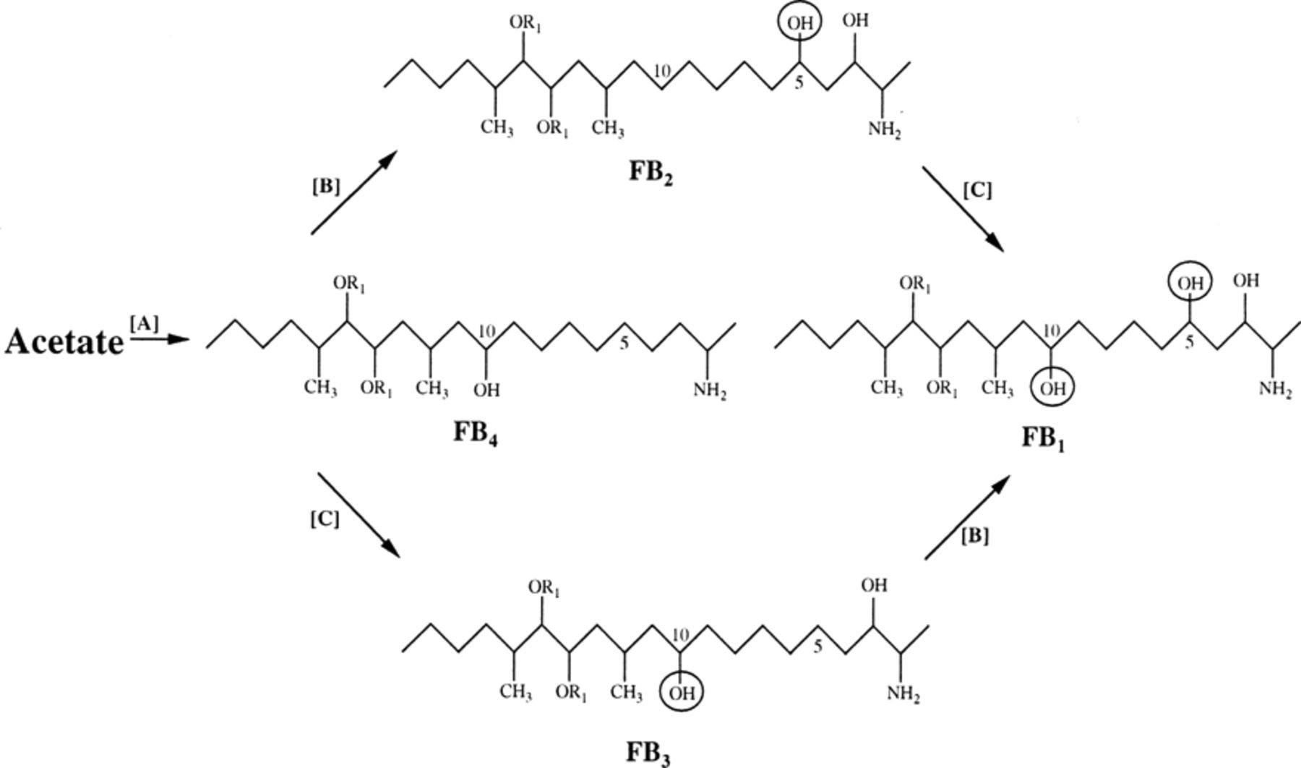
5 Proposed pathway for fumonisin biosynthesis. R₁ designates tricarballylic acid esters. Genes ...
Notes:
5 Proposed pathway for fumonisin biosynthesis. R1 designates tricarballylic acid esters. Genes involved: [A] fum 1, [B] fum 3 and [C] fum 2. (Taken from [16].)
Unless provided in the caption above, the following copyright applies to the content of this slide: © 1999 Federation of European Microbiological Societies. Published by Elsevier Science B.V. All rights reserved.

