Slide 1
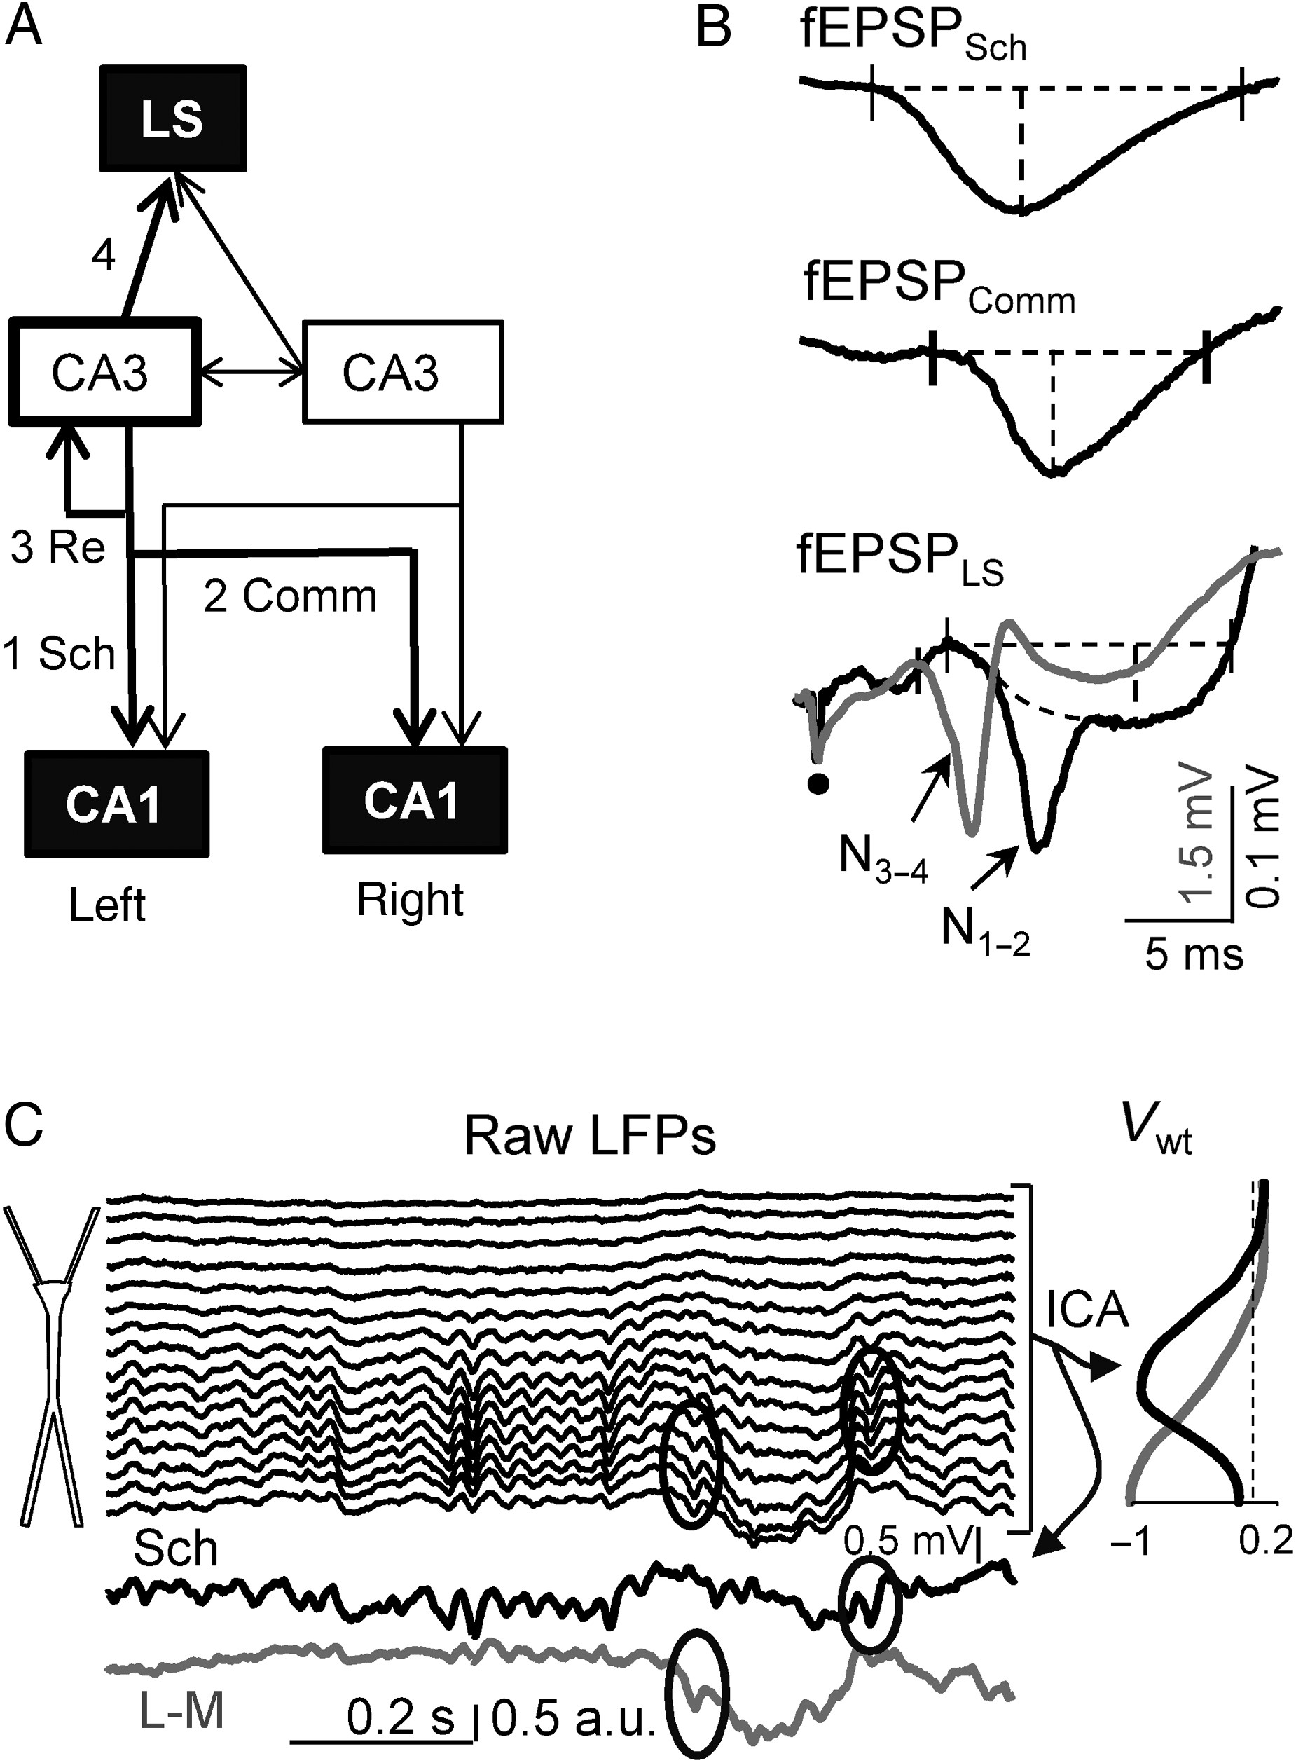
Figure 1. Spontaneous and evoked LFP activity produced by the main targets of CA3 pyramidal cells. (A) Block scheme of ...
Notes:
Figure 1. Spontaneous and evoked LFP activity produced by the main targets of CA3 pyramidal cells. (A) Block scheme of main efferent connections of the bilateral CA3 population. We explored the following pathways: 1—ipsilateral CA3→CA1 (Schaffer), 2—contralateral CA3→CA1 (Commissural), 3—recurrent CA3→CA3 (Re), 4—CA3→LS. (B) CA3-evoked field excitatory postsynaptic potentials (fEPSPs) in different regions. The septal fEPSP is presented at low (black) and high (gray) stimulus intensities. The 2 presented fEPSP/spike negative complex (N1–2, and N3–4, respectively) of different latency, amplitude (note vertical scale), and spatial coverage (Supplementary Fig. 2 for spatial characterization). Intervals marked by dashed lines correspond to the amplitude and duration of fEPSPs. Dot marks the onset of stimulation. (C) Extraction of pathway-specific LFP components by ICA. Upper traces belong to linear recordings of a sample epoch across CA1 layers, and lower traces show the temporal activation of 2 found LFP generators (black: Schaffer-LFPs; gray: lacunosum-moleculare LFPs). Curves in the right panel show spatial weights (Vwt) of the corresponding LFP generators with maxima in the layer of synaptic band. Bouts of gamma band dominate the Schaffer-LFPs and were also present in the L-M LFPs along with slower waves. Gamma waves may appear in one or coincide in both LFP generators. Note the efficiency of separation in isolated waves occupying different sets of contiguous electrodes (ovals).
Unless provided in the caption above, the following copyright applies to the content of this slide: © The Author 2015. Published by Oxford University Press. All rights reserved. For Permissions, please e-mail: journals.permissions@oup.com

Slide 2
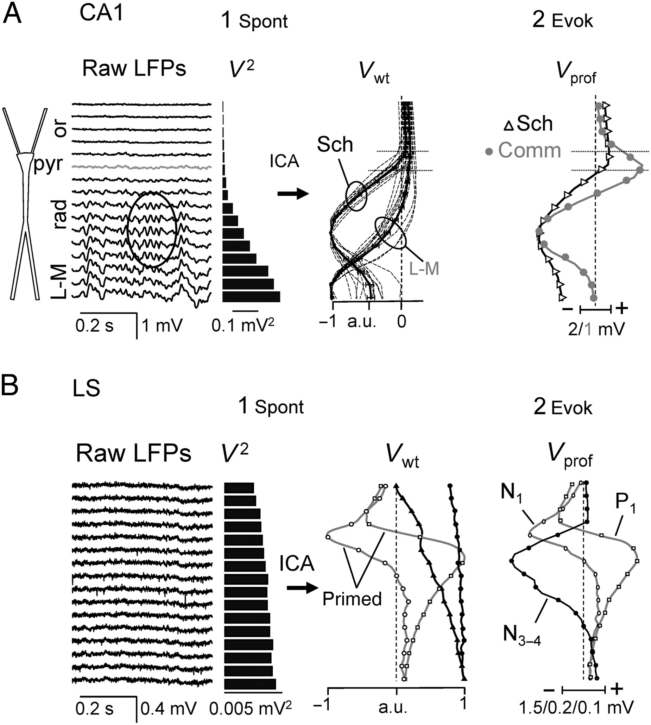
Figure 2. Spatial features of CA3-elicited spontaneous and evoked activity in the ipsi- and contralateral CA1 regions ...
Notes:
Figure 2. Spatial features of CA3-elicited spontaneous and evoked activity in the ipsi- and contralateral CA1 regions (A), and in the LS (B). (A) Raw LFP profiles in the CA1 show a characteristic gradient of increasing variance (V2) toward the distal apical dendrites. The ICA yielded 2 partially overlapped components (Vwt) centered on the mid (Sch group) and distal apical dendrites of the CA1 neurons (L-M group). Thirteen superimposed spatial profiles (thin dashed traces) superimposed on each group belong to different animals, and the mean ± s.e.m. is plotted in the thick traces. Horizontal lines mark the soma layer. (2) Spatial profile of subthreshold ipsi- (Schaffer, in black) and contralateral (Commissural, in gray) CA3-evoked potentials (Vprof). Note the similarity of spontaneous and Sch-evoked spatial profiles, whereas the Commissural EP has no spontaneous counterpart. (B) Raw LFPs in the LS (1) are smaller and “noisier.” The ICA revealed 2 spatial components with near-flat profiles (black curves) accounting for most of the variance. Curves without local maxima indicate remote activity. The ICA components capture spontaneous as well as evoked activity in a pathway. Thus, only when the septal LFPs contained CA3-evoked activity did 2 additional weak components appear (“primed”) with local maxima that have identical profiles to the N1 and P1 waves in CA3-EPs (2). Upon increasing stimulus intensity, additional components of the EP appeared that prompted a new ICA component with spatial distribution matching that of the N3–4 wave. All these primed components contributed <1% of total variance. or, st. oriens; pyr, st. pyramidale; rad, st. radiatum; L-M, st. lacunosum-moleculare. Except for Panel A1, all other panels are sample experiments. For population statistics, see the main text.
Unless provided in the caption above, the following copyright applies to the content of this slide: © The Author 2015. Published by Oxford University Press. All rights reserved. For Permissions, please e-mail: journals.permissions@oup.com

Slide 3
Figure 3. Patterns of activity in all LFP components found in the CA1 and LS. (A) From left to right: sample epochs ...
Notes:
Figure 3. Patterns of activity in all LFP components found in the CA1 and LS. (A) From left to right: sample epochs containing 4 CA3-elicited events (evoked potentials, sharp waves [SPWs], baseline gamma activity, averaged gamma wave [γ-Avg, n = 1600 events]), and theta oscillations. Asterisks in Sch and LSN1 components mark CA3 monosynaptic origin. LSrem1,2: remote components volume-conducted to the LS from regions out of recording sites. SPWs in the CA1 were mirrored by SPWs of smaller amplitude in the excitatory (LSN1) and inhibitory (LSP1) septal components. Baseline gamma activity is too small in the LS, but their presence is revealed by averaging using CA1 waves for timing. Note the different vertical calibration (in mV) for the CA1 and LS. (B) Mean power (mean ± s.e.m) of separated LFP components (n = 11 animals for Schaffer and n = 4 for all others).
Unless provided in the caption above, the following copyright applies to the content of this slide: © The Author 2015. Published by Oxford University Press. All rights reserved. For Permissions, please e-mail: journals.permissions@oup.com

Slide 4
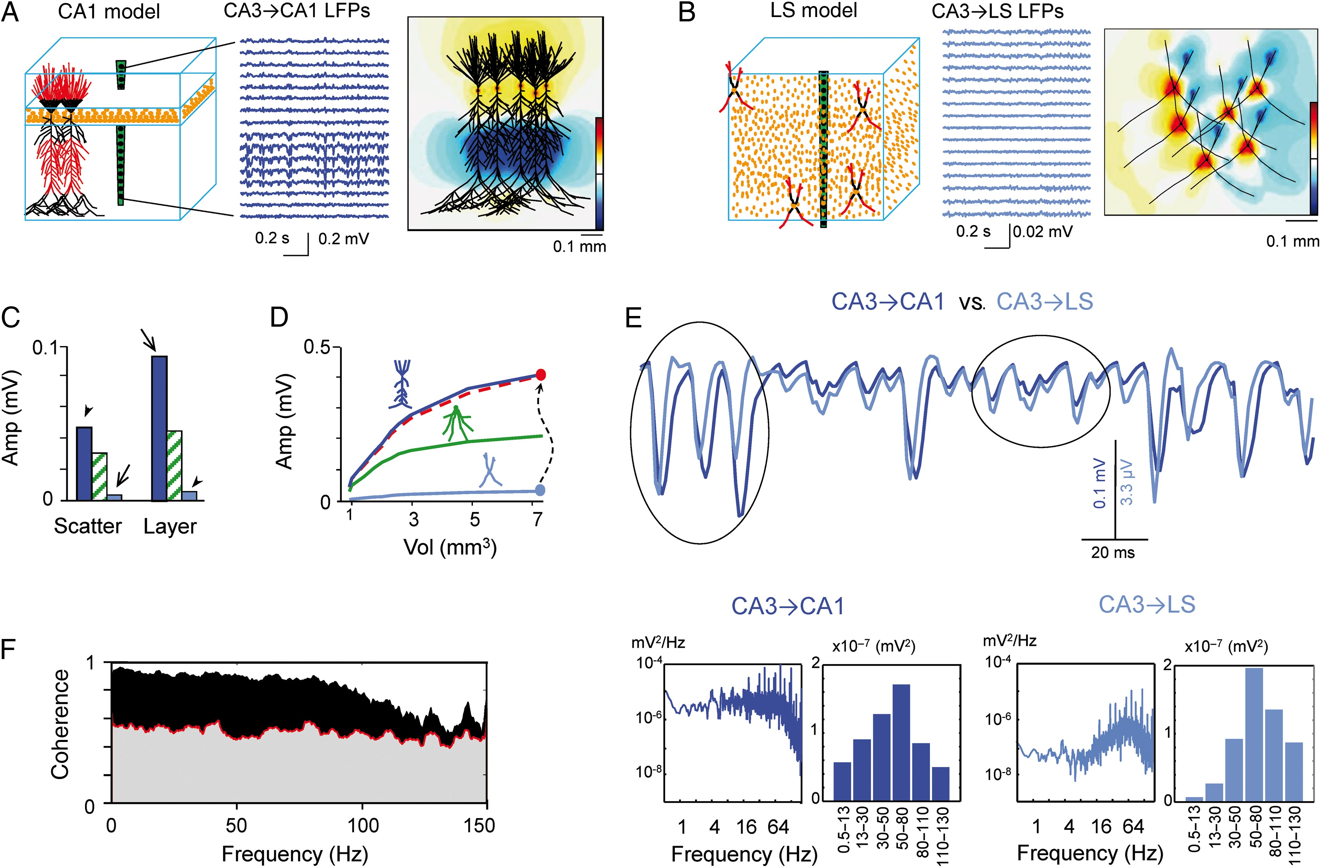
Figure 4. The cytoarchitecture and morphoelectronic features of CA3-targeted neurons in the CA1 and LS explain the ...
Notes:
Figure 4. The cytoarchitecture and morphoelectronic features of CA3-targeted neurons in the CA1 and LS explain the observed amplitude of LFPs. (A,B) Multineuronal realistic models of the CA1 and LS (left panels). CA1 pyramidal neurons and LS interneuron-like cells are arranged in a layered or a scattered manner, respectively (orange dots represent the position of cell somata). Middle panels: LFPs calculated for identical gamma-patterned excitatory inputs to the apical and basal dendrites (red compartments in cell dummies) were ∼20 times larger in the CA1. Note the dominance of negative polarity in CA1 apical dendrites despite the strong basal co-activation. Right panels: snapshot of isopotential contours recreated for small cell aggregates in an XY zero plane. The spatial clustering of inward and outward currents in the orderly CA1 population builds up a strong macroscopic dipole, whereas currents mix and cancel in the scattered arrangement of the LS model give rise to smaller LFPs. Blue and yellow/red contours correspond to negative and positive polarity, respectively (color bar: ±0.2 mV and ±4 µV). See also Supplementary movies M1–M2. (C) Mean amplitude of LFPs in the CA1 (blue bars) and LS (cyan bars) models using realistic cytoarchitectures (arrows) compared with the least-optimum case by switching cell types (arrowheads). The reduction in amplitude differences quantifies the separate effects of cell morphology and cell arrangement. Hatched bars correspond to additional simulations using a fake cell type with a polarized morphology and intermediate surface (granule cell like). (D) The plots represent the mean LFP amplitude for increasing aggregate size. The CA1-to-LS amplitude ratio remains proportional regardless of the aggregate size (plotted as the red dashed line and normalized to CA1’s by the maximum values: end-dots). Green trace belongs to the imaginary aggregate of granule cells. (E) Amplification of an LFP epoch to a similar visual scale to show the temporal detail of the LFPs. The input series were identical for the CA1 and LS aggregates. Small afferent quanta produced gamma waves with similar dynamics, but larger quanta produced waves of different duration and phase (compare ovals). Lower panels (left: power spectra; right: cumulative power in predefined frequency bands) show increased content of higher frequencies in the LFPs caused by macroscopic scaling of the different intracellular summation of synaptic currents in CA1 pyramidal cells or the smaller LS interneurons. (F) Spectral coherence between model LFP in CA1 and the LS activated with the same temporal gamma pattern (variable quanta at 45 Hz mean rate). The black surface represents the statistically significant coherence (surrogate test). Note a strong reduction of coherence in the high-gamma band.
Unless provided in the caption above, the following copyright applies to the content of this slide: © The Author 2015. Published by Oxford University Press. All rights reserved. For Permissions, please e-mail: journals.permissions@oup.com

Slide 5
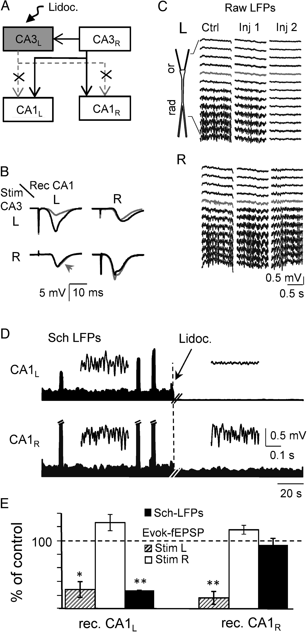
Figure 5. Suppression of CA3 activity in one side of the hippocampus does not disclose a contralateral CA3 contribution ...
Notes:
Figure 5. Suppression of CA3 activity in one side of the hippocampus does not disclose a contralateral CA3 contribution to CA1 LFPs. (A) Lidocaine injection in the left CA3 isolates the ipsilateral CA3-to-CA1 projection to the right hippocampus. (B) Mean EPs (n = 6 stimuli) recorded in the st. radiatum of left and right CA1 upon stimulation of the left or right CA3, before (black traces) and after (gray) lidocaine administration to the left CA3. Note the selective reduction of EPs when driven from the left side. (C) The effect of 2 lidocaine injections (inj) separated by 5 min on raw LFPs across the CA1 in both hippocampi. CA1 LFPs were selectively suppressed on the left side leaving the contralateral CA1 LFPs unaffected. (D) Representative experiment showing the time envelopes of the mean power (sliding window of 0.5 s) at the site of maximum activity in the st. radiatum, components of CA1 LFPs separated by the ICA in both hippocampi. Lidocaine was injected into the left CA3 at the dashed vertical line. Large peaks correspond to SPWs (truncated). Insets are fragments of the baseline gamma activity. Pre- and postlidocaine LFP fragments were analyzed together to ensure the presence of ICA components that were active before treatment. Panels B, C, and D correspond to sample experiments, and the population data are plotted in (E): Pooled data of the evoked fEPSP and spontaneous Schaffer-LFPs in both hippocampi following lidocaine administration to the left CA3 (as percentage of the control): *P < 0.01; **P < 0.005, Student t-Test.
Unless provided in the caption above, the following copyright applies to the content of this slide: © The Author 2015. Published by Oxford University Press. All rights reserved. For Permissions, please e-mail: journals.permissions@oup.com

Slide 6
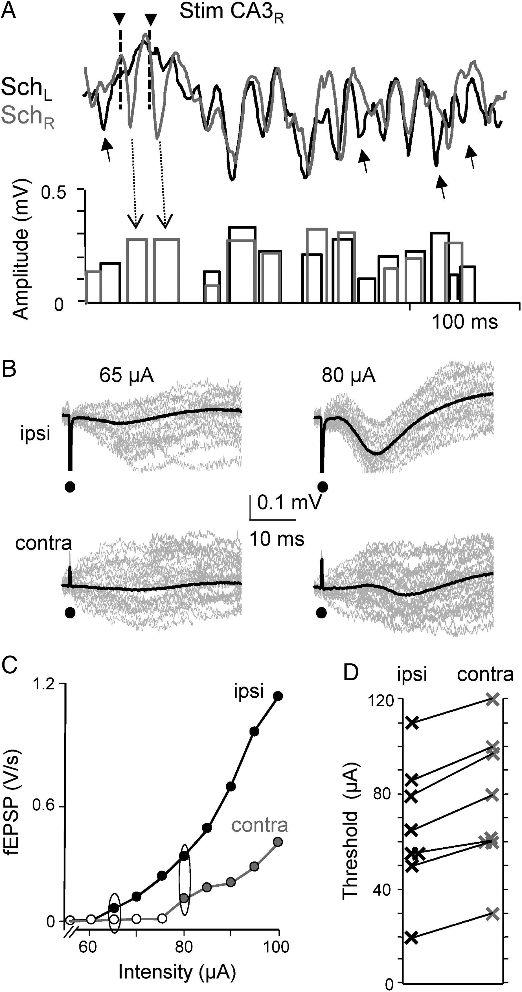
Figure 6. Spontaneous or evoked CA3-CA1 baseline gamma waves can only be appreciated ipsilaterally. (A) Gamma waves in ...
Notes:
Figure 6. Spontaneous or evoked CA3-CA1 baseline gamma waves can only be appreciated ipsilaterally. (A) Gamma waves in the left and right CA1 (top traces) are identified by the Haar wavelet analysis (bottom bars). The bar height and width correspond to the amplitude and duration of the event, respectively. Most events were paired (synchronized) in the left and right CA1, but some appeared on only one side (arrows). CA3 stimuli on the right side (triangles) delivered at threshold intensity produced small fEPSPs on the right but not on the left side. Their amplitude is equivalent to spontaneous gamma waves. The panel corresponds to a sample experiment: population statistics is in the main text. (B) Responses (averaged in black and 30 raw potentials in gray) to stimuli in one side of the CA3 recorded from both sides of the CA1 in a sample experiment. (C,D) input/output curves in a representative experiment and pooled data (n = 8 animals) to estimate the ipsi- and contralateral threshold intensities (ovals in C) for fEPSPs obtained in both CA1 (each dot averaged 60 responses, mean ± s.e.m).
Unless provided in the caption above, the following copyright applies to the content of this slide: © The Author 2015. Published by Oxford University Press. All rights reserved. For Permissions, please e-mail: journals.permissions@oup.com

Slide 7
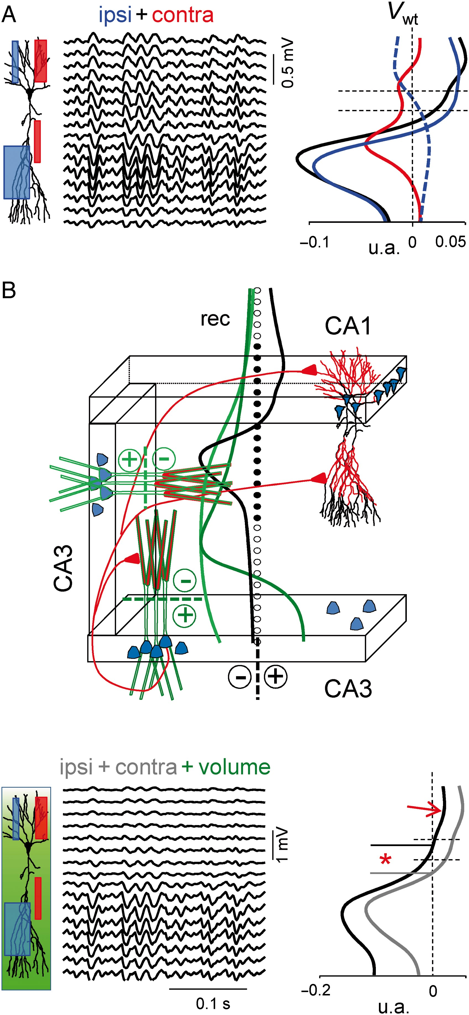
Figure 7. Apical dominance and volume conduction from nearby regions shape the CA1 spatial profiles. (A) Model LFPs. ...
Notes:
Figure 7. Apical dominance and volume conduction from nearby regions shape the CA1 spatial profiles. (A) Model LFPs. The position and width of the boxes next to the dummy of a pyramidal neuron denote the synaptic territories and the relative strengths of the ipsi- (blue) and contralateral (red) inputs to the CA1. Spatial curves in the right panel (Vwt) were obtained by the ICA for LFPs simulated from separate inputs or when combined (black). Both apical and basal dendritic trees were simultaneously activated, except for the blue dashed curve that belongs to selective ipsilateral activation to the basal dendrites. Note the dominant negative field in the apical tree for the contralateral input alone, even if the input in this case was stronger in the basal tree. The combined activation generates a markedly bipolar spatial distribution (apical negative) similar to the ipsilateral input alone. Thus, apical dominance for LFP generation explains the selective ipsilateral visualization of CA3-CA1 baseline events. Arbitrary units are comparable in all Vwt curves. (B) The influence of volume-conducted currents from concurrent local gamma waves in the nearby CA3 modifies important features of the CA1 waves. Two blocks of model neurons simulating the CA3 region were added to the CA1 model. Recurrent CA3 excitation was simulated by apical activation, and the corresponding field potentials were estimated in the CA1 recording track (black circles; filled dots conform the standard 16-sites CA1 track). The voltage introduced by each CA3 block is depicted as Vwt curves (green traces). Note that the different tilt of the respective dipoles projects all-negative potentials toward the CA1. The black curve belongs to the Vwt during joint ipsi- and contralateral CA3 activation on CA1 (as in panel A). The bottom panels show the combined local plus volume configuration of CA1 LFPs (sample epoch to the left and the Vwt black curve to the right; for comparison, the superimposed gray curve has no volume added). The most notable changes are a shift in the polarity reversal site (asterisk), the dampening of the strong somato-basal positive potential (arrow), and absolute increase in already negative sites.
Unless provided in the caption above, the following copyright applies to the content of this slide: © The Author 2015. Published by Oxford University Press. All rights reserved. For Permissions, please e-mail: journals.permissions@oup.com

Slide 8
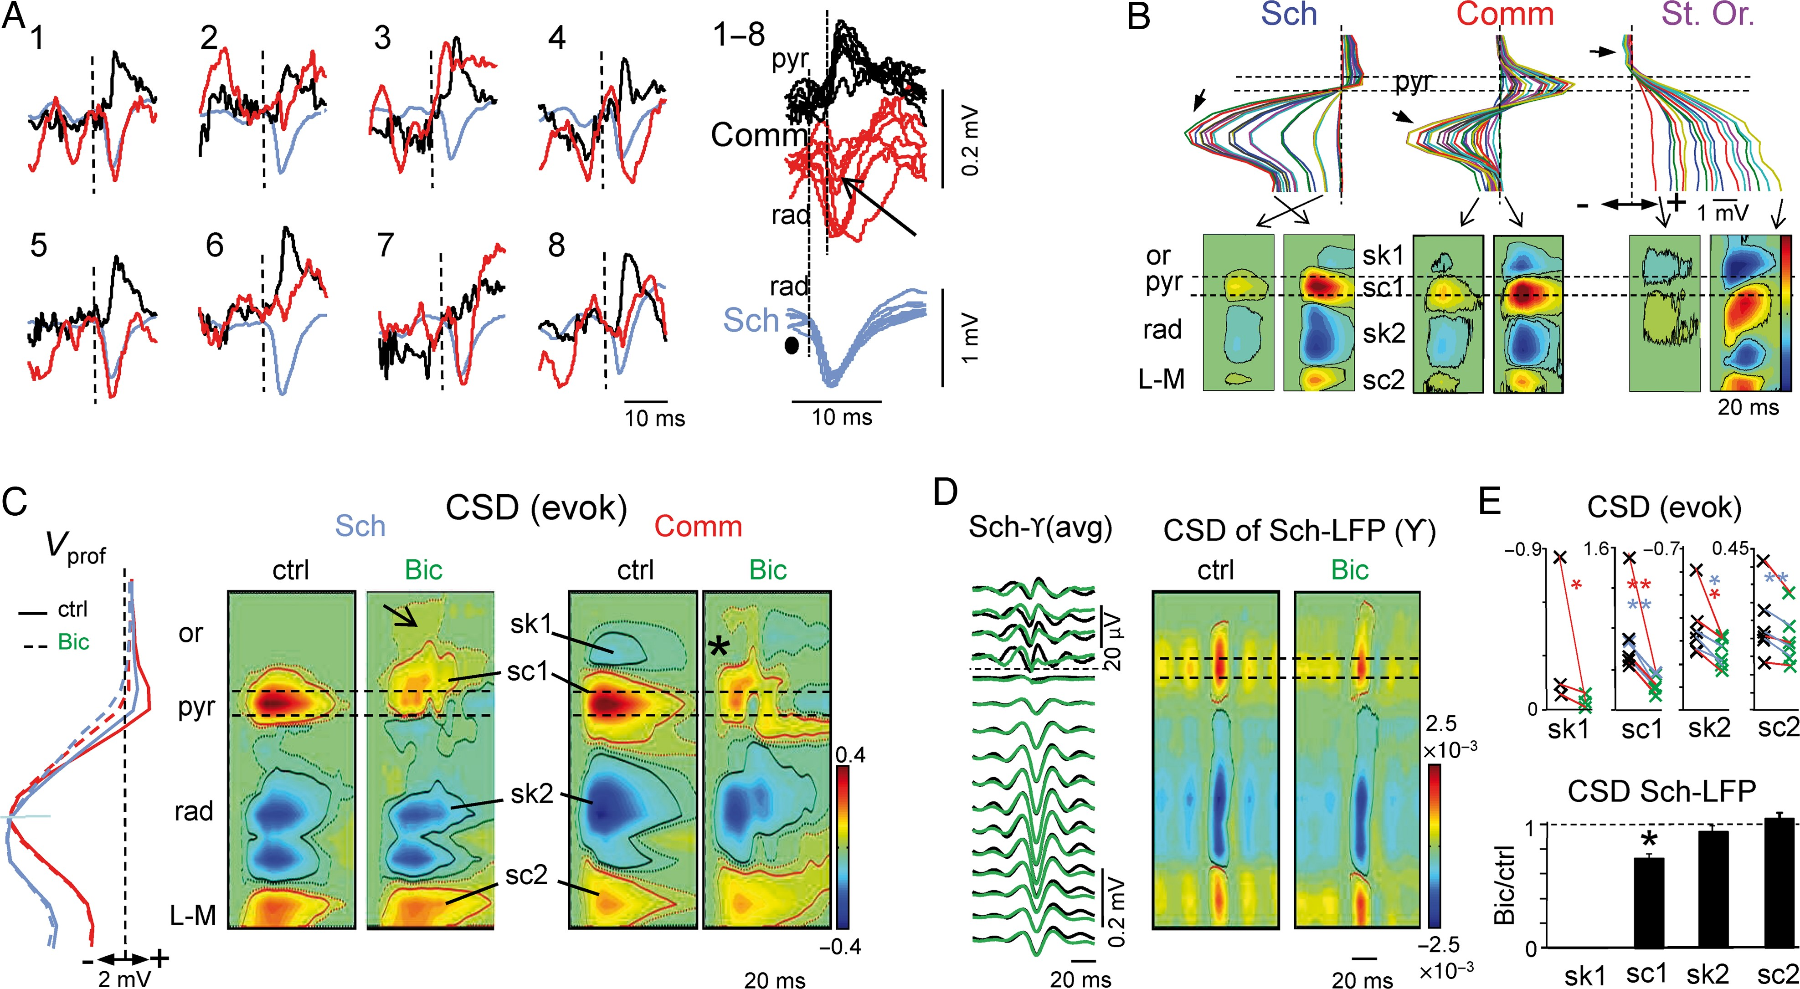
Figure 8. Somatic inhibition in CA1 is differentially co-activated by ipsi- or contralateral CA3 and merges in LFPs ...
Notes:
Figure 8. Somatic inhibition in CA1 is differentially co-activated by ipsi- or contralateral CA3 and merges in LFPs along with excitatory currents. (A) Eight consecutive responses to CA3 stimulation at intensities that were close to the threshold for the contralateral (Commissural) CA1 responses (vertical dashed lines, time of stimuli; black and red traces, recordings in the soma and apical layers, respectively). Note the inconsistent appearance of Commissural fEPSPs whereas the somatic potentials were readily activated. A smaller and shorter negative potential is often seen when the fEPSP failed (arrow). The ipsilateral (Schaffer) fEPSPs are in blue. (B) Upper panels correspond to CA1 spatial profiles for EPs elicited by increasing stimulus intensities in the Schaffer and Commissural pathways, and the CA3a St. Oriens. The small arrows point to the negativity elicited by each stimulation site. Note the dissimilar growth of somatic positive and apical negative portions in Sch and Comm responses. The lower panels show sample CSD contour plots at 2 intensities. Note the absence of the basal sink (sk1) only during subthreshold Sch activation. CSD calibration bar (in arbitrary proportional units): Sch: ±1.1; Comm and St. Or: 0.4. Results in Panels A and B belong to 2 representative experiments. (C,D,E) Sample experiments and pooled data illustrating the presence of a perisomatic inhibition concurrent to evoked (C) and spontaneous (D) CA3-CA1 excitatory potentials. (C) Left: voltage profiles (Vprof) for the Sch and Comm fEPSPs before (ctrl) and after local injection of the GABAA blocker bicuculline (Bic) in the pyramidal/oriens border. Note the selective reduction of the somatic positive portion. The corresponding currents shown in the contour plots (CSD evok) to the right highlight the strong reduction of a somatic (active) source (sc1), whereas the remaining (passive) source was then able to extend into basal dendrites (arrow) after Bic. The asterisk marks the concurrent disappearance of the basal sink (sk1) before the occurrence of pop spikes (see somatic EPs below CSD plots). This st. oriens sink was exclusive to the Comm response. (D) Averaged profiles of the spontaneous CA3-CA1 baseline gamma waves before (black) and after Bic (green), and the corresponding CSD contour plots. (E) Upper plots show the effect of Bic on each main source and sink (blue and red lines represent the Sch and Comm responses; n = 3 animals each). Lower histogram: similar data for the currents underlying spontaneous gamma waves: *P < 0.01; **P < 0.005 (Student t-Test).
Unless provided in the caption above, the following copyright applies to the content of this slide: © The Author 2015. Published by Oxford University Press. All rights reserved. For Permissions, please e-mail: journals.permissions@oup.com

Slide 9
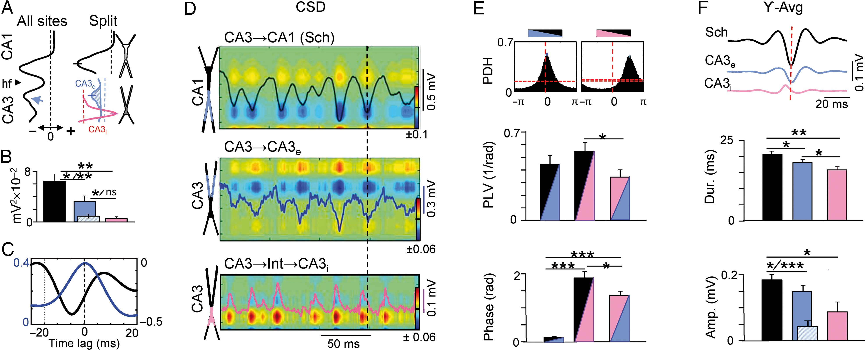
Figure 9. Excitatory and inhibitory recurrent contributions to CA3 LFPs. (A) Left: spatial profile of the ...
Notes:
Figure 9. Excitatory and inhibitory recurrent contributions to CA3 LFPs. (A) Left: spatial profile of the characteristic Sch component (black profile) obtained by an ICA from CA1/CA3 linear LFPs, which also contain a local CA3 maximum (blue arrow). Right: the excitatory CA1 (Sch, in black) and CA3 recurrent components (shaded area) can be split by separate analysis of the CA1 and CA3 groups of recordings, thereby optimizing the temporal accuracy of local generators in each subfield. The CA3e peaked in the st. radiatum and an additional perisomatic CA3i component (pink) was found. Data from a representative experiment. (B) Population data (n = 4 animals) for the mean power of all 3 components quantified at the site of maximum power (marked by dashes in A). The CA3e component was corrected to remove the volume contribution from CA1 (dashed bar; statistical tests were calculated in both cases). (C) Cross-correlation between Schaffer and CA3e (blue), and Schaffer and CA3i components (black) in a representative experiment. (D) CSD analysis of a sample epoch. The voltage fluctuation of each LFP component is superimposed in the contour plots. The Sch and CA3e components displayed dominant sinks in the respective st. radiatum, whereas the CA3i displayed a strong somatic source (inhibitory). Note the similar pace of gamma waves in the Sch and CA3e (albeit with different amplitudes), and the out-phased waves in the CA3i generator (the vertical line is for visual reference). The colored bars are for calibration in arbitrary proportional units. (E) Upper histograms are PDHs between the time activations of LFP components quantifying the temporal relationship between excitatory and inhibitory gamma waves in long epochs in a representative experiment. Two-colored bars indicate the crossings: black, Schaffer; blue, CA3e; pink, CA3i. The maximum probability and preferred phases are measured by the PLV and Phase histograms below. (F) Upper traces are averaged LFP components of a representative 15-min epoch using the timings of the individual gamma waves in the CA1 obtained by a Haar wavelet analysis. Note the identical polarity for the Sch and CA3e gamma waves, and the opposing polarity of the CA3i perisomatic waves. The histograms below represent the pooled data of the mean amplitude and duration of gamma waves across animals: *P < 0.01; **P < 0.005; ***P < 0.001 (Student t-Test ; n = 4 animals).
Unless provided in the caption above, the following copyright applies to the content of this slide: © The Author 2015. Published by Oxford University Press. All rights reserved. For Permissions, please e-mail: journals.permissions@oup.com

