Slide 1
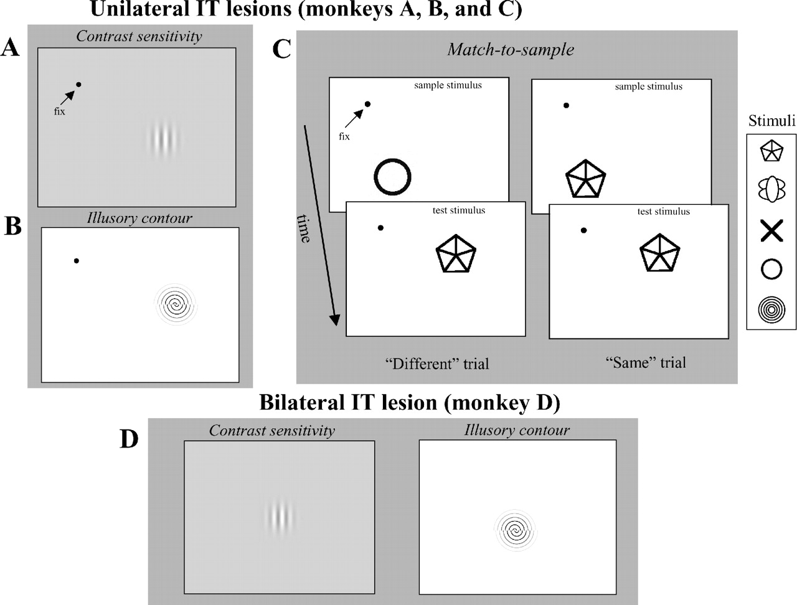
Figure 1. Visual tasks and stimuli. The three monkeys given unilateral IT lesions were tested on an ...
Notes:
Figure 1. Visual tasks and stimuli. The three monkeys given unilateral IT lesions were tested on an orientation discrimination, with controlled fixation, for (A) contrast sensitivity and (B) illusory contour orientation as well as on (C) shape and color matching (shape matching is illustrated). The location of the fixation spot and test stimulus were arranged to place test stimuli in the control or lesioned hemifield. (D) The single monkey given a bilateral IT lesion was tested without fixation control on contrast sensitivity and the orientation of illusory contours.
Unless provided in the caption above, the following copyright applies to the content of this slide:

Slide 2
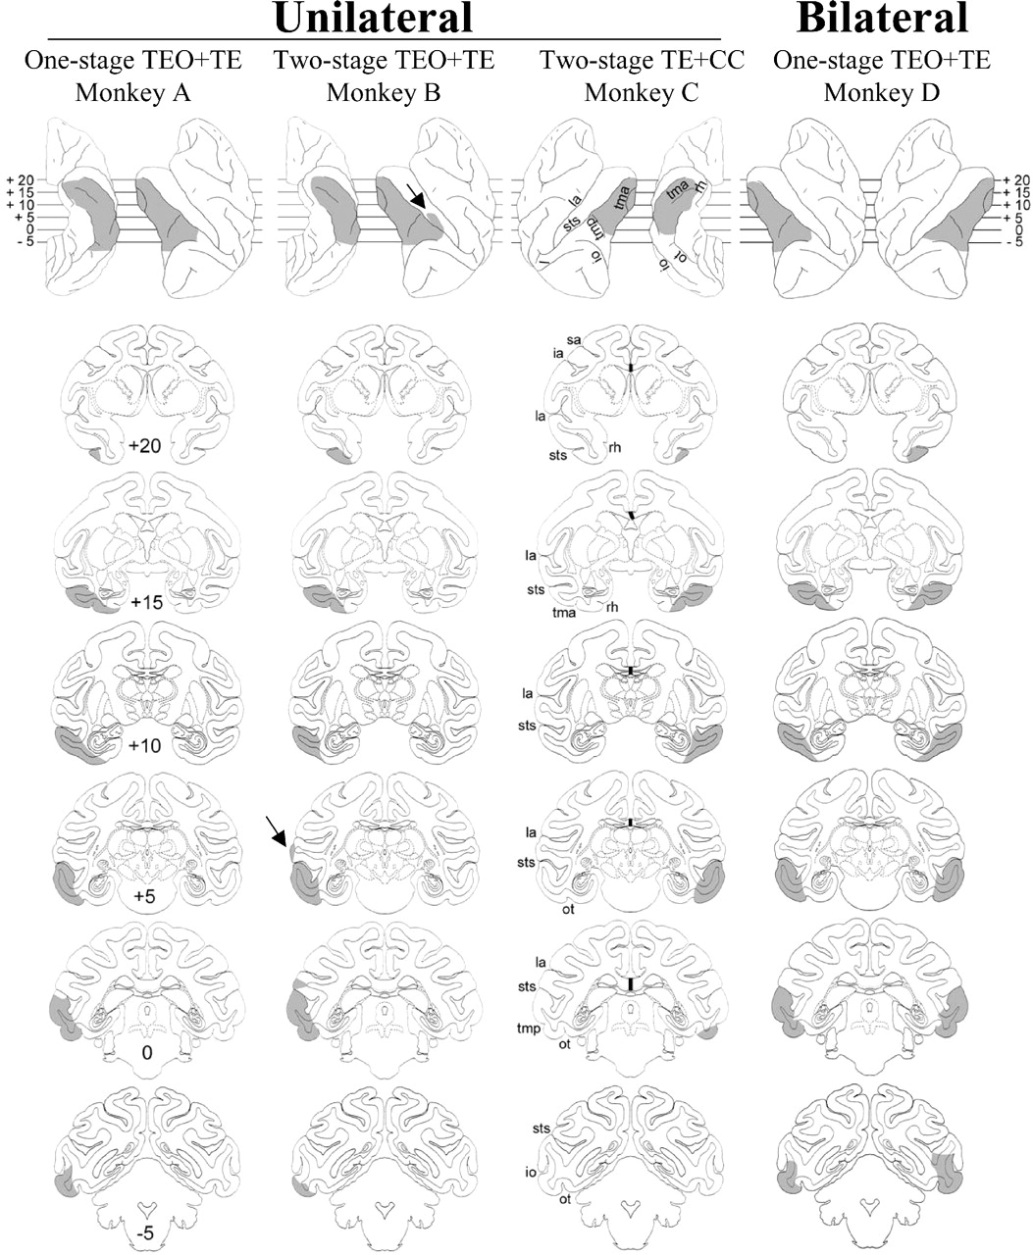
Figure 2. Reconstruction of IT lesions, shown at five coronal levels. The level of each coronal section is ...
Notes:
Figure 2. Reconstruction of IT lesions, shown at five coronal levels. The level of each coronal section is illustrated above on lateral and ventral views of the brains. The lesions were largely as intended. There was no LGN degeneration in any of the brains. One brain, 541, had some damage to the superior temporal gyrus (arrows) probably because we had to re-open the dura to extend the lesion.
Unless provided in the caption above, the following copyright applies to the content of this slide:

Slide 3
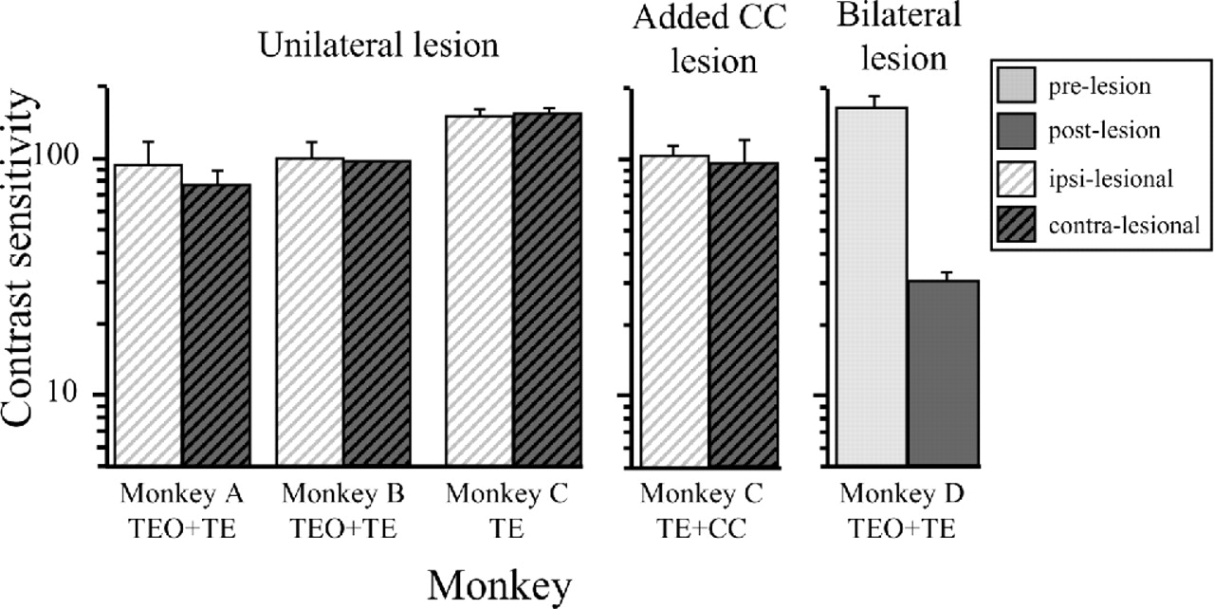
Figure 3. Luminance contrast sensitivity in the ipsilesional and contralesional visual fields for monkeys A ...
Notes:
Figure 3. Luminance contrast sensitivity in the ipsilesional and contralesional visual fields for monkeys A (TEO + TE), B (TEO + TE), and C (TE) after unilateral IT lesions, and before and after a bilateral IT lesion in monkey D (bil. TEO + TE). Results are also shown for monkey C (TE + CC) following addition of section of the anterior commissure and corpus callosum. Error bars show ±SD.
Unless provided in the caption above, the following copyright applies to the content of this slide:

Slide 4
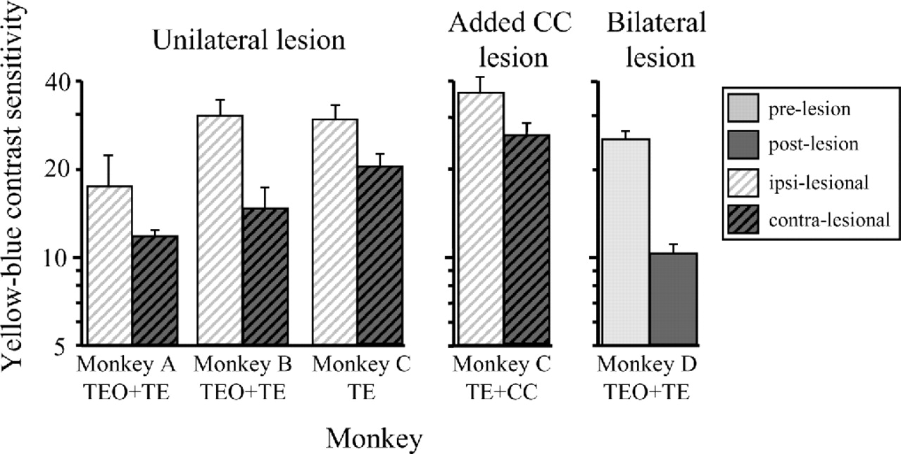
Figure 4. Chromatic (yellow–blue) contrast sensitivity in the ipsilesional and contralesional visual fields ...
Notes:
Figure 4. Chromatic (yellow–blue) contrast sensitivity in the ipsilesional and contralesional visual fields of monkeys with unilateral IT lesions, and before and after a bilateral IT lesion in monkey D. Results are also shown for monkey C following additional section of the anterior commissure and corpus callosum. Error bars show ±SD.
Unless provided in the caption above, the following copyright applies to the content of this slide:

Slide 5
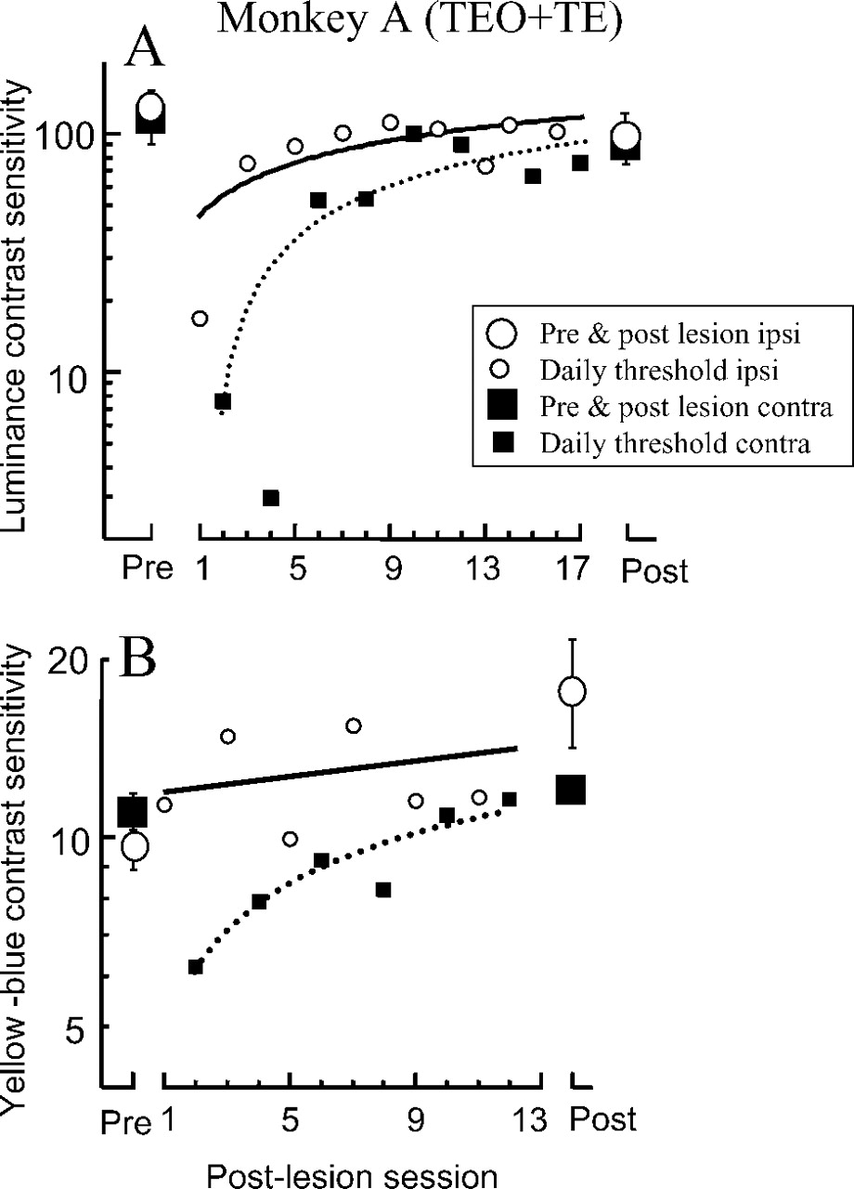
Figure 5. Time course of (A) luminance and (B) yellow–blue contrast sensitivity for monkey A (TEO + TE) ...
Notes:
Figure 5. Time course of (A) luminance and (B) yellow–blue contrast sensitivity for monkey A (TEO + TE) before, and immediately after a one-stage lesion of TEO and TE, as well as after performance stabilized. Large open circles show ipsilesional thresholds before the lesion and after stability, and large filled squares show the same results for the contralesional field. Small open circles and the solid curve show daily ipsilesional sensitivity immediately after the lesion, and small filled squares and dotted curves show sensitivity in the contralesional field.
Unless provided in the caption above, the following copyright applies to the content of this slide:

Slide 6
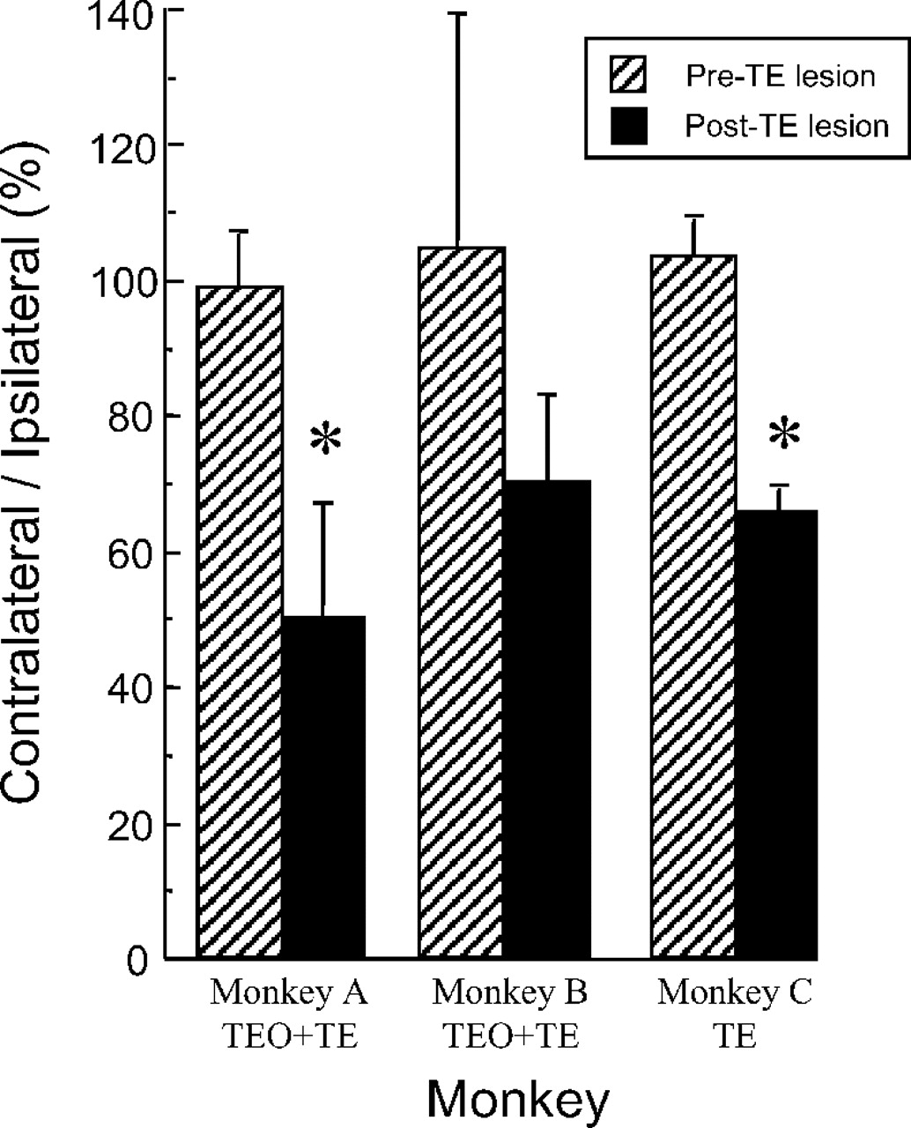
Figure 6. Ratio of contralesional to ipsilesional yellow–blue contrast sensitivity before (hatching) and ...
Notes:
Figure 6. Ratio of contralesional to ipsilesional yellow–blue contrast sensitivity before (hatching) and after (black) a unilateral lesion of area TE. For monkey A, this figure compares results from before to after a single stage lesion of areas TEO and TE. For monkey B, the figure compares results from before to after the TE stage of a two-stage lesion. For monkey C, the figure compares results from before to after a TE lesion. Error bars show ±SD. *P < 0.01, Student’s t-test.
Unless provided in the caption above, the following copyright applies to the content of this slide:

Slide 7
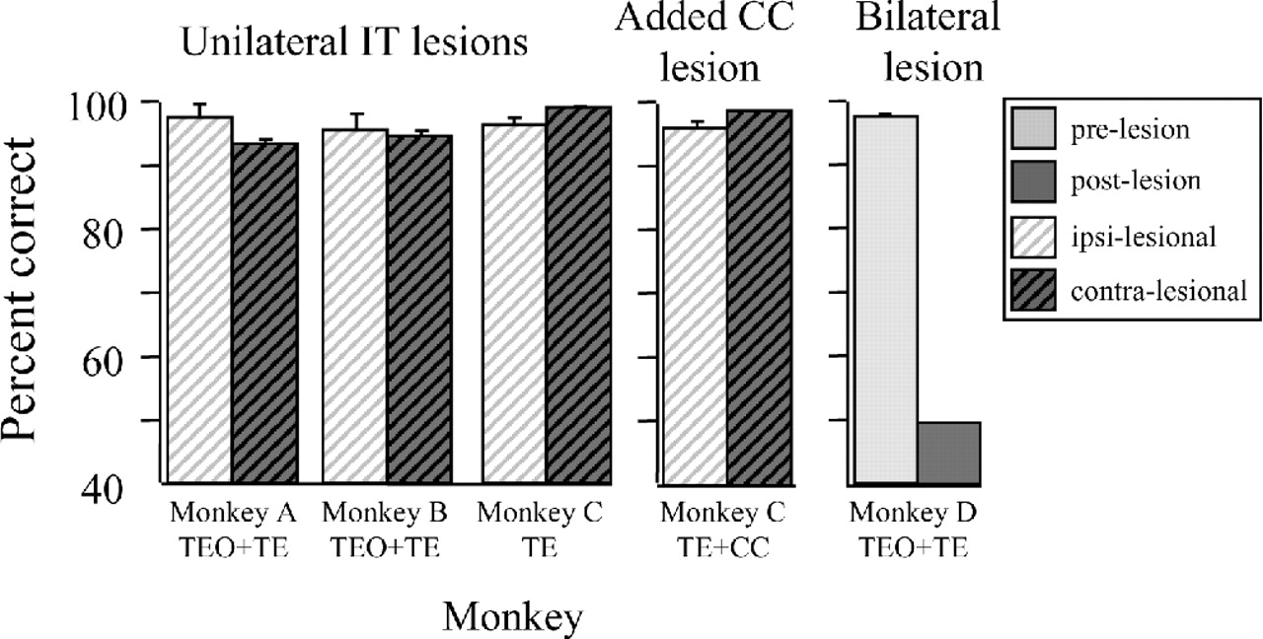
Figure 7. Effect of IT lesions on illusory contour discrimination, comparing ipsilesional to contralesional ...
Notes:
Figure 7. Effect of IT lesions on illusory contour discrimination, comparing ipsilesional to contralesional visual fields of monkeys with unilateral IT lesions [monkeys A (TEO + TE), B (TEO + TE), and C (TE)], and comparing pre- to post-bilateral IT lesion in monkey D (bil. TEO + TE). Results are also shown for monkey C (TE + CC) following additional section of the anterior commissure and corpus callosum. Error bars show ±SD.
Unless provided in the caption above, the following copyright applies to the content of this slide:

Slide 8
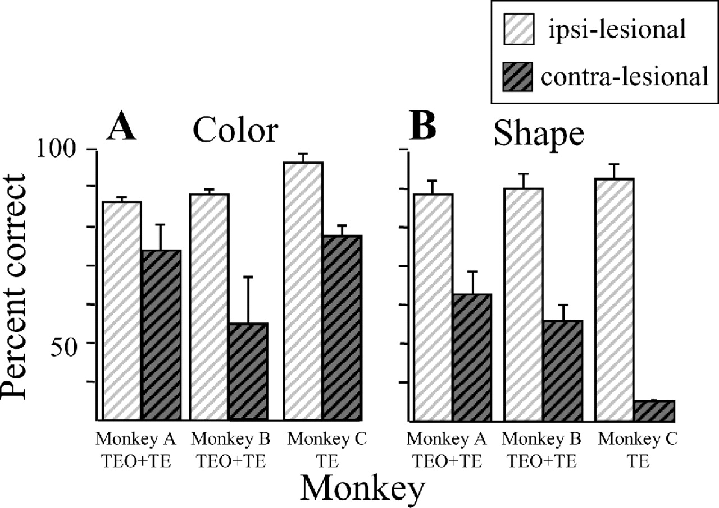
Figure 8. Shape and color-matching performance of the three monkeys with unilateral IT lesions. Lightly ...
Notes:
Figure 8. Shape and color-matching performance of the three monkeys with unilateral IT lesions. Lightly hatched bars show performance in the ipsilesional hemifield and darkly hatched bars the contralesional hemifield. Error bars show ±SD.
Unless provided in the caption above, the following copyright applies to the content of this slide:

