Slide 1
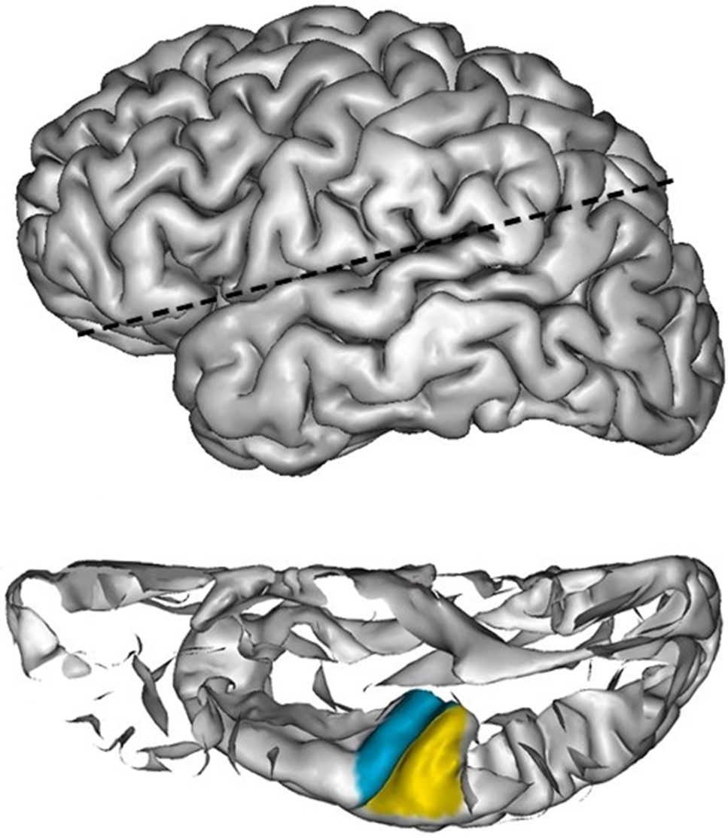
Figure 1. The top panel shows a lateral view on a left hemisphere mesh. The cutting plane applied for the labeling is ...
Notes:
Figure 1. The top panel shows a lateral view on a left hemisphere mesh. The cutting plane applied for the labeling is indicated by the dotted black line. The bottom panel shows the superior temporal plane applied to label the planum temporale (yellow) and Heschl's gyrus (blue).
Unless provided in the caption above, the following copyright applies to the content of this slide: © The Author 2016. Published by Oxford University Press. All rights reserved. For Permissions, please e-mail: journals.permissions@oup.com

Slide 2
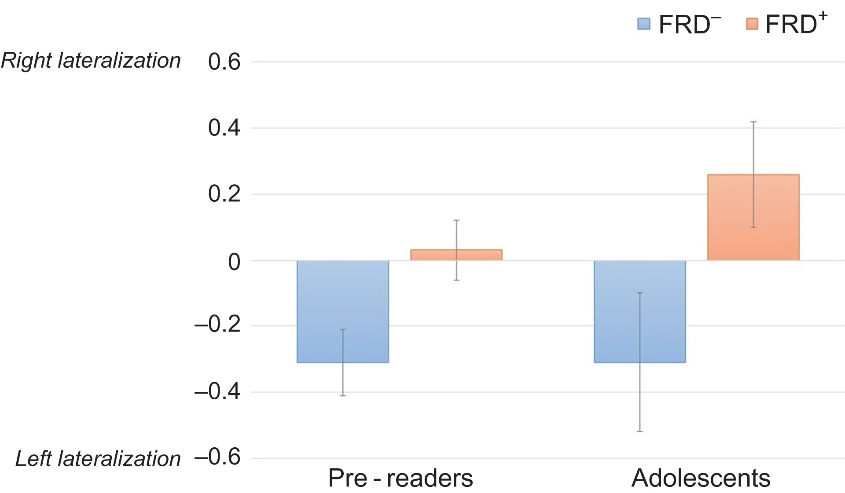
Figure 2. Mean normalized lateralization index and standard error for pre-readers and adolescents, with ...
Notes:
Figure 2. Mean normalized lateralization index and standard error for pre-readers and adolescents, with (FRD+) and without (FRD−) a familial risk for dyslexia. Positive scores indicate a rightward planum temporale lateralization (right > left) and negative scores indicate a leftward lateralization (left > right).
Unless provided in the caption above, the following copyright applies to the content of this slide: © The Author 2016. Published by Oxford University Press. All rights reserved. For Permissions, please e-mail: journals.permissions@oup.com

Slide 3
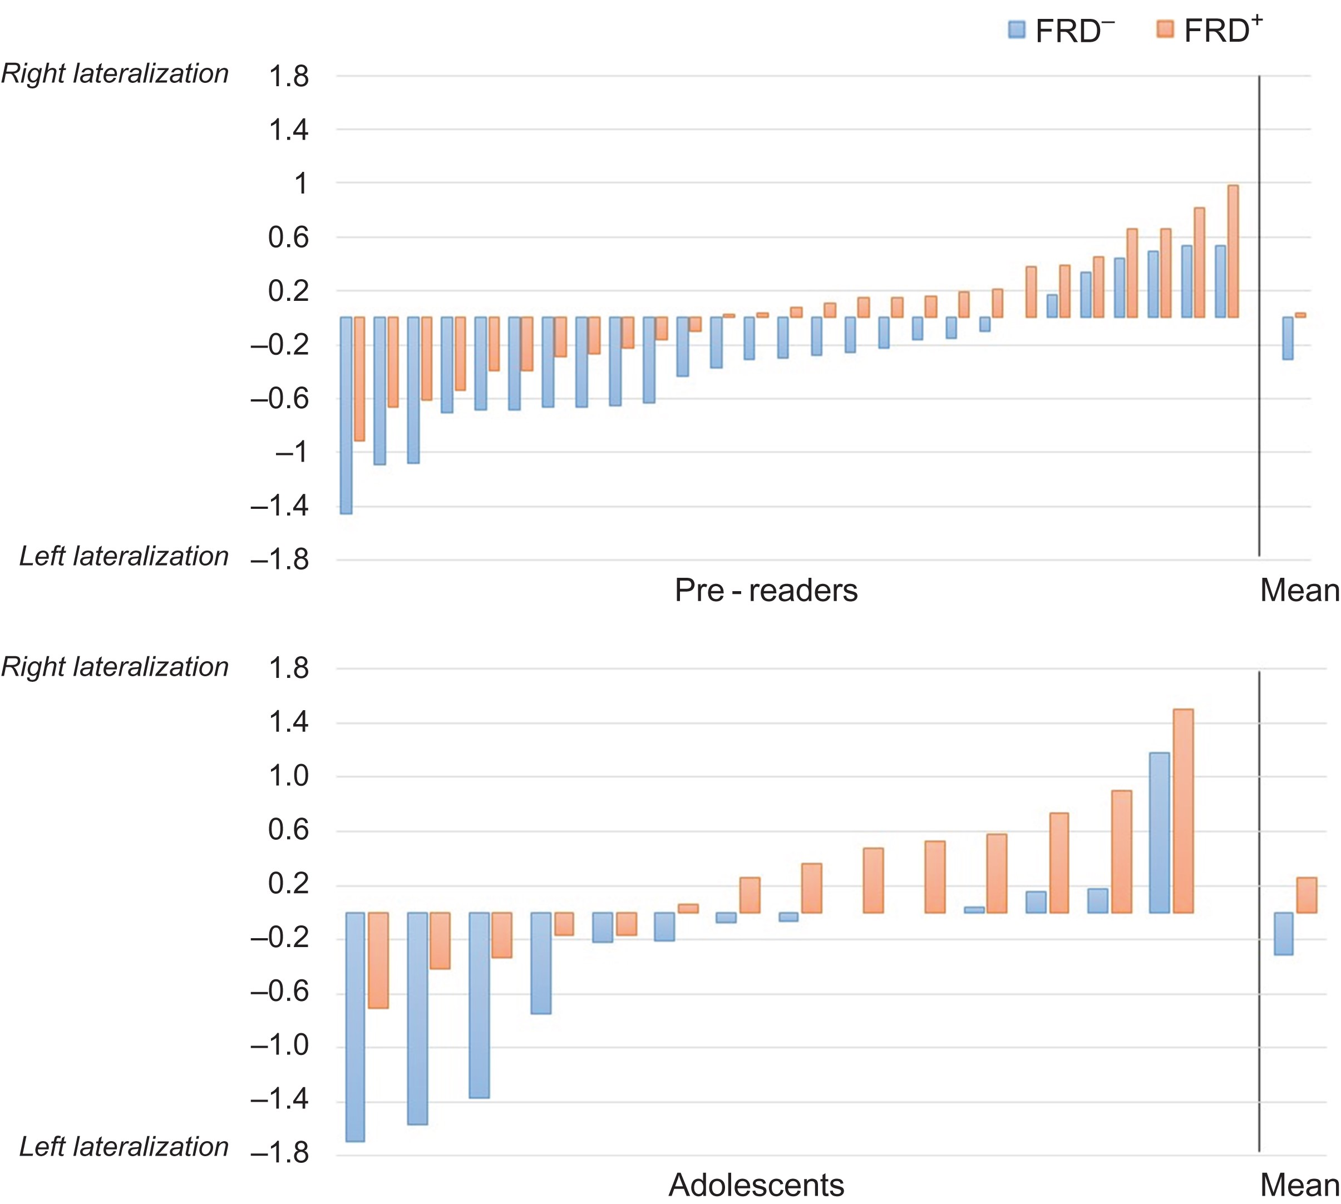
Figure 3. The normalized planum temporale AI for each pre-reader (top panel) and adolescent (bottom panel). Positive ...
Notes:
Figure 3. The normalized planum temporale AI for each pre-reader (top panel) and adolescent (bottom panel). Positive scores indicate a rightward planum temporale lateralization (right > left) and negative scores indicate a leftward lateralization (left > right). Within each group (blue = FRD−, red = FRD+) participants are ranked from low to high AI. In the right panel, mean lateralization is presented for each group.
Unless provided in the caption above, the following copyright applies to the content of this slide: © The Author 2016. Published by Oxford University Press. All rights reserved. For Permissions, please e-mail: journals.permissions@oup.com

