Slide 1
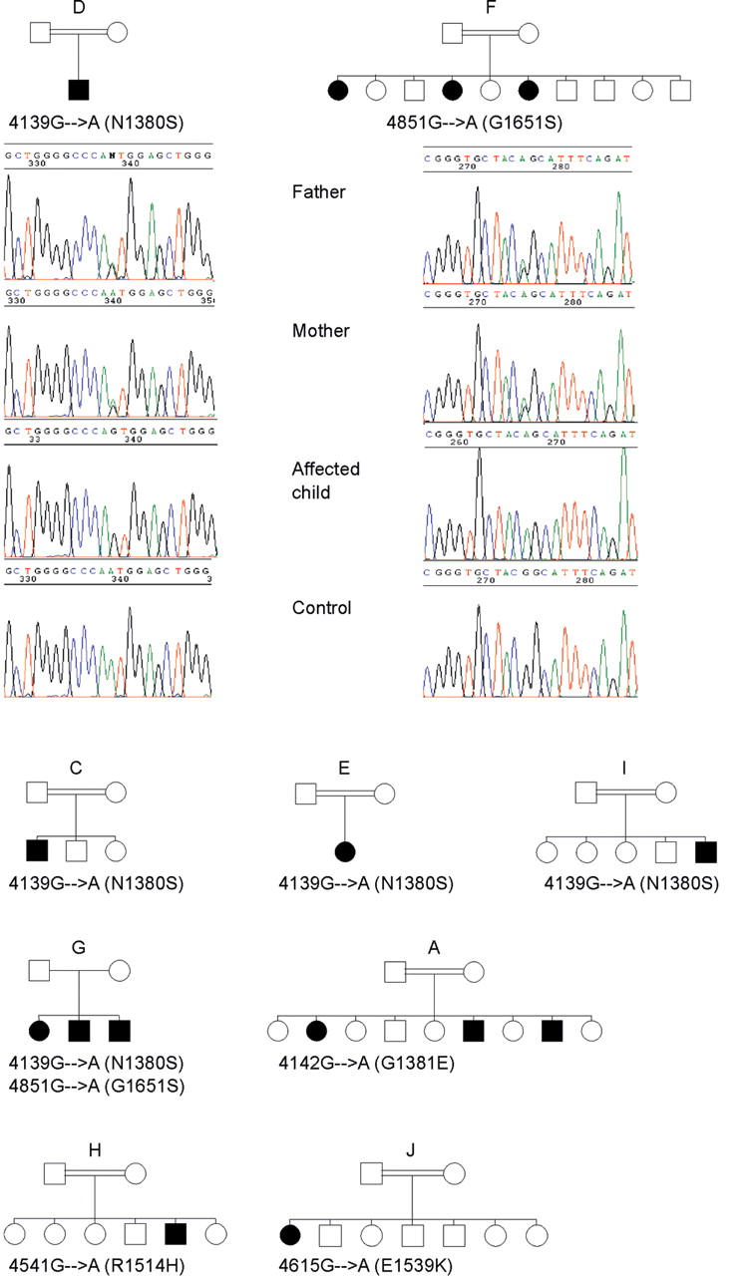
Figure 1. Sequences from patients and parents from family D (4139G→A) and F (4851G→A) and normal controls are ...
Notes:
Figure 1. Sequences from patients and parents from family D (4139G→A) and F (4851G→A) and normal controls are shown. Pedigrees of the other affected families are also depicted. Affected individuals are indicated by blackened symbols.
Unless provided in the caption above, the following copyright applies to the content of this slide:

Slide 2
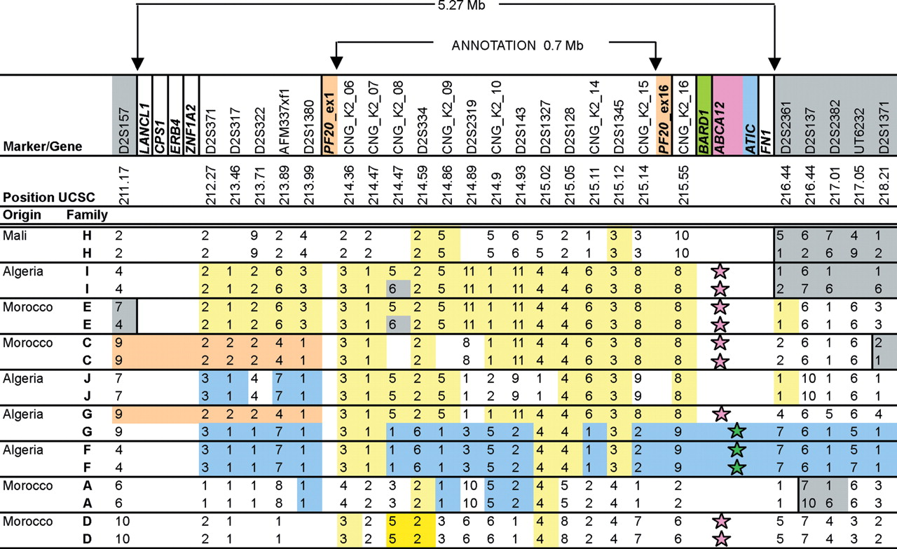
Figure 2. Construction of haplotypes. Genotypes of one patient per family for 25 microsatellite markers from ...
Notes:
Figure 2. Construction of haplotypes. Genotypes of one patient per family for 25 microsatellite markers from a 7 cM region on chromosome 2q33–35 are shown. The most centromeric marker is on the left. Common haplotypes are in the same color; colored stars indicate the common mutations. Position UCSC indicates the Mb position from the Golden Path database ( http://genome.ucsc.edu ). Genes are in bold.
Unless provided in the caption above, the following copyright applies to the content of this slide:

Slide 3
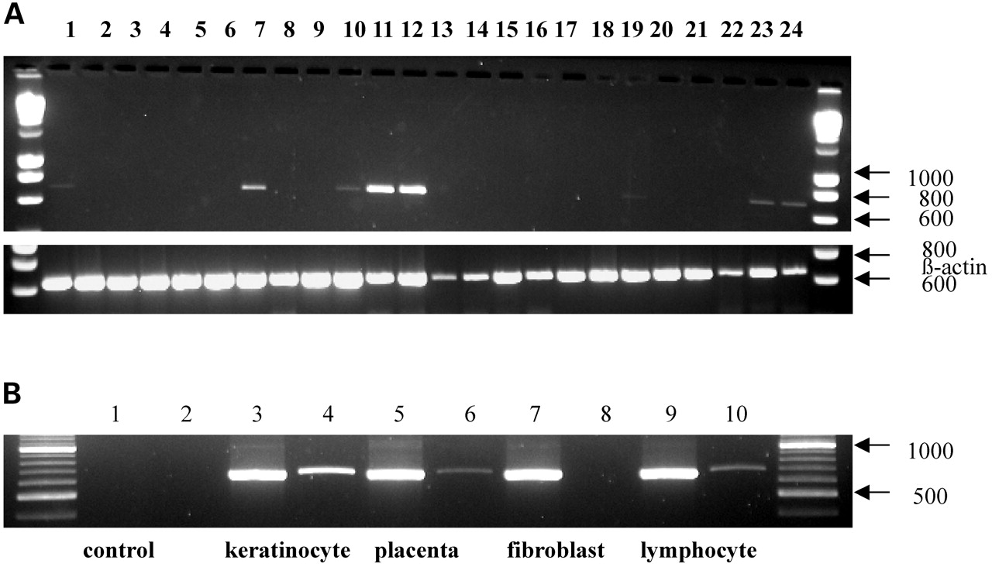
Figure 3. ( A ) Expression of ABCA12 transcripts by RT–PCR in 24 different tissues from the Rapid Scan ...
Notes:
Figure 3. ( A ) Expression of ABCA12 transcripts by RT–PCR in 24 different tissues from the Rapid Scan Expression panel (OriGene Technologies). Lanes: 1, brain; 2, heart; 3, kidney; 4, spleen; 5, liver; 6, colon; 7, lung; 8, small intestine; 9, muscle; 10, stomach; 11, testis; 12, placenta; 13, salivary gland; 14, thyroid; 15, adrenal gland; 16, pancreas; 17, ovary; 18, uterus; 19, prostate; 20, skin; 21, peripheral blood lymphocytes; 22, bone marrow; 23, fetal brain; 24, fetal liver. Strong expression was found in testis (lane 11), and placenta (lane 12); lower expression was detectable in lung (lane 7), and very low expression was found in brain (lane 1), stomach (lane 10), prostate (lane 19), fetal brain (lane 23) and fetal liver (lane 24). No expression was detectable in the other tissues including skin. The molecular marker for quantification and fragment size determination (lane A and B) is Quanti-Ladder TM DNA. The corresponding β-actin expression is shown below. ( B ) Expression analysis of the ABCA12 mRNA by RT–PCR. RT–PCR of ABCA12 in negative controls (lanes 1 and 2), cultured keratinocytes (lanes 3 and 4), placenta (lanes 5 and 6), cultured fibroblasts (lanes 7 and 8) and cultured lymphoblasts (lanes 9 and 10) using RT10 primers which amplify a transcript of 673 bp (lanes 4, 6, 8 and 10) using β-actin as a positive control (661 bp) (lanes 3, 5, 7 and 9); left and right lanes—molecular marker (XIV, Roche Molecular Biochemicals). A stronger expression of ABCA12 was observed in keratinocytes than in placenta or lymphocytes, and no expression was observed in cultured fibroblasts from skin biopsies.
Unless provided in the caption above, the following copyright applies to the content of this slide:

Slide 4
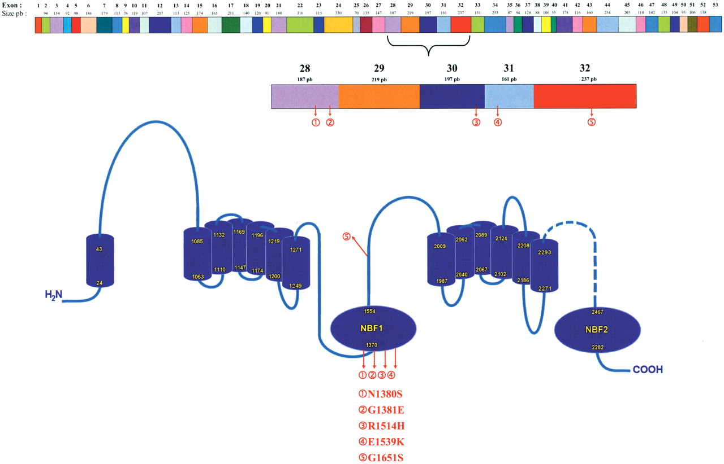
Figure 4. Diagram of ABCA12 cDNA and schematic representation of the predicted structure of the ABCA12 ...
Notes:
Figure 4. Diagram of ABCA12 cDNA and schematic representation of the predicted structure of the ABCA12 protein showing transmembrane domains, nucleotide-binding folds (NBF) and location of mutations.
Unless provided in the caption above, the following copyright applies to the content of this slide:

