Slide 1
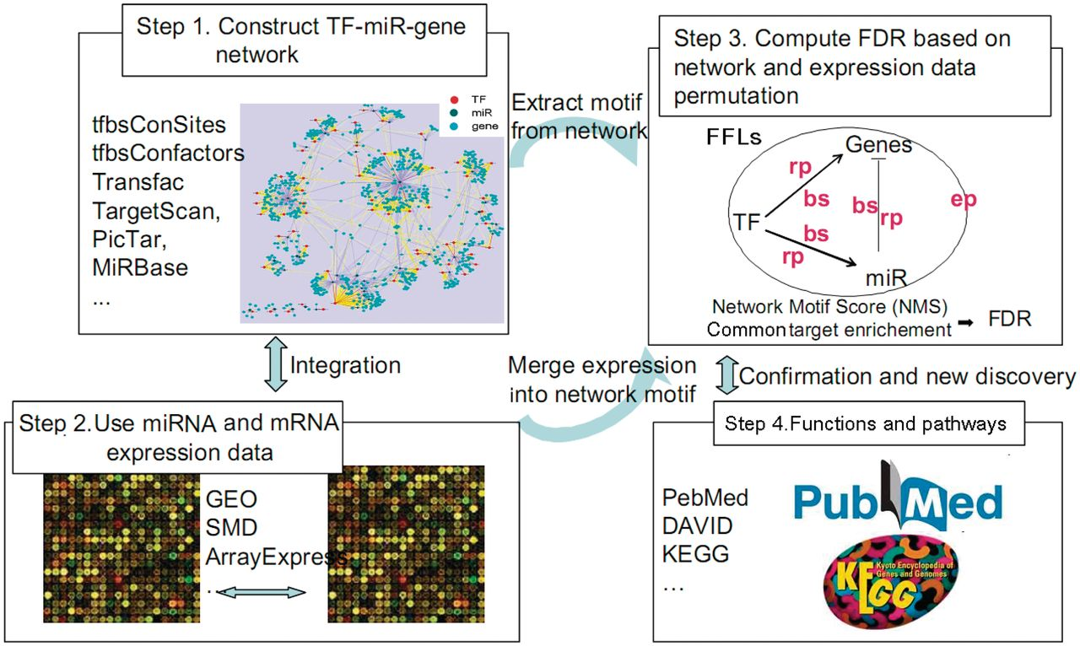
Figure 1. dChip-GemiNI workflow for integrated network and expression analysis. We construct candidate TF–miRNA–gene ...
Notes:
Figure 1. dChip-GemiNI workflow for integrated network and expression analysis. We construct candidate TF–miRNA–gene network using different databases (Step 1), obtain gene and miRNA expression profiles from different studies (Step 2), select significant FFL motifs through integration of network motifs and expression data (Step 3) and further validate the results (Step 4). See Materials and Methods section for details. Step 3 shows a typical TF–miRNA–gene FFL. bs: binding score; rp: en r ichment P -value; ep: differential e xpression P -value.
Unless provided in the caption above, the following copyright applies to the content of this slide: © The Author(s) 2012. Published by Oxford University Press.This is an Open Access article distributed under the terms of the Creative Commons Attribution Non-Commercial License (http://creativecommons.org/licenses/by-nc/3.0), which permits unrestricted non-commercial use, distribution, and reproduction in any medium, provided the original work is properly cited.

Slide 2
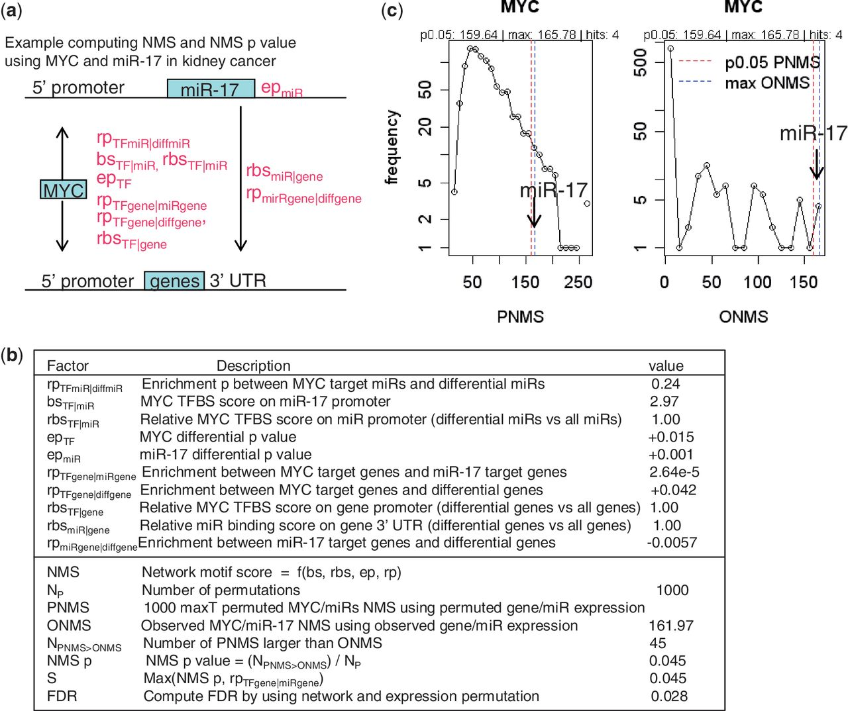
Figure 2. Computation of NMS and FDR with multiple scoring factors. ( a ) Computing NMS for the FFL of MYC and miR-17 ...
Notes:
Figure 2. Computation of NMS and FDR with multiple scoring factors. ( a ) Computing NMS for the FFL of MYC and miR-17 using different scoring factors. ( b ) The list of scoring factors and example values and results. The ± signs indicate up/down-regulation of single or enriched genes. ( c ) Left: the distribution of N P (1000) maximal permutated NMS statistics (PNMS); right: the distribution of the observed NMS from all FFLs involving MYC (ONMS). With 1000 permutations, there are 45 PNMS larger than the observed NMS of MYC-miR-17 FFL, resulting in a permutation P = 0.045. The P -values for all TF–miRNA FFLs can be computed similarly. The NMS P -values are combined with common target enrichment P -values during network permutation to further compute FDR. See Materials and Methods section for details.
Unless provided in the caption above, the following copyright applies to the content of this slide: © The Author(s) 2012. Published by Oxford University Press.This is an Open Access article distributed under the terms of the Creative Commons Attribution Non-Commercial License (http://creativecommons.org/licenses/by-nc/3.0), which permits unrestricted non-commercial use, distribution, and reproduction in any medium, provided the original work is properly cited.

Slide 3
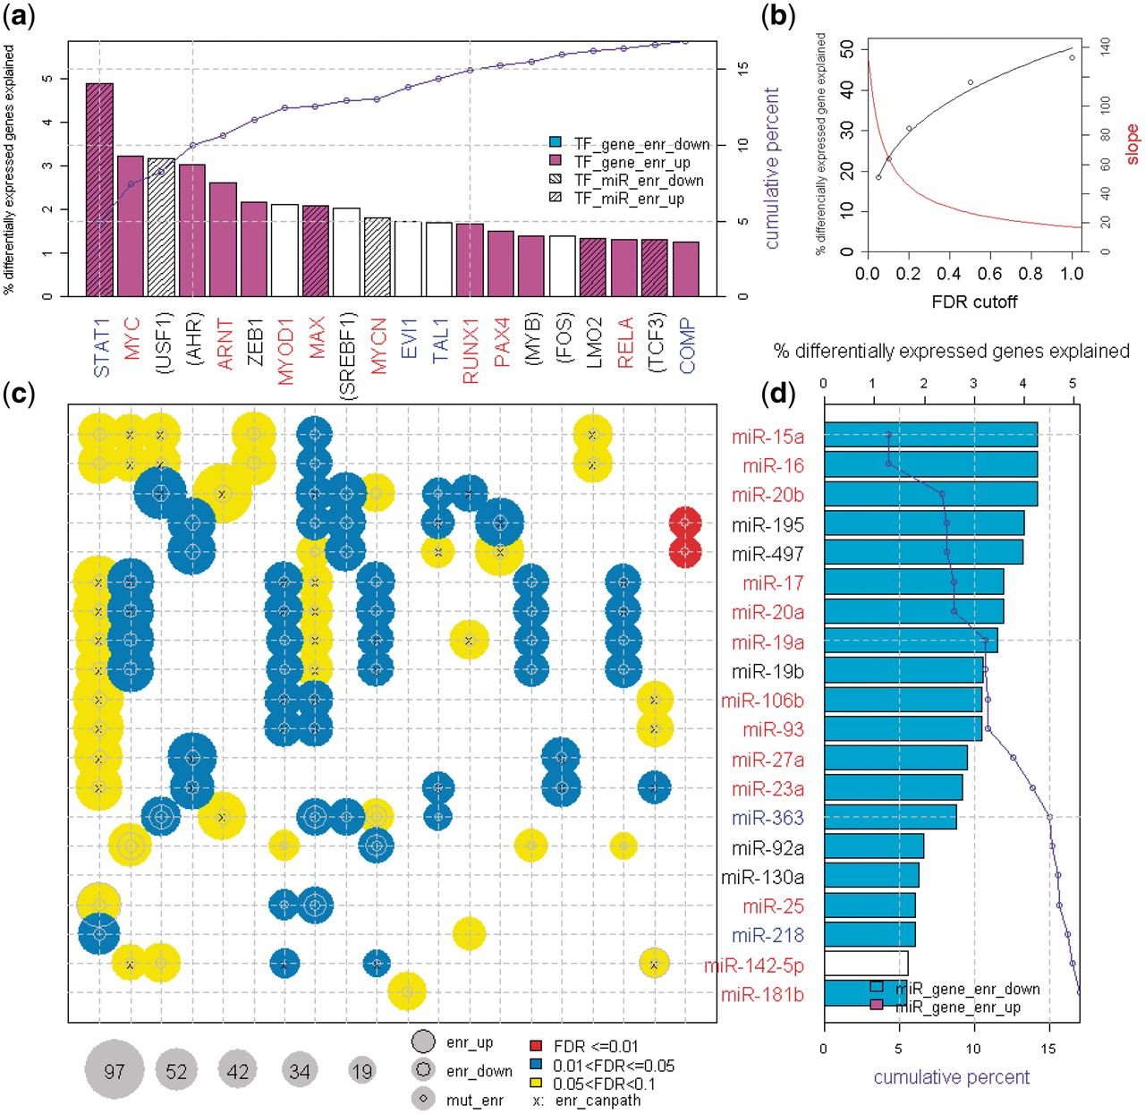
Figure 3. The summary bubble-bar plot from dChip-GemiNI analysis of the kidney cancer data, highlighting the amount of ...
Notes:
Figure 3. The summary bubble-bar plot from dChip-GemiNI analysis of the kidney cancer data, highlighting the amount of differentially expressed genes explained by FFLs, TFs and miRNAs. TFs on the top ( a ) and miRNAs on the right ( d ) are ranked by the percentage of differentially expressed genes explained by all the significant FFLs involving a TF or miRNA (the height of bars). The top 20 TFs and miRNAs are displayed (for complete plots, see Supplementary File S1 ). The bubbles in the lower left panel ( c ) correspond to TF–miRNA FFLs with FDR <0.1 from the kidney cancer data. The bubble size indicates the number of differentially expressed FFL target genes, and color indicates the FFL significance. The cumulative percentage of differentially expressed genes explained by TFs and miRNAs is also shown in the barplots ( a and d ). The parenthesis around a TF or miRNA name indicates that its differential expression is not used in NMS due to missing data or low-expression filtering (other scoring factors are still used). TF and miRNA name color: red, expression is upregulated in cancer; blue, downregulated; black, no change. The following target enrichment analyses are called at Fisher’s exact test P < 0.05. enr_up (enr_down): TF and miRNA common target genes are enriched in upregulated (downregulated) genes; TF_gene_enr_up (TF_gene_enr_down): TF target genes are enriched in upregulated (downregulated) genes; TF_miR_enr_up (TF_miR_enr_down): TF target miRNAs are enriched in upregulated (downregulated) miRNAs; miR_gene_enr_up (miR_gene_enr_down): miRNA target genes are enriched in upregulated (downregulated) genes; Mut_enr: TF target genes and miRNA target genes are enriched in each other; enr_canpath: TF and miRNA common and differentially expressed target genes are enriched in KEGG cancer pathways.
Unless provided in the caption above, the following copyright applies to the content of this slide: © The Author(s) 2012. Published by Oxford University Press.This is an Open Access article distributed under the terms of the Creative Commons Attribution Non-Commercial License (http://creativecommons.org/licenses/by-nc/3.0), which permits unrestricted non-commercial use, distribution, and reproduction in any medium, provided the original work is properly cited.

Slide 4
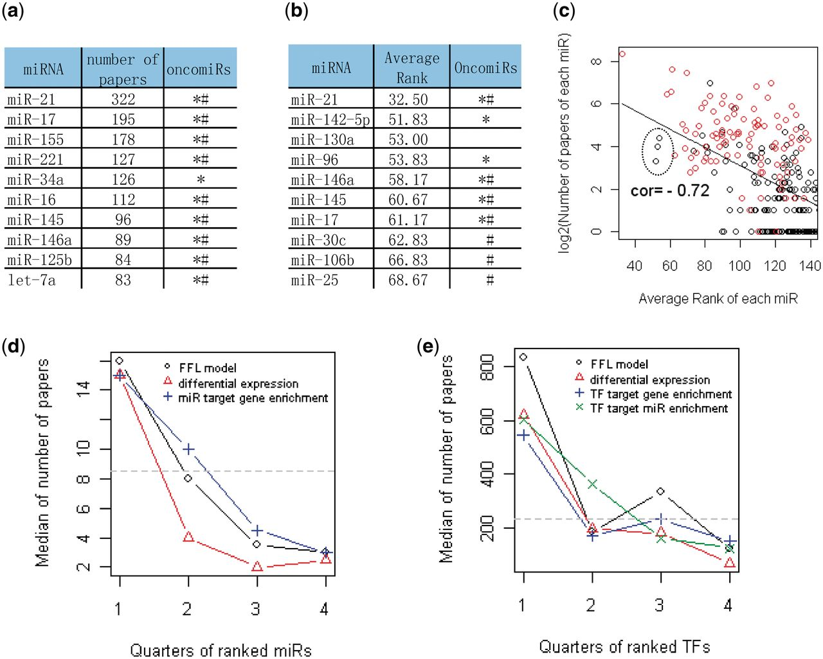
Figure 4. Validation of top TFs and miRNAs ranked by different analysis methods. ( a ) The top 10 miRNAs based on the ...
Notes:
Figure 4. Validation of top TFs and miRNAs ranked by different analysis methods. ( a ) The top 10 miRNAs based on the number of cancer-related papers from literature mining. Asterisks indicate oncomiRs summarized in reviews ( 2 , 3 , 40 , 41 ); Hash indicate oncomiRs from the SBI OncomiR collection ( http://www.systembio.com/services/microrna/oncomir-collection ). See Supplementary Files S3 and Supplementary Data for details. ( b ) The top 10 miRNAs by the average rank of differential expression P -values from the six cancer data sets. See Supplementary File S4 for the complete list. ( c ) The scatter plot between the number of cancer-related papers and the average rank of miRNAs by differential expression. Higher rank (lower rank number) is correlated with more papers, so the correlation is negative. The red circles are known oncomiRs from SBI. The top-ranked miRNAs could also suggest novel oncomiR candidates, such as the three leftmost black points corresponding to miR-142-5p, miR-130a and miR-96 (indicated in the large circle). ( d ) The miRNAs are first ordered by their average ranks in the six cancer data sets using each analysis method and then divided into four quarters ( X -axis). Then, the median number of cancer-related papers of the miRNAs in each quarter is plotted ( Y -axis) for different methods. The gray horizontal line is the median number of papers for all miRNAs. ( e ) The similar plot as (d) for TFs.
Unless provided in the caption above, the following copyright applies to the content of this slide: © The Author(s) 2012. Published by Oxford University Press.This is an Open Access article distributed under the terms of the Creative Commons Attribution Non-Commercial License (http://creativecommons.org/licenses/by-nc/3.0), which permits unrestricted non-commercial use, distribution, and reproduction in any medium, provided the original work is properly cited.

