Slide 1
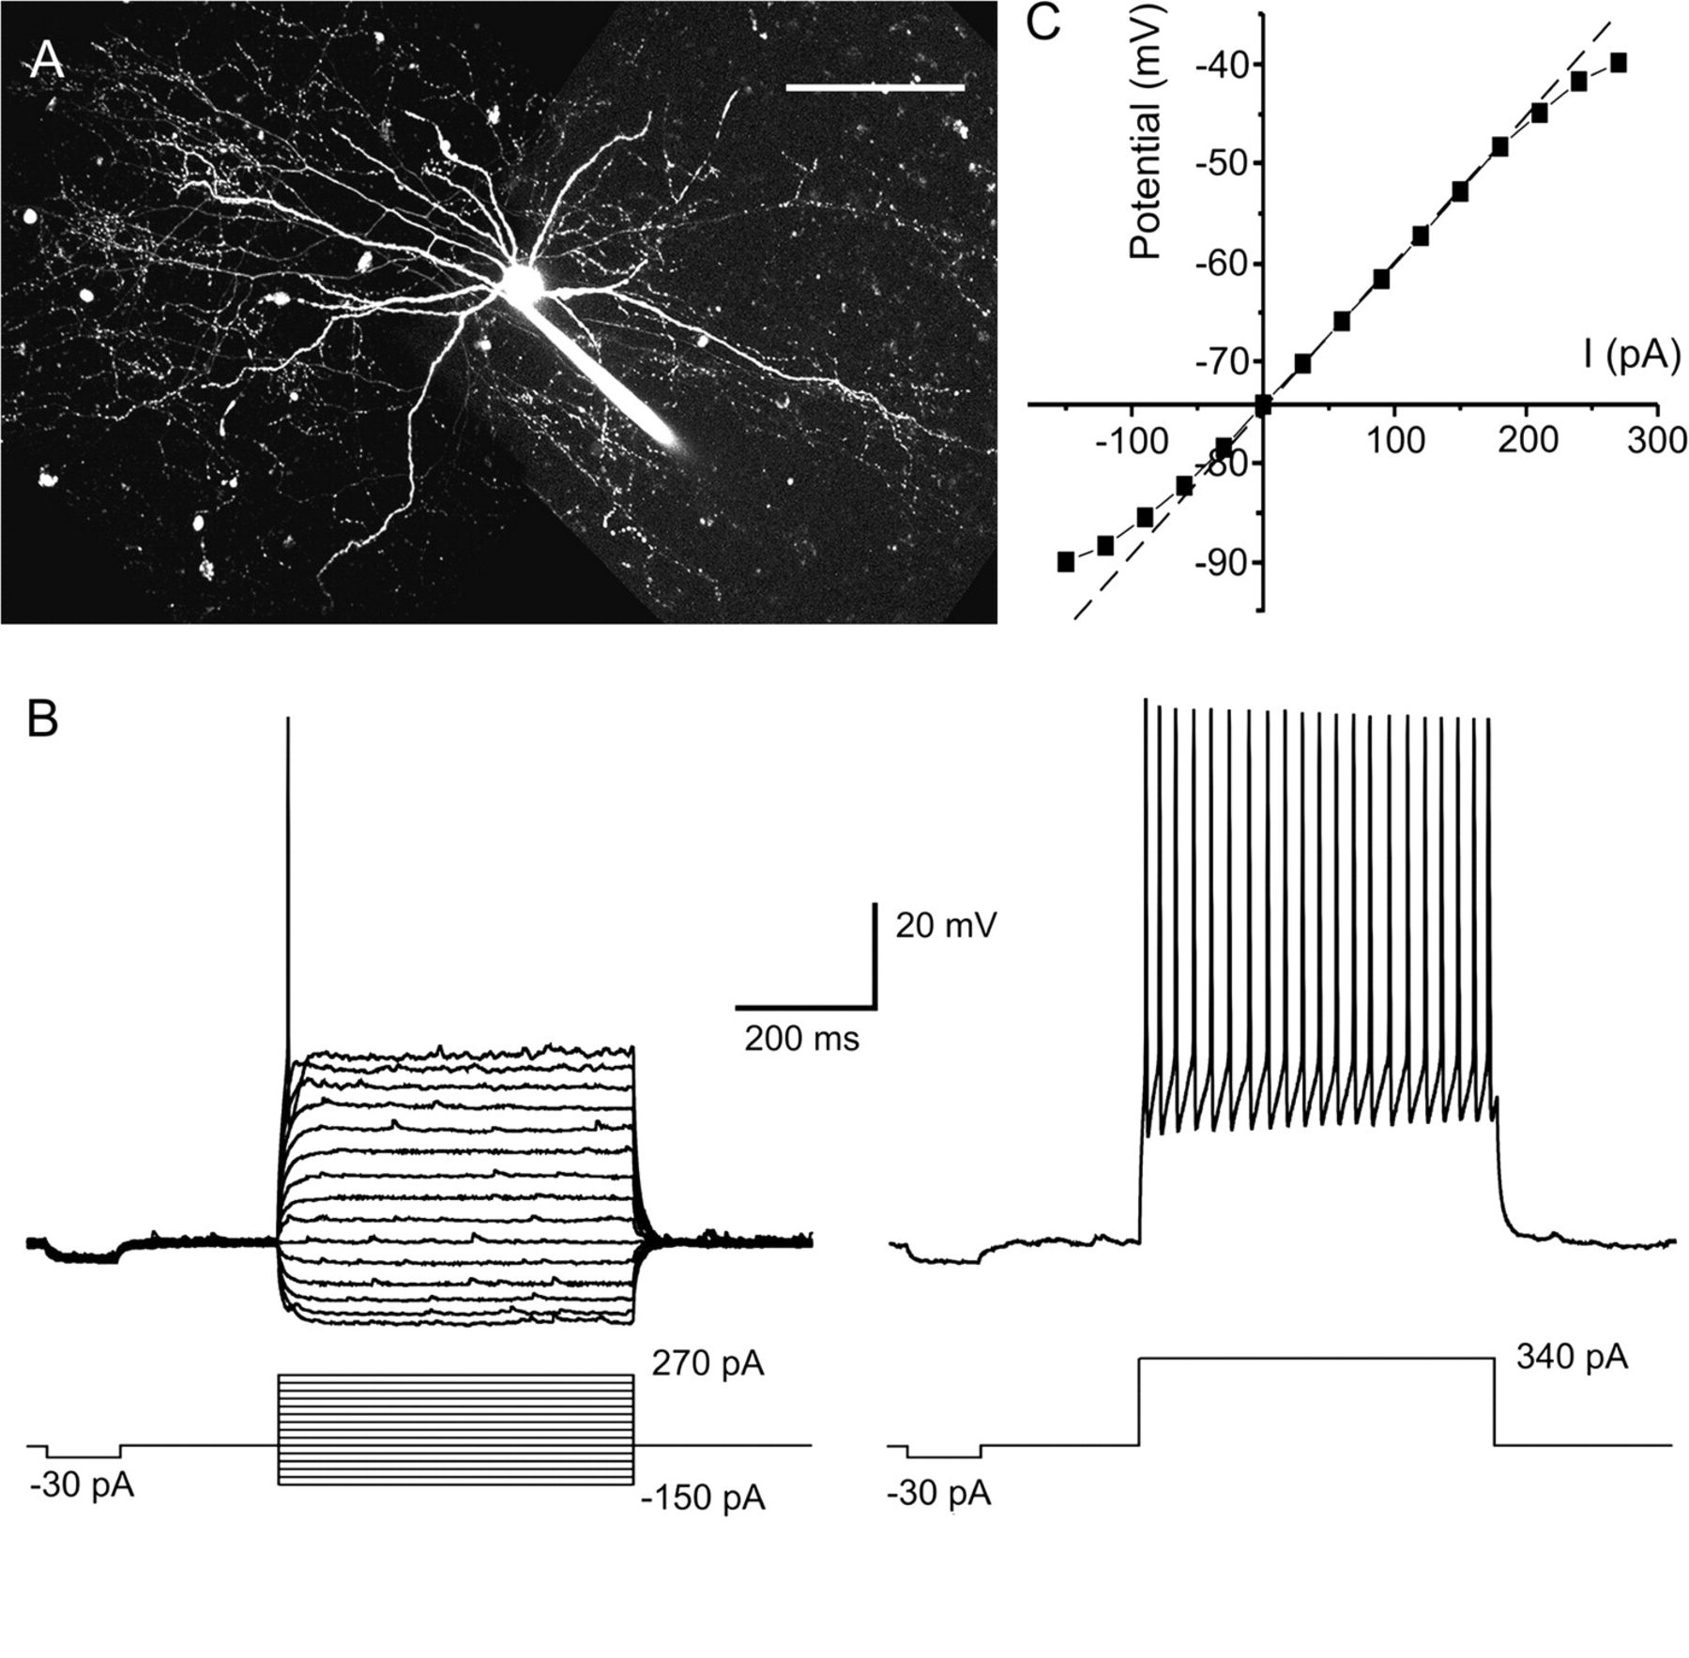
Figure 1. Properties of fast-spiking interneurons from mouse PFC in vitro. (A) Morphological characteristics of a ...
Notes:
Figure 1. Properties of fast-spiking interneurons from mouse PFC in vitro. (A) Morphological characteristics of a fast-spiking interneuron in the mouse medial prefrontal cortex. The cell was filled with Alexa 594 during whole-cell recording and reconstructed using z-stacked confocal images. The scale bar represents 100 μm. (B) Typical responses of a fast-spiking interneuron to depolarizing and hyperpolarizing somatic current injection (−150 pA to + 270 pA, 30 pA increments). Suprathreshold responses (trace on the right) show high frequency firing with little adaptation and deep AHP that follow individual spikes. (C) Current-voltage plot obtained from the traces shown in B. As shown in this example, fast-spiking interneurons typically showed a small inward rectification with fast onset in the hyperpolarizing direction as well as outward rectification at depolarizing membrane potentials close to spike threshold (deviations from the dotted line which indicates the linear portion of the current–voltage response).
Unless provided in the caption above, the following copyright applies to the content of this slide: © The Author 2007. Published by Oxford University Press. All rights reserved. For permissions, please e-mail: journals.permissions@oxfordjournals.org

Slide 2
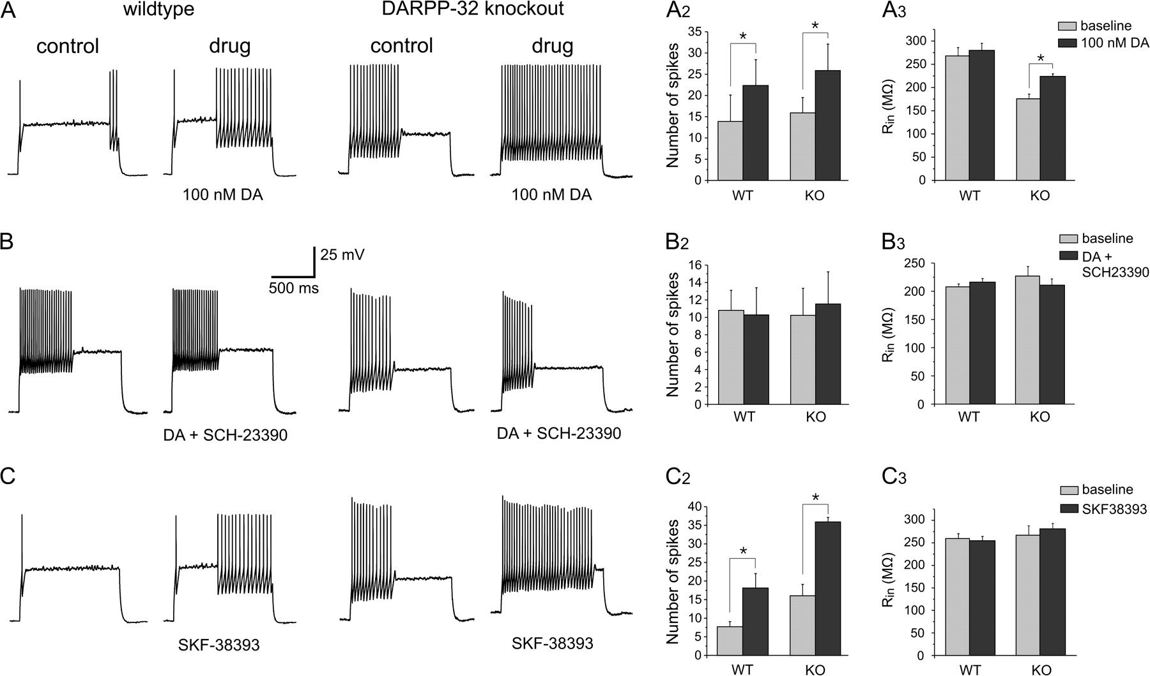
Figure 2. Low concentrations of DA increase the firing rate of fast-spiking interneurons via activation of D1 ...
Notes:
Figure 2. Low concentrations of DA increase the firing rate of fast-spiking interneurons via activation of D1 receptors, cAMP, and PKA, but independently of DARPP-32.A low dose of DA (100 nM) enhanced evoked firing in fast-spiking interneurons from WT and DARPP-32 KO animals. This effect depended on D1 receptor activation. (A) Representative traces showing 100 nM DA increases the firing rate of fast-spiking interneurons in WT (left column) and DARPP-32 KO animals. (A2) Summary plot for the effect on evoked firing in cells from WT (n = 8) and KO (n = 8) animals. (A3) The effects on evoked firing were independent of changes in input resistance in WT animals but were accompanied by an increase in Rin in KO animals. (B) The D1 receptor antagonist SCH-23390 (5–10 μM) prevents the effect of low DA in both WT and DARPP-32 KO cells. (B2) Summary plot for the effects of 100 nM DA in the presence of SCH-23390 on evoked spikes in WT (n = 5) and KO (n = 4) animals. (B3) Effects on input resistance. (C) Application of the D1 receptor agonist SKF-38393 (5–10 μM) mimicked the effect of DA in cells from animals of both genotypes. (C2) Summary plots for the effects of SKF-38393 on evoked firing in WT (n = 6) and KO (n = 4) animals. (C3) Effects on input resistance. Asterisks denote significant differences at P < 0.05.
Unless provided in the caption above, the following copyright applies to the content of this slide: © The Author 2007. Published by Oxford University Press. All rights reserved. For permissions, please e-mail: journals.permissions@oxfordjournals.org

Slide 3
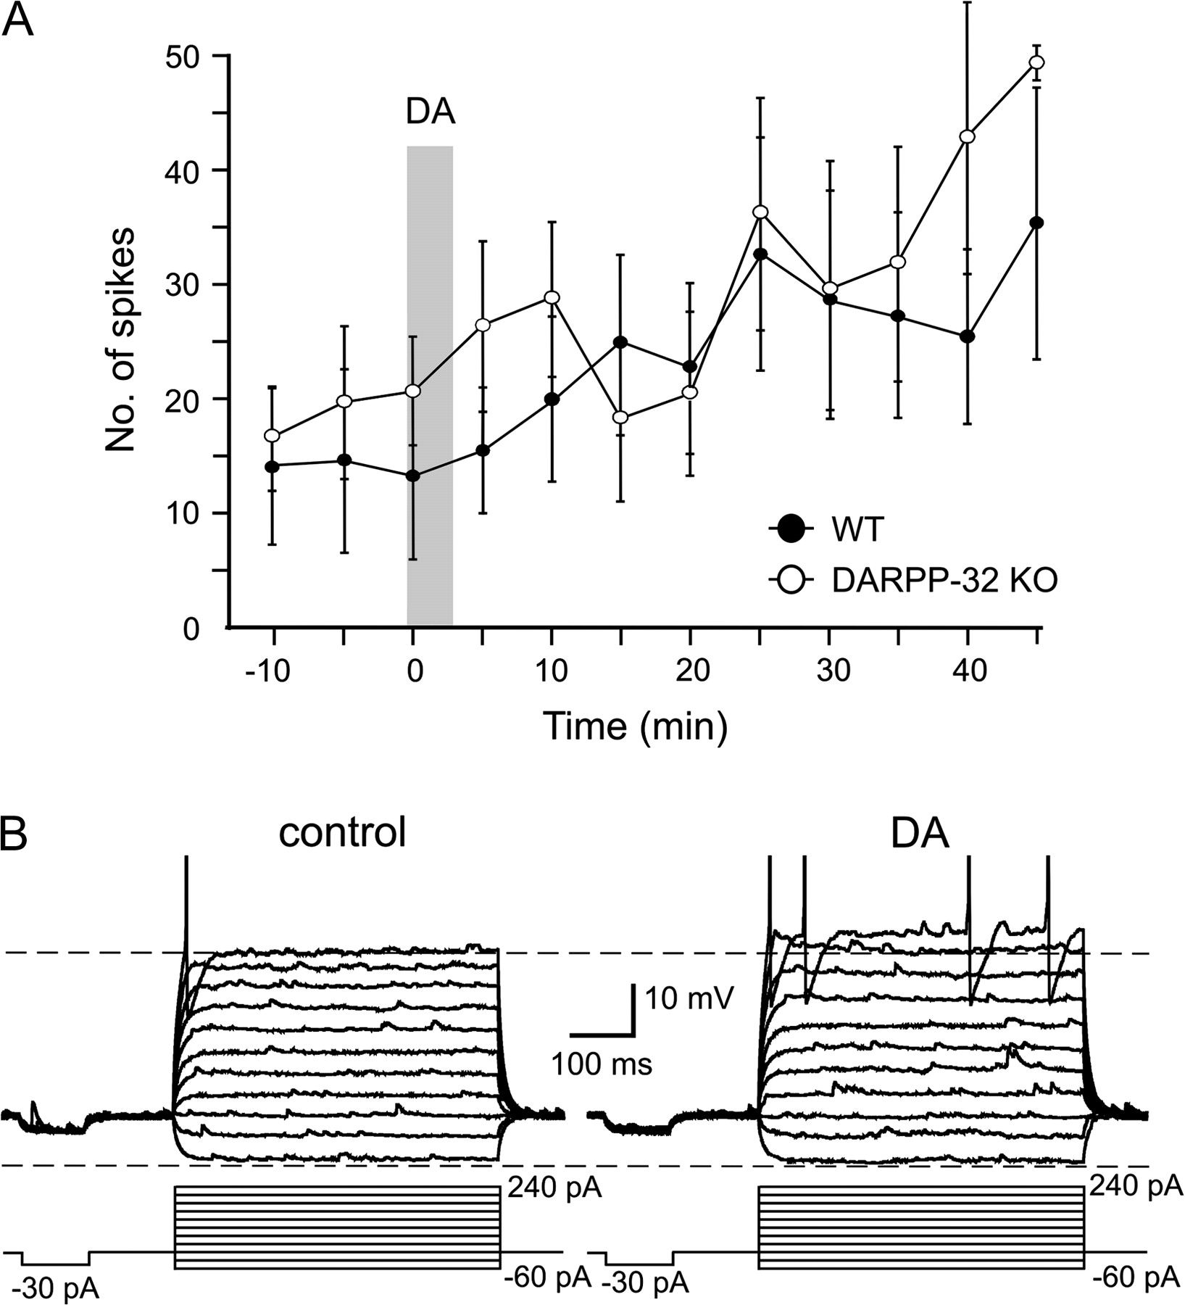
Figure 3. Time course of DA effects (A) Brief bath application of a low dose of DA (100 nM) resulted in prolonged ...
Notes:
Figure 3. Time course of DA effects (A) Brief bath application of a low dose of DA (100 nM) resulted in prolonged enhancement of current evoked firing in fast-spiking interneuron from both WT (filled circles) and DARPP-32 KO (open circles) animals. (B) Example traces illustrating the effects of DA on evoked responses. DA had no effect on apparent input resistance at potentials close to resting membrane potential. In contrast, at potentials close to spike threshold DA reduced outward rectification leading to increased spike firing (top trace). Action potentials are truncated for clarity.
Unless provided in the caption above, the following copyright applies to the content of this slide: © The Author 2007. Published by Oxford University Press. All rights reserved. For permissions, please e-mail: journals.permissions@oxfordjournals.org

Slide 4
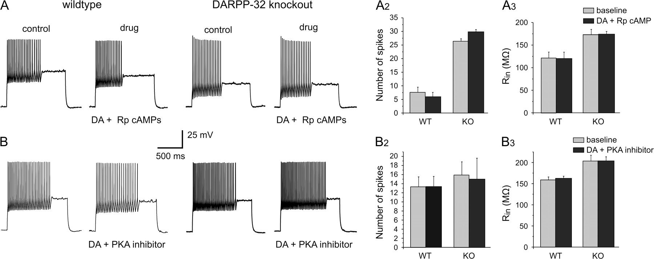
Figure 4. Low concentrations of DA increase the firing rate of fast-spiking interneurons via a cAMP and PKA pathway, ...
Notes:
Figure 4. Low concentrations of DA increase the firing rate of fast-spiking interneurons via a cAMP and PKA pathway, but independently of DARPP-32. Representative traces showing that blockade of the cAMP or PKA pathways prevent the DA modulation of evoked firing in fast-spiking interneurons from WT (left columns) and DARPP-32 KO animals. (A) The cAMP inhibitor Rp-cAMPs (100 μM) blocks the effects of 100 nM DA in both WT and DARPP-32 KO animals. (A2) Summary plot for the effect on evoked firing in cells from WT (n = 6) and KO (n = 3) animals. (A3) The effects on evoked firing were independent of changes in input resistance in WT and KO animals. (B) Inhibition of PKA (using one of the following compounds: H-89 [10 μM], KT5720 [10 μM], or PKI 5-24 [20 μM] prevents the effects of low DA on firing rate in both WT and DARPP-32 KO cells. (B2) Summary plot for the effects of 100 nM DA in the presence of PKA inhibitors on evoked spikes in WT (n = 8) and KO (n = 6) animals. (B3) Summary of the effects on input resistance. In all experiments, the antagonist/inhibitor was applied for 10 min before DA application, which lasted 3 min (see Methods for details).
Unless provided in the caption above, the following copyright applies to the content of this slide: © The Author 2007. Published by Oxford University Press. All rights reserved. For permissions, please e-mail: journals.permissions@oxfordjournals.org

Slide 5
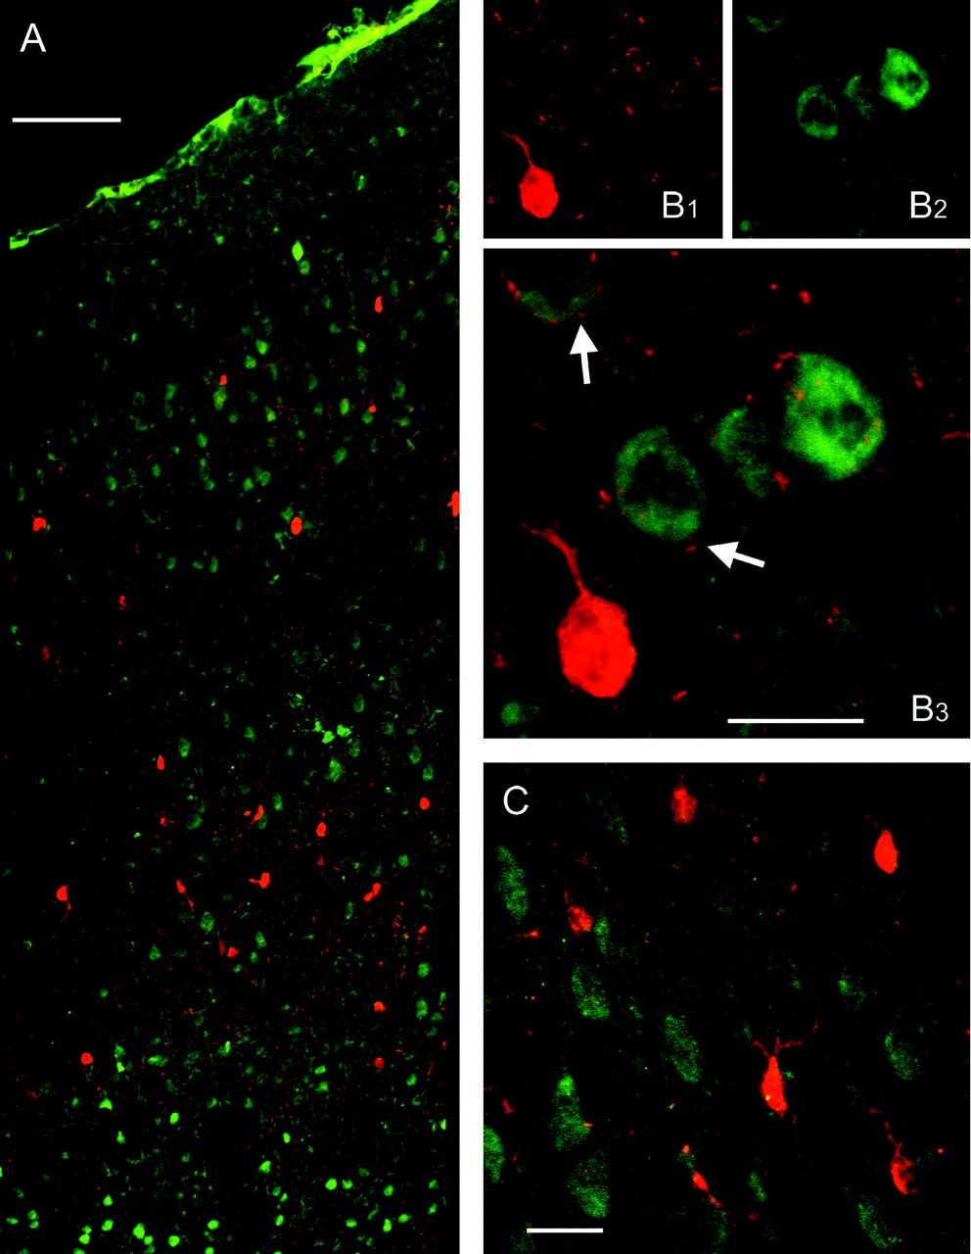
Figure 5. Double labeling of calcium-binding proteins and DARPP-32. (A) Composite confocal images showing the laminar ...
Notes:
Figure 5. Double labeling of calcium-binding proteins and DARPP-32. (A) Composite confocal images showing the laminar distribution of PV-labeled (red) and DARPP-32-labeled (green) cells in the prefrontal cortex of the rat. The pia is at the top of the image. (B) Somatic double labeling of PV and DARPP-32 was absent among a large number of neurons from 4 animals. However, PV-positive punctae were frequently observed in close apposition to DARPP-32 positive somata (arrows), which is in agreement with the known proximal/somatic innervation of pyramidal cells by several morphological types of fast-spiking interneurons. (C) Calbindin-positive cells (red) also show no double labeling with DARPP-32 (green). Scale bars represent 100 μm in A, and 20 μm in (B) and (C).
Unless provided in the caption above, the following copyright applies to the content of this slide: © The Author 2007. Published by Oxford University Press. All rights reserved. For permissions, please e-mail: journals.permissions@oxfordjournals.org

