Slide 1
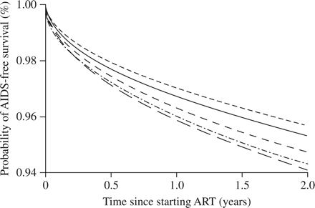
Figure 2 Estimated AIDS-free survival among 13 546 antiretroviral-naive HIV-infected patients in the Antiretroviral ...
Notes:
Figure 2 Estimated AIDS-free survival among 13 546 antiretroviral-naive HIV-infected patients in the Antiretroviral Therapy Cohort Collaboration study initiating antiretroviral therapy with zidovudine plus lamivudine stratified by the third drug in their regimen (2000–2005). Survival curves are estimated from a Weibull model with follow-up censored at 2 years, with covariates set at the average value across the population of patients and for the cohort with median survival. Efavirenz, continuous line; nevirapine, long dashed line; boosted lopinavir, widely spaced dashed line; nelfinavir, short dashed line; abacavir, dot plus dashed line. Corresponding adjusted HRs for the composite of incident AIDS event or death, compared with efavirenz, were: nevirapine, 1.20 (95% CI 0.95–1.50); boosted lopinavir, 1.08 (95% CI 0.89–1.32); nelfinavir, 0.95 (95% CI 0.77–1.18); and abacavir, 1.16 (95% CI 0.92–1.45). Reproduced with permission from Mugavero et al.45
Unless provided in the caption above, the following copyright applies to the content of this slide: © The Author 2009. Published by Oxford University Press on behalf of the British Society for Antimicrobial ChemotherapyThis is an Open Access article distributed under the terms of the Creative Commons Attribution Non-Commercial License (http://creativecommons.org/licenses/by-nc/2.5/uk/) which permits unrestricted non-commercial use, distribution, and reproduction in any medium, provided the original work is properly cited.

Slide 2
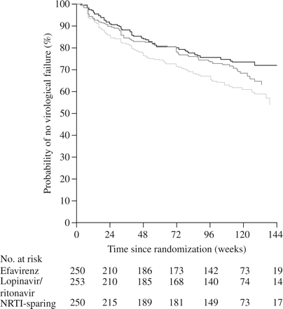
Figure 1 Time to virological failure in patients treated with efavirenz (upper line), boosted lopinavir (middle line), ...
Notes:
Figure 1 Time to virological failure in patients treated with efavirenz (upper line), boosted lopinavir (middle line), each in combination with two NRTIs, or efavirenz plus boosted lopinavir (lower line), the NRTI-sparing regimen, in the overall population in the AIDS Clinical Trial Group A5142 study. Reproduced with permission from the New England Journal of Medicine.25 Copyright © 2009 Massachusetts Medical Society. All rights reserved.
Unless provided in the caption above, the following copyright applies to the content of this slide: © The Author 2009. Published by Oxford University Press on behalf of the British Society for Antimicrobial ChemotherapyThis is an Open Access article distributed under the terms of the Creative Commons Attribution Non-Commercial License (http://creativecommons.org/licenses/by-nc/2.5/uk/) which permits unrestricted non-commercial use, distribution, and reproduction in any medium, provided the original work is properly cited.

Slide 3
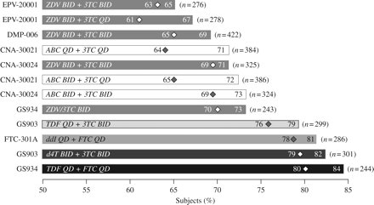
Figure 3 Virological response using the time to loss of virological response rate (TLOVR) for HIV RNA <50 and <400 ...
Notes:
Figure 3 Virological response using the time to loss of virological response rate (TLOVR) for HIV RNA <50 and <400 copies/mL thresholds at week 48 by study arm. The NRTI combination for each study is identified on the bars and the number of subjects in each arm is listed. The diamond shape indicates the TLOVR response rate at HIV RNA <50 copies/mL. ABC, abacavir; BID, twice daily; FTC, emtricitabine; QD, once daily; TDF, tenofovir; ZDV, zidovudine; 3TC, lamivudine; ddI, didanosine; d4T, stavudine. Reproduced with permission of Thomas Land Publishers from Bartlett et al.;63 permission conveyed through Copyright Clearance Center, Inc.
Unless provided in the caption above, the following copyright applies to the content of this slide: © The Author 2009. Published by Oxford University Press on behalf of the British Society for Antimicrobial ChemotherapyThis is an Open Access article distributed under the terms of the Creative Commons Attribution Non-Commercial License (http://creativecommons.org/licenses/by-nc/2.5/uk/) which permits unrestricted non-commercial use, distribution, and reproduction in any medium, provided the original work is properly cited.

Slide 4
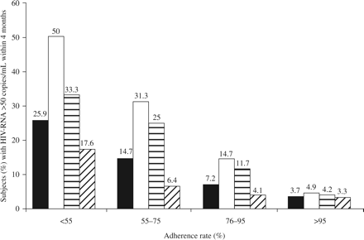
Figure 4 Proportions of patients experiencing virological rebound according to their reported adherence rate. Total ...
Notes:
Figure 4 Proportions of patients experiencing virological rebound according to their reported adherence rate. Total and type of HAART adjusted analysis. Total HAART, column 1; single PI, column 2; boosted PI, column 3; NNRTI, column 4. Reproduced with permission of Thomas Land Publishers from Maggiolo et al.;66 permission conveyed through Copyright Clearance Center, Inc.
Unless provided in the caption above, the following copyright applies to the content of this slide: © The Author 2009. Published by Oxford University Press on behalf of the British Society for Antimicrobial ChemotherapyThis is an Open Access article distributed under the terms of the Creative Commons Attribution Non-Commercial License (http://creativecommons.org/licenses/by-nc/2.5/uk/) which permits unrestricted non-commercial use, distribution, and reproduction in any medium, provided the original work is properly cited.

