Slide 1
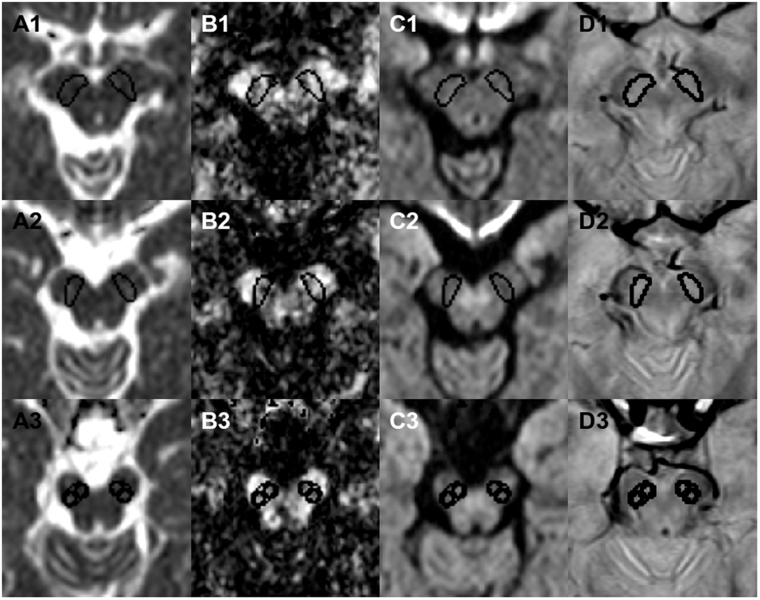
Figure 1 The substantia nigra was segmented on the fractional anisotropy maps (B), on the trace images (C), and on the ...
Notes:
Figure 1 The substantia nigra was segmented on the fractional anisotropy maps (B), on the trace images (C), and on the proton-density weighted images (D) after co-registration. Segmentation was performed with the help of the window synchronization tool of ImageJ permitting simultaneous drawing in all activated windows. The fractional anisotropy maps provided an excellent delineation between substantia nigra and crura cerebri, whereas the proton-density weighted image as well as the b−1000 images permitted an accurate delineation of the posterior border. The substantia nigra was divided in three levels [upper (1), middle (2) and lower (3)]. At the lower level, we positioned two separate regions of interest in the medial and the lateral part of the substantia nigra. After segmentation, the regions of interest were applied to the fractional anisotropy maps and the co-registered mean diffusivity maps (A).
Unless provided in the caption above, the following copyright applies to the content of this slide: © The Author (2013). Published by Oxford University Press on behalf of the Guarantors of Brain. All rights reserved. For Permissions, please email: journals.permissions@oup.com

Slide 2
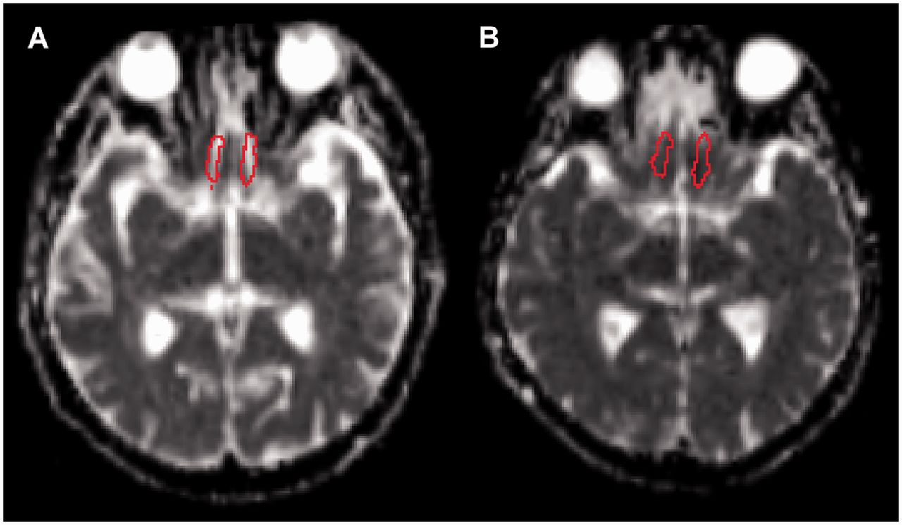
Figure 2 Regions of interest within the olfactory tract superimposed on a mean diffusivity image of a patient with ...
Notes:
Figure 2 Regions of interest within the olfactory tract superimposed on a mean diffusivity image of a patient with Parkinson’s disease (A) and a healthy control subject (B). Regions of interest represent voxel clusters previously obtained from a separate voxel-based group analysis of patients with Parkinson’s disease and healthy controls (Scherfler et al., 2006).
Unless provided in the caption above, the following copyright applies to the content of this slide: © The Author (2013). Published by Oxford University Press on behalf of the Guarantors of Brain. All rights reserved. For Permissions, please email: journals.permissions@oup.com

Slide 3
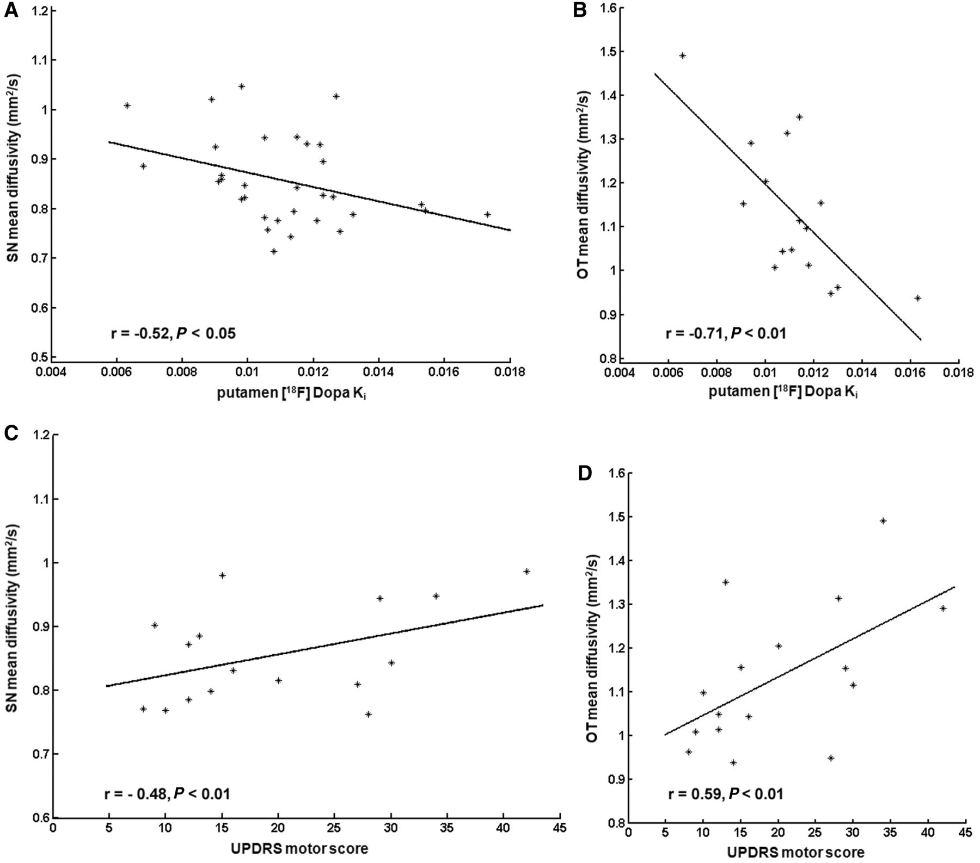
Figure 3 Correlation between mean diffusivity values of the ipsilateral and contralateral middle and medial caudal ...
Notes:
Figure 3 Correlation between mean diffusivity values of the ipsilateral and contralateral middle and medial caudal section of the substantia nigra and the corresponding [18F] DOPA mean putamen Ki values in patients with Parkinson’s disease (A). Correlation between mean diffusivity values of both olfactory tracts and the mean putaminal [18F] DOPA Ki values in patients with Parkinson’s disease (B). Correlation between the UPDRS motor score and the mean diffusivity values of the middle and medial caudal section of the substantia nigra (C) and the mean diffusivity values of both olfactory tracts (D) in patients with Parkinson’s disease. OT = olfactory tract; SN = substantia nigra.
Unless provided in the caption above, the following copyright applies to the content of this slide: © The Author (2013). Published by Oxford University Press on behalf of the Guarantors of Brain. All rights reserved. For Permissions, please email: journals.permissions@oup.com

