Slide 1
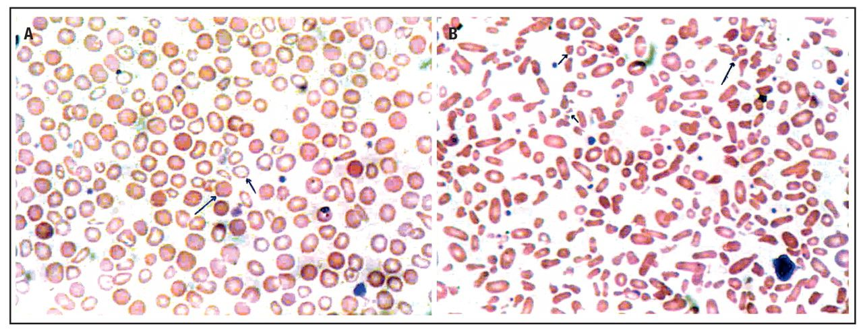
Image 1 (A) Wright-stained peripheral blood film from post-iron treated patient showing dual population of ...
Notes:
Image 1 (A) Wright-stained peripheral blood film from post-iron treated patient showing dual population of hypochromic-microcytic (short arrow) and normochromic-normocytic red cells (long arrow). (B) Peripheral blood film from post-splenectomized patient with hereditary pyropoikilocytosis showing dimorphic picture of extreme variability of the RBCs such as red cell fragments (short arrow), microspherocytes (regular arrow), membrane budding (long arrow), elliptocytes, oval macrocytes, and polychromasia.
Unless provided in the caption above, the following copyright applies to the content of this slide: © American Society of Clinical Pathologists

Slide 2
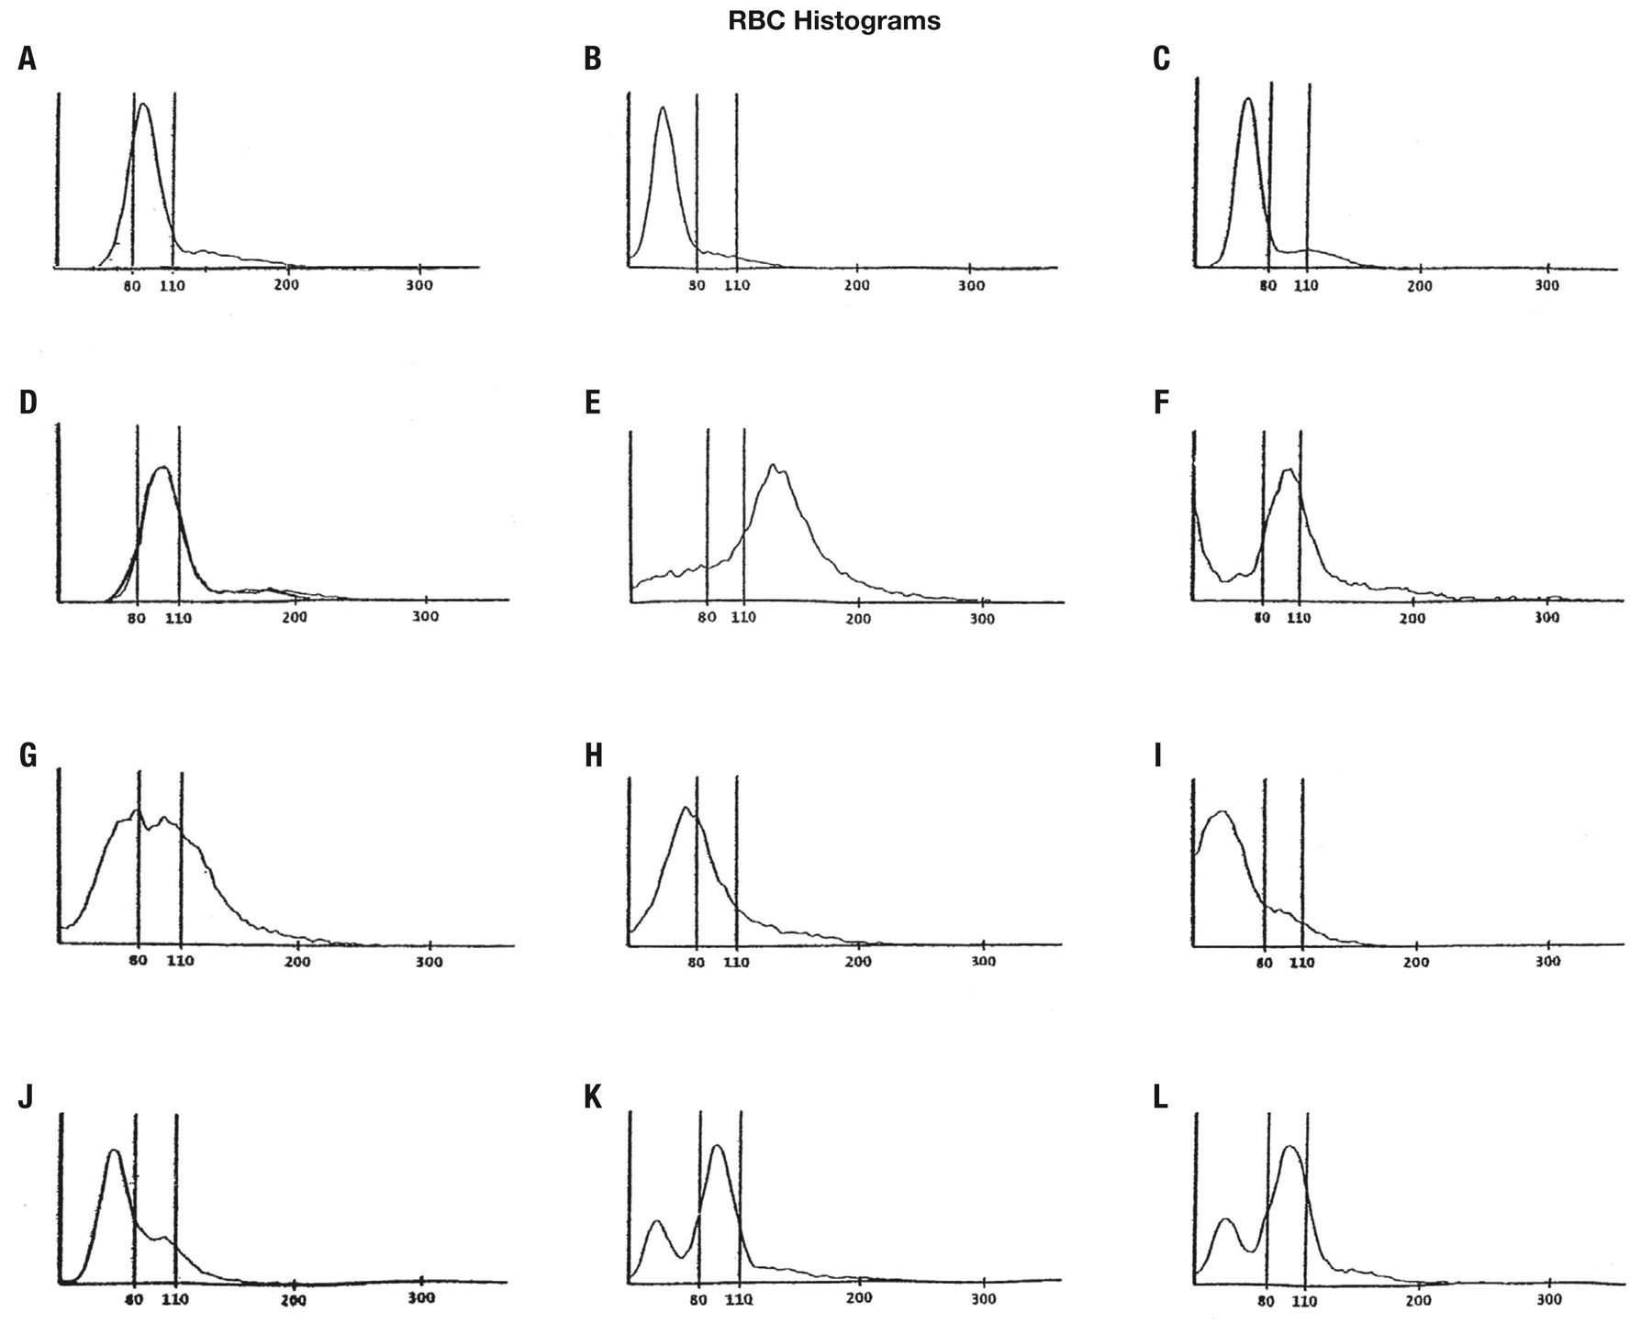
Figure 1 Red cell histograms in various hematological conditions. (Key hematological features of these conditions are ...
Notes:
Figure 1 Red cell histograms in various hematological conditions. (Key hematological features of these conditions are summarized in Table 2.) Figure (A) Normal histogram, (B) Microcytosis, iron deficiency anemia, (C) Microcytosis, beta thal trait, (D) Macrocytosis with normal RDW, (E) Macrocytosis, megaloblastic anemia, (F) Cold agglutination, (G) Sideroblastic anemia, (H) Beta thalassemia major, (I) Pyropoikilocytosis, (J) Reticulocytosis, (K) Post-iron therapy, (L) Post-iron therapy.
Unless provided in the caption above, the following copyright applies to the content of this slide: © American Society of Clinical Pathologists

Slide 3
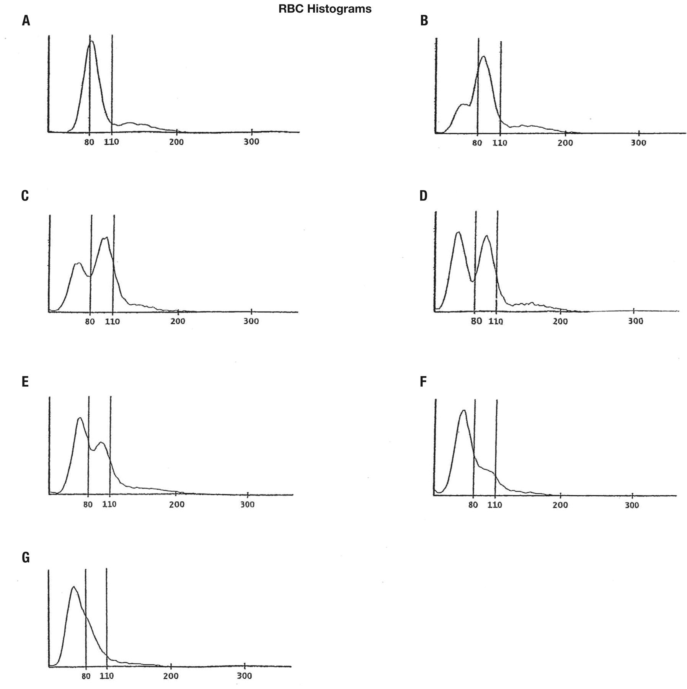
Figure 2 Histograms of iron deficiency anemia after treatment (key hematological features are summarized in Table 3). ...
Notes:
Figure 2 Histograms of iron deficiency anemia after treatment (key hematological features are summarized in Table 3). Figures B to G are representative examples of dimorphic (dual) red cell population response to hematinic treatment of iron deficiency anemia in 6 patients.
Unless provided in the caption above, the following copyright applies to the content of this slide: © American Society of Clinical Pathologists

Slide 4
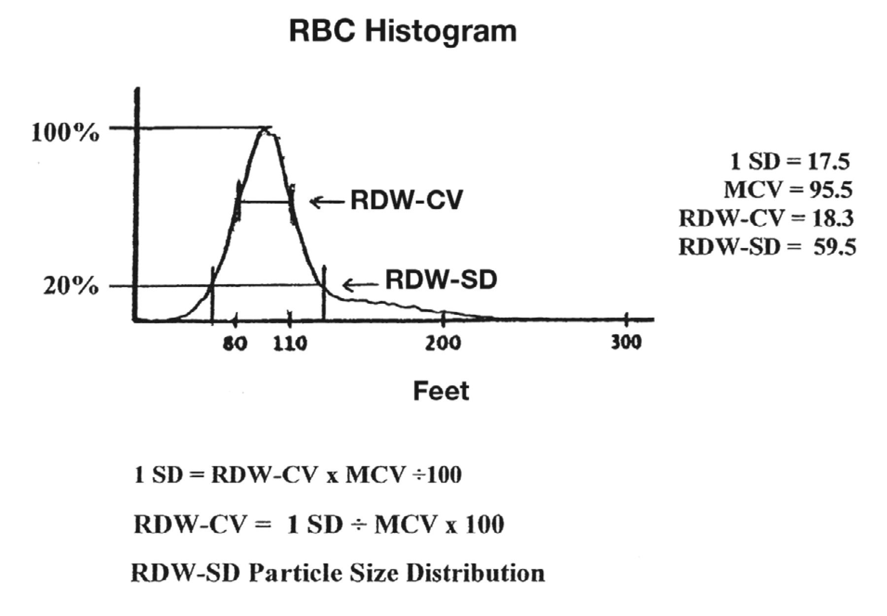
Figure 3 Calculation of RDW. The RDW is calculated from the width of the histogram at 1 SD from the mean divided by ...
Notes:
Figure 3 Calculation of RDW. The RDW is calculated from the width of the histogram at 1 SD from the mean divided by MCV. The normal RDW-CV is 11.5% to 14.5%. The RDW-SD is the arithmetic width of the distribution curve measured at the 20% frequency curve. The normal RDW-SD is 39 to 47 fL.14
Unless provided in the caption above, the following copyright applies to the content of this slide: © American Society of Clinical Pathologists

