Slide 1
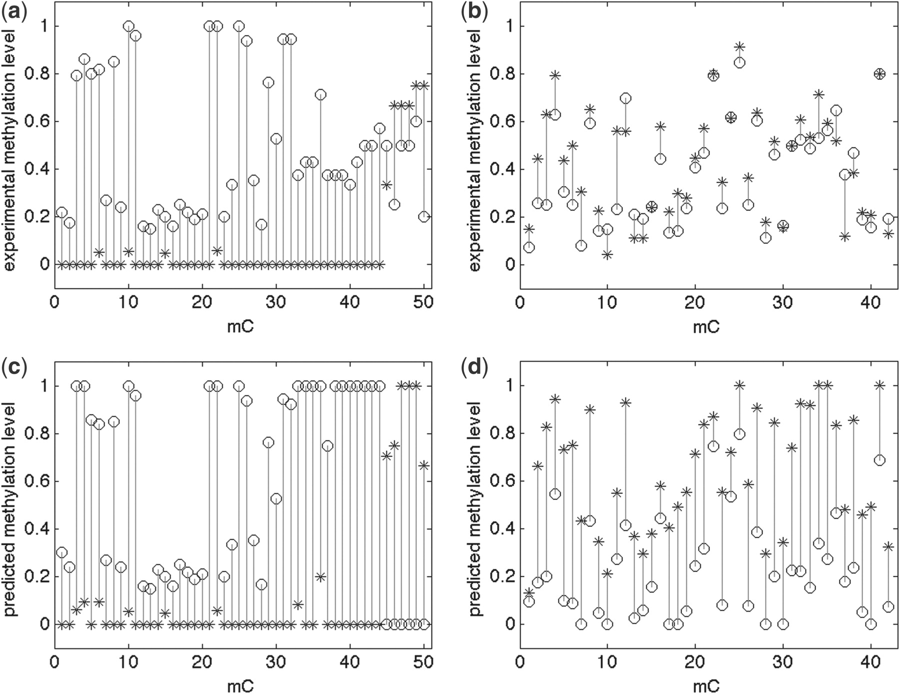
Fig. 1. Experimental (a and b) versus predicted (c and d) methylation levels of the synthetic methylome. Experimental ...
Notes:
Fig. 1. Experimental (a and b) versus predicted (c and d) methylation levels of the synthetic methylome. Experimental methylation levels from Wer+ are shown in circles, Scr+ in stars. Two symbols in the bottom figures (c and d) indicate two predicted individual methylomes for the synthetic methylome. The left (a and c) is of an allele-specific region: chromosome 1: [7313026, 7313482] on forward strand. The region contains 50 methylcytosines (mC); 160 reads are aligned to this region. The right (b and d) is of a non-specific region: chromosome 3: [12698733, 12699133] on forward strand. The region contains 42 mC; 367 reads are aligned to the region
Unless provided in the caption above, the following copyright applies to the content of this slide: © The Author(s) 2012. Published by Oxford University Press.This is an Open Access article distributed under the terms of the Creative Commons Attribution Non-Commercial License (http://creativecommons.org/licenses/by-nc/3.0), which permits unrestricted non-commercial use, distribution, and reproduction in any medium, provided the original work is properly cited.

Slide 2
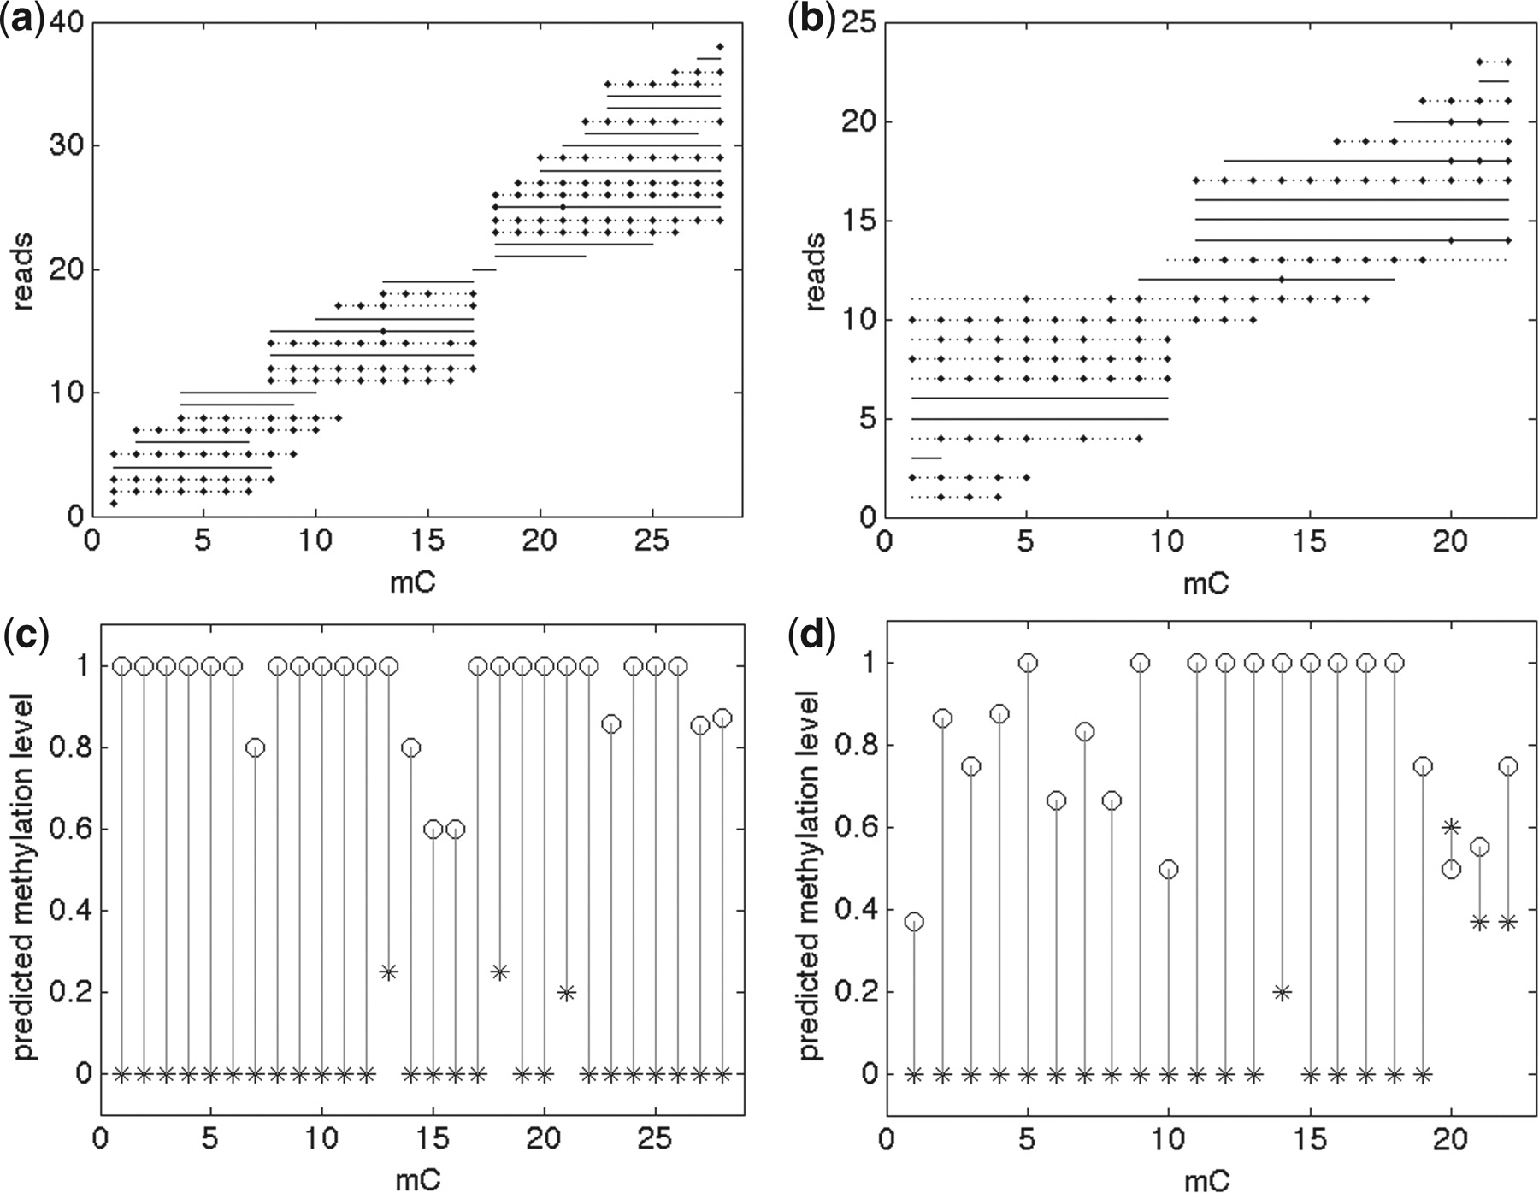
Fig. 2. Read assignments (a and b) and methylation levels (c and d) of the predicted ASM regions of Arabidopsis Wer+ ...
Notes:
Fig. 2. Read assignments (a and b) and methylation levels (c and d) of the predicted ASM regions of Arabidopsis Wer+ cell. Circle and star symbols in c and d represent two alleles. Lines in top (a and b) figures are restricted reads (solid and dotted lines represent two alleles); small diamonds on lines are methylations. Left (a and c) : a region of Table 4(1): chrom 4: [13269127, 13269376] − strand. Right (b and d) : a region of Table 4(2): chrom 5: [17406449, 17406557] + strand
Unless provided in the caption above, the following copyright applies to the content of this slide: © The Author(s) 2012. Published by Oxford University Press.This is an Open Access article distributed under the terms of the Creative Commons Attribution Non-Commercial License (http://creativecommons.org/licenses/by-nc/3.0), which permits unrestricted non-commercial use, distribution, and reproduction in any medium, provided the original work is properly cited.

Slide 3
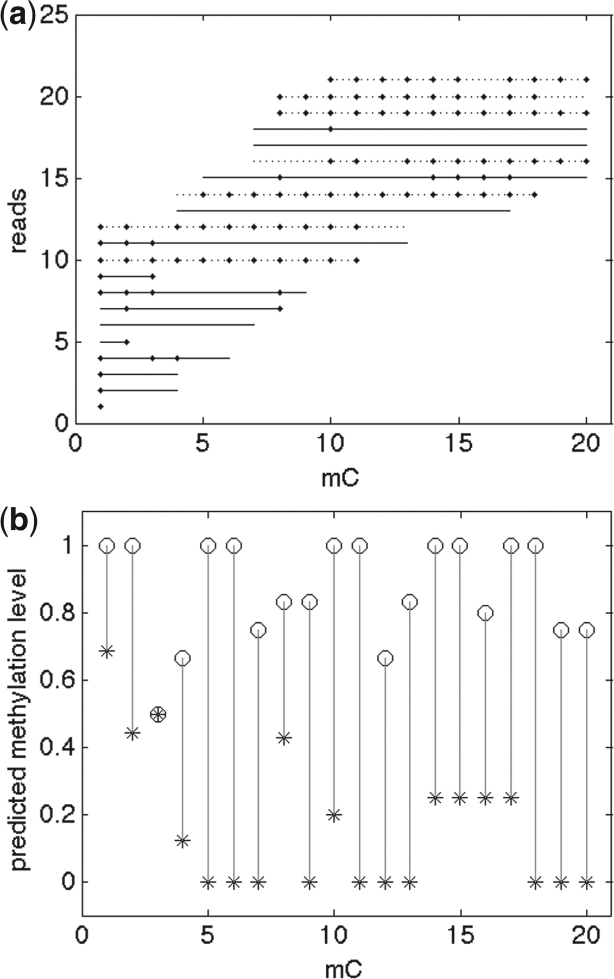
Fig. 3. An example from Table 4 group (3): region: chrom 1: [77393, 77508] − strand, 20 mC. (a) reads assignments. ...
Notes:
Fig. 3. An example from Table 4 group (3): region: chrom 1: [77393, 77508] − strand, 20 mC. (a) reads assignments. (b) predicted methylation levels
Unless provided in the caption above, the following copyright applies to the content of this slide: © The Author(s) 2012. Published by Oxford University Press.This is an Open Access article distributed under the terms of the Creative Commons Attribution Non-Commercial License (http://creativecommons.org/licenses/by-nc/3.0), which permits unrestricted non-commercial use, distribution, and reproduction in any medium, provided the original work is properly cited.

