Slide 1
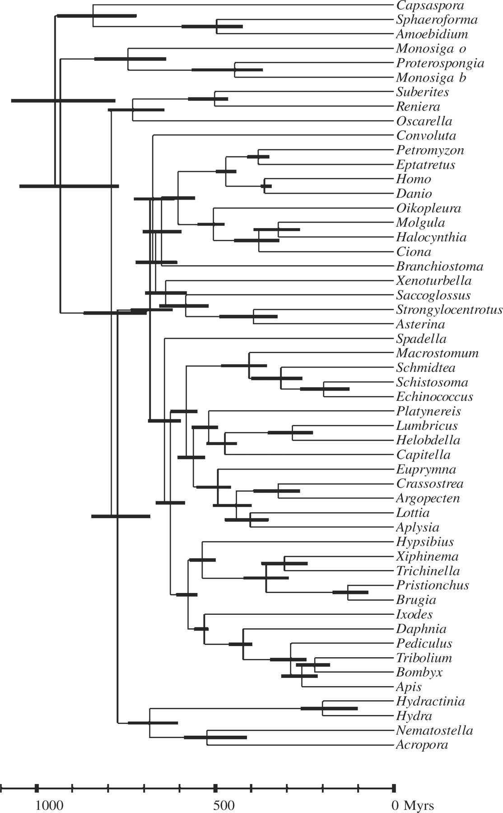
Fig. 1. Chronogram obtained for the dataset of Philippe et al. (2007). Two fossil calibration were used, taken from ...
Notes:
Fig. 1. Chronogram obtained for the dataset of Philippe et al. (2007). Two fossil calibration were used, taken from Douzery et al. (2004): the ancestor of vertebrates (354–417 Mya), and of arthropods (490–543 Mya). These calibrations were proposed as soft bounds under a birth–death prior (Inoue et al., 2009).
Unless provided in the caption above, the following copyright applies to the content of this slide: © The Author 2009. Published by Oxford University Press. All rights reserved. For Permissions, please email: journals.permissions@oxfordjournals.org

