Slide 1
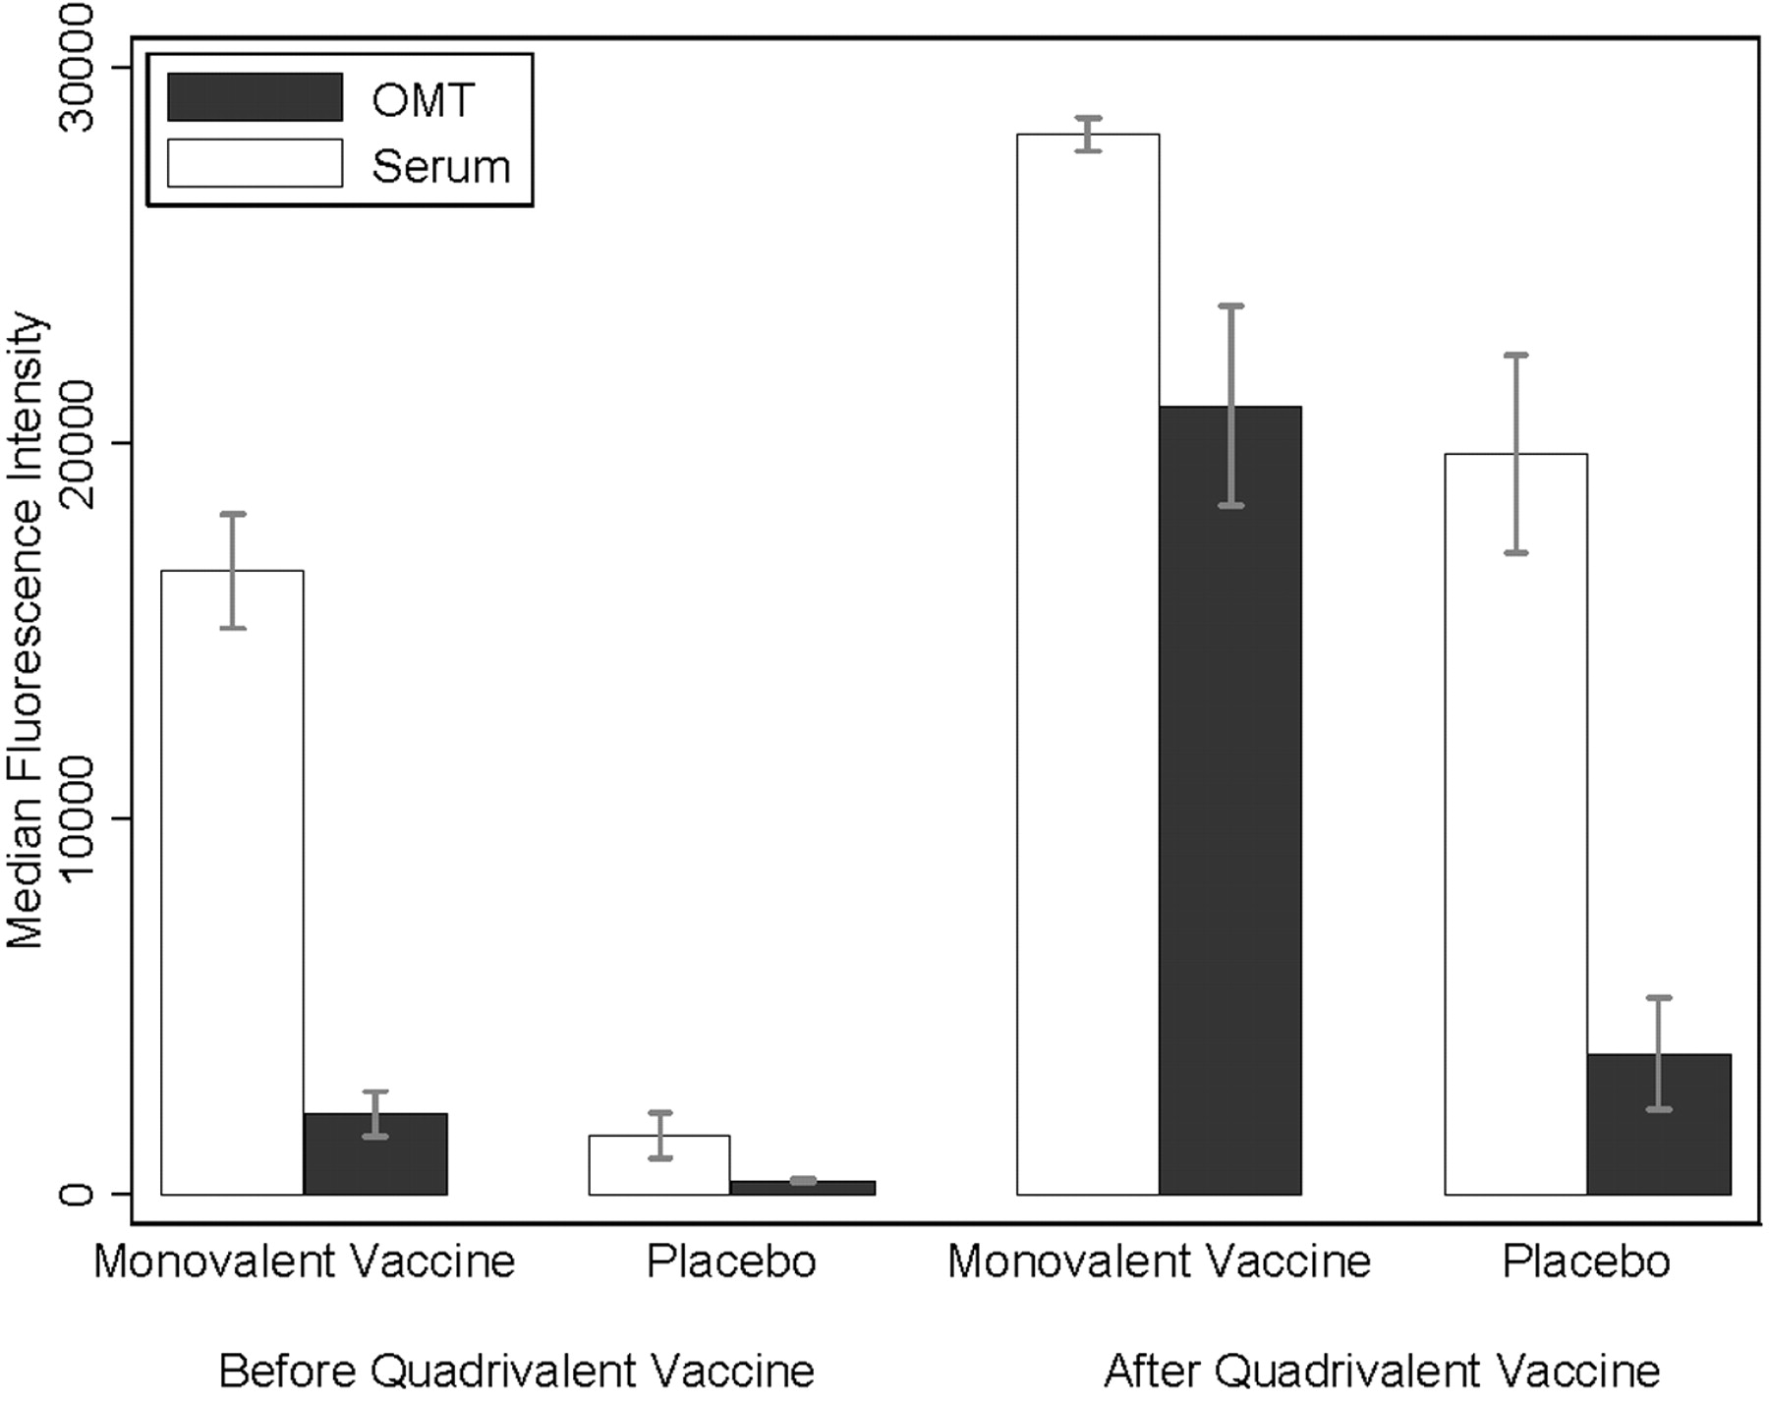
Figure 1 Reactivity of antibody to human papillomavirus 16 in serum and oral mucosal transudate (OMT) specimens before ...
Notes:
Figure 1 Reactivity of antibody to human papillomavirus 16 in serum and oral mucosal transudate (OMT) specimens before and after administration of the quadrivalent vaccine
Unless provided in the caption above, the following copyright applies to the content of this slide: © 2009 by the Infectious Diseases Society of America

Slide 2
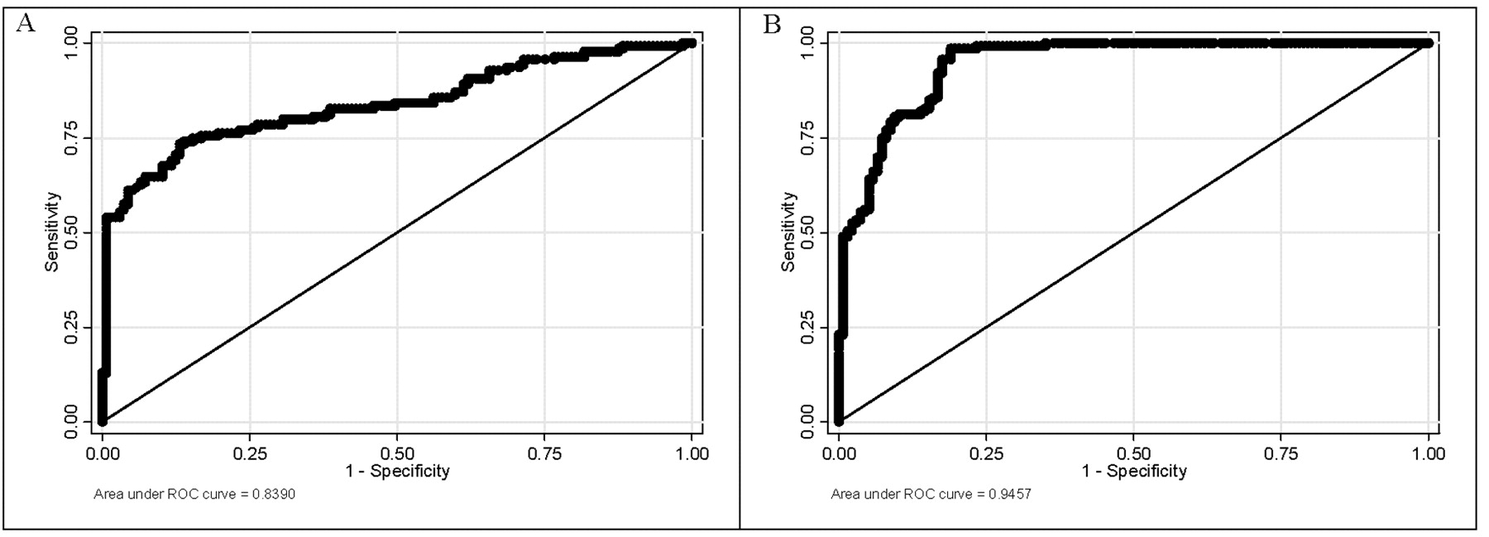
Figure 2 Receiver operating characteristic (ROC) curves for the performance of oral mucosal transudate (A) and serum ...
Notes:
Figure 2 Receiver operating characteristic (ROC) curves for the performance of oral mucosal transudate (A) and serum (B) in classifying participants in the monovalent vaccine trial by their vaccination status
Unless provided in the caption above, the following copyright applies to the content of this slide: © 2009 by the Infectious Diseases Society of America

