Slide 1
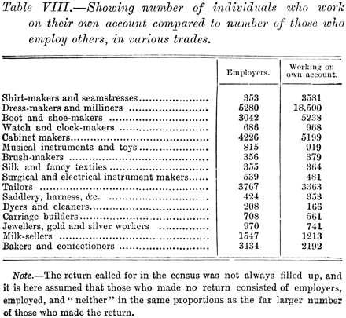
Table 1. The number of individuals who work on their own account, from Booth, Life and Labour, Second Series, ...
Notes:
Table 1. The number of individuals who work on their own account, from Booth, Life and Labour, Second Series, vol. 5, 1897, p. 57.
Unless provided in the caption above, the following copyright applies to the content of this slide: © The Author 2011. Published by Oxford University Press on behalf of History Workshop Journal, all rights reserved.

