Slide 1
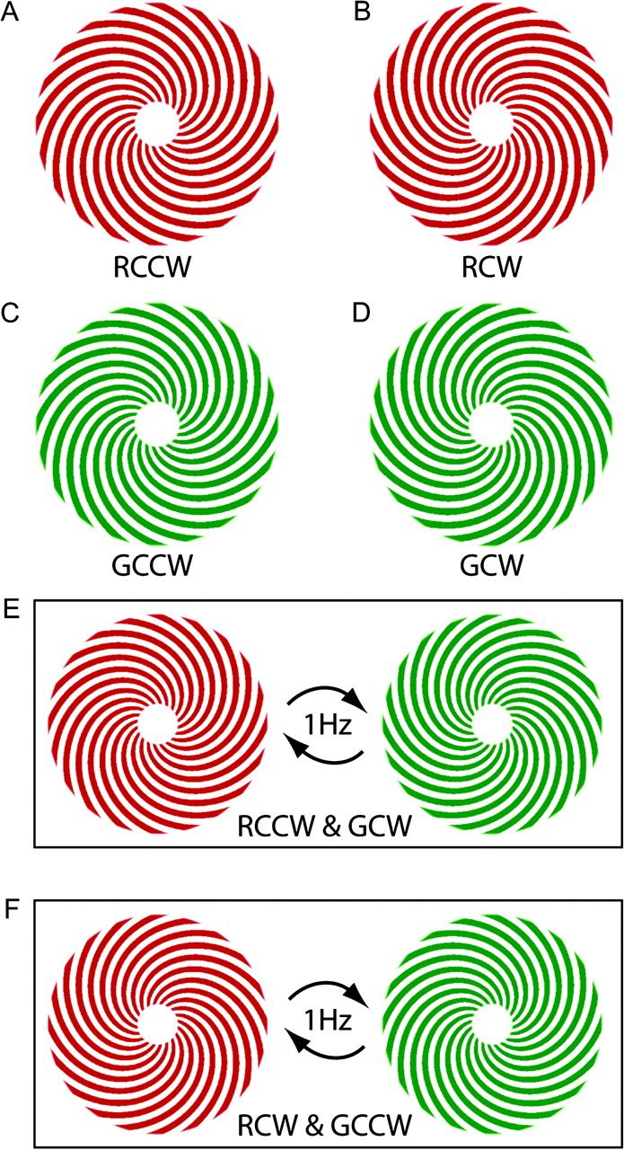
Figure 1. Schematic representation of the 6 stimulus conditions used in the experiment. (A–D) Single-conjunction ...
Notes:
Figure 1. Schematic representation of the 6 stimulus conditions used in the experiment. (A–D) Single-conjunction stimuli, containing 1 color and 1 spiral orientation pattern each. Conditions E and F are double-conjunction stimuli, each containing both colors and both orientations, alternating between 2 single conjunctions at any one time. Note that the double-conjunction conditions would be indistinguishable to a linear classifier without conjunction-specific responses. Thus, a classifier could not rely on activation from color-specific and form-specific voxels to distinguish the stimuli. As all 4 features are displayed in both conditions.
Unless provided in the caption above, the following copyright applies to the content of this slide: © The Author 2009. Published by Oxford University Press. All rights reserved. For permissions, please e-mail: journals.permissions@oxfordjournals.org

Slide 2
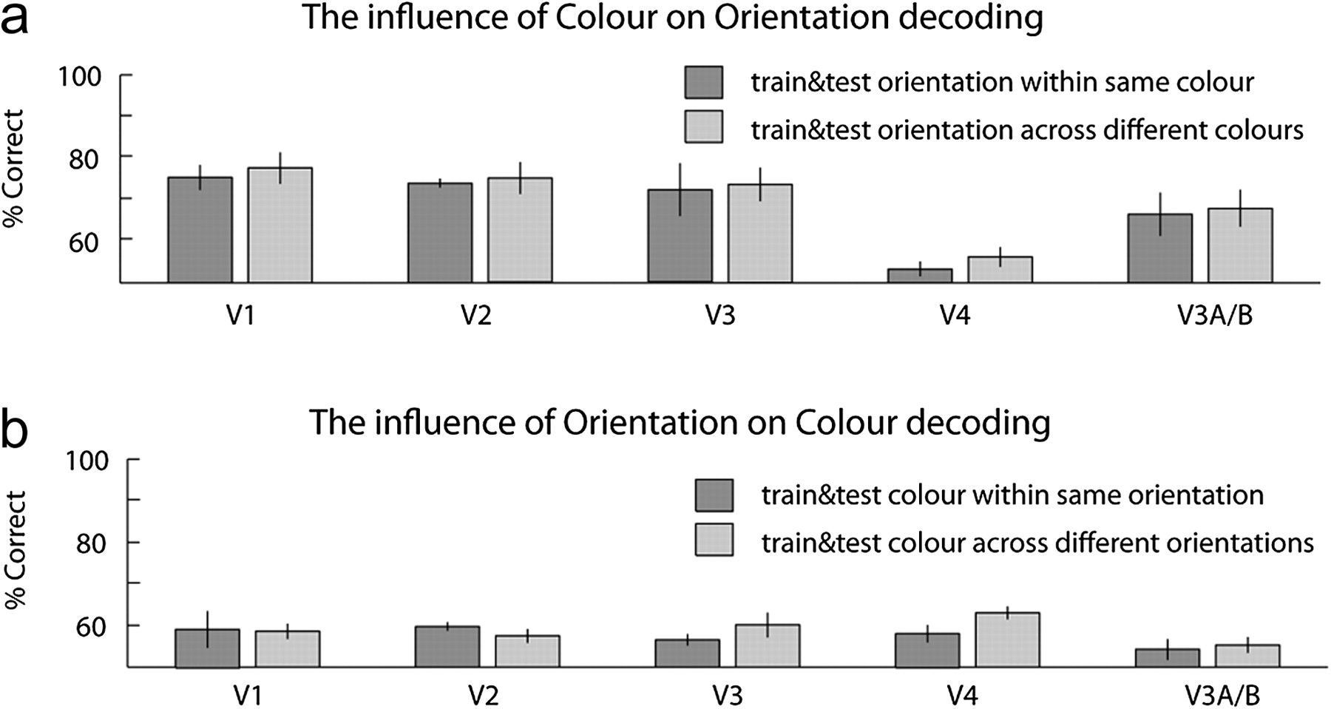
Figure 4. Invariance of orientation coding with respect to color and vice versa. (a) The classifier was trained to ...
Notes:
Figure 4. Invariance of orientation coding with respect to color and vice versa. (a) The classifier was trained to discriminate responses to orientation stimuli presented in one color, and then tested on responses to orientation presented in the same or different color. Classifier performance was not affected when training and test stimuli were different colors. (b) Color discrimination: the classifier was trained to discriminate responses to red or green stimuli in one orientation and then tested on responses to color stimuli presented in the same or opposite orientation. Classifier performance was not affected when training and test stimuli had different orientations. Error bars: SE across 5 subjects.
Unless provided in the caption above, the following copyright applies to the content of this slide: © The Author 2009. Published by Oxford University Press. All rights reserved. For permissions, please e-mail: journals.permissions@oxfordjournals.org

Slide 3
Figure 3. Classification bias to color or orientation in visual cortical regions. The classifier was trained on voxel ...
Notes:
Figure 3. Classification bias to color or orientation in visual cortical regions. The classifier was trained on voxel responses to one set of single-conjunction stimuli, for example, RCW versus GCCW and tested on another, for example, GCW versus RCCW. The classifier was thus forced to achieve a correct orientation classification performance at the expense of an incorrect color classification or vice versa (50% = chance, i.e., the classifier relied equally often on color and orientation information). All areas except for hV4 showed a significant bias toward orientation classification. Classification based on hV4 (biased toward color) differed significantly from all other areas (biased toward orientation) (P < 0.05). Error bars: standard error (SE) across 5 subjects.
Unless provided in the caption above, the following copyright applies to the content of this slide: © The Author 2009. Published by Oxford University Press. All rights reserved. For permissions, please e-mail: journals.permissions@oxfordjournals.org

Slide 4
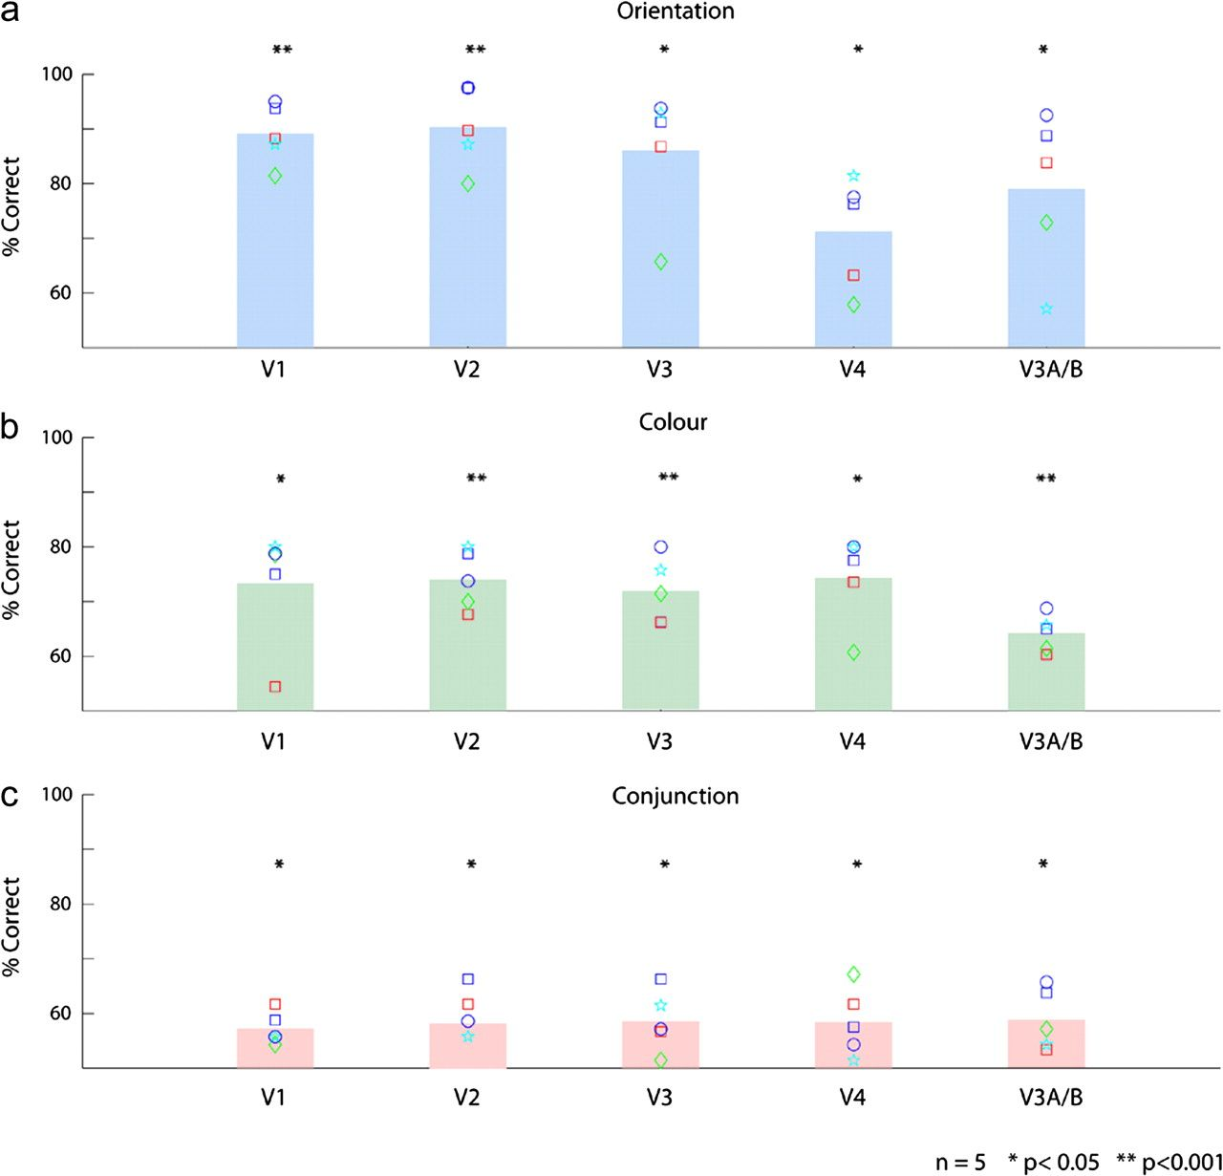
Figure 2. Discrimination performance of a linear classifier (SVM) at orientation, color, and double-conjunction ...
Notes:
Figure 2. Discrimination performance of a linear classifier (SVM) at orientation, color, and double-conjunction stimuli. (a) Decoding of orientation (CW vs. CCW) was significantly above chance (chance = 50%) in every ROI, averaged across 5 subjects. (b) Decoding of color (red vs. green) was also significant in each area (c) decoding of double-conjunction stimuli (GCW&RCCW vs RCW&GCCW) reached significance in all areas. Symbols: single subject–decoding performances (n = 5 subjects).
Unless provided in the caption above, the following copyright applies to the content of this slide: © The Author 2009. Published by Oxford University Press. All rights reserved. For permissions, please e-mail: journals.permissions@oxfordjournals.org

Slide 5
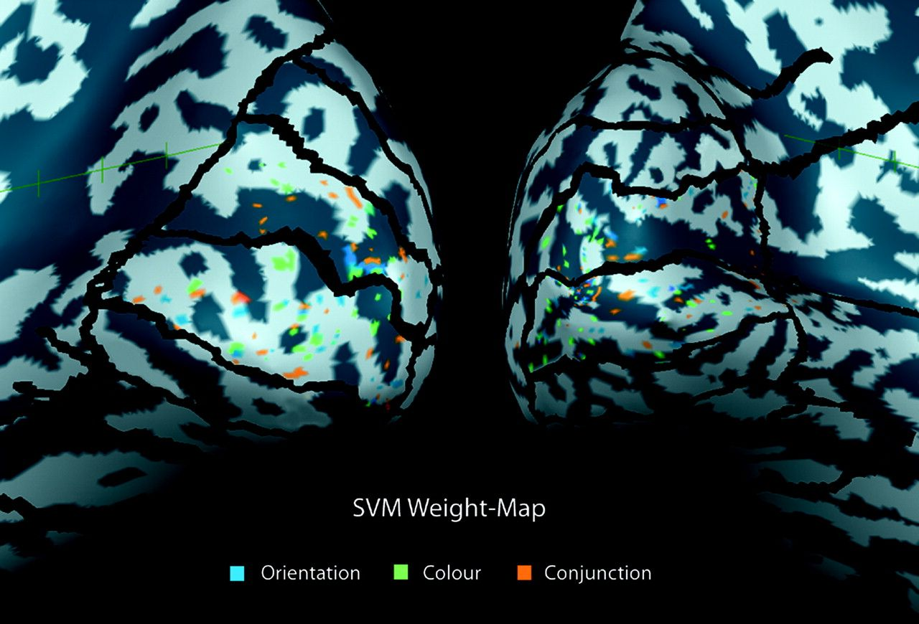
Figure 5. A weight map of the best-coding voxels (≥2SD) in V1 for subject KS as determined by 3 SVM analyses, for ...
Notes:
Figure 5. A weight map of the best-coding voxels (≥2SD) in V1 for subject KS as determined by 3 SVM analyses, for orientation, color, and conjunction discrimination. Note their apparent random (nonoverlapping) distribution for each condition and the lack of hemifield or quadrant biases.
Unless provided in the caption above, the following copyright applies to the content of this slide: © The Author 2009. Published by Oxford University Press. All rights reserved. For permissions, please e-mail: journals.permissions@oxfordjournals.org

