Slide 1
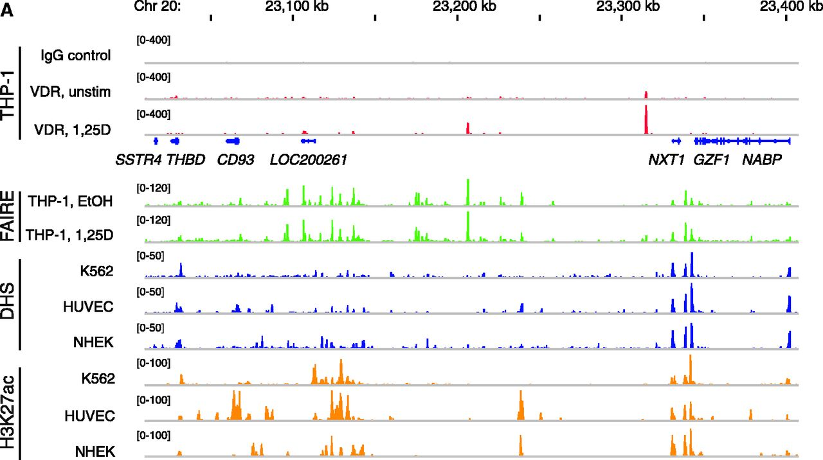
Figure 1. Genome view of the THBD locus and effects of 1α,25(OH)₂D₃ and TsA. (A) The peak tracks ...
Notes:
Figure 1. Genome view of the THBD locus and effects of 1α,25(OH)2D3 and TsA. (A) The peak tracks show data from a VDR ChIP-seq experiment in THP-1 cells (34) (IgG control in grey, VDR binding in unstimulated cells and VDR binding after 40 min 1α,25(OH)2D3 (1,25D) treatment in red), FAIRE-seq data from non-stimulated THP-1 cells (EtOH- and 1α,25(OH)2D3-treated for 100 min, green), and DHS-seq (blue) and H3K27ac ChIP-seq data from the ENCODE cell lines K562, HUVEC and NHEK (45) as a sign of open chromatin and histone acetylation. The gene structures are shown in blue. qPCR was performed to determine the relative changes of mRNA expression of all seven genes of the THBD locus in relation to the reference genes B2M, GAPDH and HPRT1 in THP-1 cells in response to incubation with 100 nM 1α,25(OH)2D3 (B) or 300 nM TsA (C) for the indicated times. The columns represent the means of three cell treatments and the bars indicate standard deviations. Two-tailed Student’s t-tests were performed to determine the significance of the mRNA induction by 1α,25(OH)2D3 or TsA in reference to solvent-treated cells (*P < 0.05; **P < 0.01; ***P < 0.001).
Unless provided in the caption above, the following copyright applies to the content of this slide: © The Author(s) 2012. Published by Oxford University Press.This is an Open Access article distributed under the terms of the Creative Commons Attribution License (http://creativecommons.org/licenses/by-nc/3.0/), which permits non-commercial reuse, distribution, and reproduction in any medium, provided the original work is properly cited. For commercial re-use, please contact journals.permissions@oup.com.

Slide 2
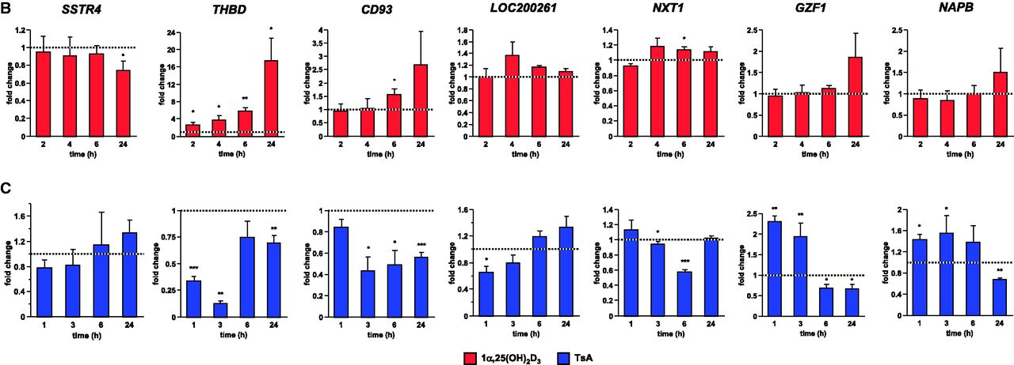
Figure 1. Genome view of the THBD locus and effects of 1α,25(OH)₂D₃ and TsA. (A) The peak tracks ...
Notes:
Figure 1. Genome view of the THBD locus and effects of 1α,25(OH)2D3 and TsA. (A) The peak tracks show data from a VDR ChIP-seq experiment in THP-1 cells (34) (IgG control in grey, VDR binding in unstimulated cells and VDR binding after 40 min 1α,25(OH)2D3 (1,25D) treatment in red), FAIRE-seq data from non-stimulated THP-1 cells (EtOH- and 1α,25(OH)2D3-treated for 100 min, green), and DHS-seq (blue) and H3K27ac ChIP-seq data from the ENCODE cell lines K562, HUVEC and NHEK (45) as a sign of open chromatin and histone acetylation. The gene structures are shown in blue. qPCR was performed to determine the relative changes of mRNA expression of all seven genes of the THBD locus in relation to the reference genes B2M, GAPDH and HPRT1 in THP-1 cells in response to incubation with 100 nM 1α,25(OH)2D3 (B) or 300 nM TsA (C) for the indicated times. The columns represent the means of three cell treatments and the bars indicate standard deviations. Two-tailed Student’s t-tests were performed to determine the significance of the mRNA induction by 1α,25(OH)2D3 or TsA in reference to solvent-treated cells (*P < 0.05; **P < 0.01; ***P < 0.001).
Unless provided in the caption above, the following copyright applies to the content of this slide: © The Author(s) 2012. Published by Oxford University Press.This is an Open Access article distributed under the terms of the Creative Commons Attribution License (http://creativecommons.org/licenses/by-nc/3.0/), which permits non-commercial reuse, distribution, and reproduction in any medium, provided the original work is properly cited. For commercial re-use, please contact journals.permissions@oup.com.

Slide 3
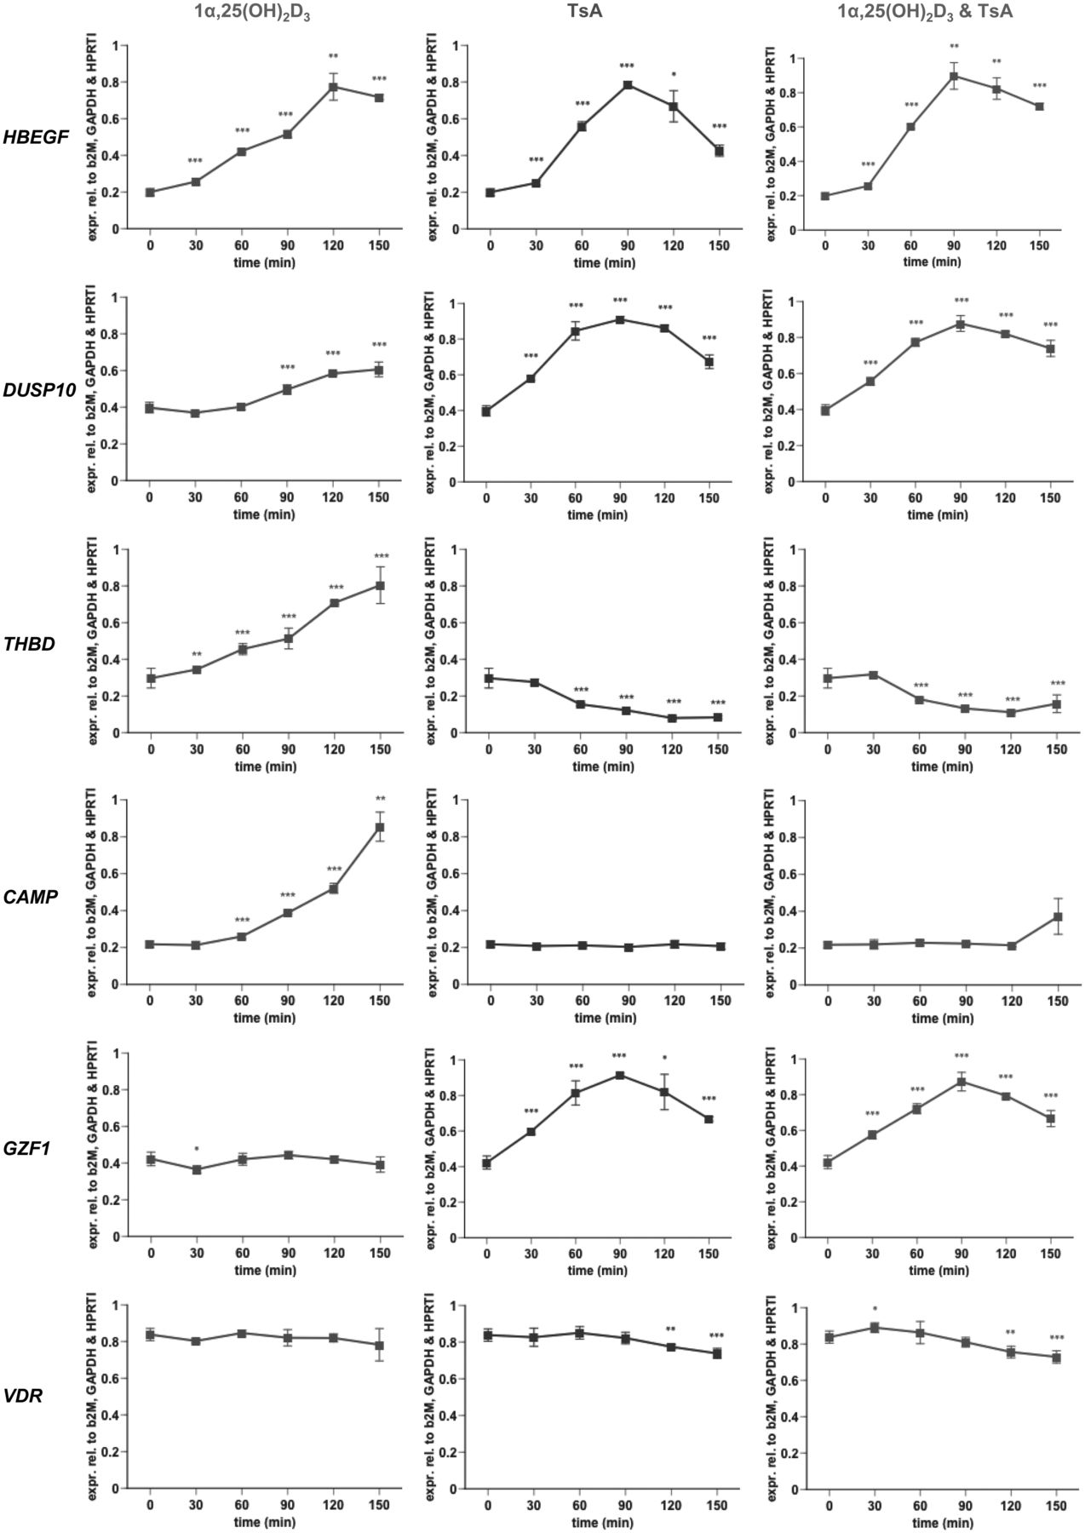
Figure 2. Early time course expression profiling of six representative genes. qPCR was performed to determine the ...
Notes:
Figure 2. Early time course expression profiling of six representative genes. qPCR was performed to determine the relative changes of mRNA expression of selected genes normalized by the three reference genes B2M, GAPDH and HPRT1 in THP-1 cells in response to incubation with 100 nM 1α,25(OH)2D3 and 300 nM TsA, alone or in combination, over a time period of 150 min. A representative of at least three independent experiments, each performed in triplicate individual cell treatments, is shown. The data points represent the means of three cell treatments and the bars indicate standard deviations. Two-tailed Student’s t-tests were performed to determine the significance of the mRNA induction by the stimuli in reference to solvent-treated cells (*P < 0.05; **P < 0.01; ***P < 0.001).
Unless provided in the caption above, the following copyright applies to the content of this slide: © The Author(s) 2012. Published by Oxford University Press.This is an Open Access article distributed under the terms of the Creative Commons Attribution License (http://creativecommons.org/licenses/by-nc/3.0/), which permits non-commercial reuse, distribution, and reproduction in any medium, provided the original work is properly cited. For commercial re-use, please contact journals.permissions@oup.com.

Slide 4
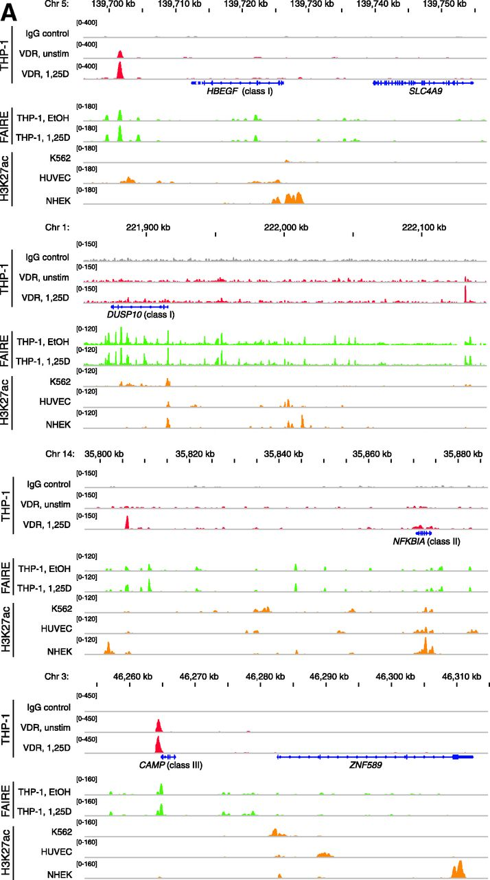
Figure 3. VDR association, histone acetylation and sites of open chromatin for selected loci. (A) Loci of the genes ...
Notes:
Figure 3. VDR association, histone acetylation and sites of open chromatin for selected loci. (A) Loci of the genes HBEGF, DUSP10, NFKBIA and CAMP. The peak tracks for the four different gene loci show data from a VDR ChIP-seq experiment in THP-1 cells (34) (IgG control in grey, VDR binding in unstimulated cells and VDR binding after 40 min 1α,25(OH)2D3 (1,25D) treatment in red), FAIRE-seq data from THP-1 cells (EtOH- and 1α,25(OH)2D3-treated for 100 min, green), and H3K27ac ChIP-seq data from the ENCODE (45) cell lines K562, HUVEC and NHEK (orange) as a sign of histone acetylation. The gene structures are shown in blue. (B) VDR association, H3K27 acetylation and unspecific IgG binding at VDR binding sites and TSS regions of four VDR target genes, determined by ChIP-qPCR after 40 min treatments of THP-1 cells with solvent, 1α,25(OH)2D3, TsA or the combination of both. Each graph is a representative of four independent experiments. Please note that the best VDR binding sites of the THBD and NFKBIA loci chosen for this assay are those close to the NXT1 and PSMA6 genes, respectively (Figures 1A and 3A).
Unless provided in the caption above, the following copyright applies to the content of this slide: © The Author(s) 2012. Published by Oxford University Press.This is an Open Access article distributed under the terms of the Creative Commons Attribution License (http://creativecommons.org/licenses/by-nc/3.0/), which permits non-commercial reuse, distribution, and reproduction in any medium, provided the original work is properly cited. For commercial re-use, please contact journals.permissions@oup.com.

Slide 5
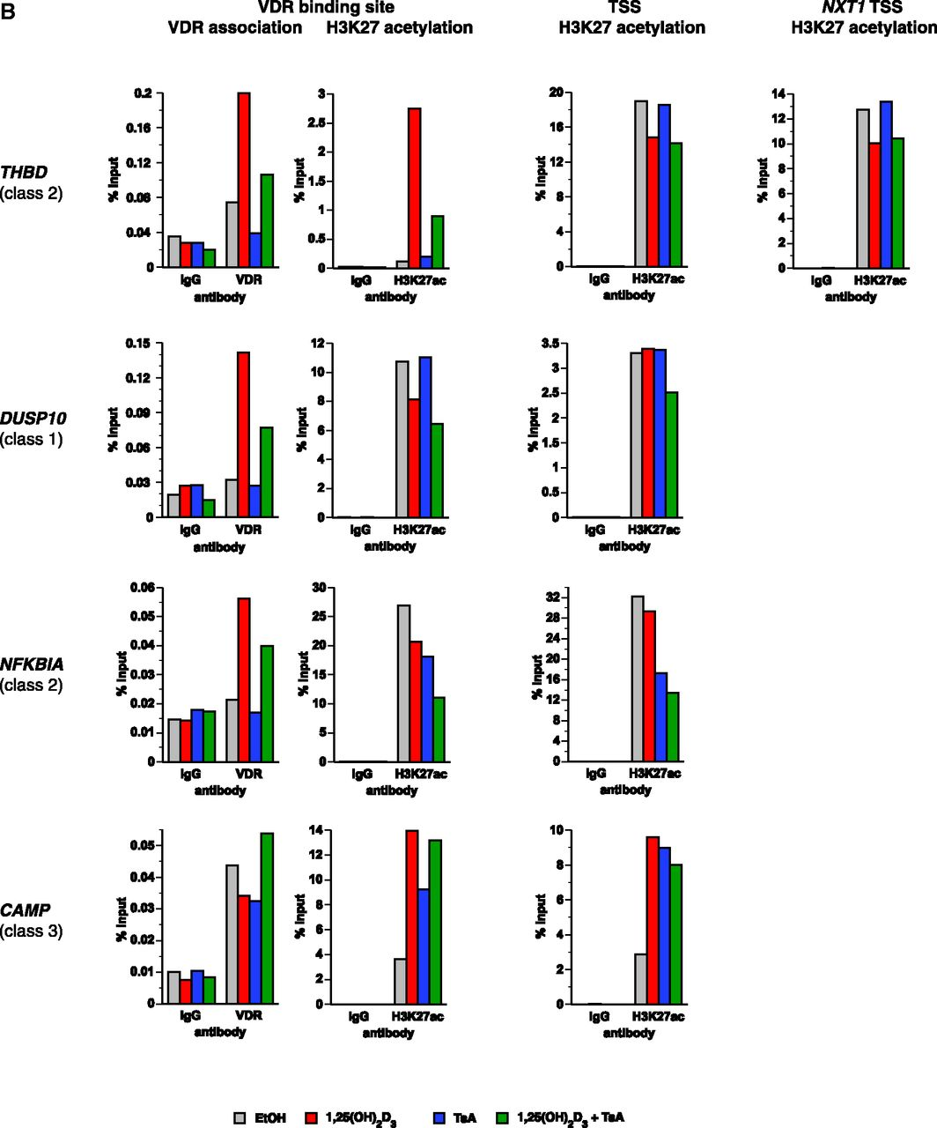
Figure 3. VDR association, histone acetylation and sites of open chromatin for selected loci. (A) Loci of the genes ...
Notes:
Figure 3. VDR association, histone acetylation and sites of open chromatin for selected loci. (A) Loci of the genes HBEGF, DUSP10, NFKBIA and CAMP. The peak tracks for the four different gene loci show data from a VDR ChIP-seq experiment in THP-1 cells (34) (IgG control in grey, VDR binding in unstimulated cells and VDR binding after 40 min 1α,25(OH)2D3 (1,25D) treatment in red), FAIRE-seq data from THP-1 cells (EtOH- and 1α,25(OH)2D3-treated for 100 min, green), and H3K27ac ChIP-seq data from the ENCODE (45) cell lines K562, HUVEC and NHEK (orange) as a sign of histone acetylation. The gene structures are shown in blue. (B) VDR association, H3K27 acetylation and unspecific IgG binding at VDR binding sites and TSS regions of four VDR target genes, determined by ChIP-qPCR after 40 min treatments of THP-1 cells with solvent, 1α,25(OH)2D3, TsA or the combination of both. Each graph is a representative of four independent experiments. Please note that the best VDR binding sites of the THBD and NFKBIA loci chosen for this assay are those close to the NXT1 and PSMA6 genes, respectively (Figures 1A and 3A).
Unless provided in the caption above, the following copyright applies to the content of this slide: © The Author(s) 2012. Published by Oxford University Press.This is an Open Access article distributed under the terms of the Creative Commons Attribution License (http://creativecommons.org/licenses/by-nc/3.0/), which permits non-commercial reuse, distribution, and reproduction in any medium, provided the original work is properly cited. For commercial re-use, please contact journals.permissions@oup.com.

Slide 6
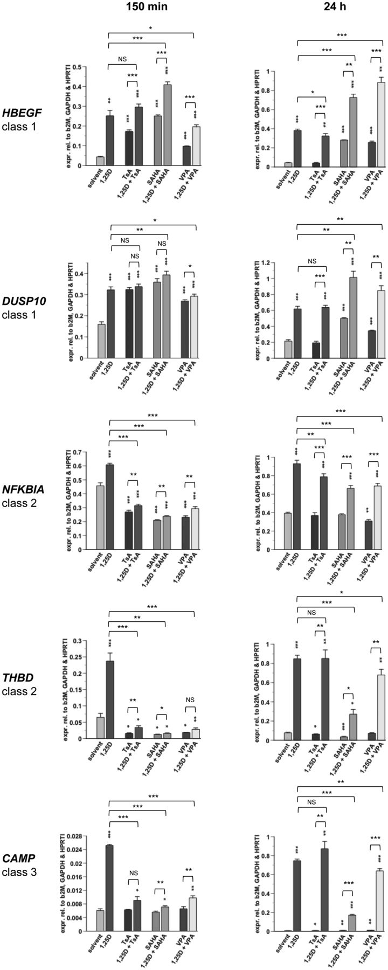
Figure 4. Short- and long-term effects of HDAC inhibition on VDR target genes. qPCR was performed to determine the ...
Notes:
Figure 4. Short- and long-term effects of HDAC inhibition on VDR target genes. qPCR was performed to determine the relative changes of mRNA expression of selected genes normalized by the three reference genes B2M, GAPDH and HPRT1 in THP-1 cells in response to incubation with 100 nM 1α,25(OH)2D3 (1,25D), 300 nM TsA, 3 µM SAHA and 1 mM VPA, alone or in combination, for 150 min and 24 h. A representative experiment of two independent experiments, both performed in triplicate individual cell treatments, is shown. The data points represent the means of three cell treatments and the bars indicate standard deviations. Two-tailed Student’s t-tests were performed to determine the significance of the mRNA induction by the stimuli in reference to solvent-treated cells (*P < 0.05; **P < 0.01; ***P < 0.001).
Unless provided in the caption above, the following copyright applies to the content of this slide: © The Author(s) 2012. Published by Oxford University Press.This is an Open Access article distributed under the terms of the Creative Commons Attribution License (http://creativecommons.org/licenses/by-nc/3.0/), which permits non-commercial reuse, distribution, and reproduction in any medium, provided the original work is properly cited. For commercial re-use, please contact journals.permissions@oup.com.

