Slide 1
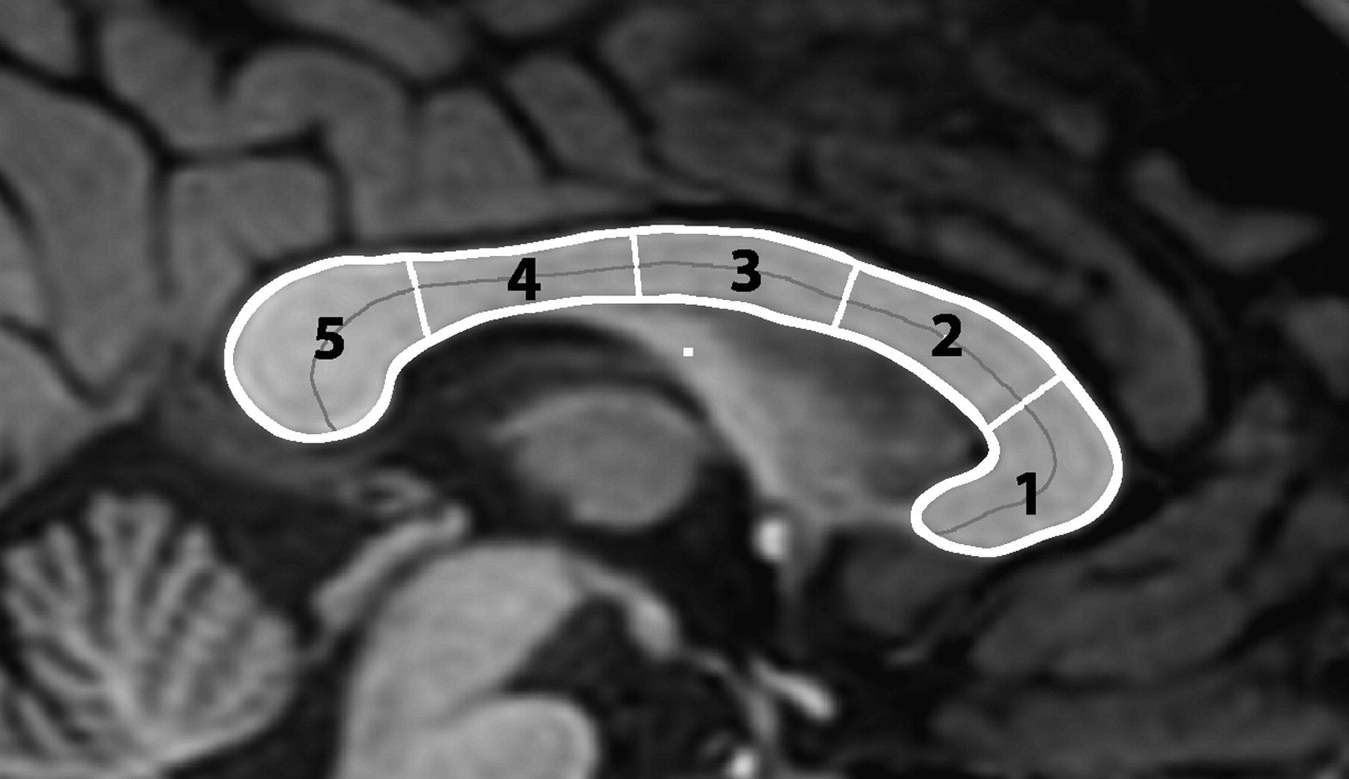
Figure 1. The divisions of the corpus callosum.
Notes:
Figure 1. The divisions of the corpus callosum.
Unless provided in the caption above, the following copyright applies to the content of this slide: © The Author 2008. Published by Oxford University Press. All rights reserved. For permissions, please e-mail: journals.permissions@oxfordjournals.org

Slide 2
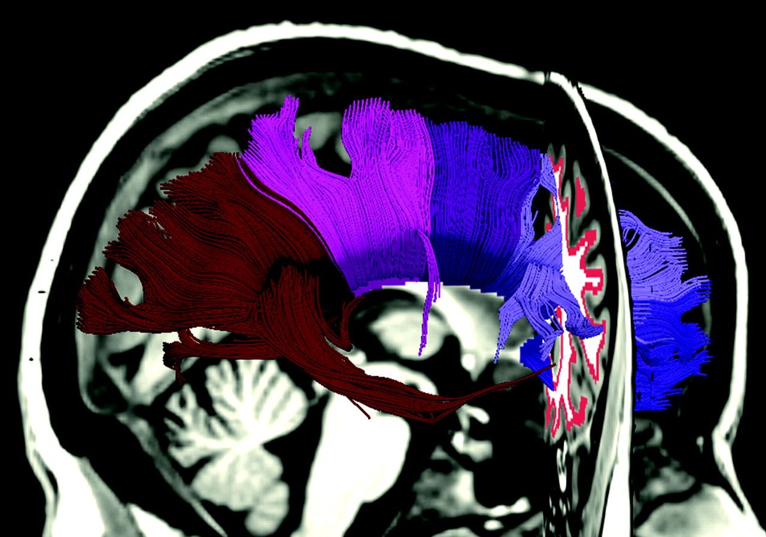
Figure 2. The set of tracts that pass through the 5 subregions of the corpus callosum. The seed region for the tracts ...
Notes:
Figure 2. The set of tracts that pass through the 5 subregions of the corpus callosum. The seed region for the tracts is visible in the coronal plane.
Unless provided in the caption above, the following copyright applies to the content of this slide: © The Author 2008. Published by Oxford University Press. All rights reserved. For permissions, please e-mail: journals.permissions@oxfordjournals.org

Slide 3
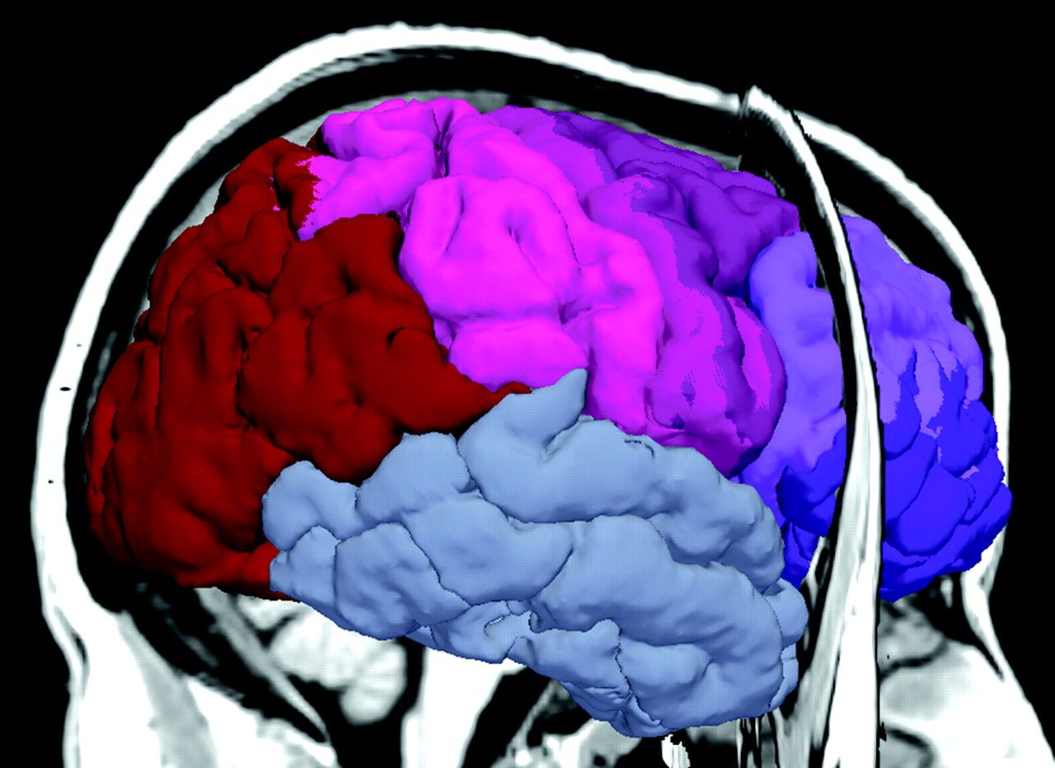
Figure 3. The cortical divisions corresponding to the 5 subregions of the corpus callosum.
Notes:
Figure 3. The cortical divisions corresponding to the 5 subregions of the corpus callosum.
Unless provided in the caption above, the following copyright applies to the content of this slide: © The Author 2008. Published by Oxford University Press. All rights reserved. For permissions, please e-mail: journals.permissions@oxfordjournals.org

Slide 4
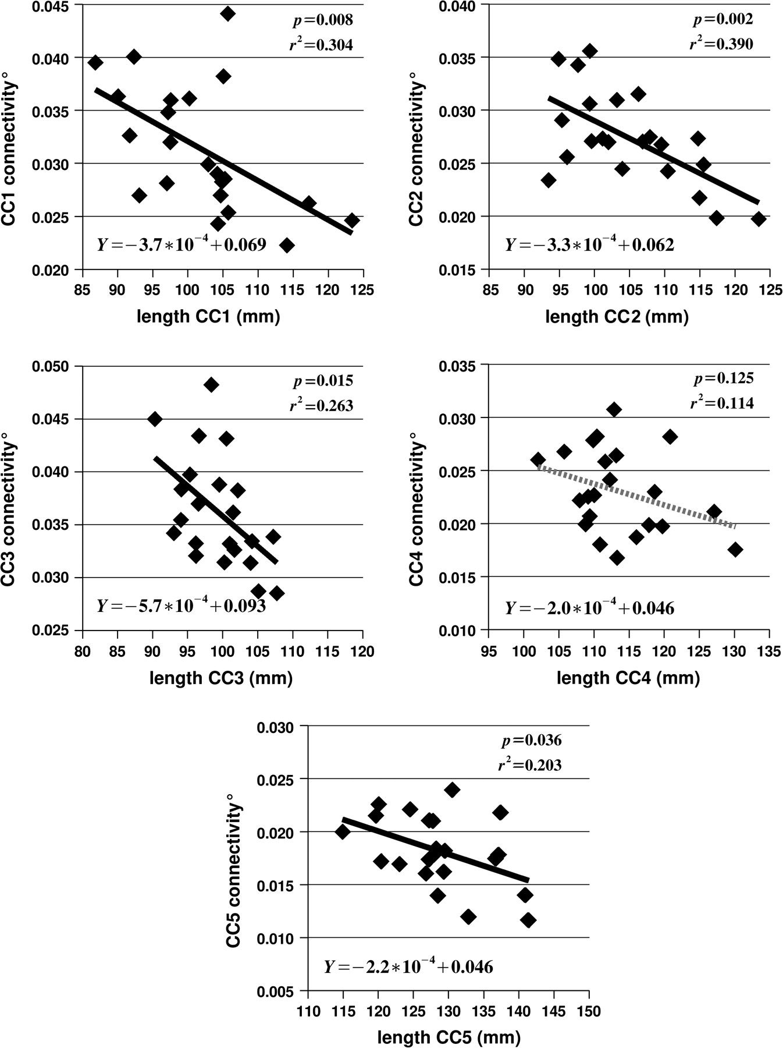
Figure 5. The relation between degree of connectivity for subregion i of the callosum—indicated as CC_{i} ...
Notes:
Figure 5. The relation between degree of connectivity for subregion i of the callosum—indicated as CCi connectivity—and the average length of the connections passing through region i. The black regression lines in subregions 1, 2, 3, and 5 indicate that the relationship is significant at P ≤ .05. The equation for each regression line is given in the lower left corner of each plot, and the significance and r2 values are presented in the upper right corner.
Unless provided in the caption above, the following copyright applies to the content of this slide: © The Author 2008. Published by Oxford University Press. All rights reserved. For permissions, please e-mail: journals.permissions@oxfordjournals.org

Slide 5
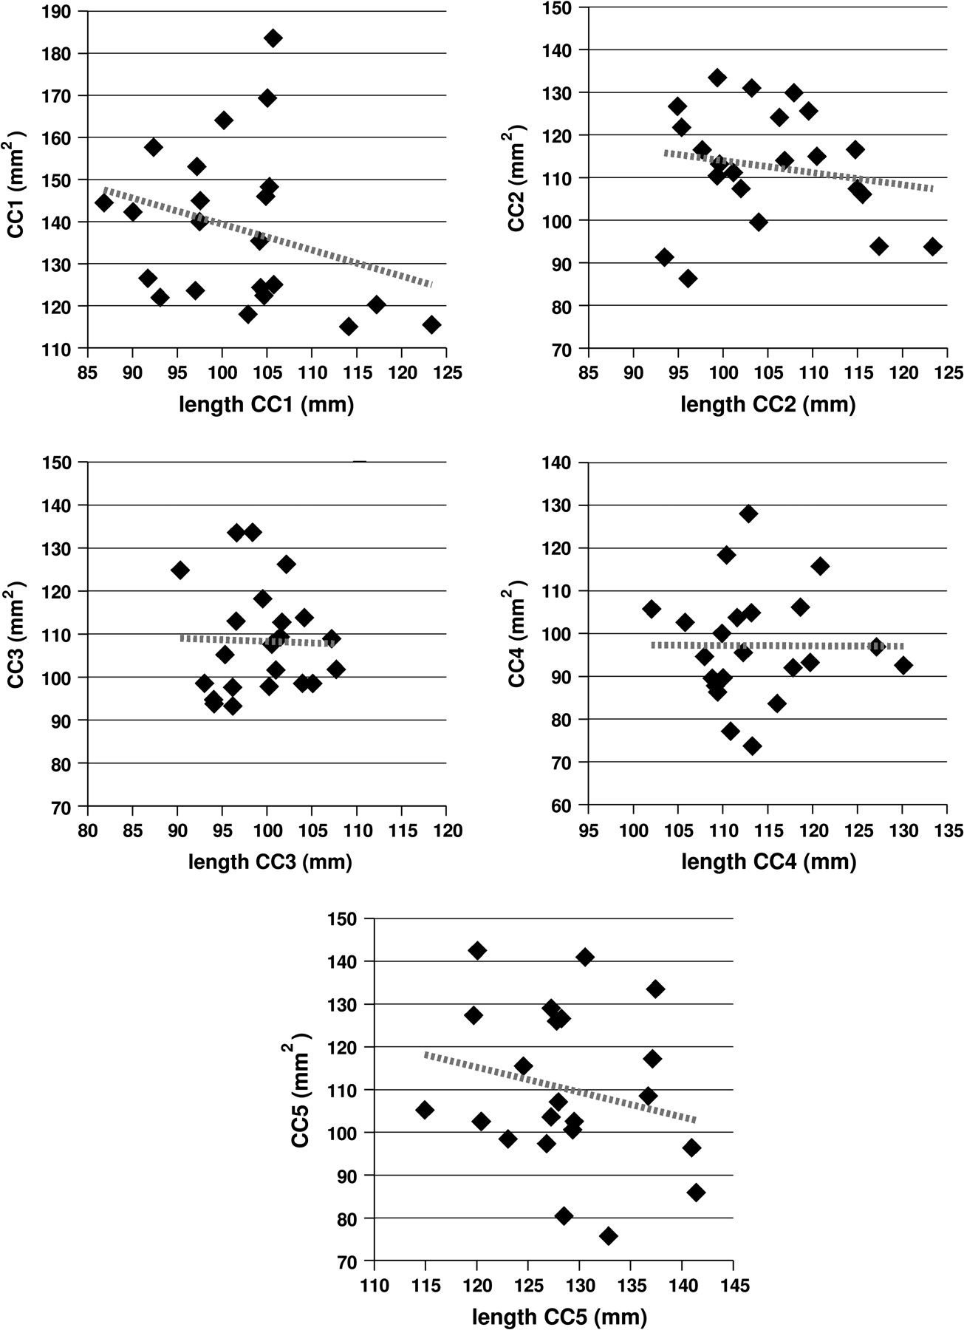
Figure 4. The relation between the cross-sectional area for a given subregion of the callosum and the average length of ...
Notes:
Figure 4. The relation between the cross-sectional area for a given subregion of the callosum and the average length of the connections passing through that subregion. The dashed lines show that the correlation is negative—callosum size decreases as connection length increases—in all subregions, though none of the relationships are significant at P ≤ .05. The significance and r2 values are given in Table 2.
Unless provided in the caption above, the following copyright applies to the content of this slide: © The Author 2008. Published by Oxford University Press. All rights reserved. For permissions, please e-mail: journals.permissions@oxfordjournals.org

