Slide 1
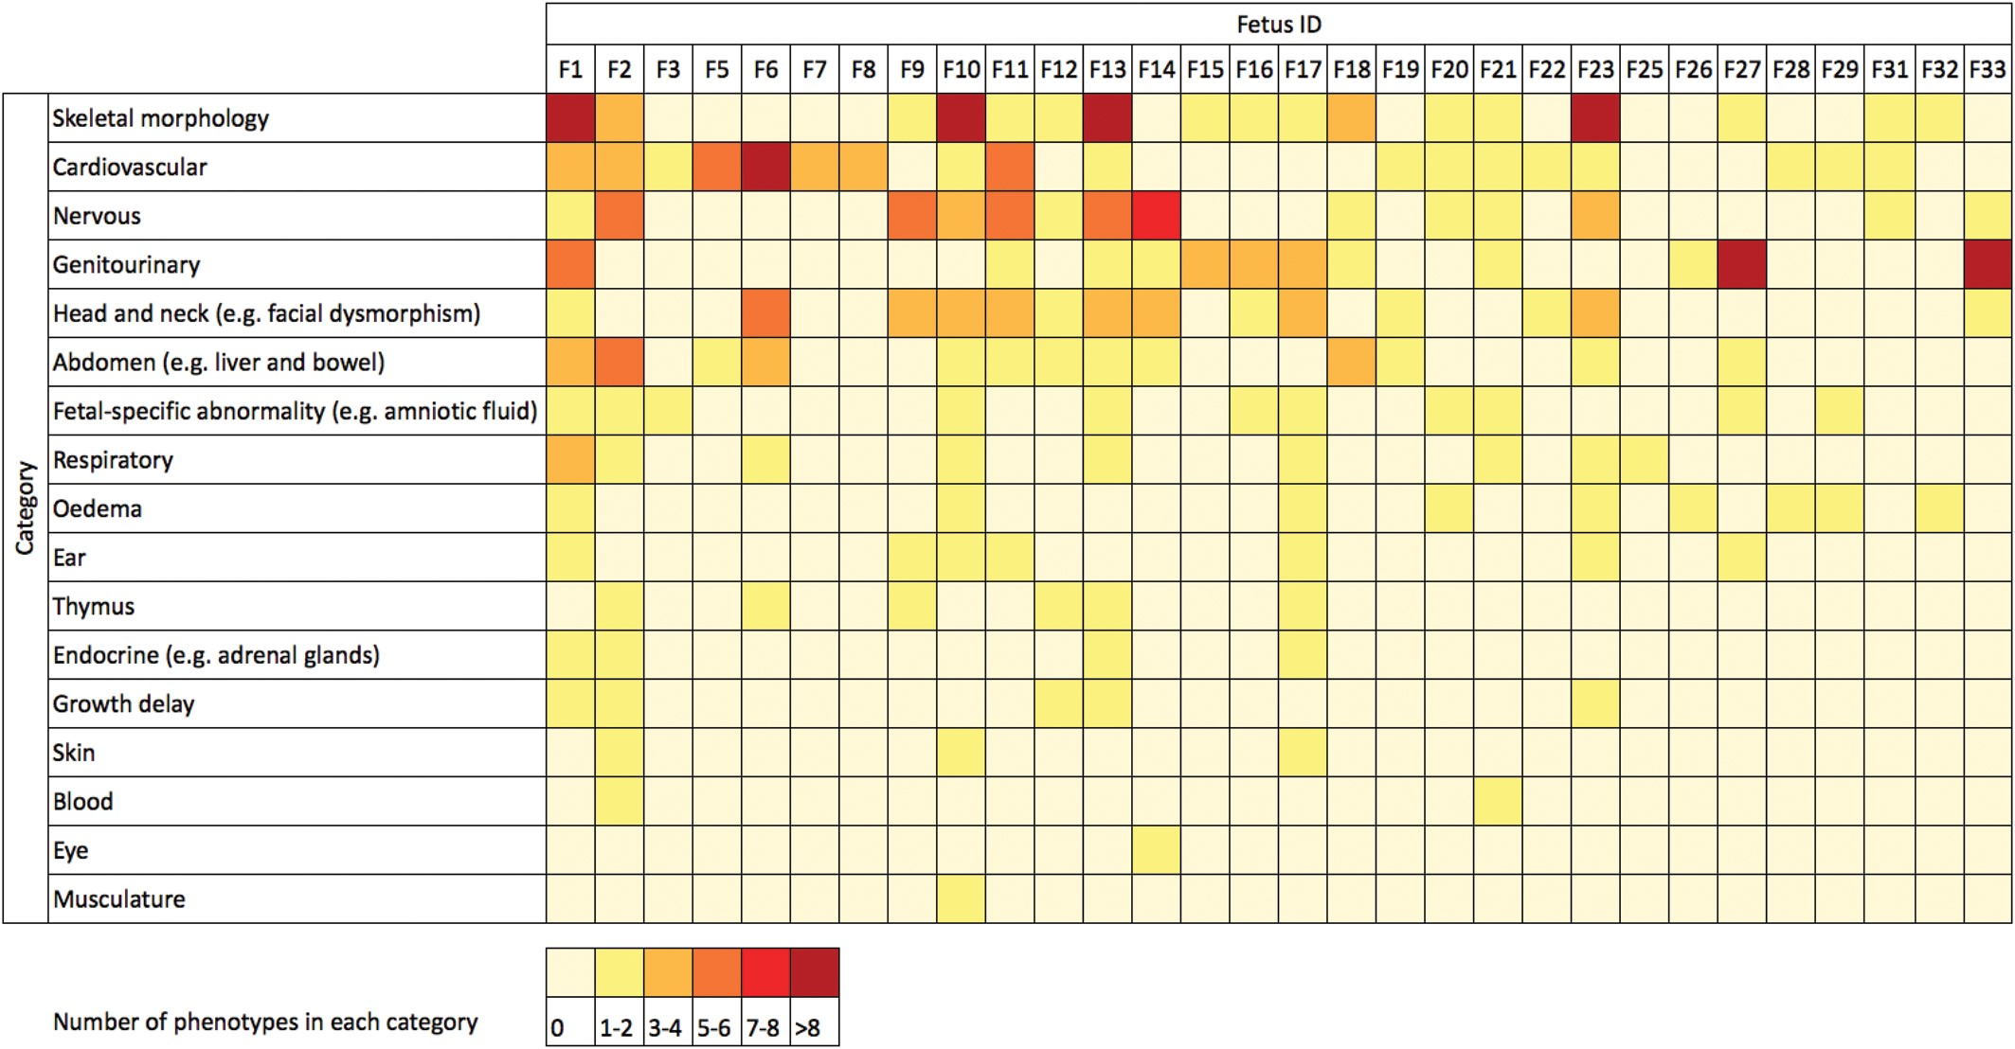
Figure 1. Matrix of phenotypes in the cohort. For each fetus (F1–F33), the color indicates the number of observed ...
Notes:
Figure 1. Matrix of phenotypes in the cohort. For each fetus (F1–F33), the color indicates the number of observed phenotypes that are in each category of phenotypes. For example, F1 has more than eight separate abnormalities of skeletal morphology. The categories are modified higher order HPO terms, and the data come from ultrasound scans, postmortem reports or pediatric follow-up. The phenotype of each fetus is detailed in the Supplementary Material, Appendix.
Unless provided in the caption above, the following copyright applies to the content of this slide: © The Author 2014. Published by Oxford University Press.This is an Open Access article distributed under the terms of the Creative Commons Attribution License (http://creativecommons.org/licenses/by/3.0/), which permits unrestricted reuse, distribution, and reproduction in any medium, provided the original work is properly cited.

Slide 2
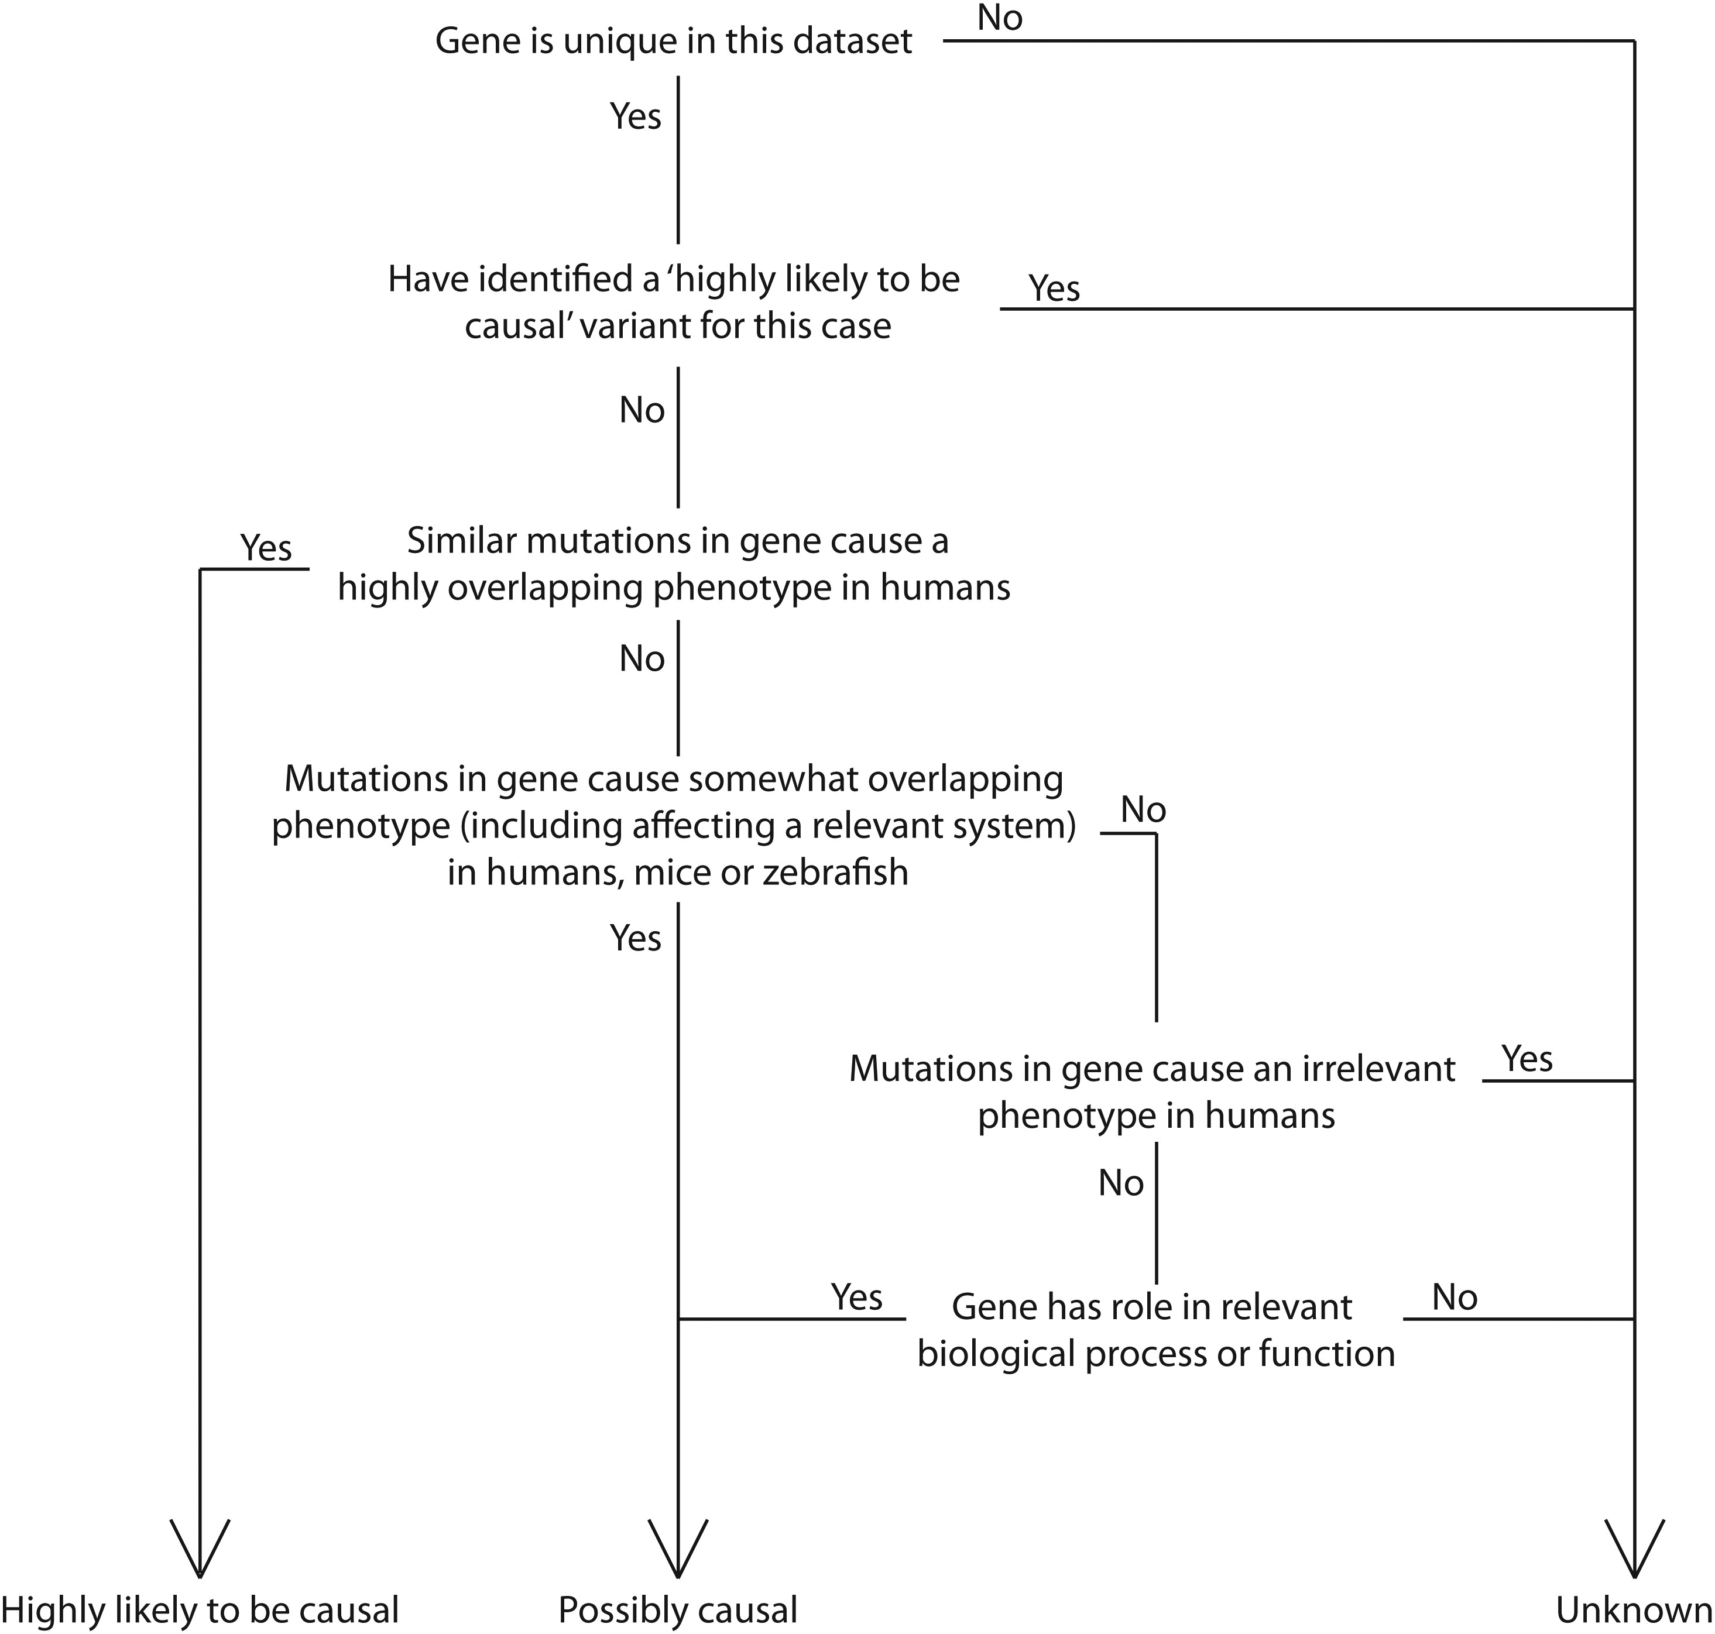
Figure 2. Decision tree for prioritizing candidate genes into three categories. Data from OMIM, DDG2P, BioGPS, NHGRI ...
Notes:
Figure 2. Decision tree for prioritizing candidate genes into three categories. Data from OMIM, DDG2P, BioGPS, NHGRI GWAS catalog, IKMC, ZFIN and PubMed were used, where available.
Unless provided in the caption above, the following copyright applies to the content of this slide: © The Author 2014. Published by Oxford University Press.This is an Open Access article distributed under the terms of the Creative Commons Attribution License (http://creativecommons.org/licenses/by/3.0/), which permits unrestricted reuse, distribution, and reproduction in any medium, provided the original work is properly cited.

